Slide 1
1_Scrum: Scrum Methodology - SYNC (45 Minutes)
MEAN/MERN STACK

Slide 2
Opening (5 mins)

Slide 3
Learning Objectives:
Explain what Agile software development is.
Define the Agile software development principles.
Identify the benefits of the Agile approach for software development.
Describe the different parts of the Scrum methodology to manage software development.

Slide 4
Content (35 mins)

Slide 5
Introduction to Agile Software Development
Agile is the ability to create and respond to change. It is a way of dealing with, and ultimately succeeding in, an uncertain and turbulent environment. Agile focuses on the people doing the work and how they work together. Solutions evolve through collaboration between self-organizing cross-functional teams utilizing the appropriate practices for their context. Agile software development is more than frameworks such as Scrum, Extreme Programming, or Feature-Driven Development (FDD). Agile software development is more than practices such as pair programming, test-driven development, stand-ups, planning sessions, and sprints. Agile software development is an umbrella term for a set of frameworks and practices based on the values and principles expressed in the Manifesto for Agile Software Development and the 12 Principles behind it. Agile Manifesto “We are uncovering better ways of developing software by doing it and helping others do it. Through this work we have come to value: Individuals and interactions over processes and tools Working software over comprehensive documentation Customer collaboration over contract negotiation Responding to change over following a plan”

Slide 6
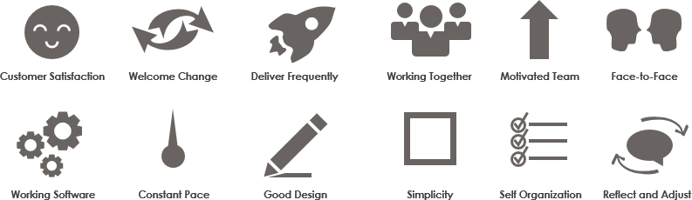
Introduction to Agile Software Development
12 Principles behind Agile Manifesto

Slide 7
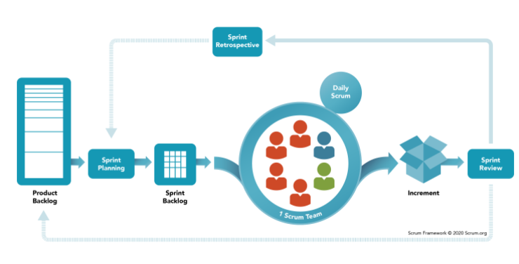
Scrum Methodology
Introduction to Scrum: Scrum is a process framework used to manage product development and other knowledge work. Scrum is empirical in that it provides a means for teams to establish a hypothesis of how they think something works, try it out, reflect on the experience, and make the appropriate adjustments. The Scrum Framework Scrum is simple. It is the opposite of a big collection of interwoven mandatory components. Scrum is not a methodology. Scrum implements the scientific method of empiricism. Scrum replaces a programmed algorithmic approach with a heuristic one, with respect for people and self-organization to deal with unpredictability and solving complex problems.

Slide 8
Scrum Methodology
Scrum Team The fundamental unit of Scrum is a small team of people, a Scrum Team. The Scrum Team consists of one Scrum Master, one Product Owner, and Developers. Within a Scrum Team, there are no sub-teams or hierarchies. It is a cohesive unit of professionals focused on one objective at a time, the Product Goal. Scrum Teams are cross-functional, meaning the members have all the skills necessary to create value each Sprint. They are also self-managing, meaning they internally decide who does what, when, and how. The Scrum Team is small enough to remain nimble and large enough to complete significant work within a Sprint, typically 10 or fewer people. In general, we have found that smaller teams communicate better and are more productive. If Scrum Teams become too large, they should consider reorganizing into multiple cohesive Scrum Teams, each focused on the same product. Therefore, they should share the same Product Goal, Product Backlog, and Product Owner. The Scrum Team is responsible for all product-related activities from stakeholder collaboration, verification, maintenance, operation, experimentation, research and development, and anything else that might be required. They are structured and empowered by the organization to manage their own work. Working in Sprints at a sustainable pace improves the Scrum Team’s focus and consistency. The entire Scrum Team is accountable for creating a valuable, useful Increment every Sprint. Scrum defines three specific accountabilities within the Scrum Team: the Developers, the Product Owner, and the Scrum Master.

Slide 9
Scrum Methodology
Developers Developers are the people in the Scrum Team that are committed to creating any aspect of a usable Increment each Sprint. The specific skills needed by the Developers are often broad and will vary with the domain of work. However, the Developers are always accountable for: Creating a plan for the Sprint, the Sprint Backlog Instilling quality by adhering to a Definition of Done Adapting their plan each day toward the Sprint Goal Holding each other accountable as professionals. Product Owner The Product Owner is accountable for maximizing the value of the product resulting from the work of the Scrum Team. The Product Owner is also accountable for effective Product Backlog management, which includes: Developing and explicitly communicating the Product Goal Creating and clearly communicating Product Backlog items Ordering Product Backlog items Ensuring that the Product Backlog is transparent, visible, and understood. The Product Owner may do the above work or may delegate the responsibility to others. Regardless, the Product Owner remains accountable. For Product Owners to succeed, the entire organization must respect their decisions. These decisions are visible in the content and ordering of the Product Backlog, and through the inspectable Increment at the Sprint Review.

Slide 10
Scrum Methodology
Scrum Master The Scrum Master is accountable for establishing Scrum as defined in the Scrum Guide. They do this by helping everyone understand Scrum theory and practice, both within the Scrum Team and the organization. The Scrum Master is accountable for the Scrum Team’s effectiveness. They do this by enabling the Scrum Team to improve its practices, within the Scrum framework. Scrum Masters are true leaders who serve the Scrum Team and the larger organization. The Scrum Master serves the Scrum Team in several ways, including: Coaching the team members in self-management and cross-functionality; Helping the Scrum Team focus on creating high-value Increments that meet the Definition of Done; Causing the removal of impediments to the Scrum Team’s progress Ensuring that all Scrum events take place and are positive, productive, and kept within the timebox. The Scrum Master serves the Product Owner in several ways, including: Helping find techniques for effective Product Goal definition and Product Backlog management Helping the Scrum Team understand the need for clear and concise Product Backlog items Helping establish empirical product planning for a complex environment Facilitating stakeholder collaboration as requested or needed. The Scrum Master serves the organization in several ways, including: Leading, training, and coaching the organization in its Scrum adoption; Planning and advising Scrum implementations within the organization; Helping employees and stakeholders understand and enact an empirical approach for complex work Removing barriers between stakeholders and Scrum Teams.

Slide 11
Scrum Methodology
Scrum Events The Sprint is a container for all other events. Each event in Scrum is a formal opportunity to inspect and adapt Scrum artifacts. These events are specifically designed to enable the transparency required. Failure to operate any events as prescribed results in lost opportunities to inspect and adapt. Events are used in Scrum to create regularity and to minimize the need for meetings not defined in Scrum. Optimally, all events are held at the same time and place to reduce complexity. The Sprint Sprints are the heartbeat of Scrum, where ideas are turned into value. They are fixed length events of one month or less to create consistency. A new Sprint starts immediately after the conclusion of the previous Sprint. All the work necessary to achieve the Product Goal, including Sprint Planning, Daily Scrums, Sprint Review, and Sprint Retrospective, happen within Sprints. During the Sprint: No changes are made that would endanger the Sprint Goal Quality does not decrease The Product Backlog is refined as needed Scope may be clarified and renegotiated with the Product Owner as more is learned. Sprints enable predictability by ensuring inspection and adaptation of progress toward a Product Goal at least every calendar month. When a Sprint’s horizon is too long the Sprint Goal may become invalid, complexity may rise, and risk may increase. Shorter Sprints can be employed to generate more learning cycles and limit risk of cost and effort to a smaller time frame. Each Sprint may be considered a short project. A Sprint could be cancelled if the Sprint Goal becomes obsolete. Only the Product Owner has the authority to cancel the Sprint.

Slide 12
Scrum Methodology
Sprint Planning Sprint Planning initiates the Sprint by laying out the work to be performed for the Sprint. This resulting plan is created by the collaborative work of the entire Scrum Team. The Product Owner ensures that attendees are prepared to discuss the most important Product Backlog items and how they map to the Product Goal. The Scrum Team may also invite other people to attend Sprint Planning to provide advice. Sprint Planning addresses the following topics: Topic One: Why is this Sprint valuable? Topic Two: What can be Done this Sprint? Topic Three: How will the chosen work get done? Topic One: Why is this Sprint valuable? The Product Owner proposes how the product could increase its value and utility in the current Sprint. The whole Scrum Team then collaborates to define a Sprint Goal that communicates why the Sprint is valuable to stakeholders. The Sprint Goal must be finalized prior to the end of Sprint Planning. Topic Two: What can be Done this Sprint? Through discussion with the Product Owner, the Developers select items from the Product Backlog to include in the current Sprint. The Scrum Team may refine these items during this process, which increases understanding and confidence. Selecting how much can be completed within a Sprint may be challenging. However, the more the Developers know about their past performance, their upcoming capacity, and their Definition of Done, the more confident they will be in their Sprint forecasts.

Slide 13
Scrum Methodology
Topic Three: How will the chosen work get done? For each selected Product Backlog item, the Developers plan the work necessary to create an Increment that meets the Definition of Done. This is often done by decomposing Product Backlog items into smaller work items of one day or less. How this is done is at the sole discretion of the Developers. No one else tells them how to turn Product Backlog items into Increments of value. The Sprint Goal, the Product Backlog items selected for the Sprint, plus the plan for delivering them are together referred to as the Sprint Backlog. Sprint Planning is timeboxed to a maximum of eight hours for a one-month Sprint. For shorter Sprints, the event is usually shorter. Daily Scrum The purpose of the Daily Scrum is to inspect progress toward the Sprint Goal and adapt the Sprint Backlog as necessary, adjusting the upcoming planned work. The Daily Scrum is a 15-minute event for the Developers of the Scrum Team. To reduce complexity, it is held at the same time and place every working day of the Sprint. If the Product Owner or Scrum Master are actively working on items in the Sprint Backlog, they participate as Developers. The Developers can select whatever structure and techniques they want, as long as their Daily Scrum focuses on progress toward the Sprint Goal and produces an actionable plan for the next day of work. This creates focus and improves self-management. Daily Scrums improve communications, identify impediments, promote quick decision-making, and consequently eliminate the need for other meetings. The Daily Scrum is not the only time Developers are allowed to adjust their plan. They often meet throughout the day for more detailed discussions about adapting or re-planning the rest of the Sprint’s work.

Slide 14
Scrum Methodology
Sprint Review The purpose of the Sprint Review is to inspect the outcome of the Sprint and determine future adaptations. The Scrum Team presents the results of their work to key stakeholders and progress toward the Product Goal is discussed. During the event, the Scrum Team and stakeholders review what was accomplished in the Sprint and what has changed in their environment. Based on this information, attendees collaborate on what to do next. The Product Backlog may also be adjusted to meet new opportunities. The Sprint Review is a working session, and the Scrum Team should avoid limiting it to a presentation. The Sprint Review is the second to last event of the Sprint and is timeboxed to a maximum of four hours for a one-month Sprint. For shorter Sprints, the event is usually shorter. Sprint Retrospective The purpose of the Sprint Retrospective is to plan ways to increase quality and effectiveness. The Scrum Team inspects how the last Sprint went with regards to individuals, interactions, processes, tools, and their Definition of Done. Inspected elements often vary with the domain of work. Assumptions that led them astray are identified and their origins explored. The Scrum Team discusses what went well during the Sprint, what problems it encountered, and how those problems were (or were not) solved. The Scrum Team identifies the most helpful changes to improve its effectiveness. The most impactful improvements are addressed as soon as possible. They may even be added to the Sprint Backlog for the next Sprint. The Sprint Retrospective concludes the Sprint. It is timeboxed to a maximum of three hours for a one-month Sprint. For shorter Sprints, the event is usually shorter.

Slide 15
Scrum Methodology
Scrum Artifacts Scrum’s artifacts represent work or value. They are designed to maximize transparency of key information. Thus, everyone inspecting them has the same basis for adaptation. Each artifact contains a commitment to ensure it provides information that enhances transparency and focus against which progress can be measured: For the Product Backlog it is the Product Goal. For the Sprint Backlog it is the Sprint Goal. For the Increment it is the Definition of Done.Note: These commitments exist to reinforce empiricism and the Scrum values for the Scrum Team and their stakeholders. Product Backlog The Product Backlog is an emergent, ordered list of what is needed to improve the product. It is the single source of work undertaken by the Scrum Team. Product Backlog items that can be Done by the Scrum Team within one Sprint are deemed ready for selection in a Sprint Planning event. They usually acquire this degree of transparency after refining activities. Product Backlog refinement is the act of breaking down and further defining Product Backlog items into smaller more precise items. This is an ongoing activity to add details, such as a description, order, and size. Attributes often vary with the domain of work. The Developers who will be doing the work are responsible for the sizing. The Product Owner may influence the Developers by helping them understand and select trade-offs.

Slide 16
Scrum Methodology
Commitment: Product Goal The Product Goal describes a future state of the product which can serve as a target for the Scrum Team to plan against. The Product Goal is in the Product Backlog. The rest of the Product Backlog emerges to define “what” will fulfill the Product Goal. A product is a vehicle to deliver value. It has a clear boundary, known stakeholders, well-defined users or customers. A product could be a service, a physical product, or something more abstract. The Product Goal is the long-term objective for the Scrum Team. They must fulfill one objective before taking on the next. As the Developers work during the Sprint, they keep the Sprint Goal in mind. If the work turns out to be different than they expected, they collaborate with the Product Owner to negotiate the scope of the Sprint Backlog within the Sprint without affecting the Sprint Goal.
Increment An Increment is a concrete steppingstone toward the Product Goal. Each Increment is additive to all prior Increments and thoroughly verified, ensuring that all Increments work together. In order to provide value, the Increment must be usable. Multiple Increments may be created within a Sprint. The sum of the Increments is presented at the Sprint Review thus supporting empiricism. However, an Increment may be delivered to stakeholders prior to the end of the Sprint. The Sprint Review should never be considered a gate to releasing value. Work cannot be considered part of an Increment unless it meets the Definition of Done.

Slide 17
Scrum Methodology
Commitment: Definition of Done The Definition of Done is a formal description of the state of the Increment when it meets the quality measures required for the product. The moment a Product Backlog item meets the Definition of Done, an Increment is born. The Definition of Done creates transparency by providing everyone a shared understanding of what work was completed as part of the Increment. If a Product Backlog item does not meet the Definition of Done, it cannot be released or even presented at the Sprint Review. Instead, it returns to the Product Backlog for future consideration. If the Definition of Done for an increment is part of the standards of the organization, all Scrum Teams must follow it as a minimum. If it is not an organizational standard, the Scrum Team must create a Definition of Done appropriate for the product. The Developers are required to conform to the Definition of Done. If there are multiple Scrum Teams working together on a product, they must mutually define and comply with the same Definition of Done.

Slide 18
Closing (3 mins)

