Slide 1
1_WEB-4_ DOM Manipulation _ Asynchronous Programming - SYNC
MEAN/MERN STACK

Slide 2
Opening (5 mins)

Slide 3
Learning Objectives:
What is DOM and DOM manipulation
Selecting and manipulating elements
Handling Scrolling
Event Listeners and The Event Object (Mouse Events, Keyboard and Input Event)

Slide 4
Content (35 mins)

Slide 5
Document Object Model(DOM):
The Document Object Model (DOM) is an application programming interface (API) for manipulating HTML documents. The DOM represents an HTML document as a tree of nodes. The DOM provides functions that allow you to add, remove, and modify parts of the document effectively. Note that the DOM is cross-platform and language-independent ways of manipulating HTML and XML documents. The DOM represents an HTML document as a hierarchy of nodes. Consider the following HTML document.
<html> <head> <title>JavaScript DOM</title> </head> <body> <p>Hello DOM!</p> </body> </html>

Slide 6
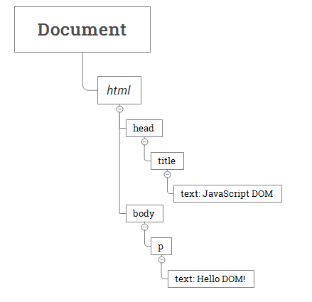
Document Object Model(DOM):
The following tree represents the above HTML document:
In this DOM tree, the document is the root node. The root node has one child node which is the <html> element. The <html> element is called the document element.’
Each document can have only one document element. In an HTML document, the document element is the <html> element. Each markup can be represented by a node in the tree.

Slide 7
Document Object Model(DOM):
Node Types: Each node in the DOM tree is identified by a node type. JavaScript uses integer numbers to determine the node types. The following table illustrates the node type constants: To get the type of node, you use the nodeType property You can compare the nodeType property with the above constants to determine the node type. For example:
if (node.nodeType == Node.ELEMENT_NODE) { // node is the element node }
Sometimes it’s easy to confuse between the Node and the Element. A node is a generic name of any object in the DOM tree. It can be any built-in DOM element such as the document. Or it can be any HTML tag specified in the HTML document like <div> or <p>. An element is a node with a specific node type Node.ELEMENT_NODE, which is equal to 1.

Slide 8
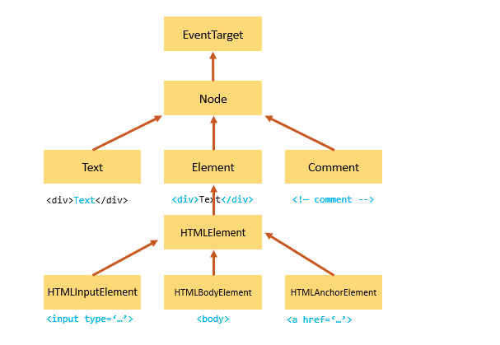
Document Object Model(DOM):
Node Types: Note that the getElementById() and querySelector() returns an object with the Element type while getElementsByTagName() or querySelectorAll() returns NodeList which is a collection of nodes. Any node has relationships to other nodes in the DOM tree. The relationships are the same as the ones described in a traditional family tree. For example, <body> is a child node of the <html> node, and <html> is the parent of the <body> node. The <body> node is the sibling of the <head> node because they share the same immediate parent, which is the <html> element.

Slide 9
Document Object Model(DOM):
Selecting elements: getElementsID: The document.getElementById() method returns an Element object that represents an HTML element with an id that matches a specified string otherwise null. Unlike the querySelector() method, the getElementById() is only available on the document object, not other elements.
const element = document.getElementById(id);
The id is unique within an HTML document. However, HTML is a forgiving language. If the HTML document has multiple elements with the same id, the document.getElementById() method returns the first element it encounters.
<html> <head> <title>JavaScript getElementById() Method</title> </head> <body> <p id="message">A paragraph</p> </body> </html> <script> const p = document.getElementById('message'); console.log(p); <script/>

Slide 10
Document Object Model(DOM):
getElementsName: Every element on an HTML document may have a name attribute. Unlike the id attribute, multiple HTML elements can share the same value of the name attribute like this. The getElementsByName() accepts a name which is the value of the name attribute of elements and returns a live NodeList of elements.
<!DOCTYPE html> <html> <head> <meta charset="utf-8"> <title>JavaScript getElementsByName Demo</title> </head> <body> <p>Please rate the service:</p> <p> <label for="very-poor"> <input type="radio" name="rate" value="Very poor" id="very-poor"> Very poor </label> <label for="poor"> <input type="radio" name="rate" value="Poor" id="poor"> Poor

Slide 11
Document Object Model(DOM):
getElementsName: First, select the submit button by its id btnRate using the getElementById() method. Second, listen to the click event of the submit button. Third, get all the radio buttons using the getElementsByName() and show the selected value in the output element.
querySelector: The querySelector() is a method of the Element interface. The querySelector() method allows you to select the first element that matches one or more CSS selectors.
let element = parentNode.querySelector(selector);
In this syntax, the selector is a CSS selector or a group of CSS selectors to match the descendant elements of the parentNode. If the selector is not valid CSS syntax, the method will raise a SyntaxError exception. If no element matches the CSS selectors, the querySelector() returns null. The querySelectorAll() method returns a static NodeList of elements that match the CSS selector. If no element matches, it returns an empty NodeList.
et nodeList = document.querySelectorAll(selector); let elements = Array.from(nodeList);

Slide 12
Document Object Model(DOM):
querySelector: Basic selectors: Explain each of these
Universal selector
Type selector
Class selector
ID Selector
Attribute selector
descendant combinator
Child combinator
Adjacent sibling combinator
Pseudo-classes
Pseudo-elements

Slide 13
Document Object Model(DOM):
Manipulating elements: createElement(): To create an HTML element, you use the document.createElement() method. The following example uses the document.createElement() to create a new <div> element:
let div = document.createElement('div'); div.innerHTML = '<p>CreateElement example</p>'; To attach the div to the document, you use the appendChild() method: document.body.appendChild(div);
Add class and id to div
let div = document.createElement('div'); div.id = 'content'; div.className = 'note'; div.innerHTML = '<p>CreateElement example</p>'; document.body.appendChild(div);

Slide 14
Document Object Model(DOM):
Creating new list items li example
<ul id="menu"> <li>Home</li> </ul> <script> let li = document.createElement('li'); li.textContent = 'Products'; menu.appendChild(li); li = document.createElement('li'); li.textContent = 'About Us'; // select the ul menu element const menu = document.querySelector('#menu'); menu.appendChild(li); <script/>
Output
ul id="menu"> <li>Home</li> <li>Products</li> <li>About Us</li> </ul>

Slide 15
Document Object Model(DOM):
Working with Attributes: When the web browser loads an HTML page, it generates the corresponding DOM objects based on the DOM nodes of the document. The web browser will generate an HTMLInputElement object. For Example: The input element has two attributes: The type attribute with the value text. The id attribute with the value username. The generated HTMLInputElement object will have the corresponding properties: The input.type with the value text. The input.id with the value username.
<input type="text" id="username"></input>
To access both standard and non-standard attributes, you use the following methods:
element.getAttribute(name) – get the attribute value
element.setAttribute(name, value) – set the value for element.hasAttribute(name) – check for the existence of an attribute
element.removeAttribute(name) – remove the attribute

Slide 16
Document Object Model(DOM):
The following example shows when the value attribute changes, it reflects in the value property, but not the other way around:
et input = document.querySelector('#username'); // attribute -> property: OK input.setAttribute('value','guest'); console.log(input.value); // guest // property -> attribute: doesn't change input.value = 'admin'; console.log(input.getAttribute('value')); // guest
Manipulating Element’s Styles: Setting inline styles: To set the inline style of an element, you use the style property of that element. The style property returns the read-only CSSStyleDeclaration object that contains a list of CSS properties. For example, to set the color of an element to red.
element.style element.style.color = 'red';

Slide 17
Document Object Model(DOM):
The following table shows the common CSS properties can be found here: https://docs.google.com/spreadsheets/d/12JbtooxrwQi3rNguUQT2tb_wucRK2n7Rc-u9TJ0dL9c/edit?usp=sharing

Slide 18
Document Object Model(DOM):
The following example uses the style object to set the CSS properties of a paragraph with the id content:
<!DOCTYPE html> <html> <head> <meta charset="utf-8"> <title>JS Style Demo</title> </head> <body> <p id="content">JavaScript Setting Style Demo!</p> <script> let p = document.querySelector('#content'); p.style.color = 'red'; p.style.fontWeight = 'bold'; </script> </body> </html>
Manipulating Element’s Styles: Working with Events: An event is an action that occurs in the web browser, which the web browser feedbacks to you so that you can respond to it. Each event may have an event handler which is a block of code that will execute when the event occurs. An event handler is also known as an event listener. It listens to the event and executes when the event occurs. Suppose you have a button with the id btn.

Slide 19
Document Object Model(DOM):
<button id="btn">Click Me!</button>
To define the code that will be executed when the button is clicked, you need to register an event handler using the addEventListener() method.
let btn = document.querySelector('#btn'); function display() { alert('It was clicked!'); } btn.addEventListener('click',display);

Slide 20
Document Object Model(DOM):
HTML event handler attributes: Event handlers typically have names that begin with on, for example, the event handler for the click event is onclick.
<script> function showAlert() { alert('Clicked!'); } </script> <input type="button" value="Save" onclick="showAlert()">
The addEventListener() method accepts three arguments: an event name, an event handler function, and a Boolean value that instructs the method to call the event handler during the capture phase (true) or during the bubble phase (false).
let btn = document.querySelector('#btn'); btn.addEventListener('click',function(event) { alert(event.type); // click });

Slide 21
Closing (3 mins)

