Slide 1
3_ReactJS-1_React Fundamentals Part 3
MEAN/MERN STACK

Slide 2
Opening (5 mins)

Slide 3
Learning Objectives:
Explain React Events

Slide 4
Content (20 mins)

Slide 5
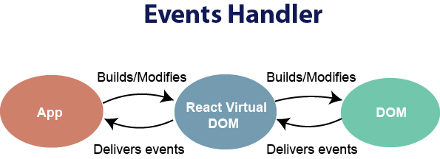
REACT FUNDAMENTALS:
React Events: An event is an action that could be triggered as a result of the user action or system generated event. For example, a mouse click, loading of a web page, pressing a key, window resizes, and other interactions are called events. React has its own event handling system which is very similar to handling events on DOM elements. The react event handling system is known as Synthetic Events. The synthetic event is a cross-browser wrapper of the browser's native event
Handling events with react have some syntactic differences from handling events on DOM. These are:React events are written in camelCase syntax: onClick instead of onclick. React event handlers are written inside curly braces: onClick={shoot} instead of onClick="shoot()" In React, we cannot return false to prevent the default behavior. We must call preventDefault event explicitly to prevent the default behavior. For example:In plain HTML, to prevent the default link behavior of opening a new page, we can write:

Slide 6
REACT FUNDAMENTALS:
a href="#" onclick="console.log('You had clicked a Link.'); return false"> Click_Me </a>
In React, we can write it as:
function ActionLink() { function handleClick(e) { e.preventDefault(); console.log('You had clicked a Link.'); } return ( <a href="#" onClick={handleClick}> Click_Me </a> ); }
Example: In the below example, only one component is used and added an onChange event. This event will trigger the changeText function, which returns the company name.

Slide 7
REACT FUNDAMENTALS:
import React, { Component } from 'react'; class App extends React.Component { constructor(props) { super(props); this.state = { companyName: '' }; } changeText(event) { this.setState({ companyName: event.target.value }); } render() { return ( <div> <h2>Simple Event Example</h2> <label htmlFor="name">Enter company name: </label> <input type="text" id="companyName" onChange={this.changeText.bind(this)}/> <h4>You entered: { this.state.companyName }</h4> </div> ); } } export default App;

Slide 8
REACT FUNDAMENTALS:
Passing Arguments to Event Handlers: Inside a loop, it is common to want to pass an extra parameter to an event handler. For example, if id is the row ID, either of the following would work:
<button onClick={(e) => this.deleteRow(id, e)}>Delete Row</button> <button onClick={this.deleteRow.bind(this, id)}>Delete Row</button>
The above two lines are equivalent, and use arrow functions and Function.prototype.bind respectively. In both cases, the e argument representing the React event will be passed as a second argument after the ID. With an arrow function, we have to pass it explicitly, but with bind any further arguments are automatically forwarded.

Slide 9
Closing (3 mins)

