Slide 1
1_ReactJS-2: Mutations - SYNC (20 Minutes)
MEAN/MERN STACK

Slide 2
Opening (5 mins)

Slide 3
Learning Objectives:
Introduction to useState
Lazy State Initialization
Update State
useState Functional Update VS Direct Update

Slide 4
Content (1 hr)

Slide 5
Introduction to useState:
Before we dive into useState, lets’ have a cursory look on what hooks are. Hooks are the new feature introduced in the React 16.8 version. It allows you to use state and other React features without writing a class. Hooks are the functions which "hook into" React state and lifecycle features from function components. It does not work inside classes. If you write a function component, and then you want to add some state to it, previously you do this by converting it to a class. But, now you can do it by using a Hook inside the existing function component. Hooks are similar to JavaScript functions, but you need to follow these two rules when using them. Hooks rule ensures that all the stateful logic in a component is visible in its source code. These rules are: Only call hooks at the top level: Do not call Hooks inside loops, conditions, or nested functions. Hooks should always be used at the top level of the React functions. This rule ensures that Hooks are called in the same order each time a components renders. Only call hooks from React functions: You cannot call Hooks from regular JavaScript functions. Instead, you can call Hooks from React function components. Hooks can also be called from custom Hooks. Let’s introduce useState now. useState is a Hook that allows you to have state variables in functional components. You pass the initial state to this function and it returns a variable with the current state value (not necessarily the initial state) and another function to update this value. There are two types of components in React: class and functional components. Class components are ES6 classes that extend from React.Component and can have state and lifecycle methods:

Slide 6
Introduction to useState
class Message extends React.Component { constructor(props) { super(props); this.state = { message: ‘’ }; } componentDidMount() { /* ... */ } render() { return <div>{this.state.message}</div>; } }
Functional components are functions that just accept arguments as the properties of the component and return valid JSX:
function Message(props) { return <div>{props.message}</div> } // Or as an arrow function const Message = (props) => <div>{props.message}</div>

Slide 7
Introduction to useState
As you can see, there are no state or lifecycle methods. However, as of React 16.8, we can use Hooks. React Hooks are functions that add state variables to functional components and instrument the lifecycle methods of classes. They tend to start with use. As stated previously, useState enables you to add state to function components. Calling React.useState inside a function component generates a single piece of state associated with that component. Whereas the state in a class is always an object, with Hooks, the state can be any type. Each piece of state holds a single value, which can be an object, an array, a boolean, or any other type you can imagine. So when should you use the useState Hook? It’s especially useful for local component state, but larger projects might require additional state management solutions. Declare state in React: useState is a named export from react. To use it, you can write:
React.useState
Or to import it just write useState:
import React, { useState } from 'react';
But unlike the state object that you can declare in a class, which allows you to declare more than one state variable, like this:
import React from 'react'; class Message extends React.Component { constructor(props) { super(props); this.state = { message: '', list: [], }; } /* ... */

Slide 8
Introduction to useState
The useState Hook allows you to declare only one state variable (of any type) at a time, like this:
import React, { useState } from 'react'; const Message= () => { const messageState = useState( '' ); const listState = useState( [] ); }
useState takes the initial value of the state variable as an argument. You can pass it directly, as shown in the previous example, or use a function to lazily initialize the variable (useful when the initial state is the result of an expensive computation):
onst Message= () => { const messageState = useState( () => expensiveComputation() ); /* ... */ }
The initial value will be assigned only on the initial render (if it’s a function, it will be executed only on the initial render). In subsequent renders (due to a change of state in the component or a parent component), the argument of the useState Hook will be ignored and the current value will be retrieved. It is important to keep this in mind because, for example, if you want to update the state based on the new properties the component receives:
const Message= (props) => { const messageState = useState( props.message ); /* ... */ }

Slide 9
Introduction to useState
Using useState alone won’t work because its argument is used the first time only — not every time the property changes (look here for the right way to do this). But useState doesn’t return just a variable as the previous examples imply. It returns an array, where the first element is the state variable and the second element is a function to update the value of the variable:
const Message= () => { const messageState = useState( '' ); const message = messageState[0]; // Contains '' const setMessage = messageState[1]; // It’s a function }
Usually, you’ll use array destructuring to simplify the code shown above:
const Message= () => { const [message, setMessage]= useState( '' ); }
This way, you can use the state variable in the functional component like any other variable:
const Message = () => { const [message, setMessage] = useState( '' ); return ( <p> <strong>{message}</strong> </p> ); };

Slide 10
Introduction to useState
But why does useState return array? Because compared to an object, an array is more flexible and easy to use. If the method returned an object with a fixed set of properties, you wouldn’t be able to assign custom names in an easy way. You’d have to do something like this (assuming the properties of the object are state and setState):
// Without using object destructuring const messageState = useState( '' ); const message = messageState.state; const setMessage = messageState // Using object destructuring const { state: message, setState: setMessage } = useState( '' ); const { state: list, setState: setList } = useState( [] );
Lazy State Initialization: If you've been working with React for a while, you've probably used useState. Here's a quick example of the API:
function Counter() { const [count, setCount] = React.useState(0) const increment = () => setCount(count + 1) return <button onClick={increment}>{count}</button> }
So, you call useState with the initial state value, and it returns an array with the value of that state and a mechanism for updating it (which is called the "state dispatch function"). When you call the state dispatch function, you pass the new value for the state and that triggers a re-render of the component which leads to useState getting called again to retrieve the new state value and the dispatch function again. This is one of the first things you learn about state when you're getting into React. But there's a lesser known feature of both the useState call and the dispatch function that can be useful at times:

Slide 11
Introduction to useState
function Counter() { const [count, setCount] = React.useState(() => 0) const increment = () => setCount(previousCount => previousCount + 1) return <button onClick={increment}>{count}</button> }
The difference is that useState in this example is called with a function that returns the initial state (rather than simply passing the initial state) and setCount (dispatch) is called with a function that accepts the previous state value and returns the new one. If you were to add a console.log to the function body of the Counter function, you would find that the function is run every time you click the button. This makes sense because your Counter function is run during every render phase and clicking the button triggers the state update which triggers the re-render. One thing you need to keep in mind is that if the function body runs, that means all the code inside it runs as well, which means any variables you create or arguments you pass are created and evaluated every render. This is normally not a big deal because JavaScript engines are very fast and can optimize for this kind of thing. So something like this would be no problem
const initialState = 0 const [count, setCount] = React.useState(initialState)
However, what if the initial value for your state is computationally expensive?
const initialState = calculateSomethingExpensive(props) const [count, setCount] = React.useState(initialState)
Or, more practically, what if you need to read into localStorage which is an IO operation?
const initialState = Number(window.localStorage.getItem('count')) const [count, setCount] = React.useState(initialState)
Remember that the only time React needs the initial state is initially. Meaning, it only really needs the initial state on the first render. But because our function body runs every time there's a re-render of our component, we end up running that code on every render, even if its value is not used or needed. This is what the lazy initialization is all about. It allows you to put that code in a function:

Slide 12
Introduction to useState
const getInitialState = () => Number(window.localStorage.getItem('count')) const [count, setCount] = React.useState(getInitialState)
Creating a function is fast. Even if what the function does is computationally expensive. So you only pay the performance penalty when you call the function. So if you pass a function to useState, React will only call the function when it needs the initial value (which is when the component is initially rendered). This is called "lazy initialization." It's a performance optimization.

Slide 13
Introduction to useState
Update State: This one's a little bit more complicated. The easiest way to explain what it's for is by showing an example. Let's say that before we can update our count state, we need to do something async:
function DelayedCounter() { const [count, setCount] = React.useState(0) const increment = async () => { await doSomethingAsync() setCount(count + 1) } return <button onClick={increment}>{count}</button> }

Slide 14
Introduction to useState
Update State: This one's a little bit more complicated. The easiest way to explain what it's for is by showing an example. Let's say that before we can update our count state, we need to do something async:
function DelayedCounter() { const [count, setCount] = React.useState(0) const increment = async () => { await doSomethingAsync() setCount(count + 1) } return <button onClick={increment}>{count}</button> }
Let's say that async thing takes 500ms. And Render the snippet. If you click it 3 times fast enough, you'll notice that the count was only incremented to 1. But that's weird, because if you added a console.log to the increment function, you'll find that it's called three times (once for every click), so why the count state is not updated three times? Well, this is where things get tricky. The fact is that the state is updated three times (once for every click), but if you added a console.log(count) right above the setCount call, you'd notice that count is 0 every time! So we're calling setCount(0+1) for every click, even though we actually want to increment the count. So why is the count 0 every time? It's because the increment function that we've given to React through the onClick prop on that button "closes over" the value of ‘count’ at the time it's created. In short, when a function is created, it has access to the variables defined outside of it and even if what those variables are assigned to changes. The problem is that we're actually calling the exact same increment function which has closed over the value of 0 for the count before it has a chance to update based on the previous click and it stays that way until React re-renders.

Slide 15
Introduction to useState
So you might think we could solve this problem if we could just trigger a re-render before the async operation, but that won't do it for us either. The problem with that approach is that while increment has access to count for this render, it won't have access to the count variable for the next render. In fact, on the next render, we'll have a completely different increment function which has access to a completely different count variable. So we'll effectively have two copies of all our variables each render. But because the count hasn't been updated yet, when the new copy of increment is created, the value of count is still 0 and that's why it's 0 when we click the button the second time as well as the first. You'll notice that if you wait for the count value to update before you click the button again, everything works fine, this is because we've waited long enough for the re-render to occur and a new increment function has been created with the latest value for count. But obviously, this is a little confusing and it's also a little problematic. So what's the solution? Function updates! What we really need is some way to determine the previous value of count when we're making our update so we can determine it based on the previous value of count. Any time we need to compute new state based on previous state, I use a function update. So here's the solution:
function DelayedCounter() { const [count, setCount] = React.useState(0) const increment = async () => { await doSomethingAsync() setCount(previousCount => previousCount + 1) } return <button onClick={increment}>{count}</button> }
If you render this solution now, you can click that as frequently as you like and it'll manage updating the count for every click. This works because we no longer worry about accessing a value that may be "stale" but instead we get access to the latest value of the variable we need. So even though the increment function we're running in has an older version of count, our function updater receives the most up-to-date version of the state.

Slide 16
Introduction to useState
useState Functional Update VS Direct Update Everybody says that do not update react state directly rather use setState function that comes with using useState hook to update state. Let’s first discuss why mutating/updating state directly is discouraged. The state contains data specific to this component that may change over time. The state is user-defined, and it should be a plain JavaScript object. It is always advised to declare a new object const obj = {} and use this.setState({ obj }) and let react handle it, just like it is done in the example below
state = { counters: [ { id: 1, value: 4 }, { id: 2, value: 0 }, { id: 3, value: 0 }, { id: 4, value: 0 }, { id: 5, value: 0 } ] }; handleIncrements = counter => { const counters = [...this.state.counters]; const index = counters.indexOf(counter); counters[index] = { ...counter }; counters[index].value++; this.setState({ counters }); }; };

Slide 17
Introduction to useState
To have a grip on this matter we first need to know how React lifecycle works. React has three lifecycle phases: Mounting Phase: When the component is mounted for the first time. It has three lifecycle hooks that we commonly use: i. constructor ii. render iii. componentDidMount Updating Phase: When the component is already mounted and a change in state or props has happened. It has two lifecycle hooks that we commonly use: i. render ii. componentDidUpdate Unmounting Phase: When a component is deleted. It has one lifecycle hook that we commonly use: i. componentWillUnmount All these lifecycle hooks are called in order. In React, whenever a component is rendering either in theMounting phase or in Updating Phase, it always renders all the components that are in its tree.

Slide 18
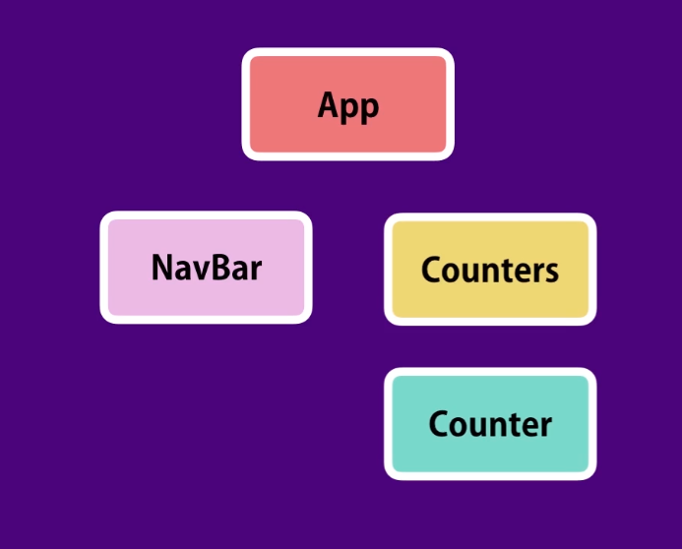
Introduction to useState
Consider that we have an App structure like this:
When we run this App and if we declare all the lifecycle hooks mentioned above and console.log() in every hook, we will see that the hooks are called in the following order.
i. App-constructor
ii. App-rendered
iii. NavBar-rendered (NavBar is a Stateless functional component)
iv. Counters-rendered (Counters is a Stateless functional component)
v. (4) Counter-rendered (Counter is a Stateless functional component)
vi. App-didMount
Now, if you don’t know what a Stateless functional component is, its a component that has no state or constructor or any lifecycle hooks and are fully controlled by their parents. They only render a react component.
So now, what happens when a state or props is changed? It renders all its components again.
Notice, it is said that all the components are rendered again not updated again.

Slide 19
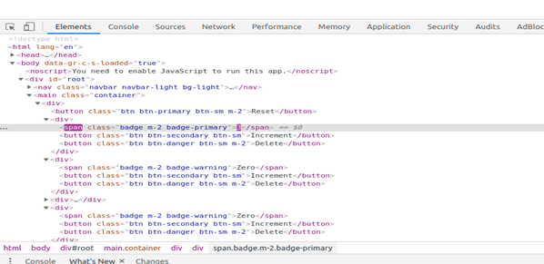
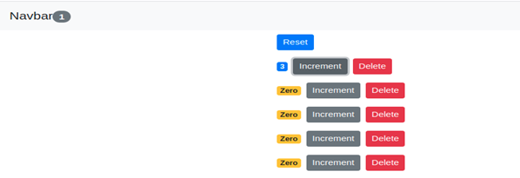
Introduction to useState
As you can see in the screenshot below, only the incremented span is being updated (in the inspect element you can see the changes in violet color). So, how it works?

Slide 20
Introduction to useState
React, keeps a track record of all its virtual DOM. Whenever a change happens, all the components are rendered and this new virtual DOM is then compared with the old virtual DOM. Only the differences found are then reflected in the original DOM. So, it’s obvious from the statement that if we mutate the state directly, it will change the reference of the state in the previous virtual DOM as well. So, React won’t be able to see that there is a change of the state and so it won’t be reflected in the original DOM until we reload. The problem is more obvious when we extend a component with React.PureComponent instead of React.Component where React tries to optimize some time by not rendering components if no changes are found. Also, mutating the state directly can lead to odd bugs and components that are hard to optimize. Now, let’s see why we should always use setState function for updating the state.
setState(updater[, callback])
setState() enqueues changes to the component state and tells React that this component and its children need to be re-rendered with the updated state. This is the primary method you use to update the user interface in response to event handlers and server responses. Think of setState() as a request rather than an immediate command to update the component. For better perceived performance, React may delay it, and then update several components in a single pass. In the rare case that you need to force the DOM update to be applied synchronously, you may wrap it in flushSync, but this may hurt performance. setState() does not always immediately update the component. It may batch or defer the update until later. This makes reading this.state right after calling setState() a potential pitfall. Instead, use componentDidUpdate or a setState callback (setState(updater, callback)), either of which are guaranteed to fire after the update has been applied. If you need to set the state based on the previous state, read about the updater argument below. setState() will always lead to a re-render unless shouldComponentUpdate() returns false. If mutable objects are being used and conditional rendering logic cannot be implemented in shouldComponentUpdate(), calling setState() only when the new state differs from the previous state will avoid unnecessary re-renders. The first argument is an updater function with the signature:

Slide 21
Introduction to useState
(state, props) => stateChange
state is a reference to the component state at the time the change is being applied. It should not be directly mutated. Instead, changes should be represented by building a new object based on the input from state and props. For instance, suppose we wanted to increment a value in state by props.step:
this.setState((state, props) => { return {counter: state.counter + props.step}; });
Both state and props received by the updater function are guaranteed to be up-to-date. The output of the updater is shallowly merged with state. The second parameter to setState() is an optional callback function that will be executed once setState is completed and the component is re-rendered. Generally we recommend using componentDidUpdate() for such logic instead. You may optionally pass an object as the first argument to setState() instead of a function:
setState(stateChange[, callback])
This form of setState() is also asynchronous, and multiple calls during the same cycle may be batched together. For example, if you attempt to increment an item quantity more than once in the same cycle, that will result in the equivalent of:
Object.assign( previousState, {quantity: state.quantity + 1}, {quantity: state.quantity + 1}, ...

Slide 22
Introduction to useState
Subsequent calls will override values from previous calls in the same cycle, so the quantity will only be incremented once. If the next state depends on the current state, we recommend using the updater function form, instead:
this.setState((state) => { return {quantity: state.quantity + 1}; });
For more information about mutations, have a look at Mastering Mutations in React Query

Slide 23
Closing (5 mins)

