Slide 1
1_Introduction to useEffect - SYNC (1 Hour 10 Minutes)
MEAN/MERN STACK

Slide 2
Opening (5 mins)

Slide 3
Learning Objectives:
useEffect Dependency Array
useEffect Cleanup Function
Lifecycle of Hooks
Async function in useEffect

Slide 4
Content (55 mins)

Slide 5
Introduction to useEffect
useEffect() is a hook that manages side-effects in functional React components. A functional React component uses props and/or state to calculate the output. If the functional component makes calculations that don't target the output value, then these calculations are named side-effects. Examples of side-effects are fetch requests, manipulating DOM directly, using timer functions like setTimeout(), and more. The component rendering and side-effect logic are independent. It would be a mistake to perform side-effects directly in the body of the component, which is primarily used to compute the output. How often the component renders isn't something you can control — if React wants to render the component, you cannot stop it.
function Greet({ name }) { const message = `Hello, ${name}!`; // Calculates output // Bad! document.title = `Greetings to ${name}`; // Side-effect! return <div>{message}</div>; // Calculates output }
How to decouple rendering from the side-effect? Welcome useEffect() — the hook that runs side-effects independently of rendering.
import { useEffect } from 'react'; function Greet({ name }) { const message = `Hello, ${name}!`; // Calculates output useEffect(() => { // Good! document.title = `Greetings to ${name}`; // Side-effect! }, [name]); return <div>{message}</div>; // Calculates output }

Slide 6
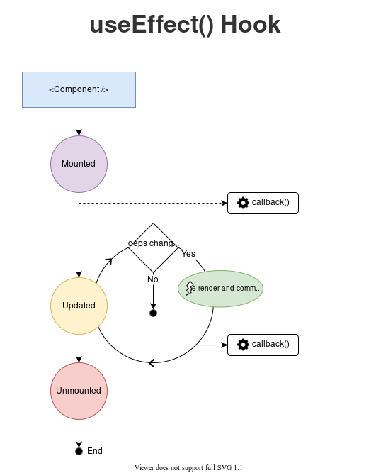
Introduction to useEffect
useEffect() hook accepts 2 arguments:
useEffect(callback[, dependencies]);
How to decouple rendering from the side-effect? Welcome useEffect() — the hook that runs side-effects independently of rendering.
callback is the function containing the side-effect logic. callback is executed right after changes were being pushed to DOM. dependencies is an optional array of dependencies. useEffect() executes callback only if the dependencies have changed between renderings. Put your side-effect logic into the callback function, then use the dependencies argument to control when you want the side-effect to run. That's the sole purpose of useEffect().

Slide 7
Introduction to useEffect
useEffect Dependency Array: Dependency arrays are a concept that is tightly coupled to hooks in React (thus also to function components). Hooks, like useEffect have 2 arguments. The first one is a callback (a function), and the second one is the dependency array. It takes the form of an array of variables. In the following example, [counter] is the dependency array of the useEffect hook:
useEffect(() => { console.log('Counter has value: ', counter); }, [counter]);
The React hooks that have dependency arrays are: useEffect useLayoutEffect useCallback useMemo The dependency array basically tells the hook to "only trigger when the dependency array changes". In the above example, it means "run the callback every time the counter variable changes". If you have multiple elements in a dependency array, the hook will trigger if any element of the dependency array changes
useEffect(() => { // this will run if `counter1` OR `counter2` changes console.log('Either counter1 or counter2 changed (or both'); }, [counter1, counter2]);

Slide 8
Introduction to useEffect
You might ask, what does it mean for the hook to "trigger" every time an element of the dependency array changes? Well, it depends on the hook. For the useEffect hook, it means running the callback. For the useCallback hook, it means changing the function being returned by the hook. Same for useMemo, but with a value. Empty Dependency Array As mentioned earlier, the dependency array controls when the hook triggers. So what happens when the dependency array is empty? It simply means that the hook will only trigger once when the component is first rendered. So for example, for useEffect it means the callback will run once at the beginning of the lifecycle of the component and never again.
useEffect(() => { console.log('I will run only once'); }, []);
This is a very common pattern when you want to do something at the beginning of the lifecycle of a component, for example to do some data fetching.
useEffect(() => { // this will run only once when the component first renders fetch('https://yourapi.com'); }, []);

Slide 9
Introduction to useEffect
Here question arises that what should be put in the dependency array? It's a pretty simple rule, made a bit harder by some exceptions. The rule is: if any variable is used inside the hook but is defined outside of it, then it should go in the dependency array. That goes both for simple variables as well as for functions.
import { useEffect } from 'react'; const ExampleComponent = () => { const width = 200; const printToConsole = (value) => { console.log(value); }; useEffect(() => { printToConsole(width); }, [width, printToConsole]); return <p>Hello World!</p>; };
This is a very common pattern when you want to do something at the beginning of the lifecycle of a component, for example to do some data fetching.
useEffect(() => { // this will run only once when the component first renders fetch('https://yourapi.com'); }, []);

Slide 10
Introduction to useEffect
Please note that this example will actually lead to a bug, because the printToConsole function isn't wrapped in useCallback. That will lead to useEffect triggering on every render of ExampleComponent! A better way to do this in the will be shown later. As you can see in the above (quite contrived) example, both the variable width and the function printToConsole are used in the useEffect hook, and thus need to go in the array. So the rule is pretty simple, but as mentioned there are some exceptions. Values defined outside of the component If a value is defined outside of a component, then it is fixed and won't change when the app is running. Thus React doesn't need you to add it to the dependency array. In the last example, there was actually no need to define width and printToConsole inside the component like it is done. The following is better:
import { useEffect } from 'react'; const width = 200; const printToConsole = (value) => { console.log(value); }; const ExampleComponent = () => { useEffect(() => { printToConsole(width); }, []); return <p>Hello World!</p>; };

Slide 11
Introduction to useEffect
It's good practice to put everything that can go outside of a component outside of it. Constants (like width) and utility functions (like printToConsole) don't need to be defined inside the component. Already optimized function As we saw, the goal of the dependency array is to make the hook trigger when one of the values changes. There's no point putting stuff in there that won't change. And there's some values that React knows for sure won't change, because React itself makes sure of that. An example of this behavior is the setter function returned by a useState hook:
const [counter, setCounter] = useState(0);
The setCounter function is optimized by React and won't change. So even if it's used in a hook with a dependency array you don't need to add it to the dependency array.
import { useState, useEffect } from 'react'; const ExampleComponent = () => { const [counter, setCounter] = useState(0); useEffect(() => { setCounter(10); }, []); return <p>Counter is: {counter}</p>;
If setCounter was passed as a prop from a higher component, you'd have to include it in the dependency array because React doesn't know where it comes from. It won't trigger the hook though, so it's safe to do so.

Slide 12
Introduction to useEffect
useEffect Cleanup Function Just like the name implies, the useEffect cleanup is a function in the useEffect Hook that allows us to tidy up our code before our component unmounts. When our code runs and reruns for every render, useEffect also cleans up after itself using the cleanup function. The useEffect Hook is built in a way that we can return a function inside it and this return function is where the cleanup happens. The cleanup function prevents memory leaks and removes some unnecessary and unwanted behaviors. There are two common kinds of side effects in React components: those that don’t require cleanup, and those that do. Let’s look at this distinction in more detail. Effects Without Cleanup Sometimes, we want to run some additional code after React has updated the DOM. Network requests, manual DOM mutations, and logging are common examples of effects that don’t require a cleanup. We say that because we can run them and immediately forget about them. Let’s compare how classes and Hooks let us express such side effects. Example using classes: In React class components, the render method itself shouldn’t cause side effects. It would be too early — we typically want to perform our effects after React has updated the DOM. This is why in React classes, we put side effects into componentDidMount and componentDidUpdate. Coming back to our example, here is a React counter class component that updates the document title right after React makes changes to the DOM:

Slide 13
Introduction to useEffect
class Example extends React.Component { constructor(props) { super(props); this.state = { count: 0 }; } componentDidMount() { document.title = `You clicked ${this.state.count} times`; } componentDidUpdate() { document.title = `You clicked ${this.state.count} times`; } render() { return ( <div> <p>You clicked {this.state.count} times</p> <button onClick={() => this.setState({ count: this.state.count + 1 })}> Click me </button> </div> ); } }

Slide 14
Introduction to useEffect
Note how we have to duplicate the code between these two lifecycle methods in class. This is because in many cases we want to perform the same side effect regardless of whether the component just mounted, or if it has been updated. Conceptually, we want it to happen after every render — but React class components don’t have a method like this. We could extract a separate method but we would still have to call it in two places. Now let’s see how we can do the same with the useEffect Hook. Example Using Hooks: We’ve already seen this example at the top of this page, but let’s take a closer look at it:
import React, { useState, useEffect } from 'react'; function Example() { const [count, setCount] = useState(0); useEffect(() => { document.title = `You clicked ${count} times`; }); return ( <div> <p>You clicked {count} times</p> <button onClick={() => setCount(count + 1)}> Click me </button> </div> ); }

Slide 15
Introduction to useEffect
What does useEffect do? By using this Hook, you tell React that your component needs to do something after render. React will remember the function you passed (we’ll refer to it as our “effect”), and call it later after performing the DOM updates. In this effect, we set the document title, but we could also perform data fetching or call some other imperative API. Why is useEffect called inside a component? Placing useEffect inside the component lets us access the count state variable (or any props) right from the effect. We don’t need a special API to read it — it’s already in the function scope. Hooks embrace JavaScript closures and avoid introducing React-specific APIs where JavaScript already provides a solution. Does useEffect run after every render? Yes! By default, it runs both after the first render and after every update. (We will later talk about how to customize this.) Instead of thinking in terms of “mounting” and “updating”, you might find it easier to think that effects happen “after render”. React guarantees the DOM has been updated by the time it runs the effects. Effects with Cleanup Earlier, we looked at how to express side effects that don’t require any cleanup. However, some effects do. For example, we might want to set up a subscription to some external data source. In that case, it is important to clean up so that we don’t introduce a memory leak! Let’s compare how we can do it with classes and with Hooks. Example Using Classes: In a React class, you would typically set up a subscription in componentDidMount, and clean it up in componentWillUnmount. For example, let’s say we have a ChatAPI module that lets us subscribe to a friend’s online status. Here’s how we might subscribe and display that status using a class:

Slide 16
Introduction to useEffect
class FriendStatus extends React.Component { constructor(props) { super(props); this.state = { isOnline: null }; this.handleStatusChange = this.handleStatusChange.bind(this); } componentDidMount() { ChatAPI.subscribeToFriendStatus( this.props.friend.id, this.handleStatusChange ); } componentWillUnmount() { ChatAPI.unsubscribeFromFriendStatus( this.props.friend.id, this.handleStatusChange ); } handleStatusChange(status) { this.setState({ isOnline: status.isOnline }); } render() { if (this.state.isOnline === null) { return 'Loading...'; } return this.state.isOnline ? 'Online' : 'Offline'; } }

Slide 17
Introduction to useEffect
Notice how componentDidMount and componentWillUnmount need to mirror each other. Lifecycle methods force us to split this logic even though conceptually code in both of them is related to the same effect. Example Using Hooks: Let’s see how we could write this component with Hooks. You might be thinking that we’d need a separate effect to perform the cleanup. But code for adding and removing a subscription is so tightly related that useEffect is designed to keep it together. If your effect returns a function, React will run it when it is time to clean up:
import React, { useState, useEffect } from 'react'; function FriendStatus(props) { const [isOnline, setIsOnline] = useState(null); useEffect(() => { function handleStatusChange(status) { setIsOnline(status.isOnline); } ChatAPI.subscribeToFriendStatus(props.friend.id, handleStatusChange); // Specify how to clean up after this effect: return function cleanup() { ChatAPI.unsubscribeFromFriendStatus(props.friend.id, handleStatusChange); }; }); if (isOnline === null) { return 'Loading...'; } return isOnline ? 'Online' : 'Offline';

Slide 18
Introduction to useEffect
Why did we return a function from our effect? This is the optional cleanup mechanism for effects. Every effect may return a function that cleans up after it. This lets us keep the logic for adding and removing subscriptions close to each other. They’re part of the same effect! When exactly does React clean up an effect? React performs the cleanup when the component unmounts. However, as we learned earlier, effects run for every render and not just once. This is why React also cleans up effects from the previous render before running the effects next time. We don’t have to return a named function from the effect. We called it cleanup here to clarify its purpose, but you could return an arrow function or call it something different.

Slide 19
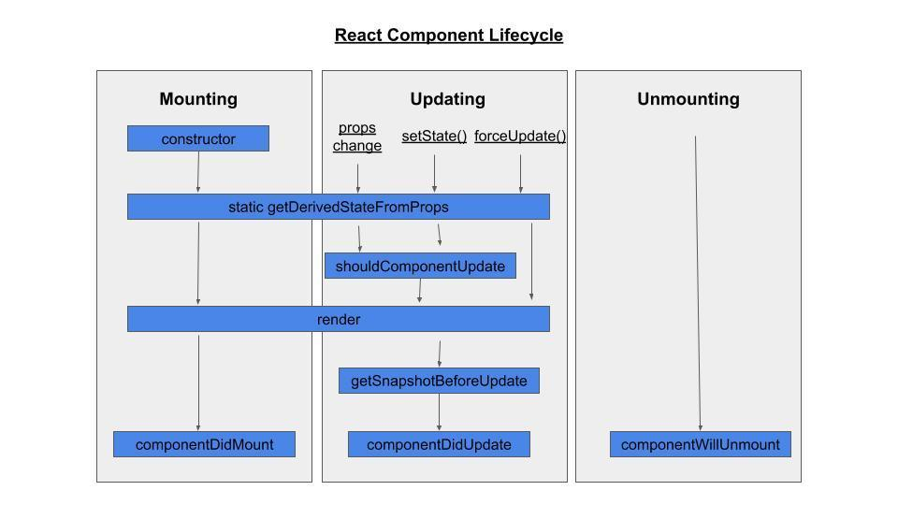
Introduction to useEffect
Lifecycle of Hooks: A React component undergoes three different phases in its lifecycle, including mounting, updating, and unmounting. Each phase has specific methods responsible for a particular stage in a component's lifecycle. These methods are technically particular to class-based components and not intended for functional components. However, since the concept of Hooks was released in React, you can now use abstracted versions of these lifecycle methods when you’re working with functional component state. Simply put, React Hooks are functions that allow you to “hook into” a React state and the lifecycle features within function components. Phases of a React component's lifecycle: A React component undergoes three phases in its lifecycle: mounting, updating, and unmounting. The mounting phase is when a new component is created and inserted into the DOM or, in other words, when the life of a component begins. This can only happen once, and is often called “initial render.” The updating phase is when the component updates or re-renders. This reaction is triggered when the props are updated or when the state is updated. This phase can occur multiple times, which is kind of the point of React. The updating phase is when the component updates or re-renders. This reaction is triggered when the props are updated or when the state is updated. This phase can occur multiple times, which is kind of the point of React.

Slide 20
Introduction to useEffect
The updating phase is when the component updates or re-renders. This reaction is triggered when the props are updated or when the state is updated. This phase can occur multiple times, which is kind of the point of React.
Hooks have gaining popularity because they make working with React cleaner and often less verbose.
React Lifecycle Methods
Let’s learn more about the methods that make up each of our three phases.
The mounting phase:
In the mounting phase, a component is prepared for and actually inserted into the DOM. To get through this phase, four lifecycle methods are called: constructor, static getDerivedStateFromProps, render, and componentDidMount.
The constructor method
The constructor method is the very first method called during the mounting phase.
It's important to remember that you shouldn't add any side effects within this method (like sending an HTTP request) as it's intended to be pure.
This method is mostly used for initializing the state of the component and binding event-handler methods within the component. The constructor method is not necessarily required. If you don't intend to make your component stateful (or if that state doesn’t need to be initialized) or bind any method, then it’s not necessary to implement.
The constructor method is called when the component is initiated, but before it’s rendered. It’s also called with props as an argument. It's important you call the super(props) function with the props argument passed onto it within the constructor before any other steps are taken.
This will then initiate the constructor of React.Component (the parent of this class-based component) and it inherits the constructor method and other methods of a typical React component.
For example, below you can see a class-based component implementation of a counter with a constructor in it, where the state is initialized and an event-handler method is bound (ignore the render method for now):

Slide 21
Introduction to useEffect
import React from 'react'; class Counter extends React.Component { constructor(props) { super(props); this.state = { count: 0 }; this.setCount = this.setCount.bind(this); } setCount() { this.setState({count: this.state.count + 1}); } render() { return ( <div> <h1>Counter</h1> <button onClick={this.setCount}>Click to add</button> <p>Count: {this.state.count}</p> </div> ) } }

Slide 22
Introduction to useEffect
In the Counter component, you can see the component's state is initialized within the constructor method to keep track of the count state. The setCount method, which is an event-handler attached to your button in this case, is bound within the constructor. The static getDerivedStateFromProps method Props and state are completely different concepts, and part of building your app intelligently is deciding which data goes where. In many cases though, your component’s state will be derivative of its props. This is where the static getDerivedStateFromProps method comes in. This method allows you to modify the state value with any props value. It's most useful for changes in props over time, and we’ll learn later that it’s also useful in the update phase. The method static getDerivedStateFromProps accepts two arguments: props and state, and returns an object, or null if no change is needed. These values are passed directly to the method, so there’s no need for it to have access to the instance of the class (or any other part of the class) and thus is considered a static method. In the mounting phase, the getDerivedStateFromProps method is called after the constructor method and right before the component is rendered. This is the most rarely used method in this phase, but it’s still important to know so you can use it if needed. For reference, here's an example of how getDerivedStateFromProps is used:

Slide 23
Introduction to useEffect
class UserPreview extends React.Component { constructor(props) { super(props); this.state = { ... fullname: "" }; } static getDerivedStateFromProps(props, state) { return { ... fullname: `${props.firstname} ${props.lastname}` } } render() { // ... } }

Slide 24
Introduction to useEffect
Another way of looking at it is just providing a default for your component state based on props. The render method The render method is the only required method for a class-based React component. It’s called after the getDerivedStateFromProps method and actually renders or inserts the HTML to the DOM. Typically, the render method returns the JSX which will eventually be rendered, but it can also return other values. It's important to remember that the render method is meant to be pure. This means you can’t modify the state, have any direct interaction with the browser, or any other kind of side effect like sending an HTTP request. Just think of it as writing HTML, but of course as JSX. Below is an example of using the render method:
lass SubmitButton extends React.Component { render() { return ( <button type="submit" style={this.props.styles} > {this.props.child} </button> ); }

Slide 25
Introduction to useEffect
The componentDidMount method componentDidMount is the last lifecycle method called in the mounting phase. It’s called right after the component is rendered or mounted to the DOM. With this method, you're allowed to add side effects like sending network requests or updating the component's state. Additionally, the componentDidMount method allows you to make subscriptions like subscribing to the Redux store. You can also call the this.setState method right away; however this will cause a re-render as it kicks in the update phase, since the state has changed. You need to be careful with componentDidMount because it may cause unnecessary re-renders. Here's an example using the componentDidMount method:

Slide 26
Introduction to useEffect
class NASACounter extends React.Component { constructor(props) { super(props); this.state = { count: 10 }; } componentDidMount() { const myTimer = setInterval(() => { this.state.count > 0 ? this.setState({ count: this.state.count - 1 }) : clearInterval(myTimer); }, 1000); } render() { return ( <div style={this.props}> <h1> NASA Countdown: <br /> {this.state.count || "🪐"} <br /> {"⭐".repeat(this.state.count) || "🚀"} </h1> {this.state.count === 0 && <h2>LIFT OFF!!!</h2>} </div> ); } }

Slide 27
Introduction to useEffect
The updating phase The Updating phase is triggered when component props or state change, and consists of the following methods: static getDerivedFromProps, shouldComponentUpdate, render, getSnapshotBeforeUpdate, and componentDidUpdate. The methods getDerivedFromProps and render are also part of the mounting phase. Since they’ve been covered previously, this section focuses on the other three methods. The static getDerivedStateFromProps In the update phase, the first lifecycle method called is getDerivedStateFromProps. This method is useful if you have updated props and you want to reflect that in the component's state. For instance, a component’s state may depend on the value of its props. With getDerivedStateFromProps, before the component was even re-rendered, its state can reflect those changes and can be shown (if applicable) to the newly updated component. Remember, this method is rarely used and isn’t ideal for most situations. The shouldComponentUpdate method shouldComponentUpdate is another rarely used lifecycle method. It’s specifically intended for performance optimization, and basically lets you tell React when you don't need to re-render when a new state or props comes in. While it can help avoid re-renders, you shouldn’t rely on it to prevent re-renders since you might skip a necessary update and encounter bugs. To prevent renders, you can opt in to logical rendering instead, or use a PureComponent which is recommended by React. This method can accept nextProps and nextState as arguments, however, they’re optional, and you can declare it without the arguments. This method then returns a Boolean value. The Boolean value defines whether a re-render happens. The default value is true, where re-render happens in all cases whenever state or props changes. Note that the shouldComponentUpdate method is ignored when forceUpdate() is invoked.

Slide 28
Introduction to useEffect
The getSnapshotBeforeUpdate method The getSnapshotBeforeUpdate method gives you access to the previous props and state of the component before it's updated. This allows you to work or check on the previous values of the state or props. It’s another method that’s rarely used. A good use case for this method is handling scroll positions in a chat app. When a new message comes in as the user is viewing old messages, it shouldn’t push the old ones out of view. getSnapshotBeforeUpdate is called after the render method, and before componentDidUpdate. If the getSnapshotBeforeUpdate method returns anything, it will be passed as a parameter for the componentDidUpdate method:

Slide 29
Introduction to useEffect
class ChatList extends React.Component { constructor(props) { super(props); this.chatsList = React.createRef(); } getSnapshotBeforeUpdate(prevProps, prevState) { if (prevProps.list.length < this.props.list.length) { const list = this.chatsList.current; return list.scrollHeight - list.scrollTop; } return null; } componentDidUpdate(prevProps, prevState, snapshot) { if (snapshot !== null) { const list = this.chatsList.current; list.scrollTop = list.scrollHeight - snapshot; } } render() { return ( <div ref={this.chatsList}>{/* ...contents... */}</div> ); } }

Slide 30
Introduction to useEffect
class WritePost extends React.Component { constructor(props) { super(props); this.state = { postContent: "" }; this.handleInput = this.handleInput.bind(this); this.handleSubmit = this.handleSubmit.bind(this); } handleInput(e) { this.setState({postContent: this.state.postContent + e.target.value}) } handleSubmit() { // ... } autosave() { // send network request to save post... } componentDidUpdate() { this.autosave() } render() { return( <form onSubmit={this.handleSubmit}> <input type={text} value={this.state.postContent} onChange={e => handleInput(e)} /> <button type="submit">Post</button> </form> ) } }
The componentDidUpdate Method
The componentDidUpdate method is the last lifecycle method invoked in the update phase. It allows you to create side effects like sending network requests or calling the this.setState method. It’s important to remember that there should always be a way to avoid the setState (like some sort of logic), or it will result in an infinite loop of re-rendering.
This method can accept up to three parameters: prevProps, prevState, and snapshot (if you implement the getSnapshotBeforeUpdate method).
Here's an example of using componentDidUpdate method for implementing autosave functionality:

Slide 31
Introduction to useEffect
class MyComponent extends React.Component { constructor(props) { super(props); this.state = { ... } // whatever bindings... } componentDidMount() { const { subscribe } = this.props.store; this.unsubscribe = subscribe(this.forceUpdate); } componentWillUnmount() { this.unsubscribe(); } render() { return ( <div> ... </div> ) } }
The unmounting phase
The unmounting phase is the third and final phase of a React component. At this phase, the component is removed from the DOM. Unmounting only has one lifecycle method involved: componentWillUnmount.
The componentWillUnmount Method
componentWillUnmount is invoked right before the component is unmounted or removed from the DOM. It’s meant for any necessary clean up of the component, like unsubscribing to any subscriptions (i.e., Redux) or canceling any network requests. Once this method is done executing, the component will be destroyed.
Here's an example of using the componentWillUnmount to unsubscribe from a Redux store:

Slide 32
Introduction to useEffect
Async function in useEffect useEffect is usually the place where data fetching happens in React. Data fetching means using asynchronous functions, and using them in useEffect might not be as straightforward as you'd think. There's one wrong way to do data fetching in useEffect. If you write the following code, your linter will scream at you! To read more about linter, read this documentation
· · · // ❌ don't do this useEffect(async () => { const data = await fetchData(); }, [fetchData]) · · ·
The issue here is that the first argument of useEffect is supposed to be a function that returns either nothing (undefined) or a function (to clean up side effects). But an async function returns a Promise, which can't be called as a function! It's simply not what the useEffect hook expects for its first argument. So how do you use asynchronous code inside a useEffect? Usually the solution is to simply write the data fetching code inside the useEffect itself, like so:
· · · useEffect(() => { // declare the data fetching function const fetchData = async () => { const data = await fetch('https://yourapi.com'); } // call the function fetchData() // make sure to catch any error .catch(console.error); }, []) · · ·

Slide 33
Introduction to useEffect
One caveat is that if you want to use the result from the asynchronous code, you should do so inside the fetchData function, not outside. For example, the following would lead to issues:
· · · useEffect(() => { // declare the async data fetching function const fetchData = async () => { // get the data from the api const data = await fetch('https://yourapi.com'); // convert data to json const json = await data.json(); return json; } // call the function const result = fetchData() // make sure to catch any error .catch(console.error);; // ❌ don't do this, it won't work as you expect! setData(result); }, [])
Can you guess what the result variable will be when the setData(result) line is called? One way to see this is to write a dummy asynchronous function that just waits for a certain amount of time.

Slide 34
Introduction to useEffect
useEffect(() => { // declare the async data fetching function const fetchData = async () => { function sleep(ms) { return new Promise(resolve => setTimeout(resolve, ms)); } // waits for 1000ms await sleep(1000); return 'Hello World'; }; const result = fetchData() // make sure to catch any error .catch(console.error);; // what will be logged to the console? console.log(result); }, [])
What will get logged to the console? If you got it right, congrats! result will be holding a pending Promise object. In the console you'll see something like:
Promise {<pending>}

Slide 35
Introduction to useEffect
So how should you use the result of asynchronous code inside a useEffect? Inside the fetch data function! To fix the above example, you would do it this way:
useEffect(() => { const fetchData = async () => { await sleep(1000); // this will log 'Hello Word' to the console console.log('Hello World'); }; fetchData() // make sure to catch any error .catch(console.error);; }, [])
Translated with a setState function, it looks like this:
useEffect(() => { // declare the async data fetching function const fetchData = async () => { // get the data from the api const data = await fetch('https://yourapi.com'); // convert the data to json const json = await response.json(); // set state with the result setData(json); } // call the function fetchData() // make sure to catch any error .catch(console.error);; }, [])

Slide 36
Closing (5 mins)

