Slide 1
1_React: Advanced React Concepts - SYNC (20 minutes)
MEAN/MERN STACK

Slide 2
Opening (5 mins)

Slide 3
Learning Objectives:
Destructing Props
Simple state machine
Compound components
Flexible compound components

Slide 4
Content (15 mins)

Slide 5
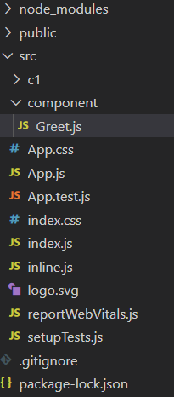
Advanced React Concepts
Destructuring Props Destructuring is a simple property that is used to make code much clear and readable, mainly when we pass props in React. Destructuring was introduced in ES6. It’s a JavaScript feature that allows us to extract multiple pieces of data from an array or object and assign them to their own variables. In destructuring, It does not change an array or any object, it makes a copy of the desired object or array element by assigning them in its own new variables, later we can use this new variable in React (class or functional) components. It makes the code more clear. When we access the props using this keyword, we have to use this/ this.props throughout the program, but by the use of restructuring, we can discard this/ this.props by assigning them in new variables. This is very difficult to monitor props in complex applications, so by assigning these props in new own variables we can make a code more readable. We can use the Destructuring in the following method in ReactJS: Using this.props method In this example, we are going to simply display some words using destructuring and without destructuring. Project Structure: It will look like the following

Slide 6
Advanced React Concepts
Destructuring gives access to the use of props in a more readable format and discards the need for props for every property. App.js: Now write down the following code in the App.js file. Here, App is our default component where we will print our component code.
import React from "react" import Greet from './component/Greet' class App extends React.component{ render(){ return( <div className = "App"> <Greet active="KAPIL GARG" activeStatus = "CSE"/> </div> ); } } export default App;
Greet.js: In this file, we will write component code about the destructuring process. Without Destructuring:

Slide 7

Advanced React Concepts
import React from 'react'; const Greet = props =>{ return ( <div> <div className="XYZ"> <h3> {props.active} </h3> </div> <div className="PQR"> <h1>{props.activeStatus}</h1> </div> </div> ) } export default Greet;
Output: Here props are unnecessarily coming again inside the return, so more concise names of these Destructuring properties are used.

Slide 8
Advanced React Concepts
With Destructuring:
import React from 'react'; const Greet = props =>{ // Destructuring const {active, activeStatus} = props; return ( <div> <div className="XYZ"> <h3> {active} </h3> </div> <div className="PQR"> <h1>{activeStatus}</h1> </div> </div> ) } export default Greet;
Output

Slide 9
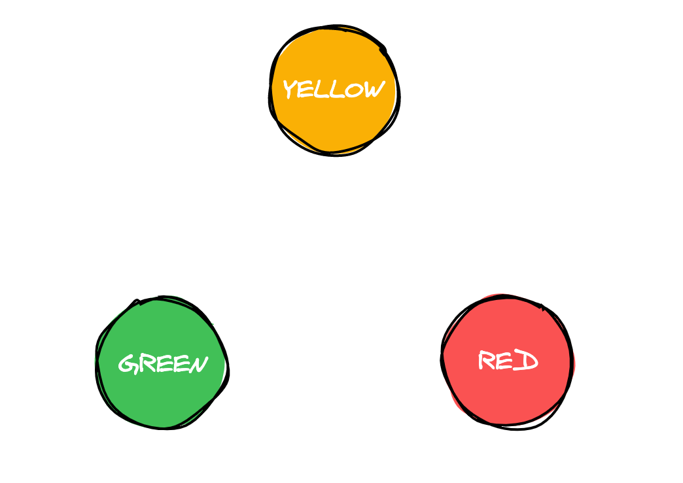
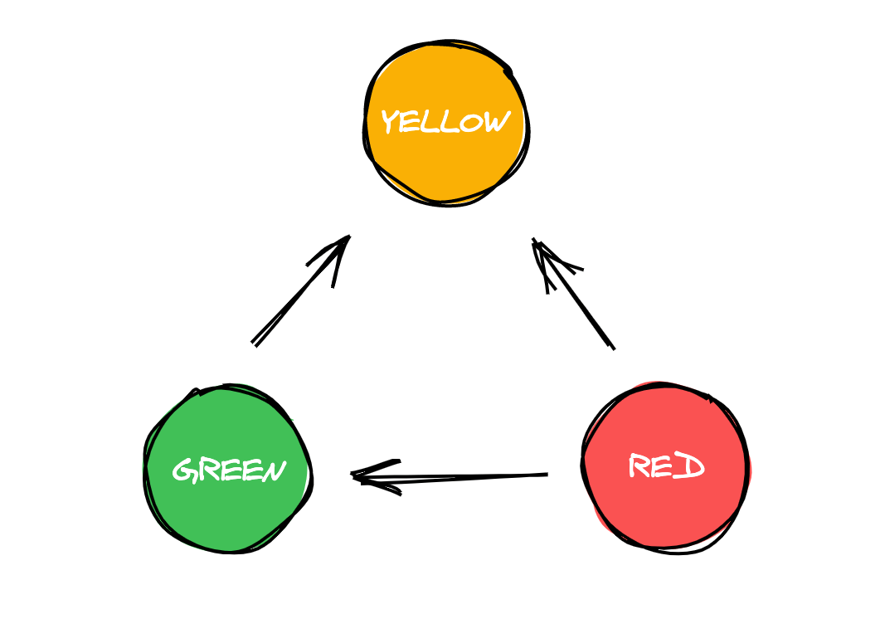
Advanced React Concepts
What Are Finite State Machines? Whether or not you’ve heard the term “finite state machines,” we’ve been using them for a long time, and not only in computation—in real life too. The most common finite state machine example that we can use is a traffic light. A traffic light has only three states: green, yellow and red.
This is how a traffic light works:
We have an initial state of green.
We have a timer, and, after the timer hits 30 seconds, the state will change to yellow.
Now that our state is yellow, after the timer hits 10 seconds, the state will change to red.
In our red state, after the timer hits 30 seconds again, it will change our state to green.

Slide 10
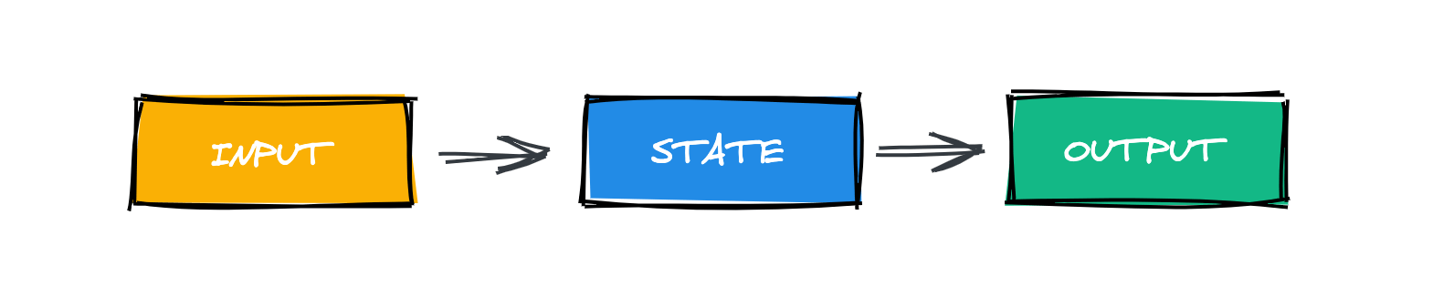
Advanced React Concepts
Very simple. We have a finite number of states (green, yellow and red), which means that we only have three possible states. There isn’t another state possibility.
To change for another state, we need input. In our traffic light example, the input is our timer. Whenever the timer hits a specific amount of seconds, it transitions to another state. This new state is our output.
That’s basically how a finite state machine works.
We have a finite number of states and an initial state.
The state can only change (transition) in response to an input.
After the state changes, it produces an output.
With a very simple example, we can understand how finite state machines work. Now, take a look at your code. I’m pretty sure that you can identify a few small finite machines in your code very easily.
Why Use Finite State Machines?
You might be wondering what the benefits of a finite state machine are, why you should use it to handle complex state logic. I’ll list a few advantages:
A finite number of states. If you have a finite number of states, you already know how your state logic is going to look and when should you change from one state to another.
Visualized modeling. With finite state machines you can use a state machine visualization tool to create your state machine and visualize how your state logic will look. Also it gets easier to identify errors or when you’re changing to a wrong state.
Avoid unexpected side effects. This is one of the most powerful advantages of finite state machines. It’s relative to the first point, but with a finite number of states, you’ll drastically reduce the number of unexpected side effects that you create in your state logic.
Relatively easy to debug. Debugging a finite state machine is relatively easy. You can use a state machine visualization tool for that, and it’ll save you a few hours when you’re debugging.
Strong test coverage. With a finite number of states, it gets pretty easy to write tests for your state logic. If you don’t know how and to where your state is going to change, you can avoid a lot of useless tests and remove those side effect tests that we usually write.

Slide 11
Advanced React Concepts
Finite State Machines vs Statecharts Statecharts were invented by David Harel, and they are an extension of state machines. Statecharts are more scalable and consistent than simple state machines, and they come with some expensive features to help more complex systems. One of the main features of statecharts is that they have a hierarchy state and each state can have substates. In a statechart, a state that has no substate is called an atomic state. A state that has a substate is called a compound state. Other nice features that statecharts have are actions, guards, multiple transitions and state history. So, when you see someone else talking about statecharts, don’t get confused—they’re just an extension of a finite state machine with a few extra powerful features. Now that we know about state machines and how they work, let’s find out how we can use them in our React apps. XState XState is a JavaScript/TypeScript library to create finite state machines and statecharts. This library is, by far, the best option nowadays to start to working with finite state machines and statecharts in our apps. In this tutorial, we’re going to work with XState for React, but this library also has a package for Vue. So, let’s get started with XState and learn how we can create our first finite state machine and achieve a better level of state logic in our apps. XState has a visualizer that helps us create our finite state machines. We can use this visualizer to see how our finite state machine is working and if we have any errors. So, let’s use this visualizer to have a better understanding of how XState works. Creating our First Finite State Machine To create a finite state machine using XState, we should use the Machine object. Inside this object is where we’re going to create all the transitions and events for our finite state machine. Let’s name this machine lightMachine and use the Machine object:
const lightMachine = Machine({ ... });

Slide 12
Advanced React Concepts
Each Machine should have an id and an initial state. We’re going to give the id of lightMachine, and the initial state of our traffic light state machine will be green.
const lightMachine = Machine({ id: 'lightMachine', initial: 'green' });
States Our state is basically a representation of our system: As the events occur in our applications, the state changes. A finite state machine can only be in one state at a given time; it’s impossible to be in more than one. In a traffic light, we can think in only three possible states: green, yellow and red. Inside our Machine object, we define our state using a property called states, which is also an object. So, let’s create our first states.
const lightMachine = Machine({ id: 'lightMachine', initial: 'green', states: { green: {}, yellow: {}, red: {} } });

Slide 13
Advanced React Concepts
For now, our finite state machine is doing basically nothing. Inside each state, we’re going to use a property called on. This property will change our state when a transition occurs. This is how it works: We give a name to the transition and the final state that we want. So, for example, we want to give the name of YELLOW to our transition, and we want to go to the yellow state. Let’s do the same for the other states, but we’re going to change the final state, and follow the same behavior of a traffic light. From green to yellow, from yellow to red, from red to green.
const lightMachine = Machine({ id: 'lightMachine', initial: 'green', states: { green: { on: { YELLOW: 'yellow' } }, yellow: { on: { RED: 'red' } }, red: { on: { GREEN: 'green' } } } });

Slide 14
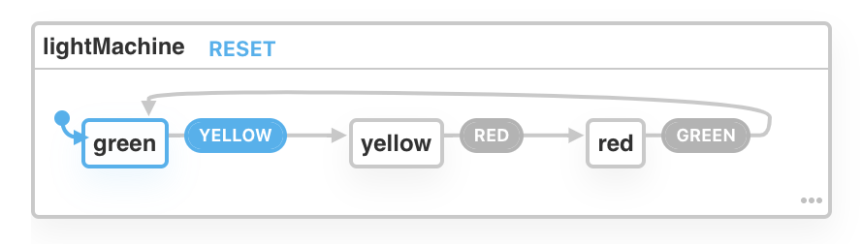
Advanced React Concepts
In our visualizer, this is how our finite state machine is looking: By clicking in our transitions, we can see our state changing, and our finite state machine is working as expected. One state at a time, without any errors. Context In XState, we have something called Context. Context can be defined as “quantitative data”. We can understand it like strings, functions, objects, etc. So, let’s create our context to understand how it works. Inside our Machine object, below the initial property, we’re going to create an object called context.
context: { updated: 0 },
Now, every time we change our state, we’re going to increment that context by 1. But how we can do that? Well, in XState, we have something called Actions. With Actions we can easily dispatch side effects. Actions So, we’re going to create a function called updateAction, and use the assign function to update our context.
const updatedAction = assign({ updated: (context, event) => context.updated + 1 })
Also, we’re going to change a few things inside our Machine object now. Inside each state, we’re going to change to something like this:

Slide 15
Advanced React Concepts
green: { on: { yellow: { target: 'yellow', actions: 'updatedAction' } } }, yellow: { on: { red: { target: 'red', actions: 'updatedAction' } } }, red: { on: { GREEN: { target: 'green', actions: 'updatedAction' } } }
When we have actions to dispatch, we need to change our events to an object and have two properties: target is the next state, and actions are the actions that we’re going to dispatch.

Slide 16
Advanced React Concepts
const updatedAction = assign({ updated: (context, event) => context.updated + 1 }) const lightMachine = Machine({ id: 'lightMachine', initial: 'green', context: { updated: 0 }, states: { green: { on: { YELLOW: { target: 'yellow', actions: 'updatedAction' } } }, yellow: { on: { RED: { target: 'red', actions: 'updatedAction' } } }, red: { on: { GREEN: { target: 'green', actions: 'updatedAction' } } } } });

Slide 17
Advanced React Concepts
Usage in React We now have our finite state machine working fine, so let’s get started using it in React and see how it works. First, let’s install some packages:
yarn add xstate @xstate/react
Now, we should import the Machine object from xstate and the useMachine hook from @xstate/react.
import { Machine } from "xstate"; import { useMachine } from "@xstate/react";
Inside our component, we’re going to paste the finite state machine that we created using the visualizer, and also use the useMachine hook. The useMachine hook is pretty similar to the other hooks of React. The returned state is current, and the send function is to update our state using our actions. We’re going to put the useMachine that we created as value, and also create a new object. Inside this new object we’re going to create a property called actions and put our updatedAction action there.
const [current, send] = useMachine(lightMachine, { actions: { updatedAction } });
Inside our current state, we have a lot of different properties. For now, we’re going to use context and matches. With the context property, we’ll be able to get our context, and the matches property is a function to check if our finite state machine is in that specific state. So, we’ll create a title to display how many times our state was updated, and also create three div elements using the matches property to display content. We’re going to compare each div element to each state, so we’ll only display the div of that respective element.

Slide 18
Advanced React Concepts
return ( <div> <h1>Light traffic</h1> <h1>Updated: {current.context.updated} times</h1> {current.matches('green') ? ( <div style={{ width: 60, height: 60, borderRadius: "50%", background: "green", marginTop: 10 }} /> ): null} {current.matches('yellow') ? ( <div style={{ width: 60, height: 60, borderRadius: "50%", background: "yellow", marginTop: 10 }} /> ): null} {current.matches('red') ? ( <div style={{ width: 60, height: 60, borderRadius: "50%", background: "red", marginTop: 10 }} /> ): null} </div> );
Now, we’re going to create three buttons. Each button will change the state for a specific target. To change the state, we’ll use the send function from our useMachine hook. If the button doesn’t match the state that we want, the button will be disabled. So, for example, we know that our first state is green, and after that, we go to yellow. So our first button will have the name of Yellow, but it will be disabled if it doesn’t match the state of green. To change our state, we’ll simply put an onClick method and use the send function, passing the next target which is YELLOW.
<button disabled={!current.matches('green')} onClick={() => send('YELLOW')}> YELLOW </button>

Slide 19
Advanced React Concepts
Very simple. Now we’ll do that for the other two states, and our final component will look like this:
const Light = () => { const lightMachine = Machine({ id: 'lightMachine', initial: 'green', context: { updated: 0 }, states: { green: { on: { yellow: { target: 'yellow', actions: 'updatedAction' } } }, yellow: { on: { red: { target: 'red', actions: 'updatedAction' } } }, red: { on: { GREEN: { target: 'green', actions: 'updatedAction' } } } } | }); const updatedAction: any = assign({ updated: (context: any, event: any) => context.updated + 1 }) const [current, send] = useMachine(lightMachine, { actions: { updatedAction } }); return ( <div> <h1>Light traffic</h1> <h1>Updated: {current.context.updated} times</h1> {current.matches('green') ? ( <div style={{ width: 60, height: 60, borderRadius: "50%", background: "green", marginTop: 10 }} /> ): null} {current.matches('yellow') ? ( <div style={{ width: 60, height: 60, borderRadius: "50%", background: "yellow", marginTop: 10 }} /> ): null} {current.matches('red') ? ( <div style={{ width: 60, height: 60, borderRadius: "50%", background: "red", marginTop: 10 }} /> ): null} <button disabled={!current.matches('green')} onClick={() => send('YELLOW')}>YELLOW</button> <button disabled={!current.matches('yellow')} onClick={() => send('RED')}>RED</button> <button disabled={!current.matches('red')} onClick={() => send('GREEN')}>GREEN</button> </div> ); };

Slide 20
Advanced React Concepts
We now have a traffic light application working using XState. That’s very awesome. We can see that our logic is bug-free, since we’re not able to be in more than one state at a time. XState and finite state machines make a lot of sense to create better applications when you’ll have a lot of different states. Maybe it’ll take some time to grasp the concepts of this powerful library, but in the long term, it’ll help you to write better state logic. Compound components Compound components are an advanced pattern, so it might be overwhelming to use. This guide aims to help you understand the pattern so that you can use it effectively with confidence and clarity. Here, we’ll use context API. What are compound components in React? Compound components are a pattern in which components are used together such that they share an implicit state that lets them communicate with each other in the background. In other words, when multiple components work together to have a shared state and handle logic together, they are called compound components. Think of compound components like the <select> and <option> elements in HTML. Apart they don’t do too much, but together they allow you to create the complete experience. When you click on an option, select knows which option you clicked. Like select and option, the components share the state on their own, so you don’t have to explicitly configure them. Example of a compound component is given below

Slide 21
Advanced React Concepts
<TabSwitcher> <header> <ul className="tablist"> <li> <Tab id="a"> <button>Tab A</button> </Tab> </li> <li> <Tab id="b"> <button>Tab B</button> </Tab> </li> </ul> </header> <main> <TabPanel whenActive="a"> <div> a panel </div> </TabPanel> <TabPanel whenActive="b"> <div> b panel </div> </TabPanel> </main> </TabSwitcher>

Slide 22
Advanced React Concepts
When you click on the buttons inside the Tab component, the corresponding tab panels’ content is rendered. Furthermore, notice that we are using multiple components together to create one single compound component. As a result, this helps in code reusability. Why do I need it when I have render props? Render props is a great pattern. It is versatile and easy to understand. However, this doesn’t mean that we have to use it everywhere. If used carelessly, it can lead to obfuscated code. Having too many nested functions inside the markup makes it difficult to read. Remember, nothing is a silver bullet, not even render props. Advantages of using compound component patterns By looking at the example, some advantages to using compound components are pretty clear. For example, the developer owns the markup. The implementation of TabSwitcher doesn’t need a fixed markup structure. You can do whatever you like, nest a Tab 10 levels deep (I’m not judging) and it will still work. Because they are compounded together, they can share state data with each other seamlessly Also, the developer can rearrange the components in any order. Suppose you want the Tabs to come below the Tab Panels. No changes are required in the component implementation, we just have to rearrange the components in the markup And finally, components don’t have to be jammed together explicitly. They can be written independently but are still able to communicate. In the example, Tab and TabPanel components are not connected directly, but they are able to communicate via their parent TabSwitcher component. How compound components work The parent component (TabSwitcher) has some state Using the context-api, TabSwitcher shares its state and methods with child components. In this case, our child components are Tab and TabPanel The child component Tab uses the shared methods to communicate with TabSwitcher The child component TabPanel uses the shared state to decide if it should render its content

Slide 23
Advanced React Concepts
Implementing the TabSwitcher compound component in React To implement a compound component, we usually follow these steps. List down the components required Write the boilerplate Implement the individual components List down the components required: For TabSwitcher, we need to have two things. First, you need to know which tab content to show, and second, it should switch tab panels when the user clicks. This means we need to control the rendering of the tab panel content and have a click event listener on the tabs, so when Tab is clicked, the corresponding tab panel content is shown. To accomplish this, we need three components: TabSwitcher : parent component to hold the state Tab : component that tell its parent if it’s clicked TabPanel: component that renders when the parent tells it to Write the boilerplate: The compound component pattern has some boilerplate code. This is great because in most cases, we can write it without too much thinking.

Slide 24
Advanced React Concepts
import React, { useState, createContext, useContext } from "react"; //the name of this context will be DataContext const DataContext = createContext({}); function Tab({ id, children }) { //extract the 'setActiveTabID` method from the DataContext state. const [, setActiveTabID] = useContext(DataContext); return ( <div> <div onClick={() => setActiveTabID(id)}>{children}</div> </div> ); } function TabPanel({ whenActive, children }) { //get the 'activeTabID' state from DataContext. const [activeTabID] = useContext(DataContext); return <div>{activeTabID === whenActive ? children : null}</div>; } function TabSwitcher(props) { const [activeTabID, setActiveTabID] = useState("a"); //since this component will provide data to the child components, we will use DataContext.Provider return ( <DataContext.Provider value={[activeTabID, setActiveTabID]}> {props.children} </DataContext.Provider> ); } export default TabSwitcher;. export { Tab, TabPanel };

Slide 25
Advanced React Concepts
Here, we are making a context. The child components will take data and methods from the context. The data will be the state shared by the parent, and the methods will be for communicating changes to the state back to the parent. Implement the individual components The Tab component needs to listen to click events and tell the parent which tab was clicked. It can be implemented like this :
function Tab({ id, children }) { //extract the 'setActiveTabID` method from the DataContext state. const [, setActiveTabID] = useContext(DataContext); return ( <div> <div onClick={() => setActiveTabID(id)}>{children}</div> </div> ); }
Tab component takes the id prop and on-click event call setActiveTabID method, passing its id. This way, the parent knows which Tab was clicked. The TabPanel component needs to render its children only when it is the active panel. It can be implemented like this :
unction TabPanel({ whenActive, children }) { //get the 'activeTabID' state from DataContext. const [activeTabID] = useContext(DataContext); return <div>{activeTabID === whenActive ? children : null}</div>; }
TabPanel takes whenActiveprop, which tells it when to render the children. The context provides the activeTabId through which TabPanel decides if it should render its children or not. TabSwitcher needs to maintain active tab state and pass the state and methods to the child components.

Slide 26
Advanced React Concepts
function TabSwitcher(props) { const [activeTabID, setActiveTabID] = useState("a"); //since this component will provide data to the child components, we will use DataContext.Provider return ( <DataContext.Provider value={[activeTabID, setActiveTabID]}> {props.children} </DataContext.Provider> );
The TabSwitcher component stores activeTabID. By default, it is a. So, the first panel will be visible initially. It has a method that is used to update the activeTabID state. TabSwitcher shares the state and the methods to the consumers. Let’s see how they all fit together.

Slide 27
Advanced React Concepts
import React, { useState, createContext, useContext } from "react"; //the name of this context will be DataContext const DataContext = createContext({}); function Tab({ id, children }) { //extract the 'setActiveTabID` method from the DataContext state. const [, setActiveTabID] = useContext(DataContext); return ( <div> <div onClick={() => setActiveTabID(id)}>{children}</div> </div> ); } function TabPanel({ whenActive, children }) { //get the 'activeTabID' state from DataContext. const [activeTabID] = useContext(DataContext); return <div>{activeTabID === whenActive ? children : null}</div>; } function TabSwitcher(props) { const [activeTabID, setActiveTabID] = useState("a"); //since this component will provide data to the child components, we will use DataContext.Provider return ( <DataContext.Provider value={[activeTabID, setActiveTabID]}> {props.children} </DataContext.Provider> ); } export default TabSwitcher; export { Tab, TabPanel };

Slide 28
Advanced React Concepts
The compound component can be used like this:
import TabSwitcher, { Tab, TabPanel } from "./TabSwitcher"; function App() { return ( <div className="App"> <h1>TabSwitcher with Compound Components</h1> <TabSwitcher> <Tab id="a"> <button>a</button> </Tab> <Tab id="b"> <button>b</button> </Tab> <TabPanel whenActive="a"> <div>a panel</div> </TabPanel> <TabPanel whenActive="b"> <div>b panel</div> </TabPanel> </TabSwitcher> </div> ); } export default App;
This will be the output:

Slide 29
Advanced React Concepts
Flexible Compound Components Compound components have characteristics of flexibility. Each of the child components can only holds a single html (jsx) element. This is one of the things that makes the compound component pattern so very powerful, because now your <Card> component just became very flexible, for example you can do this if you want:
<Card> <Card.Button>Toggle</Card.Button> <Card.Heading>My title</Card.Heading> </Card>
You can also define props/attributes to each component freely, one thing that is harder to do if you have one component with multiple div's (or other element types) that each need some attribute. I'll admit, without using the compound component pattern, the component will look so much simpler:
<Card title="My title" button={true} />
but who now decides which order the title and button is rendered in? How would we add inline styling to the title and the button? What about flexible className's? Should we add a prop to place the button above? Something like this:
<Card style={{border: "2px solid blue"}} className="MyCard" title="My title" titleClass="MyTitle" titleStyle={{color: "blue"}} button={true} buttonAbove={true} buttonClass="MyButton" buttonStyle={{border: "1px dotted blue"}} />

Slide 30
Advanced React Concepts
This is just plain awful and, well, not that simple anymore! Imagine having much more than the title- and the button elements, how would you control the order then? The inline styles, className, etc.? A gigantic amount of props and so many if statements... No thanks! Compound components helps tremendously with this problem. Not only is it easier to customize the look, feel and behavior of your component when using it, but the process of creating the component is also so much easier by using this simple and structural pattern.

Slide 31
Closing (5 mins)

