Slide 1
0_NEM-1: Introduction to Node.js - SYNC ( 45 mins)
MEAN/MERN STACK

Slide 2
Opening (5 mins)

Slide 3
Learning Objectives:
Introduction to Node.js?
Advantages of Node.js
Installing Node.js
Setting up Development Environment
Working with NPM
Web server model
Node.js Process model

Slide 4
Content (35 mins)

Slide 5
Introduction to Node
Introduction/Why/Advantages of Node.js: Node.js is a very powerful JavaScript-based platform built on Google Chrome's JavaScript V8 Engine. It is used to develop I/O intensive web applications like video streaming sites, single-page applications, and other web applications. Node.js is open source, completely free, and used by thousands of developers around the world. As an asynchronous event-driven JavaScript runtime, Node.js is designed to build scalable network applications. Node has a lot in common with other popular web servers, like Microsoft’s Internet Information Services (IIS) or Apache. Another major difference between Node and more traditional web servers is that Node is single threaded. At first blush, this may seem like a step backward. As it turns out, it is a stroke of genius. Single threading vastly simplifies the business of writing web apps, and if you need the performance of a multithreaded app, you can simply spin up more instances of Node, and you will effectively have the performance benefits of multi‐ threading. In terms of the way apps are written, Node apps have more in common with PHP or Ruby apps than .NET or Java apps. Another compelling benefit of Node apps is that Node is incredibly platform independent. It’s not the first or only platform-independent server technology, but platform independence is really more of a spectrum than a binary proposition. Node, of course, lies at the heart of the stack. It’s the software that enables JavaScript to run on the server, uncoupled from a browser, which in turn allows frameworks written in JavaScript (like Express) to be used One of the key advantages of Node.js is that developers find it easy to scale the applications in horizontal as well as the vertical directions. The applications can be scaled in horizontal manner by the addition of additional nodes to the existing system. Since JavaScript is one of the most popular programming languages, most of the front-end developers have a good grasp over it. It becomes much easier for them to start using the Node.js at the backend. It is easier to learn Node.js and consumes less time to work with it. Node.js has been regarded as a full-stack JavaScript for serving both the client and the server-side applications. Therefore, the advantage is that you don’t have to hire separate developers for backend as well as the front-end development. It saves both your valuable money and time.

Slide 6
Introduction to Node
Introduction/Why/Advantages of Node.js: Node.js is blessed to have a large and active community of developers who keep on continuously contributing towards its further development and improvement. In fact, the groups of developers are well supported by the JavaScript programmers providing ready-made and easy solutions and codes in GitHub. It is expected that the developers will initiate many further developers in the future. The open-source runtime environment of the Node.js also provides the facility of caching single modules. Whenever there is any request for the first module, it gets cached in the application memory. With Node.js, the developers can get an extended support for the various commonly used tools. Let’s take an example. Suppose, you want to test the source code of Node.js application; you can do so by using the Jasmin and other such unit-testing tools. Similarly, if you want to identify and install the project dependencies, you can make use of npm, a powerful package manager. You can use grunt for task running of the project Node.js = Runtime Environment + JavaScript Library

Slide 7
Introduction to Node
Installing Node.js: Getting Node installed on your system couldn’t be easier. The Node team has gone to great lengths to make sure the installation process is simple and straightforward on all major platforms. The installation is so simple, as a matter of fact, that it can be summed up in three simple steps: Go to the Node download page https://nodejs.org/en/download/. For Windows and OS X, an installer will be downloaded that walks you through the process. For Linux, you will probably be up and running more quickly if you use a package manager. You can also download a standalone installer, which can be helpful if you are distributing Node to your organization. If you have trouble building Node, or for some reason you would like to build Node from scratch, please refer to the official installation instructions. NVM: The best way to install Node.js and npm is through Node.js Version Manager, or nvm. With nvm, you can install multiple versions of both the Node.js runtime and npm, and they can all coexist, though you can only specify one active version of either at a time. What I mean is, you don't have to uninstall one version of Node.js or npm to install another, just tell nvm which one you want to use. It's great for compatibility testing and managing your Node.js environment in general. For Windows users: nvm is officially supported only on MacOS and Linux, but there are 2 alternatives. nvm-windows: https://github.com/coreybutler/nvm-windows nodist: https://github.com/nullivex/nodist

Slide 8
Introduction to Node
Installing nvm is a snap. Go to the creationix GitHub repo and scroll down to the Installation section (or go to the nvm GitHub page. Copy the install command and paste it into a Terminal window or command prompt:
curl -o- https://raw.githubusercontent.com/creationix/nvm/v0.39.0/install.sh | bash
Verify that nvm installed correctly by running the nvm --version command. You should see output like this: To install Node.js and npm, run the nvm install --lts command, which tells nvm to install the LTS version Once Node.js and npm are installed, verify that they are installed correctly:
node -v npm -v
You should see output like this:
$ node -v v10.4.0 $ npm -v 6.1.0

Slide 9
Introduction to Node
Installing VS Code: VS Code free, open source, and has an active user community with lots of extensions, which means you're likely to find lots of different extensions for your favorite language, platform, or file format. Plus, VS Code is built on the Electron framework, which uses Node.js under the hood. If you're running on Windows, the file is an installer. Instructions for installing it are on the VS Code Setup for Windows page. If you're running Linux, you can find setup instructions VS Code Setup for Linux page. VS Code plugs into the Node.js runtime, so you can run your code from within VS Code. Follow these steps: Navigate to the directory where you cloned the code. NPM: One of the major factors of Node's success is npm - its popular package manager, which allows JavaScript developers to share useful packages like lodash and moment quickly and easily. NPM – or "Node Package Manager" – is the default package manager for JavaScript's runtime Node.js. NPM consists of two main parts: a CLI (command-line interface) tool for publishing and downloading packages. an online repository that hosts JavaScript packages. package.json: Every project in JavaScript – whether it's Node.js or a browser application – can be scoped as an npm package with its own package information and its package.json job to describe the project. package.json will be generated when npm init is run to initialise a JavaScript/Node.js project, with these basic metadata provided by developers: name: the name of your JavaScript library/project version: the version of your project. Often times, for application development, this field is often neglected as there's no apparent need for versioning opensource libraies. But still, it can come handy as a source of the deployment's version. description: the project's description license: the project's license

Slide 10
Introduction to Node
npm scripts: package.json also supports a scripts property that can be defined to run command-line tools that are installed in the project's local context. For example, the scripts portion of an npm project can look something like this:
{ "scripts": { "build": "tsc", "format": "prettier --write **/*.ts", "format-check": "prettier --check **/*.ts", "lint": "eslint src/**/*.ts", "pack": "ncc build", "test": "jest", "all": "npm run build && npm run format && npm run lint && npm run pack && npm test" } }
with eslint, prettier, ncc, jest not necessarily installed as global executables but rather as local to your project inside node_modules/.bin/. The recent introduction of npx allows us to run these node_modules project-scoped commands just like a globally installed program by prefixing npx ... (i.e. npx prettier --write **/*.ts). dependencies vs devDependencies: These two come in form of key-value objects with npm libraries' names as the key and their semantic-formatted versions as the value. This is an example from Github's TypeScript Action template.

Slide 11
Introduction to Node
{ "dependencies": { "@actions/core": "^1.2.3", "@actions/github": "^2.1.1" }, "devDependencies": { "@types/jest": "^25.1.4", "@types/node": "^13.9.0", "@typescript-eslint/parser": "^2.22.0", "@zeit/ncc": "^0.21.1", "eslint": "^6.8.0", "eslint-plugin-github": "^3.4.1", "eslint-plugin-jest": "^23.8.2", "jest": "^25.1.0", "jest-circus": "^25.1.0", "js-yaml": "^3.13.1", "prettier": "^1.19.1", "ts-jest": "^25.2.1", "typescript": "^3.8.3" } }

Slide 12
Introduction to Node
These dependencies are installed via the npm install command with --save and --save-dev flags. They're meant to be used for production and development/test environments respectively. package-lock.json: This file describes the exact versions of the dependencies used in an npm JavaScript project. If package.json is a generic descriptive label, package-lock.json is an ingredient table. And just like how we don't usually read the ingredient table of a product (unless you are too bored or need to know), package-lock.json is not meant to be read line-by-line by developers (unless we're desperate to resolve "works in my machine" issues). package-lock.json is usually generated by the npm install command, and is also read by our NPM CLI tool to ensure reproduction of build environments for the project with npm ci. npm install: By default, npm install <package-name> will install the latest version of a package with the ^ version sign. An npm install within the context of an npm project will download packages into the project's node_modules folder according to package.json specifications, upgrading the package version (and in turn regenerating package-lock.json) wherever it can based on ^ and ~ version matching. You can specify a global flag -g if you want to install a package in the global context which you can use anywhere across your machine (this is common for command-line tooling packages like live-server). npm has made installing JavaScript packages so easy that this command is often used incorrectly. This is where the --production flag comes to the rescue. This --production flag is how the differences in node_modules are made. By attaching this flag to the npm install command, we will only install packages from dependencies, thus drastically reducing the size of our node_modules to whatever is absolutely necessary for our applications to be up and running.

Slide 13
Introduction to Node
npm ci: Just like how if package-lock.json doesn't already exist in the project it's generated whenever npm install is called, npm ci consumes this file to download the exact version of each individual package that the project depends on. This is how we can make sure that the our project's context stays exactly the same across different machines, whether it's our laptops used for development or CI (Continuous Integration) build environments like Github Actions. npm audit With the humongous number of packages that have been published and can easily be installed, npm packages are susceptible to bad authors with malicious intentions. Realising that there was an issue in the ecosystem, the npm.js organisation came up with the idea of npm audit. They maintain a list of security loopholes that developers can audit their dependencies against using the npm audit command. If the remediations are available in the next non-breaking version upgrades, npm audit fix can be used to upgrade the affected dependencies' versions automatically. npm publish Sending a package to our npmjs.com fulfillment centre is super easy as we only need to run npm publish. The tricky part, which is not specific to npm package authors, is determining the version of the package. The rule of thumb according to semver.org: MAJOR version when you make incompatible API changes. MINOR version when you add functionality in a backwards compatible manner. PATCH version when you make backwards compatible bug fixes. It's even more important to follow the above rule when publishing your packages to ensure that you're not breaking anyone's code as the default version matching in npm is ^ (aka the next minor version).

Slide 14
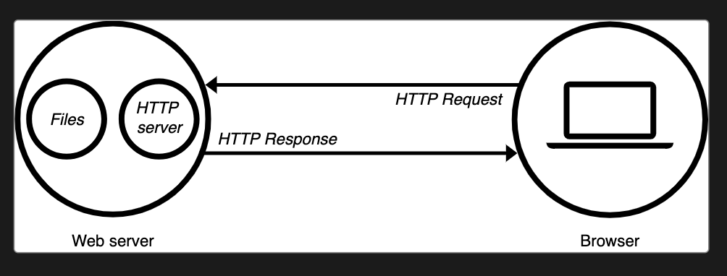
Introduction to Node
Web Server Model: The term web server can refer to hardware or software, or both of them working together. On the hardware side, a web server is a computer that stores web server software and a website's component files (for example, HTML documents, images, CSS stylesheets, and JavaScript files). A web server connects to the Internet and supports physical data interchange with other devices connected to the web. On the software side, a web server includes several parts that control how web users access hosted files. At a minimum, this is an HTTP server. An HTTP server is software that understands URLs (web addresses) and HTTP (the protocol your browser uses to view webpages). An HTTP server can be accessed through the domain names of the websites it stores, and it delivers the content of these hosted websites to the end user's device. At the most basic level, whenever a browser needs a file that is hosted on a web server, the browser requests the file via HTTP. When the request reaches the correct (hardware) web server, the (software) HTTP server accepts the request, finds the requested document, and sends it back to the browser, also through HTTP. (If the server doesn't find the requested document, it returns a 404 response instead.)

Slide 15
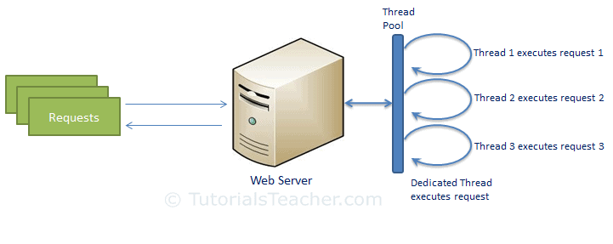
Introduction to Node
To publish a website, you need either a static or a dynamic web server. A static web server, or stack, consists of a computer (hardware) with an HTTP server (software). We call it "static" because the server sends its hosted files as-is to your browser. A dynamic web server consists of a static web server plus extra software, most commonly an application server and a database. We call it "dynamic" because the application server updates the hosted files before sending content to your browser via the HTTP server. Node.js Model: In the traditional web server model, each request is handled by a dedicated thread from the thread pool. If no thread is available in the thread pool at any point of time then the request waits till the next available thread. Dedicated thread executes a particular request and does not return to thread pool until it completes the execution and returns a response.

Slide 16
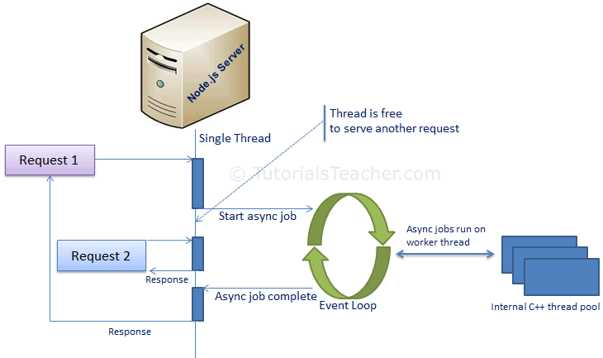
Introduction to Node
Node.js processes user requests differently when compared to a traditional web server model. Node.js runs in a single process and the application code runs in a single thread and thereby needs less resources than other platforms. All the user requests to your web application will be handled by a single thread and all the I/O work or long running job is performed asynchronously for a particular request. So, this single thread doesn't have to wait for the request to complete and is free to handle the next request. When asynchronous I/O work completes then it processes the request further and sends the response. An event loop is constantly watching for the events to be raised for an asynchronous job and executing callback function when the job completes. Internally, Node.js uses libev for the event loop which in turn uses internal C++ thread pool to provide asynchronous I/O. The following figure illustrates asynchronous web server model using Node.js. Node.js process model increases the performance and scalability with a few caveats. Node.js is not fit for an application which performs CPU-intensive operations like image processing or other heavy computation work because it takes time to process a request and thereby blocks the single thread.

Slide 17
Closing (5 mins)

