Slide 1
0_NEM-1: Introduction to Node.js - SYNC ( 45 mins)
MEAN/MERN STACK

Slide 2
Opening (5 mins)

Slide 3
Learning Objectives:
Using Node.js Console Module
Understanding Event Loop in Node.js
What is callback? Why it is used?
How we use Global Objects
How utility objects are used and how are they helpful?

Slide 4
Content (35 mins)

Slide 5
Introduction to Node
Node.js Console: Node.js provides a console module which provides tons of very useful ways to interact with the command line. Node.js console module is a global object that provides a simple debugging console similar to JavaScript to display different levels of message. It is basically the same as the console object you find in the browser. It is provided by web browsers. The console module contains two components: Console class: The console class methods are console.log(), console.error() and console.warn() to display Node.js stream. global console: It is used without calling require(‘console’). The most basic and most used method is console.log(), which prints the string you pass to it to the console.
const x = 'x'; const y = 'y'; console.log(x, y);
This is one example of global console.
// It will display 'This is the first object example' to stdout console.log('This is the first object example'); // It will display 'This is the second object example' to stdout console.log('This is the %s example', 'second object'); // It will display 'Error: New Error has happened' to stderr console.error(new Error('New Error has happened')); const obj = 'third object'; // It will display 'This is the third object example' to stderr console.warn(`This is the ${obj} example`);

Slide 6
Introduction to Node
If you observe above code, we are trying to write a messages to node.js stream by using global console object methods such as console.log(), console.error() and console.warn(). Here, we are accessing global console object without importing it using require directive. Now, we will execute example_console_object.js file, for that open a command prompt (cmd) and navigate to the folder that contains this code in a file and write the command with node filename.js. Now, we will execute example_console_object.js file, for that open a command prompt (cmd) and navigate to the folder that contains a example_console_object.js file and write the command node example_console_object.js and hit enter button like as shown below. console.count(): It is used to count the number of times a specific label has been called.
const x = 1 const y = 2 const z = 3 console.count( 'The value of x is ' + x + ' and has been checked .. how many times?' ) console.count( 'The value of x is ' + x + ' and has been checked .. how many times?' ) console.count( 'The value of y is ' + y + ' and has been checked .. how many times?' )

Slide 7
Introduction to Node
console.clear(): It is used to clear the console history. console.info(): It is used to write a messages on console and it is an alias of console.log() method. console.time(): It is used to get the starting time of an action.
const doSomething = () => console.log('test'); const measureDoingSomething = () => { console.time('doSomething()'); // do something, and measure the time it takes doSomething(); console.timeEnd('doSomething()'); }; measureDoingSomething();
console.timeEnd(): It is used to get the end time of specific action. console.dir(): It use util.inspect() on object and prints the resulting string to stdout. console.trace(): It is used to print the call stack trace of a function, maybe to answer the question how did you reach that part of the code?
const function2 = () => console.trace(); const function1 = () => function2(); function1();

Slide 8
Introduction to Node
Node.js Console: Node.js is a single-threaded event-driven platform that is capable of running non-blocking, asynchronously programming. These functionalities of Node.js make it memory efficient. The event loop allows Node.js to perform non-blocking I/O operations despite the fact that JavaScript is single-threaded. It is done by assigning operations to the operating system whenever and wherever possible. Most operating systems are multi-threaded and hence can handle multiple operations executing in the background. When one of these operations is completed, the kernel tells Node.js and the respective callback assigned to that operation is added to the event queue which will eventually be executed. This will be explained further in detail later in this topic. Features of Event Loop: Event loop is an endless loop, which waits for tasks, executes them and then sleeps until it receives more tasks. The event loop executes tasks from the event queue only when the call stack is empty i.e. there is no ongoing task. The event loop allows us to use callbacks and promises. The event loop executes the tasks starting from the oldest first.
console.log("This is the first statement"); setTimeout(function(){ console.log("This is the second statement"); }, 1000); console.log("This is the third statement");

Slide 9
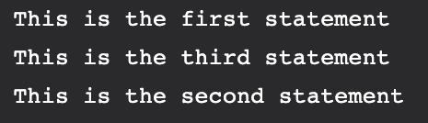
Introduction to Node
Output
In the above example, the first console log statement is pushed to the call stack and “This is the first statement” is logged on the console and the task is popped from the stack.
Next, the setTimeout is pushed to the queue and the task is sent to the Operating system and the timer is set for the task. This task is then popped from the stack.
Next, the third console log statement is pushed to the call stack and “This is the third statement” is logged on the console and the task is popped from the stack.
When the timer set by setTimeout function (in this case 1000 ms) runs out, the callback is sent to the event queue.
The event loop on finding the call stack empty takes the task at the top of the event queue and sends it to the call stack.
The callback function for setTimeout function runs the instruction and “This is the second statement” is logged on the console and the task is popped from the stack.
When Node.js starts, it initializes the event loop, processes the provided input script which may make async API calls, schedule timers, then begins processing the event loop.
In the previous example, the initial input script consisted of console.log() statements and a setTimeout() function which schedules a timer.
When using Node.js, a special library module called libuv is used to perform async operations.
This library is also used, together with the back logic of Node, to manage a special thread pool called the libuv thread pool.This thread pool is composed of four threads used to delegate operations that are too heavy for the event loop. I/O operations, Opening and closing connections, setTimeouts are the example of such operations.

Slide 10
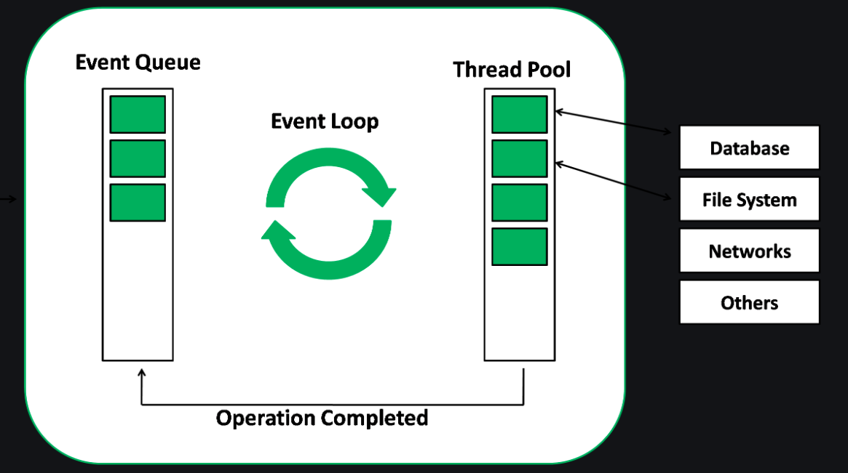
Introduction to Node
When the thread pool completes a task, a callback function is called which handles the error(if any) or does some other operation. This callback function is sent to the event queue. When the call stack is empty, the event goes through the event queue and sends the callback to the call stack The following diagram is a proper representation of the event loop in a Node.js server: The following diagram shows a simplified overview of the event loop order of operations:

Slide 11
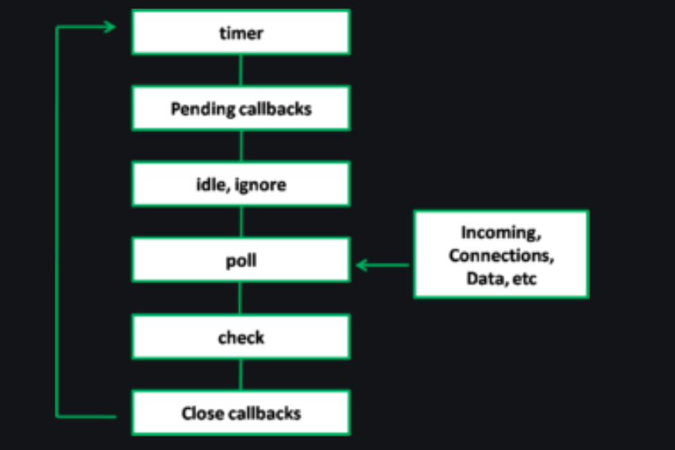
Introduction to Node
Timers: Callbacks scheduled by setTimeout() or setInterval() are executed in this phase. Pending Callbacks: I/O callbacks deferred to the next loop iteration are executed here. Idle, Prepare: Used internally only. Poll: Retrieves new I/O events. Check: It invokes setIntermediate() callbacks. Close Callbacks: It handles some close callbacks. Eg: socket.on(‘close’, …)

Slide 12
Introduction to Node
Callback Concept: A callback is the equivalent of an asynchronous function. Asynchronous functions are also known as non-blocking functions since they do not block the thread on which they are running on. Node.js relies heavily on asynchronous functions. This is because servers often receive many requests at a time; if the server was to be synchronous, requests would be processed one at a time which would lead to a bad user experience since the user might have to wait for a long time.
function processData () { var data = fetchData (); data += 1; return data; }
This works just fine and is very typical in other development environments. However, if fetchData takes a long time to load the data (maybe it is streaming it off the drive or the internet), then this causes the whole program to 'block' - otherwise known as sitting still and waiting - until it loads the data. Node.js, being an asynchronous platform, doesn't wait around for things like file I/O to finish - Node.js uses callbacks. A callback is a function called at the completion of a given task; this prevents any blocking, and allows other code to be run in the meantime. The Node.js way to deal with the above would look a bit more like this:
function processData (callback) { fetchData(function (err, data) { if (err) { console.log("An error has occurred. Abort everything!"); return callback(err); } data += 1; callback(data); }); }

Slide 13
Introduction to Node
At first glance, it may look unnecessarily complicated, but callbacks are the foundation of Node.js. Callbacks give you an interface with which to say, "and when you're done doing that, do all this." This allows you to have as many IO operations as your OS can handle happening at the same time. For example, in a web server with hundreds or thousands of pending requests with multiple blocking queries, performing the blocking queries asynchronously gives you the ability to be able to continue working and not just sit still and wait until the blocking operations come back. This is a major improvement. The typical convention with asynchronous functions (which almost all of your functions should be):
function asyncOperation ( a, b, c, callback ) { // ... lots of hard work ... if ( /* an error occurs */ ) { return callback(new Error("An error has occurred")); } // ... more work ... callback(null, d, e, f); } asyncOperation ( params.., function ( err, returnValues.. ) { //This code gets run after the async operation gets run });
You will almost always want to follow the error callback convention, since most Node.js users will expect your project to follow them. The general idea is that the callback is the last parameter. The callback gets called after the function is done with all of its operations. Traditionally, the first parameter of the callback is the error value. If the function hits an error, then they typically call the callback with the first parameter being an Error object. If it cleanly exits, then they will call the callback with the first parameter being null and the rest being the return value(s).

Slide 14
Introduction to Node
Global Objects: Node.js Global Objects are the objects that are available in all modules. We do not need to include these objects in our application, rather we can use them directly. Global Objects are built-in objects that are part of the JavaScript and can be used directly in the application without importing any particular module. The following variables may appear to be global but are not. They exist only in the scope of modules, __dirname __filename exports module require() Console is also part of Global objects but we have discussed in detail above. You should also discuss buffer, timer, process. Utility Module: There are various utility modules available in node.js module library. The modules are extremely useful in developing node based web applications. Various utility modules present in node.js are as follows: OS Module: Operating System based utility modules for node.js are provided by OS module.
var os = require("os"); // Display operating System type console.log('Operating System type : ' + os.type()); // Display operating System platform console.log('platform : ' + os.platform()); // Display total memory console.log('total memory : ' + os.totalmem() + " bytes."); // Display available memory console.log('Available memory : ' + os.availmem() + " bytes.");

Slide 15
Introduction to Node
Path Module: Path module in node.js is used for transforming and handling various file paths.
var path = require('path'); // Display Resolve console.log('resolve:' + path.resolve('paths.js')); // Display Extension console.log('extension:' + path.extname('paths.js'));
DNS Module: DNS Module enables us to use the underlying Operating System name resolution functionalities. The actual DNS lookup is also performed by the DNS Module. This DNS Module provides an asynchronous network wrapper. The DNS Module can be imported using the below syntax.
// Require dns module const dns = require('dns'); // Store the web address const website = 'www.geeksforgeeks.org'; // Call lookup function of DNS dns.lookup(website, (err, address, family) => { console.log('Address of %s is %j family: IPv%s', website, address, family); });

Slide 16
Introduction to Node
Net Module: Net Module in node.js is used for the creation of both client and server. Similar to DNS Module this module also provides an asynchronous network wrapper.
var net = require('net'); var server = net.createServer(function(connection) { console.log('client connected'); connection.on('end', function() { console.log('client disconnected'); }); connection.write('Hello World!\r\n'); connection.pipe(connection); }); server.listen(8080, function() { console.log('server listening'); });
Domain Module: Domain module in node.js is used to intercept unhandled errors. The interception can be performed by either: Internal Binding: Error emitter executes the code internally within the run method of a domain. External Binding: Error emitter is added explicitly to the domain using the add method. The domain class in the domain module provides a mechanism of routing the unhandled exceptions and errors to the active domain object. It is considered to be the child class of EventEmitter.

Slide 17
Introduction to Node
var EventEmitter = require("events").EventEmitter; var domain = require("domain"); var emit_a = new EventEmitter(); var dom_a = domain.create(); dom_a.on('error', function(err) { console.log("Error handled by dom_a ("+err.message+")"); }); dom_a.add(emit_a); emit_a.on('error', function(err) { console.log("listener handled this error ("+err.message+")"); }); emit_a.emit('error', new Error('Listener handles this')); emit_a.removeAllListeners('error'); emit_a.emit('error', new Error('Dom_a handles this')); var dom_b = domain.create(); dom_b.on('error', function(err) { console.log("Error handled by dom_b ("+err.message+")"); }); dom_b.run(function() { var emit_b = new EventEmitter(); emit_b.emit('error', new Error('Dom_b handles this')); }); dom_a.remove(emit_a); emit_a.emit('error', new Error('Exception message...!'));

Slide 18
Closing (5 mins)

