Slide 1
1_NEM-3_ Express JS-2 - SYNC
MEAN/MERN STACK

Slide 2
Opening (5 mins)

Slide 3
Learning Objectives:
Routing
static files
Templating
Restful API
Authentication and Authorization with JWT token

Slide 4
Content (5 hrs 20mins)

Slide 5
Introduction to Express JS
Routing: Routing refers to determining how an application responds to a client request to a particular endpoint, which is a URI (or path) and a specific HTTP request method (GET, POST, and so on). Each route can have one or more handler functions, which are executed when the route is matched. Route definition takes the following structure:
app.METHOD(PATH, HANDLER)
Where: app is an instance of express. METHOD is an HTTP request method, in lowercase. PATH is a path on the server. HANDLER is the function executed when the route is matched. It is assumed that an instance of express named app is created and the server is running The following examples illustrate defining simple routes.
app.get('/', (req, res) => { res.send('Hello World!') })
Respond to POST request on the root route (/), the application’s home page:
app.post('/', (req, res) => { res.send('Got a POST request') })

Slide 6
Introduction to Express JS
Respond to a PUT request to the /user route:
app.put('/user', (req, res) => { res.send('Got a PUT request at /user') })
Respond to a DELETE request to the /user route:
app.delete('/user', (req, res) => { res.send('Got a DELETE request at /user') })
Routing refers to how an application’s endpoints (URIs) respond to client requests. You define routing using methods of the Express app object that correspond to HTTP methods; for example, app.get() to handle GET requests and app.post to handle POST requests. For a full list, see app.METHOD. You can also use app.all() to handle all HTTP methods and app.use() to specify middleware as the callback function. These routing methods specify a callback function (sometimes called “handler functions”) called when the application receives a request to the specified route (endpoint) and HTTP method. In other words, the application “listens” for requests that match the specified route(s) and method(s), and when it detects a match, it calls the specified callback function. In fact, the routing methods can have more than one callback function as arguments. With multiple callback functions, it is important to provide next as an argument to the callback function and then call next() within the body of the function to hand off control to the next callback.

Slide 7
Introduction to Express JS
The following code is an example of a very basic route.
const express = require('express') const app = express() // respond with "hello world" when a GET request is made to the homepage app.get('/', (req, res) => { res.send('hello world') })
Route methods A route method is derived from one of the HTTP methods, and is attached to an instance of the express class. The following code is an example of routes that are defined for the GET and the POST methods to the root of the app
// GET method route app.get('/', (req, res) => { res.send('GET request to the homepage') }) // POST method route app.post('/', (req, res) => { res.send('POST request to the homepage') })
Express supports methods that correspond to all HTTP request methods: get, post, and so on. For a full list, see app.METHOD. There is a special routing method, app.all(), used to load middleware functions at a path for all HTTP request methods. For example, the following handler is executed for requests to the route “/secret” whether using GET, POST, PUT, DELETE, or any other HTTP request method supported in the http module.

Slide 8
Introduction to Express JS
app.all('/secret', (req, res, next) => { console.log('Accessing the secret section ...') next() // pass control to the next handler })
Route paths Route paths, in combination with a request method, define the endpoints at which requests can be made. Route paths can be strings, string patterns, or regular expressions. The characters ?, +, *, and () are subsets of their regular expression counterparts. The hyphen (-) and the dot (.) are interpreted literally by string-based paths. If you need to use the dollar character ($) in a path string, enclose it escaped within ([ and ]). For example, the path string for requests at “/data/$book”, would be “/data/([\$])book”. Here are some examples of route paths based on strings. This route path will match requests to the root route, /.
app.get('/', (req, res) => { res.send('root') })
This route path will match requests to /about.
app.get('/about', (req, res) => { res.send('about') })

Slide 9
Introduction to Express JS
This route path will match requests to /random.text.
app.get('/random.text', (req, res) => { res.send('random.text') })
Here are some examples of route paths based on string patterns. This route path will match acd and abcd.
app.get('/ab?cd', (req, res) => { res.send('ab?cd') })
This route path will match abcd, abbcd, abbbcd, and so on.
app.get('/ab+cd', (req, res) => { res.send('ab+cd') })
This route path will match abcd, abxcd, abRANDOMcd, ab123cd, and so on.
app.get('/ab*cd', (req, res) => { res.send('ab*cd') })

Slide 10
Introduction to Express JS
This route path will match /abe and /abcde.
app.get('/ab(cd)?e', (req, res) => { res.send('ab(cd)?e') })
Examples of route paths based on regular expressions: This route path will match anything with an “a” in it.
app.get(/a/, (req, res) => { res.send('/a/') })
This route path will match butterfly and dragonfly, but not butterflyman, dragonflyman, and so on.
app.get(/.*fly$/, (req, res) => { res.send('/.*fly$/') })
Route parameters Route parameters are named URL segments that are used to capture the values specified at their position in the URL. The captured values are populated in the req.params object, with the name of the route parameter specified in the path as their respective keys.
Route path: /users/:userId/books/:bookId Request URL: http://localhost:3000/users/34/books/8989 req.params: { "userId": "34", "bookId": "8989" }

Slide 11
Introduction to Express JS
To define routes with route parameters, simply specify the route parameters in the path of the route as shown below.
app.get('/users/:userId/books/:bookId', (req, res) => { res.send(req.params) })
The name of route parameters must be made up of “word characters” ([A-Za-z0-9_]). Since the hyphen (-) and the dot (.) are interpreted literally, they can be used along with route parameters for useful purposes.
Route path: /flights/:from-:to Request URL: http://localhost:3000/flights/LAX-SFO req.params: { "from": "LAX", "to": "SFO" } Route path: /plantae/:genus.:species Request URL: http://localhost:3000/plantae/Prunus.persica req.params: { "genus": "Prunus", "species": "persica" }
To have more control over the exact string that can be matched by a route parameter, you can append a regular expression in parentheses (()):
Route path: /user/:userId(\d+) Request URL: http://localhost:3000/user/42 req.params: {"userId": "42"}
Because the regular expression is usually part of a literal string, be sure to escape any \ characters with an additional backslash, for example \\d+.

Slide 12
Introduction to Express JS
Route handlers You can provide multiple callback functions that behave like middleware to handle a request. The only exception is that these callbacks might invoke next('route') to bypass the remaining route callbacks. You can use this mechanism to impose pre-conditions on a route, then pass control to subsequent routes if there’s no reason to proceed with the current route. Route handlers can be in the form of a function, an array of functions, or combinations of both, as shown in the following examples. A single callback function can handle a route. For example:
app.get('/example/a', (req, res) => { res.send('Hello from A!') })
More than one callback function can handle a route (make sure you specify the next object). For example:
app.get('/example/b', (req, res, next) => { console.log('the response will be sent by the next function ...') next() }, (req, res) => { res.send('Hello from B!') })
An array of callback functions can handle a route. For example:

Slide 13
Introduction to Express JS
const cb0 = function (req, res, next) { console.log('CB0') next() } const cb1 = function (req, res, next) { console.log('CB1') next() } const cb2 = function (req, res) { res.send('Hello from C!') } app.get('/example/c', [cb0, cb1, cb2])
A combination of independent functions and arrays of functions can handle a route. For example:
const cb0 = function (req, res, next) { console.log('CB0') next() } const cb1 = function (req, res, next) { console.log('CB1') next() } | app.get('/example/d', [cb0, cb1], (req, res, next) => { console.log('the response will be sent by the next function ...') next() }, (req, res) => { res.send('Hello from D!') })

Slide 14
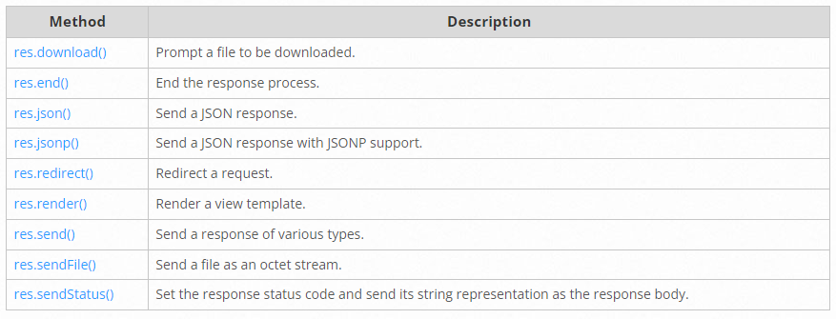
Introduction to Express JS
Response methods The methods on the response object (res) in the following table can send a response to the client, and terminate the request-response cycle. If none of these methods are called from a route handler, the client request will be left hanging.

Slide 15
Introduction to Express JS
app.route() You can create chainable route handlers for a route path by using app.route(). Because the path is specified at a single location, creating modular routes is helpful, as is reducing redundancy and typos. Here is an example of chained route handlers that are defined by using app.route().
app.route('/book') .get((req, res) => { res.send('Get a random book') }) .post((req, res) => { res.send('Add a book') }) .put((req, res) => { res.send('Update the book') })
express.Router Use the express.Router class to create modular, mountable route handlers. A Router instance is a complete middleware and routing system; for this reason, it is often referred to as a “mini-app”. The following example creates a router as a module, loads a middleware function in it, defines some routes, and mounts the router module on a path in the main app. Create a router file named birds.js in the app directory, with the following content:

Slide 16
Introduction to Express JS
onst express = require('express') const router = express.Router() // middleware that is specific to this router router.use((req, res, next) => { console.log('Time: ', Date.now()) next() }) // define the home page route router.get('/', (req, res) => { res.send('Birds home page') }) // define the about route router.get('/about', (req, res) => { res.send('About birds') }) module.exports = router
Then, load the router module in the app: The app will now be able to handle requests to /birds and /birds/about, as well as call the timeLog middleware function that is specific to the route.
const birds = require('./birds') // ... app.use('/birds', birds)

Slide 17
Introduction to Express JS
Static files In this section, you will learn how to serve static files in Express. A Node.js framework, Express facilitates data in a server and includes rendering your static files on the client-side such as images, HTML, CSS, and JavaScript. Setting up Express To begin, run the following in your terminal: Create a new directory for your project named express-static-file-tutorial: Then, load the router module in the app:
mkdir express-static-file-tutorial
Change into your new directory:
cd express-static-file-tutorial
Initialize a new Node project with defaults. This will set a package.json file to access your dependencies:
npm init -y
Create your entry file, index.js. This is where you will store your Express server:
touch index.js
Install Express as a dependency:

Slide 18
Introduction to Express JS
npm install express --save
Within your package.json, update your start script to include node and your index.js file.
{ "name": "express-static-file-tutorial", "version": "1.0.0", "description": "", "main": "index.js", "scripts": { "start": "node index.js" }, "keywords": [], "author": "Paul Halliday", "license": "MIT" }
This will allow you to use the npm start command in your terminal to launch your Express server. Structuring Your Files To store your files on the client-side, create a public directory and include an index.html file along with an image. Your file structure will look like this:
express-static-file-tutorial |- index.js |- public |- shark.png |- index.html

Slide 19
Introduction to Express JS
Now that your files are set up let’s begin your Express server. Creating Your Express Server In your index.js file, require in an Express instance and implement a GET request:
const express = require('express'); const app = express(); const PORT = 3000; app.get('/', (req, res) => { res.send('Hello World!'); }); app.listen(PORT, () => console.log(`Server listening on port: ${PORT}`));
Now let’s tell Express to handle your static files. Serving Your Static Files Express provides a built-in method to serve your static files::
app.use(express.static('public'));
When you call app.use(), you’re telling Express to use a piece of middleware. Middleware is a function that Express passes requests through before sending them to your routing functions, such as your app.get('/') route. express.static() finds and returns the static files requested. The argument you pass into express.static() is the name of the directory you want Express to serve files. Here, the public directory. In index.js, serve your static files below your PORT variable. Pass in your public directory as the argument:

Slide 20
Introduction to Express JS
const express = require('express'); const app = express(); const PORT = 3000; app.use(express.static('public')); app.get('/', (req, res) => { res.send('Hello World!'); }); app.listen(PORT, () => console.log(`Server listening on port: ${PORT}`));
With your Express server set, let’s focus on the client-side. Building Your Web Page Navigate to your index.html file in the public directory. Populate the file with body and image elements:
[label index.html] <html> <head> <title>Hello World!</title> </head> <body> <h1>Hello, World!</h1> <img src="shark.png" alt="shark"> </body> </html>

Slide 21
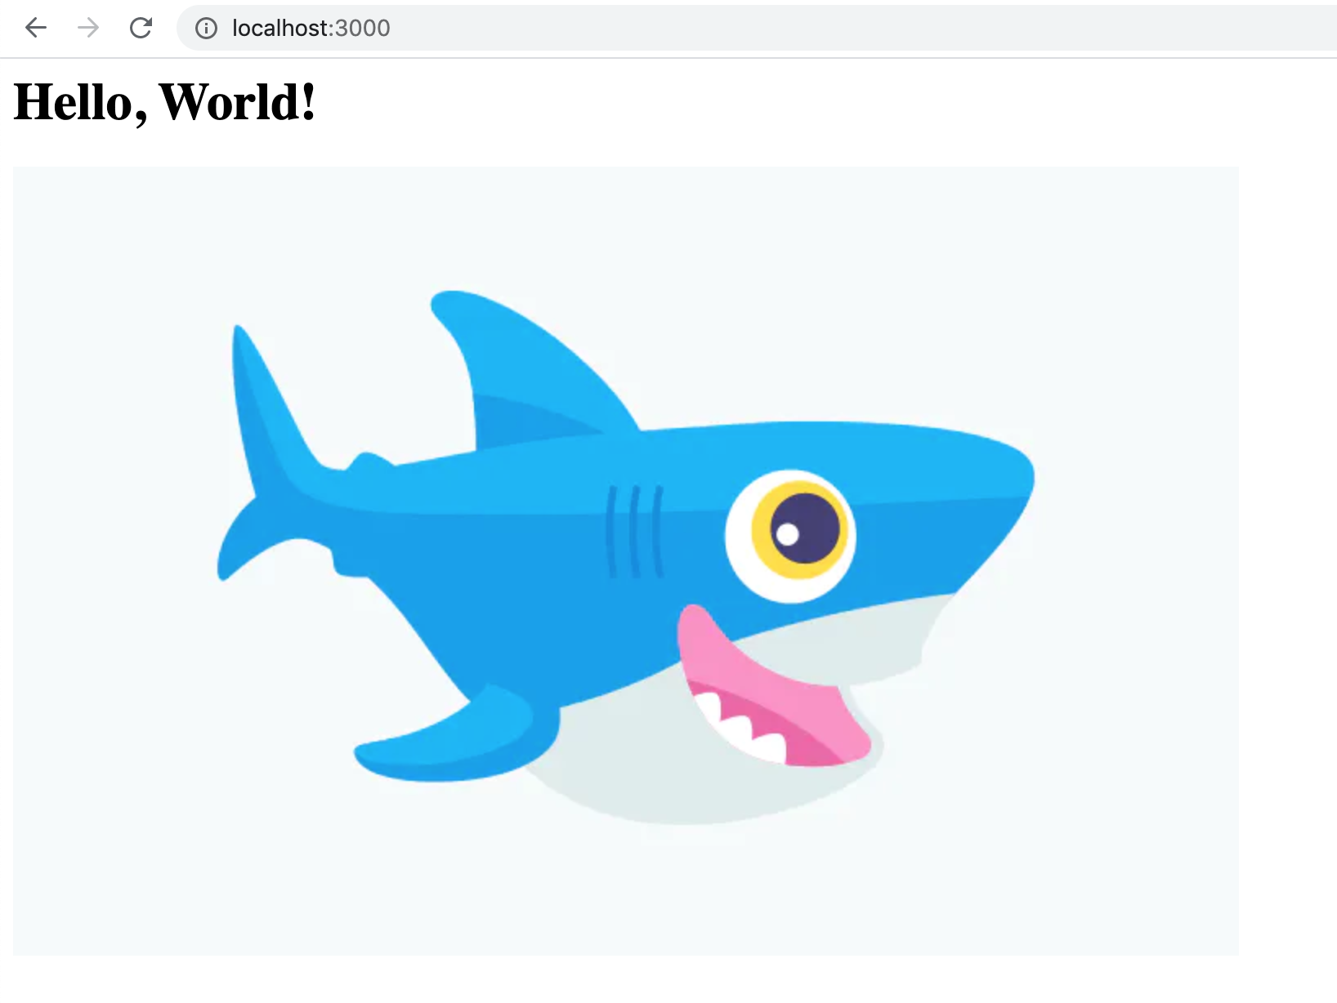
Introduction to Express JS
Notice the image element source to shark.png. Since you’ve served the public directory through Express, you can add the file name as your image source’s value. Running Your Project In your terminal, launch your Express project:
npm start
Server listening on port: 3000 Open your web browser, and navigate to http://localhost:3000. You will see your project:

Slide 22
Introduction to Express JS
To serve static files such as images, CSS files, and JavaScript files, use the express.static built-in middleware function in Express. The function signature is:
express.static(root, [options])
The root argument specifies the root directory from which to serve static assets. For more information on the options argument, see express.static. For example, use the following code to serve images, CSS files, and JavaScript files in a directory named public:
app.use(express.static('public'))
Now, you can load the files that are in the public directory:
http://localhost:3000/images/kitten.jpg http://localhost:3000/css/style.css http://localhost:3000/js/app.js http://localhost:3000/images/bg.png http://localhost:3000/hello.html
Express looks up the files relative to the static directory, so the name of the static directory is not part of the URL. To use multiple static assets directories, call the express.static middleware function multiple times:
app.use(express.static('public')) app.use(express.static('files'))

Slide 23
Introduction to Express JS
Express looks up the files in the order in which you set the static directories with the express.static middleware function. To create a virtual path prefix (where the path does not actually exist in the file system) for files that are served by the express.static function, specify a mount path for the static directory, as shown below:
app.use('/static', express.static('public'))
Now, you can load the files that are in the public directory from the /static path prefix.
http://localhost:3000/static/images/kitten.jpg http://localhost:3000/static/css/style.css http://localhost:3000/static/js/app.js http://localhost:3000/static/images/bg.png http://localhost:3000/static/hello.html
However, the path that you provide to the express.static function is relative to the directory from where you launch your node process. If you run the express app from another directory, it’s safer to use the absolute path of the directory that you want to serve:
const path = require('path') app.use('/static', express.static(path.join(__dirname, 'public')))
For more details about the serve-static function and its options, see serve-static.

Slide 24
Introduction to Express JS
Templating What is template engine? The Template Engine is used to merge HTML page with the data from your program. The engine is simple and powerful. At runtime, it replaces variables in a template file with actual values and transforms the template into an HTML file sent to the client.
Welcome <%= username %>
Here username is a variable.It will replace the username with the value received from the backend. Say username variable contains “John” value then the output will be:-
Welcome John
here are number of template engines available some of them are given below:- EJS Jade(pug) Vash Mustache Dust.js Nunjucks Handlebars ATPL HAML In this section, we are going to learn about EJS Template Engine. EJS Stands for Embedded JavaScript.

Slide 25
Introduction to Express JS
npm install --save ejs
Create a folder named “Views” in project’s root directory Because by default Express.js searches all the views(templates) in the views folder under the root folder. If you don’t want your folder to be named as views you can change name using views property in express. eg : the name of your folder is myviews then in our main file in this case app.js we write app.set(‘views’,./myviews); All the templates file are saved with template engine’s extension and in views folder. Here we are using EJS so all templates are saved with .ejs extension in views folder. EJS files are simple to write because in this file we write simple HTML and write logic, backend variables between these tags:- <% %>(to write logics) <%= %>( when we want to display content use this) <%- %> Here in this tutorial, we have two files one is main JS file i.e. app.js , which creates a server and one template file( display.ejs ). In app.js first create a basic server like this:
var express = require("express"); //requiring express module var app = express(); //creating express instance app.get("/", function(req, res) { res.send("hello"); }); app.listen(3000, function() { console.log("Node server is running.."); });

Slide 26
Introduction to Express JS
Now to send templates to frontend, first we set the view engine as follows:-
app.set("view engine","ejs");
Add the following line to app.js After setting the view engine we create a simple display.ejs file in view folder with a simple ‘hello user’ message in it.
<!DOCTYPE html> <html lang="en"> <head> <meta charset="UTF-8"> <meta name="viewport" content="width=device-width, initial-scale=1.0"> <meta http-equiv="X-UA-Compatible" content="ie=edge"> <title>templates</title> </head> <body> <p>Hello User</p> </body> </html>
Now to send the file to frontend we have a function called i.e. res.render() , it renders a view and sends the rendered HTML string to the client. To render our file in previous code we replace res.send(“hello”); with res.render(‘display’) ;

Slide 27
Introduction to Express JS
var express = require('express'); var app = express(); app.set("view engine","ejs") app.get('/', function (req, res) { //rendering our ejs template res.render('demo'); }); var server = app.listen(3000, function () { console.log('Node server is running..'); });
Run the following code as “node app.js” in terminal and press enter:-
c:\Express-project\project>node app.js
The server is now started you can see the message in terminal
c:\Express-project\project>node app.js Node server is running..
point your browser to http://localhost:3000 and you will see the message “Hello User”.

Slide 28
Introduction to Express JS
Sending variables to EJS and show on frontend If we want to send data from backend and use it in EJS file we can do this in the following manner:- Here instead of user in our display.ejs file I want to specify the name of the user. We can send data where we are rendering the file. Eg:- res.render(‘display’,{variable_name:’value’}); Say the username is ‘Rahul’ then our code will be:-
res.render('display',{user:'John'});
And to display this on front end we write this user variable inside <%= %> like this:-
<p>Hello <%= user%></p>
Now restart the server and run the code again and on refreshing the page you will see Hello Rahul instead of Hello User. Sending Arrays or Objects(JSON data) We can send any sort of data to the frontend. Suppose if I have a JSON data having an array named authors[] of author object having name and article, and I want to display it on frontend via a list, I can send an array to EJS and then loop through it and display the data. For this follow the given example:-

Slide 29
Introduction to Express JS
app.set("view engine", "ejs"); var authors = [ { name: "Andrew", article: "node.js" }, { name: "Brad", article: "express.js" }, { name: "John", article: "mongoose" } ]; app.get("/", function(req, res) { res.render("display", { authors }); }); var server = app.listen(3000, function() { console.log("Node server is running.."); });

Slide 30
Introduction to Express JS
Copy and paste this code in your app.js file here I have created an array named “authors” and I have rendered it with the ejs file. Note:- you can send the data by assigning it to a variable{values: data} or directly{data} in direct case you can access it with data and by assigning it you can access it with whatever variable you have assigned in given example by values. Now to access the author array in EJS follow the below EJS code:-
<!DOCTYPE html> <html lang="en"> <head> <meta charset="UTF-8"> <meta name="viewport" content="width=device-width, initial-scale=1.0"> <meta http-equiv="X-UA-Compatible" content="ie=edge"> <title>Document</title> </head> <body> <h3>Name Of Authors</h3> <ul> <!-- looping through authors array --> <% authors.forEach(function(author){ %> <li> <%= author.name %> </li> <% }) %> </ul> </body> </html>

Slide 31
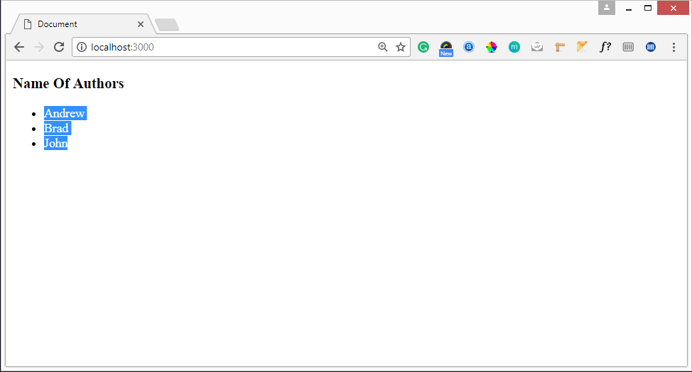
Introduction to Express JS
Here In the above EJS code, we have used a forEach loop to iterate through “authors” array and to access data of authors array one by one. Save app.js and display.ejs with the following code and then run the code, now as you refresh the web page(http://localhost:3000) you will see the following output.

Slide 32
Introduction to Express JS
REST API REST APIs are an industry-standard way for web services to send and receive data. They use HTTP request methods to facilitate the request-response cycle and typically transfer data using JSON, and more rarely - HTML, XML and other formats. For the sake of simplicity, we won't be using a database, so you don't need experience using one. We will use a simple JavaScript array to store our data instead. What is a REST API? REST (Representational State Transfer) is a standard architecture for building and communicating with web services. It typically mandates resources on the web are represented in a text format (like JSON, HTML, or XML) and can be accessed or modified by a predetermined set of operations. Given that we typically build REST APIs to leverage with HTTP instead of other protocols, these operations correspond to HTTP methods like GET, POST, or PUT. On a collection of data, like books for example, there are a few actions we'll need to perform frequently, which boil down to - Create, Read, Update and Delete (also known as CRUD Functionality). An API (Application Programming Interface), as the name suggests, is an interface that defines the interaction between different software components. Web APIs define what requests can be made to a component (for example, an endpoint to get a list of books), how to make them (for example, a GET request), and their expected responses. For REST APIs, ExpressJS is one of the most popular HTTP server libraries for Node.js, which by default isn't as friendly for API development. Using Express, we simplify API development by abstracting away the boilerplate needed to set up a server, which makes development faster, more readable and simpler. You can spin up a prototype API in seconds and a couple of lines of code. Although it's primary use was to simplify things with sensible defaults, it's highly customizable using functions called "middleware". Even though we are only going to build a REST API in this guide, the ExpressJS framework is not limited to just that - hosting static files, performing server-side rendering, or even using it as a proxy server isn't uncommon and the sky's the limit with additional middleware.

Slide 33
Introduction to Express JS
HTTP Request Types There are a few types of HTTP methods that we need to grasp before building a REST API. These are the methods that correspond to the CRUD tasks: POST: Used to submit data, typically used to create new entities or edit already existing entities. GET: Used to request data from the server, typically used to read data. PUT: Used to completely replace the resource with the submitted resource, typically used to update data. DELETE: Used to delete an entity from the server. Let's create a simple app to store information about books. In this app, we will store information about the ISBN of the book, title, author, published date, publisher and number of pages. Naturally, the basic functionality of the API will be CRUD functionality. We'll want to be able to send requests to it to create, read, update and delete Book entities. Of course, an API may do much more than this - provide users with an enpoint to get statistical data, summaries, call other APIs, etc. Non-CRUD functionalities are application-dependent, and based on your project's nature, you'll probably have other endpoints. However, practically no project can go without CRUD. To avoid making up book data - let's use a dataset from GitHub to get some sample details about books. Setting Up the Project First, let's initialize a new Node.js project:
$ npm init
Fill the requested information to your requirements - you don't have to fill all of the fields, but they're an easy way to set up identifiable data for a project. Fields like the name are much more relevant for publishing applications to the Node Package Manager, amongst other fields. Alternatively, you can use the default settings by adding the -y flag to the call:
$ npm init -y

Slide 34
Introduction to Express JS
Either way - you'll end up with a project with a package.json file. This is a json file that contains all the relevant metadata on your project and will look something along these lines by default:
{ "name": "app", "version": "1.0.0", "main": "index.js", "scripts": { "test": "echo \"Error: no test specified\" && exit 1" }, "author": "", "license": "ISC", "keywords": [], "description": "" }
The "entry"/"main" of your application is the file to run to start the project correctly - usually your main script, and index.js by default. Additionally, the version of your application and "scripts" are here! You can supply any number of custom commands in the "scripts" section, with a command associated to an alias. Here, the test alias is a wrapper for an echo statement. You'd run the test of the application via:
$ npm test > app@1.0.0 test /Users/XYZ/Desktop/app > echo "Error: no test specified" && exit 1 Error: no test specified

Slide 35
Introduction to Express JS
Oftentimes, there's a start alias that masks one or more processes that should be run when we want to start an application. In the basic form - we just run the index page with node:
{ "name": "app", "version": "1.0.0", "main": "index.js", "scripts": { "test": "echo \"Error: no test specified\" && exit 1", "start": "node index.js" }, "author": "", "license": "ISC", "keywords": [], "description": "" }
You can put any number of commands besides node index.js as the start script and when you run npm start - they'll all run:
$ test npm start > app@1.0.0 start /Users/XYZ/Desktop/app > node index.js
Since we only have one command in the starting script, it's functionally equivalent to just calling $ node index.js in the command line to start the application. Now that you're familiar with the project, let's install Express!

Slide 36
Introduction to Express JS
$ npm install --save express
A new file is created in the directory, alongside a node_modules directory. The package-lock.json file keeps track of your dependencies and contains their versions and names:
{ "name": "app", "version": "1.0.0", "lockfileVersion": 1, "requires": true, "dependencies": { "accepts": { "version": "1.3.7", "resolved": "https://registry.npmjs.org/accepts/-/accepts-1.3.7.tgz", "integrity": "sha512-Il80Qs2WjYlJIBNzNkK6KYqlVMTbZLXgHx2oT0pU/fjRHyEp+PEfEPY0R3WCwAGVOtauxh1hOxNgIf5bv7dQpA==", "requires": { "mime-types": "~2.1.24", "negotiator": "0.6.2" } }, ...

Slide 37
Introduction to Express JS
The node_modules directory actually hosts the code of the dependencies, and can get quite large very quickly. Just by installing Express, we've already got a hefty number of modules installed and tracked in the package-lock.json file. These modules are, factually, small so it's not an issue by any means. By using the package-lock.json file, another client can know which dependencies to download and which versions to use to correctly be able to start up your application. When doing version control with tools like Git - it's considered a good practice not to version the source code of the modules you use in the application. In practical terms - don't keep track or push node_modules to a repository. Others can download the dependencies based on the crucial package-lock.json which happens automatically when they run the application with npm. Creating a Simple Endpoint Now, let's start building a simple "Hello World" app. It'll have a single simple endpoint that just returns a message as a response to our request to get the home page. First, let's create a file called hello-world.js. Then, let's import the Express framework within it:
const express = require('express');
Next, we'll want to instantiate the Express app:
const app = express();
And set our port:
const port = 3000;

Slide 38
Introduction to Express JS
The port will be used a bit later, when we tell the app to listen to requests. These three lines are boilerplate - but the great thing is, that's all the boilerplate there is! Now, we can create a simple GET endpoint right beneath the boilerplate. When a user hits the endpoint with a GET request, the message "Hello World, from express" will be returned (and rendered in the browser or displayed on the console). We'd like to set it to be on the home page, so the URL for the endpoint is /:
app.get('/', (req, res) => { res.send('Hello World, from express'); });
At this point, let's start our clients:
app.listen(port, () => console.log(`Hello world app listening on port ${port}!`))
Let's run the application and visit the only endpoint we have via our browser:
$ node hello-world.js Hello world app listening on port 3000!

Slide 39
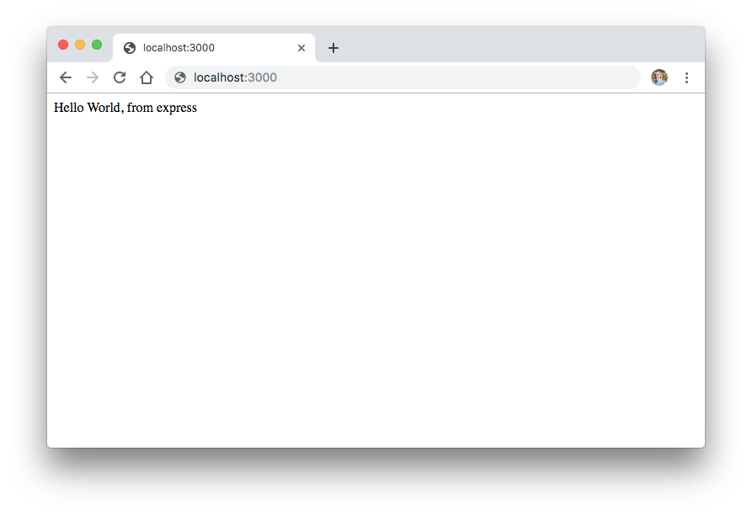
Introduction to Express JS

Slide 40
Introduction to Express JS
This is technically a working API! Though, this endpoint doesn't really do much. Let's take a look at some common middleware that'll be useful for further work and create some more useful endpoints. As mentioned above - ExpressJS is a simple HTTP server and it does not come with a lot of features out of the box. Middleware act almost like extensions for the Express server and provide additional functionalities in the "middle" of a request. Many third-party extensions like morgan for logging, multer for handling file uploads, are used routinely. For now, to get started, we need to install a middleware called body-parser, which helps us decode the body from an HTTP request:
$ npm install --save body-parser
It parses the body of the request and lets us react to it accordingly. Since we are calling the API from different locations by hitting endpoints in the browser. We also have to install the CORS middleware. If you're not yet familiar with cross-origin resource sharing, it is okay for now. Let's just install the middleware and configure it:
$ npm install --save cors

Slide 41
Introduction to Express JS
Building a REST API with Node and Express Adding Books Now we can start building our app. Create a new file called book-api.js:
const express = require('express') const bodyParser = require('body-parser'); const cors = require('cors'); const app = express(); const port = 3000; // Where we will keep books let books = []; app.use(cors()); // Configuring body parser middleware app.use(bodyParser.urlencoded({ extended: false })); app.use(bodyParser.json()); app.post('/book', (req, res) => { // We will be coding here }); app.listen(port, () => console.log(`Hello world app listening on port ${port}!`));

Slide 42
Introduction to Express JS
As you can see, we can configure body-parser by importing it and passing it to the app.use method, which enables it as middleware to the Express app instance. We will be using the books array to store our collection of books, simulating a database. There are a few types of HTTP request body types. For an example, application/x-www-form-urlencoded is the default body type for forms, whereas application/json is something we'd use when requesting a resource using jQuery or backend REST client. What the body-parser middleware will be doing is grabbing the HTTP body, decoding the information, and appending it to the req.body. From there, we can easily retrieve the information from the form - in our case, a book's information. Inside the app.post method let's add the book to the book array:
app.post('/book', (req, res) => { const book = req.body; // Output the book to the console for debugging console.log(book); books.push(book); res.send('Book is added to the database'); });

Slide 43
Introduction to Express JS
Now, let's create a simple HTML form with the fields: ISBN, title, author, published date, publisher, and number of pages in a new file, say new-book.html. We'll be sending the data to the API using this HTML form's action attribute:
<div class="container"> <hr> <h1>Create New Book</h1> <hr> <form action="http://localhost:3000/book" method="POST"> <div class="form-group"> <label for="ISBN">ISBN</label> <input class="form-control" name="isbn"> </div> <div class="form-group"> <label for="Title">Title</label> <input class="form-control" name="title"> </div> <!--Other fields--> <button type="submit" class="btn btn-primary">Submit</button> </form> </div>

Slide 44
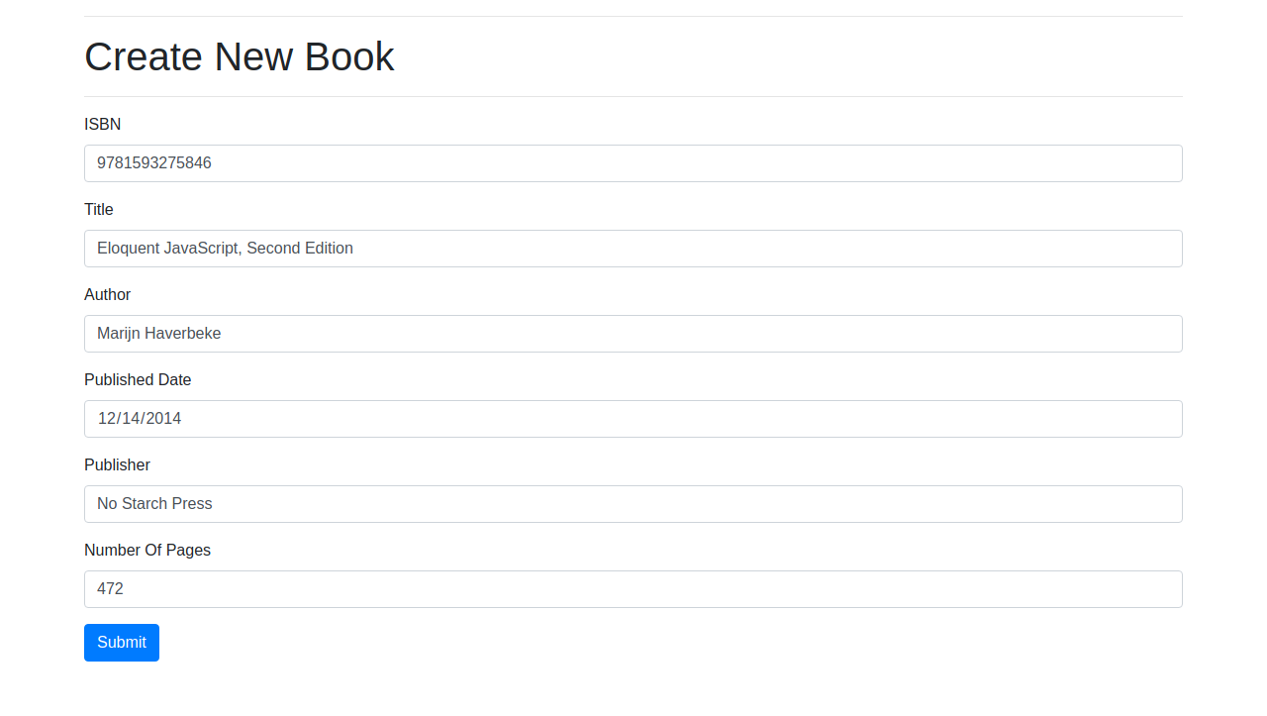
Introduction to Express JS
Here, our <form> tag's attribute corresponds to our endpoint and the information we send with the submit button is the information our method parses and adds to the array. Note that the method parameter is POST, just like in our API. You should see something like that when you open the page:

Slide 45
Introduction to Express JS
Clicking "Submit", we're greeted with the our applications console.log(book) statement:
{ isbn: '9781593275846', title: 'Eloquent JavaScript, Second Edition', author: 'Marijn Haverbeke', publish_date: '2014-12-14', publisher: 'No Starch Press', numOfPages: '472' }
Please note that since we are using an array to store data we will lose them in our next app restart.

Slide 46
Introduction to Express JS
Clicking "Submit", we're greeted with the our applications console.log(book) statement:
{ isbn: '9781593275846', title: 'Eloquent JavaScript, Second Edition', author: 'Marijn Haverbeke', publish_date: '2014-12-14', publisher: 'No Starch Press', numOfPages: '472' }
Please note that since we are using an array to store data we will lose them in our next app restart. Getting All Books Now let's create an endpoint to get all the books from the API:
app.get('/books', (req, res) => { res.json(books); });
Restart the server. If the server is already running press Ctrl + C to stop it first. Add some books and open http://localhost:3000/books in your browser. You should see a JSON response with all the books that you've added. Now let's create an HTML page to display these books in a user-friendly way. This time around, we'll create two files - book-list.html which we'll use as a template and a book-list.js file which will hold the logic to updating/deleting books and displaying them on the page: Let's start off with the template:

Slide 47
Introduction to Express JS
<div class="container"> <hr> <h1>List of books</h1> <hr> <div> <div class="row" id="books"> </div> </div> </div> <div id="editBookModal" class="modal" tabindex="-1" role="dialog"> <div class="modal-dialog" role="document"> <div class="modal-content"> <div class="modal-header"> <h5 class="modal-title">Edit Book</h5> <button type="button" class="close" data-dismiss="modal" aria-label="Close"> <span aria-hidden="true">&times;</span> </button> </div> <div class="modal-body"> <form id="editForm" method="POST"> <div class="form-group"> <label for="ISBN">ISBN</label> <input class="form-control" name="isbn" id="isbn"> | </div> <div class="form-group"> <label for="Title">Title</label> <input class="form-control" name="title" id="title"> </div> <!--Other fields--> <button type="submit" class="btn btn-primary">Submit</button> </form> </div> </div> </div> </div> <!--Our JS file--> <script src="book-list.js"></script>

Slide 48
Introduction to Express JS
With the template done, we can implement the actual logic to retrieve all books using browser-side JavaScript and our REST API:
const setEditModal = (isbn) => { // We will implement this later } const deleteBook = (isbn) => { // We will implement this later } const loadBooks = () => { const xhttp = new XMLHttpRequest(); xhttp.open("GET", "http://localhost:3000/books", false); xhttp.send(); const books = JSON.parse(xhttp.responseText); for (let book of books) { const x = ` <div class="col-4"> <div class="card"> <div class="card-body"> <h5 class="card-title">${book.title}</h5> <h6 class="card-subtitle mb-2 text-muted">${book.isbn}</h6> | <div>Author: ${book.author}</div> <div>Publisher: ${book.publisher}</div> <div>Number Of Pages: ${book.numOfPages}</div> <hr> <button type="button" class="btn btn-danger">Delete</button> <button types="button" class="btn btn-primary" data-toggle="modal" data-target="#editBookModal" onClick="setEditModal(${book.isbn})"> Edit </button> </div> </div> </div> ` document.getElementById('books').innerHTML = document.getElementById('books').innerHTML + x; } } loadBooks()

Slide 49
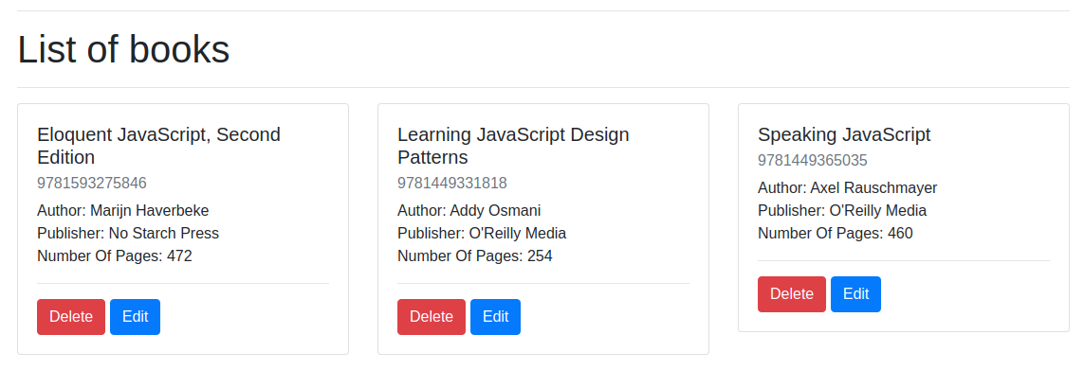
Introduction to Express JS
In the above script, we are sending a GET request to the endpoint http://localhost:3000/books to retrieve the books and then creating a Bootstrap card for every book to display it. If everything is working correctly you should see something like this on your page:
You probably noticed the Edit and Create buttons and their respective methods. For now, let's leave them empty and implement them as we go.

Slide 50
Introduction to Express JS
Retrieving a Book by ISBN If we'd like to display a specific book to the user, we'll need a way to retrieve it from the database (or the array, in our case). This is always done by a key specific to that entity. In most cases, each entity has a unique id that helps us identify them. In our case, each book has an ISBN which is unique by nature, so there's no need for another id value. This is typically done by parsing the URL parameter for an id and searching for the book with the corresponding id. For an example, if the ISBN is 9781593275846 the URL would look like, http://localhost:3000/book/9781593275846:
app.get('/book/:isbn', (req, res) => { // Reading isbn from the URL const isbn = req.params.isbn; });
Here, we're introduced to parametrized URLs. Since the ISBN depends on the book, there's potentially an infinite number of endpoints here. By adding a colon (:) to the path, we can define a variable, mapped to the variable isbn. So, if a user visits localhost:3000/book/5 the isbn parameter will be 5. You can accept more than one parameter in your URL if it makes sense in your scenario. For example /image/:width/:height, and then you can get those parameters using req.params.width and req.params.height. Now, using our endpoint, we can retrieve a single book:
app.get('/book/:isbn', (req, res) => { // Reading isbn from the URL const isbn = req.params.isbn; // Searching books for the isbn for (let book of books) { if (book.isbn === isbn) { res.json(book); return; } } // Sending 404 when not found something is a good practice res.status(404).send('Book not found'); });

Slide 51
Introduction to Express JS
Again restart the server, add a new book, and open localhost/3000/{your_isbn} and the application will return the book's information. Deleting Books When deleting entities, we typically delete them one by one to avoid big accidental data loss. To delete items, we use the HTTP DELETE method and specify a book using its ISBN number, just like how we retrieved it:
app.delete('/book/:isbn', (req, res) => { // Reading isbn from the URL const isbn = req.params.isbn; // Remove item from the books array books = books.filter(i => { if (i.isbn !== isbn) { return true; } return false; }); res.send('Book is deleted'); });
We are using the app.delete method to accept DELETE requests. We have also used the array filter method to filter out the book with the relevant ISBN to remove it from the array. Now let's implement the deleteBook method in the book-list.js file:

Slide 52
Introduction to Express JS
const deleteBook = (isbn) => { const xhttp = new XMLHttpRequest(); xhttp.open("DELETE", `http://localhost:3000/book/${isbn}`, false); xhttp.send(); // Reloading the page location.reload(); }
In this method, we are sending the delete request when the button is pressed and reloading the page to display the changes. Editing Books Very similar to deleting entities, updating them requires us to snatch a specific one, based on the ISBN and then send either a POST or PUT HTTP call with the new information. Let's go back to our book-api.js file:
app.post('/book/:isbn', (req, res) => { // Reading isbn from the URL const isbn = req.params.isbn; const newBook = req.body; // Remove item from the books array for (let i = 0; i < books.length; i++) { let book = books[i] if (book.isbn === isbn) { books[i] = newBook; } } res.send('Book is edited'); });

Slide 53
Introduction to Express JS
Upon sending a POST request, aimed at a specific ISBN, the adequate book is updated with new information. Since we have already created the edit modal, we can use the setEditModal method to gather information about the book when "Edit" button is clicked. We will also set the form's action parameter with the clicked book's URL to send the request: To verify if the update function works, edit a book. The form should be filled with the existing information about the book. Change something and click "Submit" after which you should see a "Book is edited" message
const setEditModal = (isbn) => { // Get information about the book using isbn const xhttp = new XMLHttpRequest(); xhttp.open("GET", `http://localhost:3000/book/${isbn}`, false); xhttp.send(); const book = JSON.parse(xhttp.responseText); const { title, author, publisher, publish_date, numOfPages } = book; | // Filling information about the book in the form inside the modal document.getElementById('isbn').value = isbn; document.getElementById('title').value = title; document.getElementById('author').value = author; document.getElementById('publisher').value = publisher; document.getElementById('publish_date').value = publish_date; document.getElementById('numOfPages').value = numOfPages; // Setting up the action url for the book document.getElementById('editForm').action = `http://localhost:3000/book/${isbn}`; }

Slide 54
Introduction to Express JS
Authentication and Authorization with JWT token JSON Web Tokens (JWT) have been introduced as a method of secure communication between two parties. Although it was meant for any secure communication, JWT is mainly associated with authentication and authorization. A sample JWT token looks like this:
eyJhbGciOiJIUzI1NiIsInR5cCI6IkpXVCJ9.eyJzdWIiOiIxMjM0NTY3ODkwIiwibmFtZSI6IkpvaG4gRG9lIiwiaWF0Ijo…
Which is constructed as–
HMACSHA256( base64UrlEncode(header) + "." + base64UrlEncode(payload), your - 256 - bit - secret )
The first part is base64 encoded header, which looks like this when decoded
{ "alg": "HS256", "typ": "JWT" }

Slide 55
Introduction to Express JS
This basically contains the algorithm type, which is HMAC SHA 256, and token type, which is JWT. The second part contains base64 encoded JSON data that is being exchanged (mostly a few user details in the case of authentication), which in our token looks like this,
{ "sub": "1234567890", "name": "John Doe", "iat": 1516239022 }
The third part is a signature to verify that the token is legit and information has not been changed. It is recommended to not include any sensitive data in JWT like user password. If you want to play around with JWT visit jwt.io Below is a working diagram of JWT authentication and authorization.

Slide 56
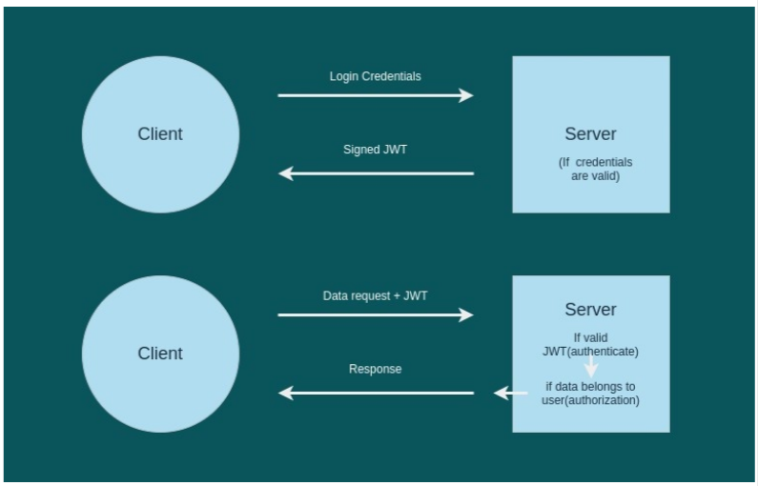
Introduction to Express JS

Slide 57
Introduction to Express JS
First the client sends a login request with login credentials (mainly username, email, password), then on the server side we check if the given login credentials are correct. If so, we generate a signed JWT token with user info and send it back to the client. After the user is logged in, a data request is sent by the client with a signed JWT token (to inform the server who is asking for data). On the server side we check if the provided JWT is valid, then we check if the user is allowed to see the data that was requested (this step is known as authorization). We send the data if both steps check out, otherwise we send an error message. Now let’s implement this. Create your project folder, open it, and then open the terminal (git bash if you are using Windows) at that location and run.
npm init -y
Create a file with name app.js (this is our main server file). Now we will install some node packages required for this tutorial. Express (framework to design API) Mongoose (to manage MongoDB database) jsonwebtoken (for JWT tokens) dotenv (store and access environment variables) bcrypt (to encrypt the password) To install packages run:
npm i express mongoose jsonwebtoken bcrypt dotenv --save

Slide 58
Introduction to Express JS
Now we need to install dev dependency nodemon to make our work easier (it reruns the application when we make changes to it). To install nodemon run:
npm i nodemon -D
Now open package.json and change the main file to app.js (as given below).
{ "name": "jwt-authentication", "version": "1.0.0", "description": "", "main": "app.js", "scripts": { "test": "echo \"Error: no test specified\" && exit 1" }, "keywords": [], "author": "", "license": "ISC", "dependencies": { "bcrypt": "^5.0.1", | "dotenv": "^10.0.0", "express": "^4.17.1", "jsonwebtoken": "^8.5.1", "mongoose": "^6.0.7" }, "devDependencies": { "nodemon": "^2.0.12" } }

Slide 59
Introduction to Express JS
Now open app.js and write the code given:
const express = require("express"), app = express(); require("dotenv") .config(); // parse requests of content-type - application/json app.use(express.json()); // parse requests of content-type - application/x-www-form-urlencoded app.use(express.urlencoded({ extended: true })); //setup server to listen on port 8080 app.listen(process.env.PORT || 8080, () => { console.log("Server is live on port 8080"); })
Now create file with the name “.env”, we will store environment passwords in it in the given form
PORT=8080

Slide 60
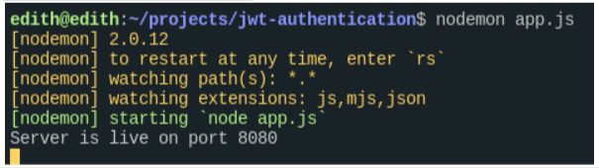
Introduction to Express JS
Open terminal and run
nodemon app.js
You will see something like this:

Slide 61
Introduction to Express JS
We will set up MongoDB now. Start MongoDB on a separate terminal by running
sudo systemctl start mongod
Run mongosh.exe on cmd (in administrator mode) in the case of Windows. Now come back to app.js and modify app.js to connect to the database as given:
const express = require("express"), app = express(), mongoose = require("mongoose"); //Connect to database try { mongoose.connect("mongodb://localhost:27017/usersdb", { useUnifiedTopology: true, useNewUrlParser: true }); console.log("connected to db"); } catch (error) { handleError(error); } | process.on('unhandledRejection', error => { console.log('unhandledRejection', error.message); }); // parse requests of content-type - application/json app.use(express.json()); // parse requests of content-type - application/x-www-form-urlencoded app.use(express.urlencoded({ extended: true })); //setup server to listen on port 8080 app.listen(process.env.PORT || 8080, () => { console.log("Server is live on port 8080"); })

Slide 62
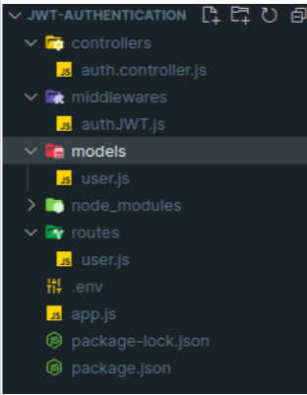
Introduction to Express JS
This try and catch block tries to connect to mongodb running on port 27017 and outputs connected to the database, if connection is successful. Otherwise, catch block will run, which catches the error. In this block handleError block tries to resolve error, if it is still left unresolved next function process.on() outputs error on the terminal. Now we are connected to the database, so let’s create our user schema. Create remaining needed files and folders as given below.

Slide 63
Introduction to Express JS
Open models/user.js (user.js file in models folder) and write the given code.
var mongoose = require('mongoose'), Schema = mongoose.Schema; /** * User Schema */ var userSchema = new Schema({ fullName: { type: String, required: [true, "fullname not provided "], }, email: { type: String, unique: [true, "email already exists in database!"], lowercase: true, trim: true, required: [true, "email not provided"], validate: { validator: function (v) { return /^[^\s@]+@[^\s@]+\.[^\s@]+$/.test(v); | }, message: '{VALUE} is not a valid email!' } }, role: { type: String, enum: ["normal", "admin"], required: [true, "Please specify user role"] }, password: { type: String, required: true }, created: { type: Date, default: Date.now } }); module.exports = mongoose.model('User', userSchema);

Slide 64
Introduction to Express JS
Here we are creating user schema with the fields email, password, fullName, role, and time of creation of the user. We are also validating email with validator function. Now we will create controllers for signup and signin. Open auth.controller.js file in the controllers folder and write the code given below.

Slide 65
Introduction to Express JS
var jwt = require("jsonwebtoken"); var bcrypt = require("bcrypt"); var User = require("../models/user"); exports.signup = (req, res) => { const user = new User({ fullName: req.body.fullName, email: req.body.email, role: req.body.role, password: bcrypt.hashSync(req.body.password, 8) }); user.save((err, user) => { if (err) { res.status(500) .send({ message: err }); return; } else { res.status(200) .send({ message: "User Registered successfully" }) } }); }; | exports.signin = (req, res) => { User.findOne({ email: req.body.email }) .exec((err, user) => { if (err) { res.status(500) .send({ message: err }); return; } if (!user) { return res.status(404) .send({ message: "User Not found." }); } //comparing passwords var passwordIsValid = bcrypt.compareSync( req.body.password, user.password ); | // checking if password was valid and send response accordingly if (!passwordIsValid) { return res.status(401) .send({ accessToken: null, message: "Invalid Password!" }); } //signing token with user id var token = jwt.sign({ id: user.id }, process.env.API_SECRET, { expiresIn: 86400 }); //responding to client request with user profile success message and access token . res.status(200) .send({ user: { id: user._id, email: user.email, fullName: user.fullName, }, message: "Login successfull", accessToken: token, }); }); };

Slide 66
Introduction to Express JS
In the above code we are importing jsonwebtoken, bcrypt, and the user model we created. Then we have defined signup controller which creates the user in the database with info provided in the request body. Here we are using bcrypt to hash our password before storing it in the database. Then we have defined signin controller which takes the user and password from the request body, checks if the user with that email exists, and if not, it responds with an error message. It will compare passwords and if the password is wrong it will respond with an error message. Otherwise it creates a JWT token with user-id and responds with a user profile success message and access token. Notice that we have used process.env.API_SECRET while signing JWT, make sure you declare this variable in the .env file. Mine looks like this: PORT=8080 API_SECRET=This_is_very_secret_string Now let’s define API routes where we will utilize these controllers. Open user.js file in the routes folder and write down the code given below.
var express = require("express"), router = express.Router(), { signup, signin } = require("../controllers/auth.controller.js"); router.post("/register", signup, function (req, res) { }); router.post("/login", signin, function (req, res) { }); module.exports = router;

Slide 67
Introduction to Express JS
Now we need to import this route in app.js and use it. Modify your app.js as follows:
const express = require("express"), app = express(), mongoose = require("mongoose"), userRoutes = require("./routes/user"); //Connect to database try { mongoose.connect("mongodb://localhost:27017/usersdb", { useUnifiedTopology: true, useNewUrlParser: true }); console.log("connected to db"); } catch (error) { handleError(error); } process.on('unhandledRejection', error => { console.log('unhandledRejection', error.message); }); // parse requests of content-type - application/json app.use(express.json()); // parse requests of content-type - application/x-www-form-urlencoded app.use(express.urlencoded({ extended: true })); | //using user route app.use(userRoutes); //setup server to listen on port 8080 app.listen(process.env.PORT || 8080, () => { console.log("Server is live on port 8080"); })

Slide 68
Introduction to Express JS
We have covered user registration (signup) and authentication. Now let’s implement authorization. For this we will implement a middleware function and we will use it while defining the endpoint which will require authorization. Open authJWT.js in middleware and write code as given below.
const jwt = require("jsonwebtoken"); User = require("../models/user"); const verifyToken = (req, res, next) => { if (req.headers && req.headers.authorization && req.headers.authorization.split(' ')[0] === 'JWT') { jwt.verify(req.headers.authorization.split(' ')[1], process.env.API_SECRET, function (err, decode) { if (err) req.user = undefined; User.findOne({ _id: decode.id }) .exec((err, user) => { if (err) { res.status(500) .send({ message: err }); } else { req.user = user; next(); } }) }); } else { req.user = undefined; next(); } }; module.exports = verifyToken;

Slide 69
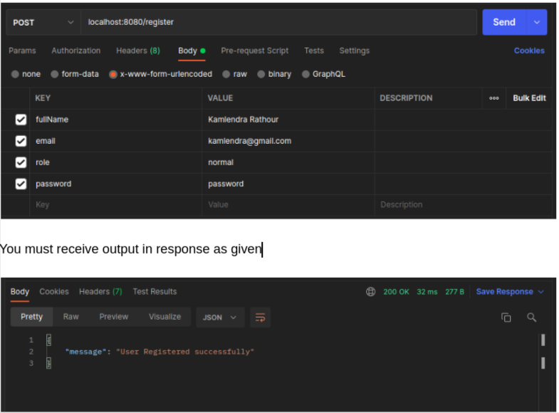
Introduction to Express JS
Here we defined a get route /hiddencontent which will check if you have a valid token. If you are admin it will send a congratulations message, otherwise it will send an unauthorised error message. Now let’s test our API, fire up Postman and create a POST request to create a user as given below.

Slide 70
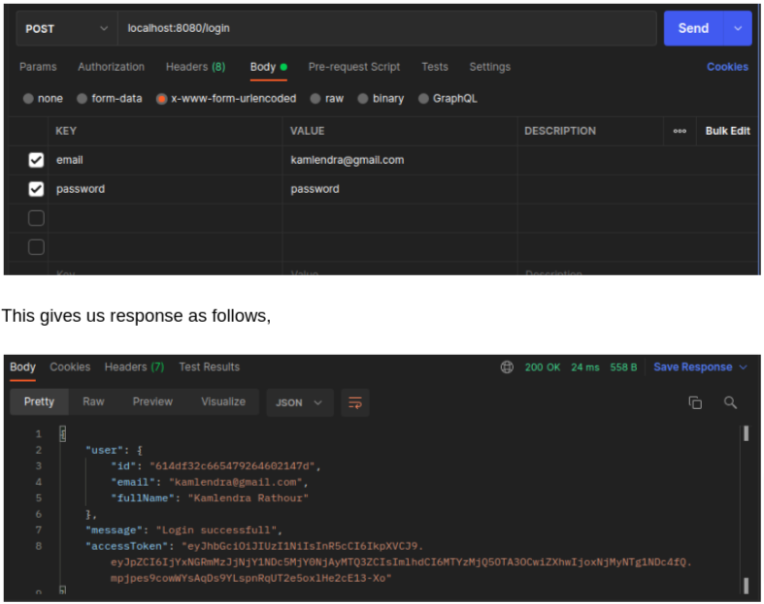
Introduction to Express JS
Now let’s test the login route. Create a POST route as given:

Slide 71
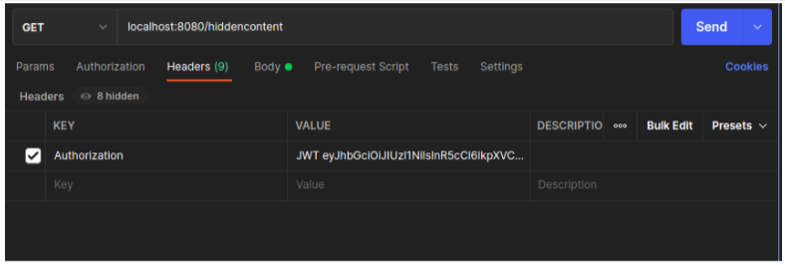
Introduction to Express JS
This shows that both register and signup are working fine. Let’s test /hiddencontent. Create a GET request as follows,

Slide 72
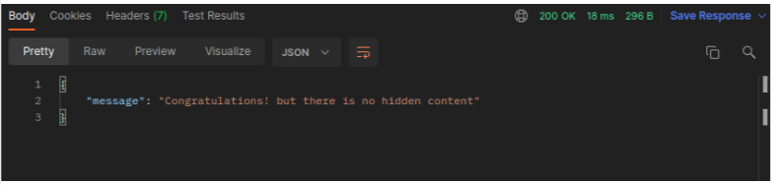
Introduction to Express JS
Make sure you write the value of the authorization token as JWT [JWT_TOKEN]. You will get response as, We successfully completed authentication and authorization with JWT.

Slide 73
Closing (5 mins)

