Slide 1
1_-RDBMS Fundamentals-RDBMS-1 SYNC (2hrs 30 mins)
MEAN/MERN STACK

Slide 2
Opening (5 mins)

Slide 3
Learning Objectives:
Introduction to Database Management System
Introduction to 3 tier Architecture in DBMS
Introduction of ER Model
Mapping from ER Model to Relational Model
Introduction of Relational Model and Codd Rules in DBMS
Types of Keys in Relational Model (Candidate, Super, Primary, Alternate and Foreign)
Introduction of Database Normalization
Normal Forms in DBMS

Slide 4
Content (35 mins)

Slide 5
Introduction of DBMS (Database Management System):
Introduction of DBMS (Database Management System): A database is a collection of inter-related data which helps in the efficient retrieval, insertion, and deletion of data from the database and organizes the data in the form of tables, views, schemas, reports, etc. For Example, a university database organizes the data about students, faculty, admin staff, etc. which helps in the efficient retrieval, insertion, and deletion of data from it. DDL is the short name for Data Definition Language, which deals with database schemas and descriptions, of how the data should reside in the database. CREATE: to create a database and its objects like (table, index, views, store procedure, function, and triggers). ALTER: alters the structure of the existing database. DROP: delete objects from the database. TRUNCATE: remove all records from a table, including all spaces allocated for the records are removed. COMMENT: add comments to the data dictionary. RENAME: rename an object DML is the short name for Data Manipulation Language which deals with data manipulation and includes most common SQL statements such SELECT, INSERT, UPDATE, DELETE, etc., and it is used to store, modify, retrieve, delete and update data in a database. SELECT: retrieve data from a database. INSERT: insert data into a table. UPDATE: updates existing data within a table. DELETE: Delete all records from a database table. MERGE: UPSERT operation (insert or update).

Slide 6
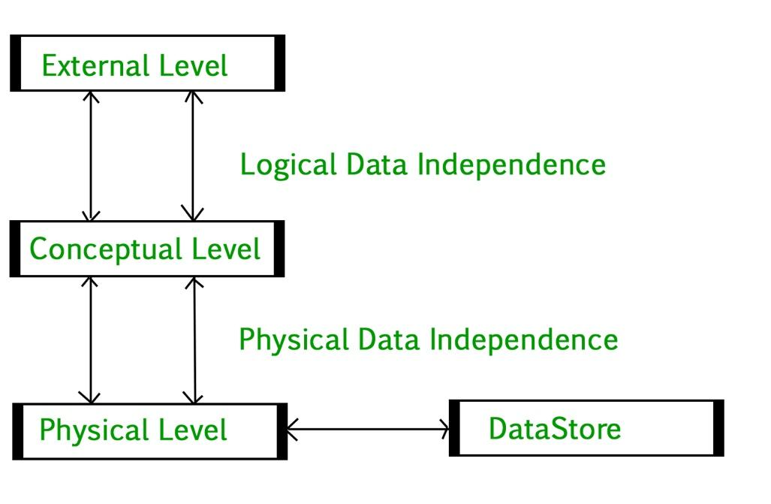
Introduction of DBMS (Database Management System):
Introduction of 3-Tier Architecture in DBMS: DBMS 3-tier architecture divides the complete system into three inter-related but independent modules as shown below.

Slide 7
Introduction of DBMS (Database Management System):
Physical Level: At the physical level, the information about the location of database objects in the data store is kept. Various users of DBMS are unaware of the locations of these objects.In simple terms,physical level of a database describes how the data is being stored in secondary storage devices like disks and tapes and also gives insights on additional storage details. Conceptual Level: At conceptual level, data is represented in the form of various database tables. For Example, STUDENT database may contain STUDENT and COURSE tables which will be visible to users but users are unaware of their storage.Also referred as logical schema,it describes what kind of data is to be stored in the database. External Level: An external level specifies a view of the data in terms of conceptual level tables. Each external level view is used to cater to the needs of a particular category of users. For Example, FACULTY of a university is interested in looking course details of students, STUDENTS are interested in looking at all details related to academics, accounts, courses and hostel details as well. Physical Data Independence: Any change in the physical location of tables and indexes should not affect the conceptual level or external view of data. This data independence is easy to achieve and implemented by most of the DBMS. Conceptual Data Independence: The data at conceptual level schema and external level schema must be independent. This means a change in conceptual schema should not affect external schema. e.g.; Adding or deleting attributes of a table should not affect the user’s view of the table. But this type of independence is difficult to achieve as compared to physical data independence because the changes in conceptual schema are reflected in the user’s view. Database Design Conceptual Design: The requirements of database are captured using high level conceptual data model. For Example, the ER model is used for the conceptual design of the database. Logical Design: Logical Design represents data in the form of relational model. ER diagram produced in the conceptual design phase is used to convert the data into the Relational Model. Physical Design: In physical design, data in relational model is implemented using commercial DBMS like Oracle, DB2.

Slide 8
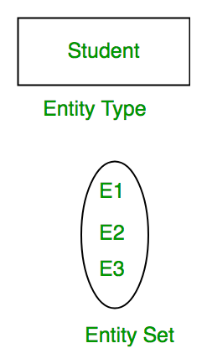
Introduction of DBMS (Database Management System):
Introduction of ER Model: ER Model is used to model the logical view of the system from data perspective which consists of these components: Entity, Entity Type, Entity Set – An Entity may be an object with a physical existence – a particular person, car, house, or employee – or it may be an object with a conceptual existence – a company, a job, or a university course. An Entity is an object of Entity Type and set of all entities is called as entity set. e.g.; E1 is an entity having Entity Type Student and set of all students is called Entity Set

Slide 9
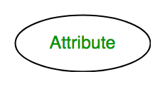
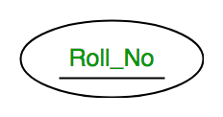
Introduction of DBMS (Database Management System):
Attribute(s): Attributes are the properties which define the entity type. For example, Roll_No, Name, DOB, Age, Address, Mobile_No are the attributes which defines entity type Student. In ER diagram, attribute is represented by an oval. Key Attribute – The attribute which uniquely identifies each entity in the entity set is called key attribute.For example, Roll_No will be unique for each student. In ER diagram, key attribute is represented by an oval with underlying lines.

Slide 10
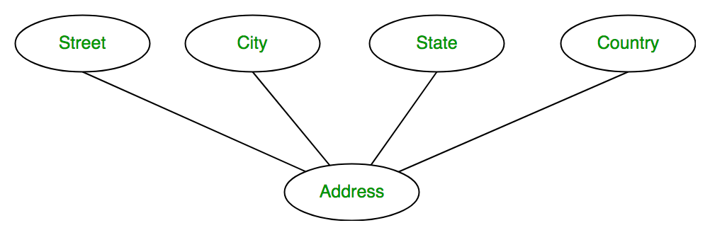
Introduction of DBMS (Database Management System):
Composite Attribute –
An attribute composed of many other attributes is called as composite attribute. For example, Address attribute of student Entity type consists of Street, City, State, and Country. In ER diagram, composite attribute is represented by an oval comprising of ovals.

Slide 11
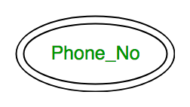
Introduction of DBMS (Database Management System):
Multivalued Attribute – An attribute consisting more than one value for a given entity. For example, Phone_No (can be more than one for a given student). In ER diagram, multivalued attribute is represented by double oval.
An attribute which can be derived from other attributes of the entity type is known as derived attribute. e.g.; Age (can be derived from DOB). In ER diagram, derived attribute is represented by dashed oval.

Slide 12

Introduction of DBMS (Database Management System):
Relationship Type and Relationship Set: A relationship type represents the association between entity types. For example, ‘Enrolled in’ is a relationship type that exists between entity type Student and Course. In ER diagram, relationship type is represented by a diamond and connecting the entities with lines.

Slide 13
Introduction of DBMS (Database Management System):
Relationship Type and Relationship Set: A relationship type represents the association between entity types. For example, ‘Enrolled in’ is a relationship type that exists between entity type Student and Course. In ER diagram, relationship type is represented by a diamond and connecting the entities with lines. Degree of a relationship set: The number of different entity sets participating in a relationship set is called as degree of a relationship set. Unary Relationship, Binary Relationship, n-ary Relationship.

Slide 14
Introduction of DBMS (Database Management System):
Relational Model in DBMS: Relational Model represents how data is stored in Relational Databases. A relational database stores data in the form of relations (tables). Consider a relation STUDENT with attributes ROLL_NO, NAME, ADDRESS, PHONE and AGE
ROLL_NO | NAME | ADDRESS | PHONE | AGE
1 | Ali | Karachi | 0344994401 | 18
2 | Saqib | Lahore | 0345889923 | 18
3 | Yasir | Islamabad | 0303554454 | 20
4 | Faris | Karachi | 033399339 | 18

Slide 15
Introduction of DBMS (Database Management System):
Attribute: Attributes are the properties that define a relation. e.g.; ROLL_NO, NAME. Relation Schema: A relation schema represents name of the relation with its attributes. e.g.; STUDENT (ROLL_NO, NAME, ADDRESS, PHONE and AGE) is relation schema for STUDENT. If a schema has more than 1 relation, it is called Relational Schema. Tuple: Each row in the relation is known as tuple. The above relation contains 4 tuples, one of which is shown as:
1 | Ali | Karachi | 0344994401 | 18
Relation Instance: The set of tuples of a relation at a particular instance of time is called as relation instance. Table 1 shows the relation instance of STUDENT at a particular time. It can change whenever there is insertion, deletion or updation in the database.
Degree: The number of attributes in the relation is known as degree of the relation. The STUDENT relation defined above has degree 5.
Cardinality: The number of tuples in a relation is known as cardinality. The STUDENT relation defined above has cardinality 4.
Column: Column represents the set of values for a particular attribute. The column ROLL_NO is extracted from relation STUDENT.
ROLL_NO
1
2
3
4

Slide 16
Introduction of DBMS (Database Management System):
NULL Values: The value which is not known or unavailable is called NULL value. It is represented by blank space. e.g.; PHONE of STUDENT having ROLL_NO 4 is NULL. Constraints in Relational Model: While designing Relational Model, we define some conditions which must hold for data present in database are called Constraints. These constraints are checked before performing any operation (insertion, deletion and updation) in database. If there is a violation in any of constrains, operation will fail. Domain Constraints: These are attribute level constraints. An attribute can only take values which lie inside the domain range. e.g,; If a constrains AGE>0 is applied on STUDENT relation, inserting negative value of AGE will result in failure. Key Integrity: Every relation in the database should have atleast one set of attributes which defines a tuple uniquely. Those set of attributes is called key. e.g.; ROLL_NO in STUDENT is a key. No two students can have same roll number. So a key has two properties: It should be unique for all tuples. It can’t have NULL values. Referential Integrity: When one attribute of a relation can only take values from other attribute of same relation or any other relation, it is called referential integrity. Let us suppose we have 2 relations Different Types of Keys in Relational Model: Candidate Key: The minimal set of attributes that can uniquely identify a tuple is known as a candidate key. Super Key: The set of attributes that can uniquely identify a tuple is known as Super Key. Primary Key: There can be more than one candidate key in relation out of which one can be chosen as the primary key. Alternate Key: The candidate key other than the primary key is called an alternate key. Foreign Key: If an attribute can only take the values which are present as values of some other attribute, it will be a foreign key to the attribute to which it refers. The relation which is being referenced is called referenced relation and the corresponding attribute is called referenced attribute and the relation which refers to the referenced relation is called referencing relation and the corresponding attribute is called referencing attribute.

Slide 17
Introduction of DBMS (Database Management System):
Introduction of Database Normalization: Database normalization is the process of organizing the attributes of the database to reduce or eliminate data redundancy (having the same data but at different places) . Problems because of data redundancy Data redundancy unnecessarily increases the size of the database as the same data is repeated in many places. Inconsistency problems also arise during insert, delete and update operations. Functional Dependency Functional Dependency is a constraint between two sets of attributes in relation to a database. A functional dependency is denoted by an arrow (→). If an attribute A functionally determines B, then it is written as A → B. What does functionally dependent mean? A function dependency A → B means for all instances of a particular value of A, there is the same value of B. Normalization is the process of minimizing redundancy from a relation or set of relations. Redundancy in relation may cause insertion, deletion, and update anomalies. So, it helps to minimize the redundancy in relations. Normal forms are used to eliminate or reduce redundancy in database tables. First Normal Form: If a relation contain composite or multi-valued attribute, it violates first normal form or a relation is in first normal form if it does not contain any composite or multi-valued attribute. A relation is in first normal form if every attribute in that relation is singled valued attribute. If a relation contain composite or multi-valued attribute, it violates first normal form or a relation is in first normal form if it does not contain any composite or multi-valued attribute. A relation is in first normal form if every attribute in that relation is singled valued attribute.

Slide 18
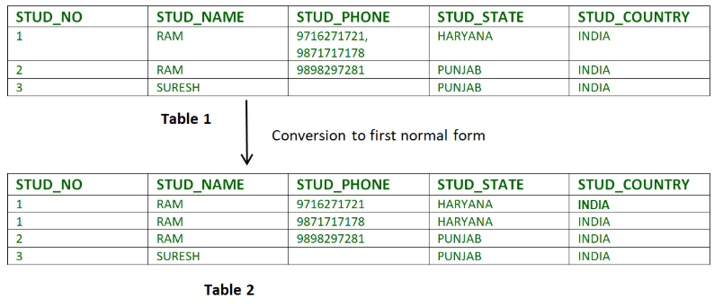
Introduction of DBMS (Database Management System):
Second Normal Form:
To be in second normal form, a relation must be in first normal form and relation must not contain any partial dependency. A relation is in 2NF if it has No Partial Dependency, i.e., no non-prime attribute (attributes which are not part of any candidate key) is dependent on any proper subset of any candidate key of the table.
Partial Dependency – If the proper subset of candidate key determines non-prime attribute, it is called partial dependency.

Slide 19
Introduction of DBMS (Database Management System):
Consider table-3 as following below.
STUD_NO COURSE_NO COURSE_FEE
1 C1 1000
2 C2 1500
1 C4 2000
4 C3 1000
4 C1 1000
2 C5 2000
COURSE_FEE cannot alone decide the value of COURSE_NO or STUD_NO;
COURSE_FEE together with STUD_NO cannot decide the value of COURSE_NO;
COURSE_FEE together with COURSE_NO cannot decide the value of STUD_NO;
Hence,
COURSE_FEE would be a non-prime attribute, as it does not belong to the one only candidate key {STUD_NO, COURSE_NO} ;
But, COURSE_NO -> COURSE_FEE, i.e., COURSE_FEE is dependent on COURSE_NO, which is a proper subset of the candidate key. Non-prime attribute COURSE_FEE is dependent on a proper subset of the candidate key, which is a partial dependency and so this relation is not in 2NF.
To convert the above relation to 2NF,
we need to split the table into two tables such as :
Table 1: STUD_NO, COURSE_NO
Table 2: COURSE_NO, COURSE_FEE

Slide 20
Introduction of DBMS (Database Management System):
Table 1 Table 2
STUD_NO COURSE_NO COURSE_NO COURSE_FEE
1 C1 C1 1000
2 C2 C2 1500
1 C4 C3 1000
4 C3 C4 2000
4 C1 C5 2000

Slide 21
Introduction of DBMS (Database Management System):
Third Normal Form:
A relation is in third normal form, if there is no transitive dependency for non-prime attributes as well as it is in second normal form.
A relation is in 3NF if at least one of the following condition holds in every non-trivial function dependency X –> Y.
X is a super key.
Y is a prime attribute (each element of Y is part of some candidate key).
Transitive dependency – If A->B and B->C are two FDs then A->C is called transitive dependency.
Example 1 – In relation STUDENT given in Table 4,
FD set: {STUD_NO -> STUD_NAME, STUD_NO -> STUD_STATE, STUD_STATE -> STUD_COUNTRY, STUD_NO -> STUD_AGE}
Candidate Key: {STUD_NO}
For this relation in table 4, STUD_NO -> STUD_STATE and STUD_STATE -> STUD_COUNTRY are true. So STUD_COUNTRY is transitively dependent on STUD_NO. It violates the third normal form. To convert it in third normal form, we will decompose the relation STUDENT (STUD_NO, STUD_NAME, STUD_PHONE, STUD_STATE, STUD_COUNTRY_STUD_AGE) as:
STUDENT (STUD_NO, STUD_NAME, STUD_PHONE, STUD_STATE, STUD_AGE)
STATE_COUNTRY (STATE, COUNTRY)
Example 2 – Consider relation R(A, B, C, D, E)
A -> BC,
CD -> E,
B -> D,
E -> A
All possible candidate keys in above relation are {A, E, CD, BC} All attributes are on right sides of all functional dependencies are prime.

Slide 22
Closing (5 mins)

