Slide 1

Understanding the Intersection of AI, Ethics, and Social Progress
Team Members (Group J):-
Ananya Kachawa- 21136751
Mohammad Saad Shaikh- 22163573
Harshal Agashe- 22157051

Slide 2
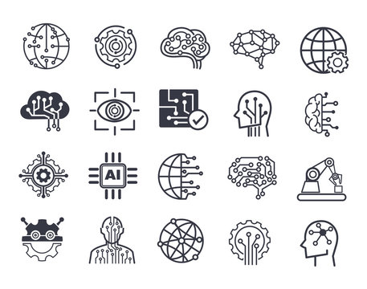
AI for Good means
Social Impact: Prominent societal challenges like poverty, access to healthcare, education, environmental sustainability, and more are the focus of AI for Good efforts.
Ethical Considerations: AI for Good places a strong emphasis on the value of developing and utilizing ethical AI. Fairness, accountability, openness, and the preservation of human rights and privacy in AI systems are all part of this.
Humanitarian Applications: The use of AI for Good encompasses humanitarian endeavors like as illness prevention, disaster relief, and enhancing the standard of living for underprivileged or vulnerable groups.
Global Collaboration: To pool resources and knowledge, AI for Good promotes cooperation between researchers, developers, policymakers, and NGOs.
Sustainability: AI for Good encourages the creation of sustainable AI solutions while considering how AI technologies may affect the environment.
Accessibility: AI for Good aims to ensure that AI developments do not worsen already-existing inequalities but rather help to reduce them by making AI technologies accessible and advantageous to all.

Slide 3

AI Algorithms in Social Domains
Healthcare:AI algorithms are used for clinical decision support, personalized medicine, and disease diagnosis. In particular, Convolutional Neural Networks (CNNs), Decision Trees, and Support Vector Machines are used.
Education: Personalized learning, automatic essay grading, and language learning applications all make use of machine learning algorithms, such as recommender systems and natural language processing (NLP) methods.
Social Services: Efficient resource allocation and sentiment analysis in social services are made possible by optimization algorithms and natural language processing techniques.
Humanitarian Aid: Planning for disaster response, satellite image analysis, and humanitarian endeavors all use AI algorithms, such as computer vision for image analysis and natural language processing (NLP) for language translation.

Slide 4

Ethical Considerations in AI for Good
Important Ideas:
Fairness: Providing objective results.
Transparency: Providing an explanation for AI procedures.
Responsibility: Assigning blame for decisions made by AI.
Privacy: Preserving individual information.

Slide 5
Case Studies in Ethical AI for Good
Project Debater by IBM:
Google's DeepMind for Healthcare:
The purpose of IBM's Project Debater is to have meaningful conversations about difficult subjects with people.
Ethical Considerations: The project places a strong emphasis on creating a framework that upholds moral principles, fosters comprehension, and encourages objective discussion.
Impact: Project Debater can help with decision-making processes, educate discussions, and improve critical thinking abilities.
Goal: By concentrating on areas like illness prediction and patient care optimization, DeepMind, a division of Alphabet, Google's parent company, has used AI to the healthcare industry.
Ethical Considerations: By establishing stringent data access controls and guaranteeing transparency in their partnerships, DeepMind has worked closely with healthcare providers to address privacy concerns.
Impact: The goals of DeepMind's healthcare initiatives are to lower expenses, increase overall healthcare delivery efficiency, and improve patient outcomes.

Slide 6

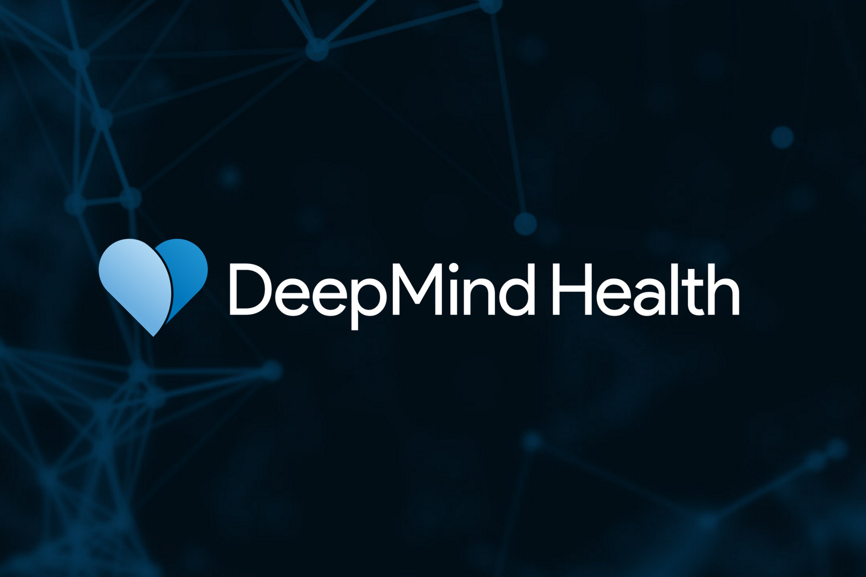
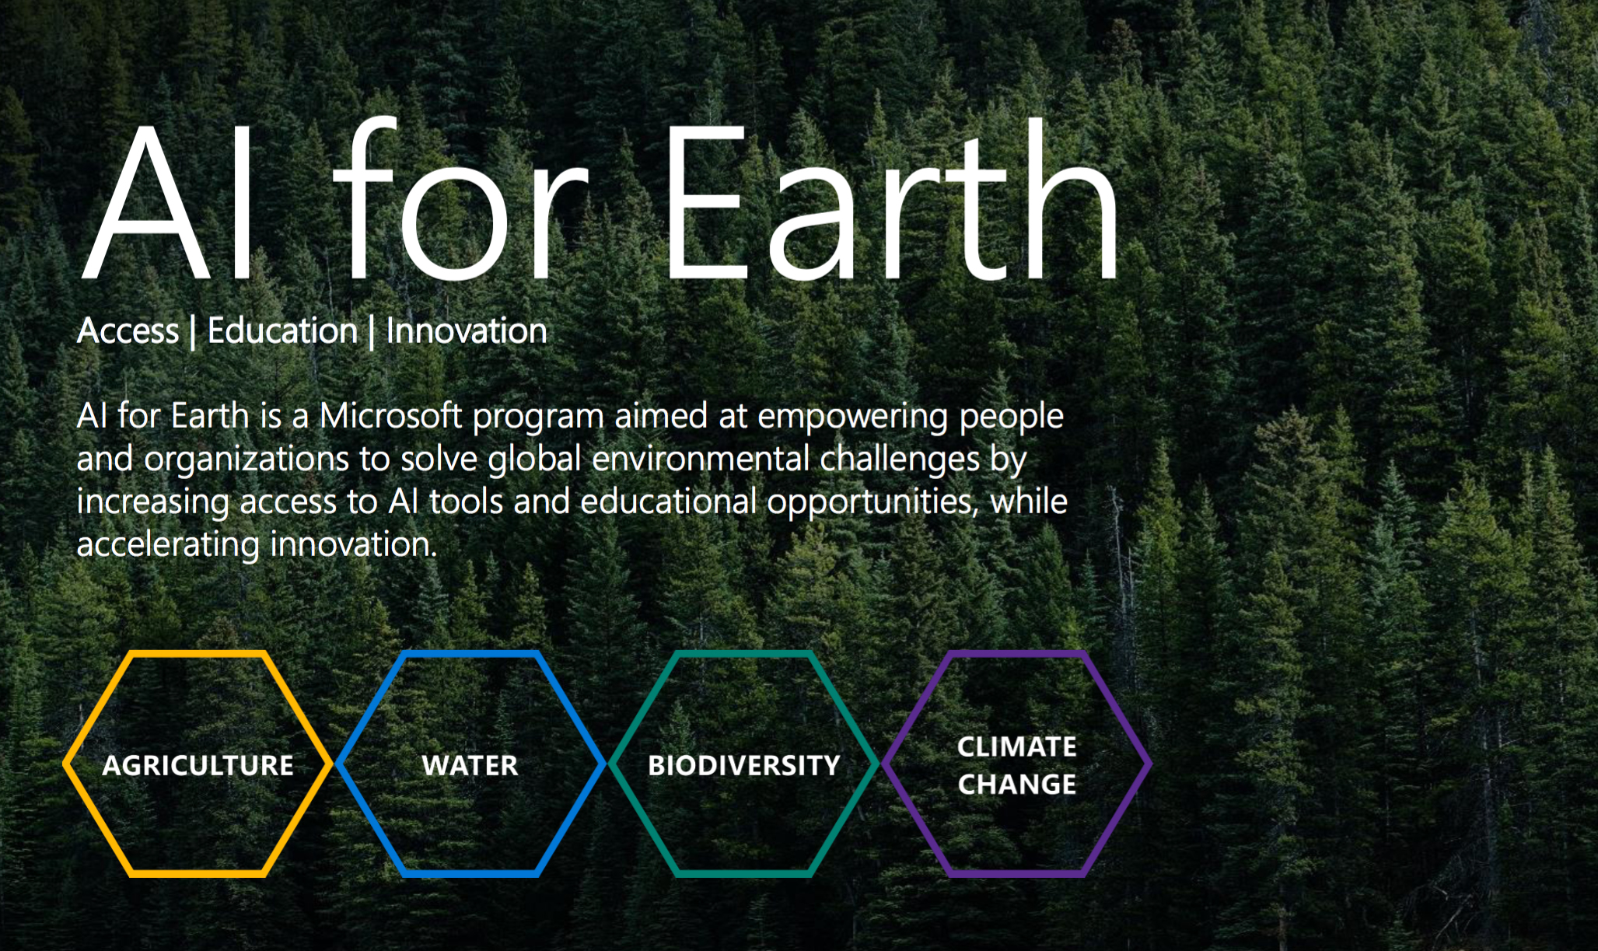
AI for Earth by Microsoft:
Goal: Using AI technologies to address environmental issues and advance sustainability is the goal of Microsoft's AI for Earth initiative.
Ethical Considerations: The project is centered on using AI to improve environmental outcomes, such as research on climate change, sustainable agriculture, and wildlife conservation.
Impact: With the help of AI for Earth, initiatives all over the world can monitor biodiversity, analyze environmental data, and create solutions for more sustainable resource management.

Slide 7
Challenges & Future Outlook
Challenges:
To stop discrimination, biases in AI models must be addressed.
Increasing the explainability and transparency of AI decision-making procedures.
Privacy Concerns: Ensuring that AI applications protect sensitive data.
Making Ethical Decisions: Clearly defining moral standards for AI programs.
Job displacement: Reducing the effects of artificial intelligence on employment and income disparities.
Future Outlook:
Global ethical standards for responsible AI adoption are called for.
Multidisciplinary Cooperation: Better coordination between various stakeholders.
There is a growing need for transparent and interpretable AI models, or explainable AI (XAI).
AI Literacy and Education: Concentrated efforts to inform decision-makers and the general public.
Responsible Innovation: Giving moral issues top priority during the entire AI development process.

Slide 8
Conclusion
To maximize AI's potential for good societal impact and minimize its negative effects, it is imperative that technological advancements be balanced with ethical considerations. Fostering a future in which AI makes fair, inclusive, and sustainable contributions to social progress is contingent upon responsible AI development.

Slide 9

Thank You

