Slide 1
PS: Safe Driver Prediction
Project Report and Analysis
TEAM - .CSV
Members -
Kashif (IMT2018042)
Vinayak (IMT2018086)
Saad (IMT2018514)

Slide 2
Project Highlights
Exploratory Data Analysis
Data Preprocessing
Model Selection
Ensemble Techniques

Slide 3
Exploratory Data Analysis
Binary Classification problem
Observing the target column, found high degree of imbalance (minority:majority=0.04)
3 columns with high percentage of missing values : ps_car_03_cat, ps_car_05_cat, ps_reg_03
Dataset had 3 categories: cat, calc, bin
calc has high correlation with other features.
Dataset was not found to be much skewed.
Some features were found to have outliers.

Slide 4
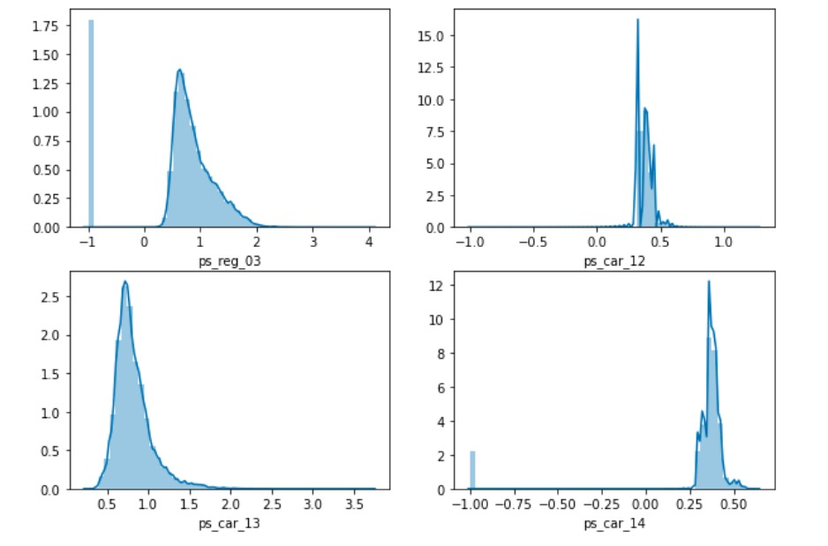
EDA (Skewness in continuous features)

Slide 5
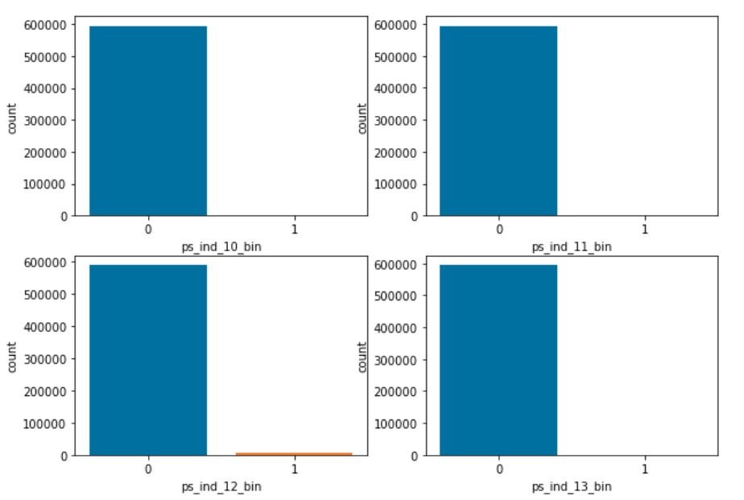
EDA (Features with imbalanced classes)

Slide 6
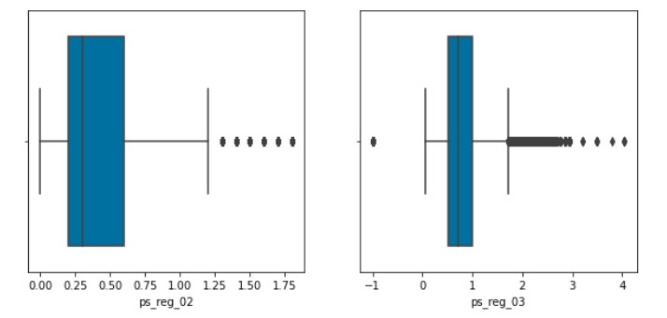
EDA (Features that have outliers)

Slide 7
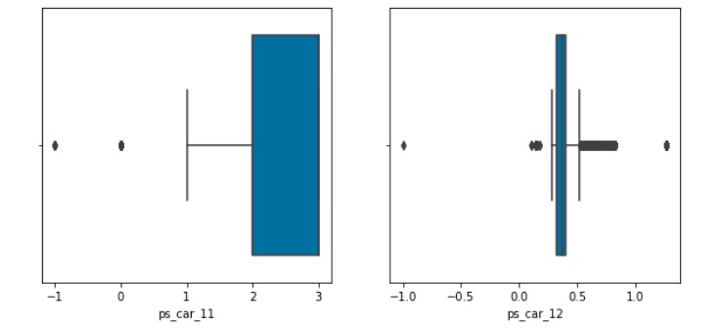
EDA (Features with outliers contd.)

Slide 8
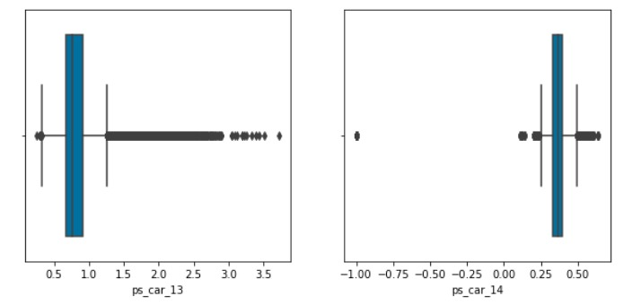
EDA (Features with outliers contd.)

Slide 9
Data Preprocessing
Combined Train and Test data for consistent encoding.
Dropped ps_ind_10_bin and ps_ind_13_bin due to highly imbalanced values.
Dropped all calc features as they had high correlation with other features and low correlation with target.
Filled the missing values in different columns with mean and mode, and some columns with new categories.
Categorical features (cat) are One Hot Encoded.
Removed skew but performance of model degraded.
Split the Data back into Test and Train Data.
Split the train data into Train and Test for model training and prediction.

Slide 10
Model Selection
We tried 6 models:
Logistic Regression
SVM
Perceptron
Random Forest Classifier
XgBoost Classifier
Lightgbm Classifier

Slide 11
Logistic Regression
Normalised Gini Index Before Tuning - 0.2264
Normalised Gini Index After Tuning - 0.2428
Hyperparameters used and tuned: max_iter=1000, penalty=l2, random_state=0

Slide 12
SVM (SGD Classifier)
Normalised Gini Index Before Tuning - 0.149
Normalised Gini Index After Tuning - 0.167
Hyperparameters used and tuned: loss=”hinge”, learning_rate=0.001, penalty=”l1”

Slide 13
Perceptron (SGD Classifier)
Normalised Gini Index Before Tuning - 0.162
Normalised Gini Index After Tuning - 0.179
Hyperparameters used and tuned: loss=”perceptron”, learning_rate=0.001, penalty=”l1”

Slide 14
Random Forest Classifier
Normalised Gini Index Before Tuning - 0.241
Normalised Gini Index Tuning - 0.253
Hyperparameters used and tuned: n_estimators=1600, class_weight="balanced”, min_samples_leaf=1000, max_leaf_nodes=150 n_jobs=-1
This worked well, but it took a lot of time to train, and xgboost and Lightgbm performed better and faster, so we shifted to them.

Slide 15
XgBoost Classifier
Normalised Gini Index before Tuning - 0.243
Normalised Gini Index after Tuning - 0.264
Hyperparameters used and tuned:- n_thread=-1, learning_rate=0.005, n_estimators=1600, colsample_bytree=0.1, scale_pos_weight=3, eval_metric=”auc”, max_depth=20
GridSearch was used for hyperparameter tuning.
This model worked well, but it took more time as compared to Lightgbm Classifier. Also Lightgbm combined with Easy Ensemble Classifier worked wayyy better.

Slide 16
Lightgbm Classifier
Normalised Gini Index before Tuning - 0.245
Normalised Gini Index afterTuning - 0.2753
Hyperparameter used and tuned: objective=’binary’, n_estimators=1600, boosting_type=’goss’, n_jobs=-1, col_bysample=0.1, learning_rate=0.005, max_bin=10
GridSearch is used for hyperparameter Tuning.
This model was very fast and performed very well.

Slide 17
Easy Ensemble Classifier + XGBoost
We used Lightgbm and Xgboost as base estimators for this. Lightgbm as a base estimator gave better result than Xgboost.
Normalised Gini Index before Tuning - 0.259
Normalised Gini Index after Tuning -0.272
Hyperparameters used and tuned: n_estimators=45, base_estimator=xgboost, random_state=42, n_jobs=-1, sampling_strategy=’majority’
Easy Ensemble is a model from the imblearn library.

Slide 18
Easy Ensemble Classifier + LGBM Classifier
Normalised Gini Index before Tuning - 0.2651
Normalised Gini Index after Tuning -0.2778
Hyperparameters used and tuned: n_estimators=45, base_estimator=lightgbm, random_state=42, n_jobs=-1, sampling_strategy=’majority’
Conclusion :- We used Lightgbm and Xgboost as base estimators for this. Lightgbm as a base estimator gave better result than Xgboost.

Slide 19
Ensemble Techniques Used
Stacking three different LGBM classifier models ( 0.278)( 0.272)
Stacking Xgboost and LightGbm models ( 0.276) ( 0.269)
Stacking EasyEnsemble(Base estimator: LGBM) and EasyEnsemble(Base estimator: Xgboost) ( 0.2783) ( 0.2739)
Stacking EasyEnsemble(Base estimator: LGBM) and EasyEnsemble(Base estimator: Random Forest Classifier)(0.270) (0.265)
Weighted average of three LGBM models with different combinations of their weightages.( 0.277)(0.273)
Weighted average of two EasyEnsembleClassifier(Base est: LGBM) models(0.2787) ( 0.2729)

Slide 20
References
https://www.kaggle.com/c/porto-seguro-safe-driver-prediction/data
https://towardsdatascience.com/6-different-ways-to-compensate-for-missing-values-data-imputation-with-examples-6022d9ca0779
https://medium.com/activewizards-machine-learning-company/top-10-data-science-use-cases-in-insurance-8cade8a13ee1
https://machinelearningmastery.com/why-one-hot-encode-data-in-machine-learning/
https://www.researchgate.net/publication/275224157_A_Review_on_Evaluation_Metrics_for_Data_Classification_Evaluations
https://www.analyticsvidhya.com/blog/2016/03/complete-guide-parameter-tuning-xgboost-with-codes-python
https://doi.org/10.1007/s13042-012-0068-x
https://sebastianraschka.com/Articles/2014_about_feature_scaling.htmlhttps://doi.org/10.1007/s13042-012-0068-x
SKLearn, Xgboost , Lightgbm and Imblearn, Latex Documentation.
Scikit Learn : https://scikit-learn.org/stable/XGBoost
https://xgboost.readthedocs.io/en/latest/index.html
https://www.kaggle.com/bertcarremans/data-preparation-exploration
https://www.kaggle.com/c/porto-seguro-safe-driver-prediction/discussion/44629

Slide 21
References
https://www.kaggle.com/c/porto-seguro-safe-driver-prediction/discussion/44579#250558
https://www.youtube.com/watch?v=mbxZ_zqHV9c
https://www.appliedaicourse.com/
https://www.kaggle.com/xiaozhouwang/2nd-place-lightgbm-solution%20
https://www.kaggle.com/golubev/simplest-model-31th-lb-0-291%20
https://www.appliedaicourse.com/%20WRITTEN%20BY%20Madanchowdary%20Follow%202
https://www.kaggle.com/ogrellier/noise-analysis-of-porto-seguro-s-feature
Machine Learning in Rock Facies Classification: An Application of XGBoost May 2017 DOI: 10.1190/IGC2017-351 Conference: International Geophysical Conference, Qingdao, China,
https://www.researchgate.net/publication/317298171_Machine_Learning_in_Rock_Facies_Classification_An_Application_of_XGBoost

Slide 22
Thank You

