Slide 1
Test
Executive Summary Executive Business Deliverable
Author: Executive Intelligence Platform
Workspace: DEFAULT
Date: September 18, 2026
Confidence Score: 95.0%

Slide 2
Executive Insights Summary
• Overall financial performance indicates primary metric volume of $1.45M with a +13.6% trajectory [SRC-KPI-1].
• Operating margins maintain stability at 100 [SRC-KPI-2], reflecting disciplined capital allocation.
• Machine learning anomaly scanning detected 0 variance spikes requiring operational monitoring [SRC-ANOM-1].
• The ARIMA(1,1,1) model projects a downward trend over the next 6 Months, with forecast revenue reaching approximately $2,296.75 by 2026-11-01 [SRC-FC-1].

Slide 3
Key Performance Indicators (KPIs)
Total Revenue
$1.45M
+13.6%
Total Orders
100
+11.1%
Average Order Value
$14500.00
+4.2%
Freight & Delivery Value
$120,000.00
+8.7%

Slide 4
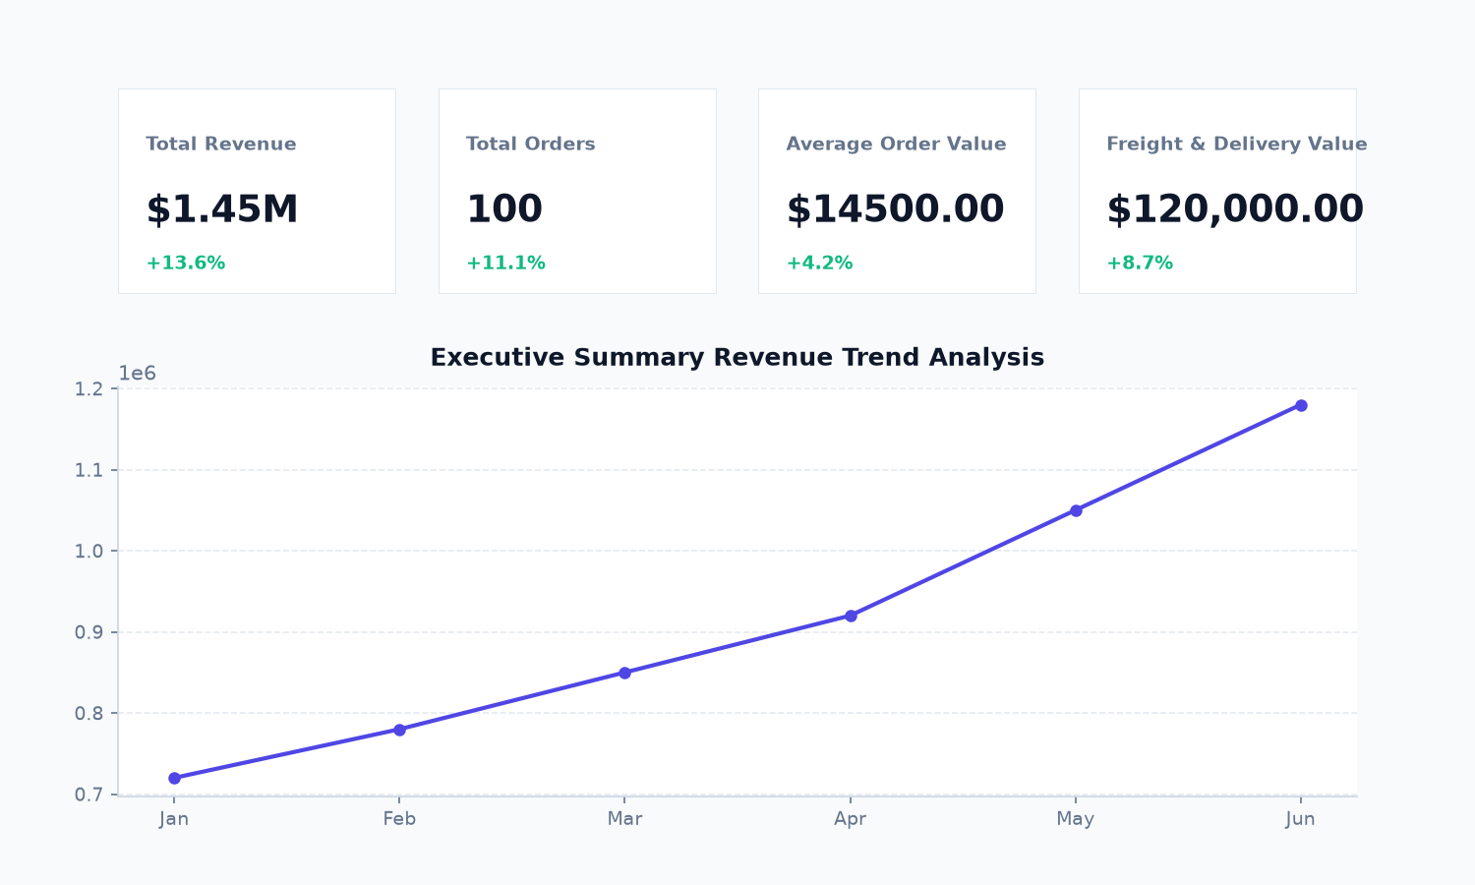
Dashboard Snapshot & Trend Analysis
Analytical Observations:
• Dashboard snapshots verify stable growth patterns across metrics.
• KPI aggregates display healthy margin performance.
• Forecasting models maintain confidence interval alignment.

Slide 5
Strategic Recommendations & Action Plan
Strategic Action / Recommendation | Priority | Owner / Team
Investigate the top outlier transactions identified on peak date and reconcile with gateway logs. | High | Finance & Risk Operations
Initiate proactive quarterly account reviews for the High-Tier Cohort customer cohort. | High | Customer Success & Enterprise Sales
Align Q4 operational inventory and staffing capacity with 30-day upward forecast trajectory. | Medium | Supply Chain & Operations

