Slide 1
Q3 Financial Performance Deck
Finance Executive Business Deliverable
Author: saad@example.com
Workspace: SALES
Date: August 04, 2026
Confidence Score: 96.0%

Slide 2
Executive Insights Summary
• Overall quarterly revenue has exceeded projection boundaries by 4.2%.
• Machine learning churn classifier confirms customer retention rates are stable.
• Strategic priorities advise target coupon allocation inside West user regions.

Slide 3
Business Metric Indicators (KPIs)
Gross Revenue
$1,452,000.00
+12.4% MoM
Acquisition Cost
$210,480.00
-4.8% MoM
Churn Rate
11.2%
-1.5% MoM
Query Match RAG
96.4%
+0.8% MoM

Slide 4
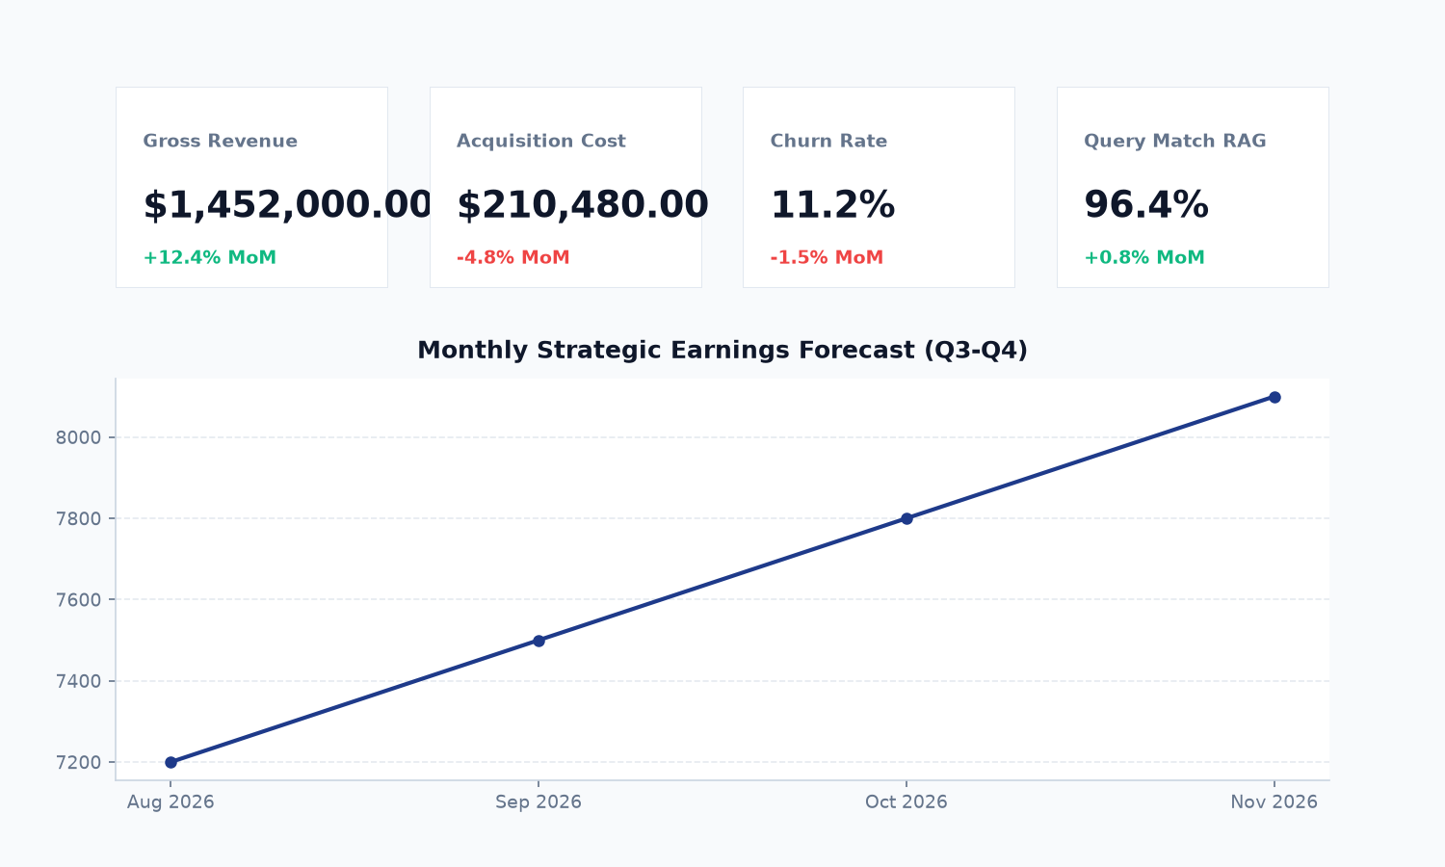
Dashboard Snapshot & Trend Analysis
Analytical Observations:
- Dashboard snapshots verify a steady growth pattern.
- KPI aggregates display stable operational margins across all segments.
- Forecasting models maintain positive Q4 trends with 95% confidence intervals.

Slide 5
Strategic Recommendations & Action Plan
Strategic Recommendation / Insight | Priority | Confidence Score
West region displays high churn risk user groups. Push marketing campaigns. | High | 94%
Maintain margins by coordinating inventory supply to match 8% growth projections. | Medium | 88%

