Slide 1
Slide : 1
CODE PLAGIARISM DETECTOR
NAME : Saad Sakib Noor
ROLL : BSSE 1122
SUPERVISOR : Md. Saeed Siddique

Slide 2
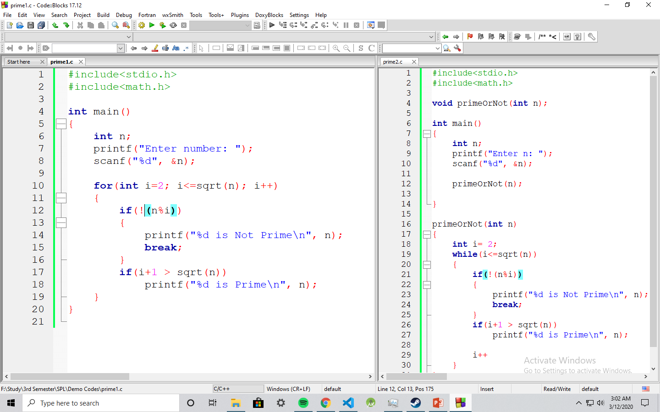
Slide : 1
Motivation
Making a tool that will easily detect code plagiarism, forcing everyone to do their own code, rather than relying on copy-pasting

Slide 3
Slide : 2
Steps
Knowing Code Clone and it’s type.
Designing a program that will work in different stages, each stage implementing different technique to detect possible different type of clone.
Finding ways to detect each types of clone.
Implementing the program in code stage by stage.
Testing and finding accuracy for each stage.
Making the code judge a set of codes rather than just a pair

Slide 4
Slide : 3
Progress
Code Clone & it’s types
Type 1 : Exact clone
Type 2 : Renamed/parameterized clone
Type 3 : Near miss clone
Type 4 : Semantic clone

Slide 5
Slide : 4
Progress
Detecting code plagiarism
AST representation of following block of code:
Abstract Syntax Tree (AST)
Code block :
for
for(int i=2; i<=sqrt(n); i++)
{
if(! (n%i) )
{
printf ("%d is Not Prime\n", n);
break;
}
if(i+1 > sqrt (n))
printf ("%d is Prime\n", n);
}
condition
=
<=
block
i
1
i
sqrt(n)
if
if
condition
condition
==
block
>
Print prime
%
0
+
sqrt(n)
Print not prime
break
n
i
1
i

Slide 6
Slide : 5
Progress
Detecting code plagiarism
CFG representation of following block of code:
Control Flow Graph (CFG)
i = 2
Code block :
for(int i=2; i<=sqrt(n); i++)
{
if(! (n%i) )
{
printf ("%d is Not Prime\n", n);
break;
}
if(i+1 > sqrt (n))
printf ("%d is Prime\n", n);
}
i <=sqrt(n)
true
n%i==0
i ++
false
true
i+1>sqrt(n)
Print not prime
true
Print prime
…

Slide 7
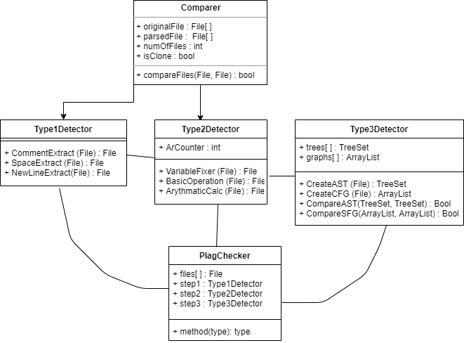
Slide : 6
Progress
Designing Program

Slide 8
Slide : 7
Further Plan
Implementing design in code.
Combining all the different types of detectors together
Creating better user interface (UI).
Making the program work for more than 2 files at a time

Slide 9
Slide : 8
Sources
Used draw.io for UML Diagram : https://www.draw.io/

