Slide 1
Source Code Plagiarism Detection
Page | 1
Name: Saad Sakib Noor
Exam Roll: 1108
Class Roll: 1122
Supervisor: Md. Saeed Siddik

Slide 2
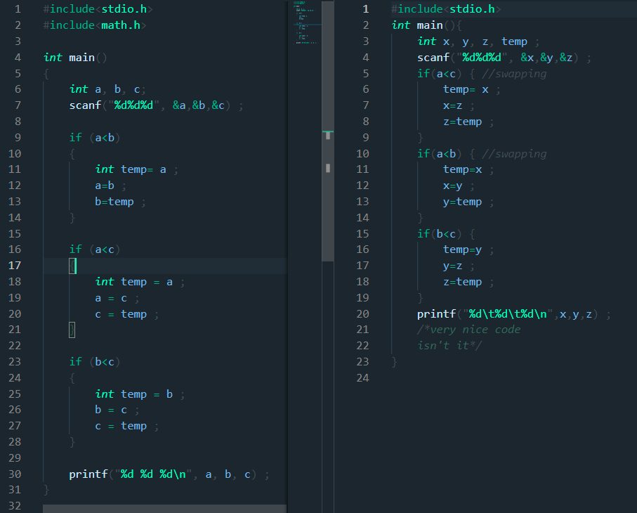
Problem Definition
Page | 2
Example:
Code clone is cloning a code or a part of a code and using it.
In our day to day life, it is a very severe problem, as people could just copy other’s code and not try it themselves, eventually no learning anything.
So it is very important to have a way to detect code clones so that these bad practices can be stopped.

Slide 3
Plagiarism Detection Technique
Page | 3
Lexical Similarities:
Converts source code into a stream of lexical tokens . During the lexical analysis phase, the source code undergoes a series of transformation.
After Conversion , use Edit Distance algorithm (DP) to find longest common sub sequence between two lexical

Slide 4
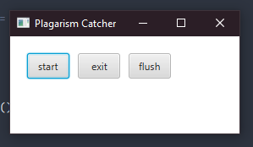
Anti Plagiarism
Page | 4
AntiPlag
Start
Exit
Flush
An easy to use simple program to detect potential similarities among many C source codes very fast.
Start
Select Folder
Process files for testing
Testing potential similarities
Flush
Delete all the intermidiate files
Works on a whole folder at once, and saves all the results and intermediate files for convenience,

Slide 5
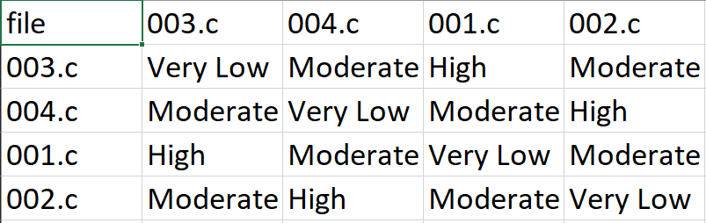
Result
Page | 5
After the program is done processing and calculating the results, the results will be saved in a .csv file. Name of the csv file
will be asked in the program. Once we open the csv file we’ll be met with this:

Slide 6
Reference & Links
Page | 6
Project git link: https://github.com/SaadDroid/AntiPlagiarism
Slide Template link: slidesgo

Slide 7
Thank You!
Page | 7

