Slide 1
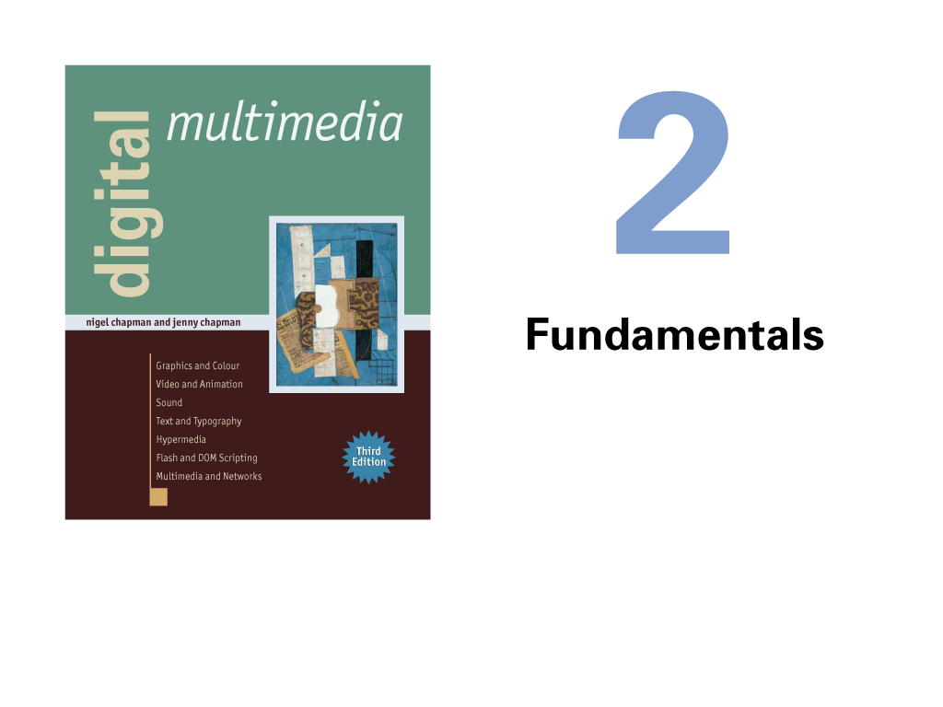

Slide 2
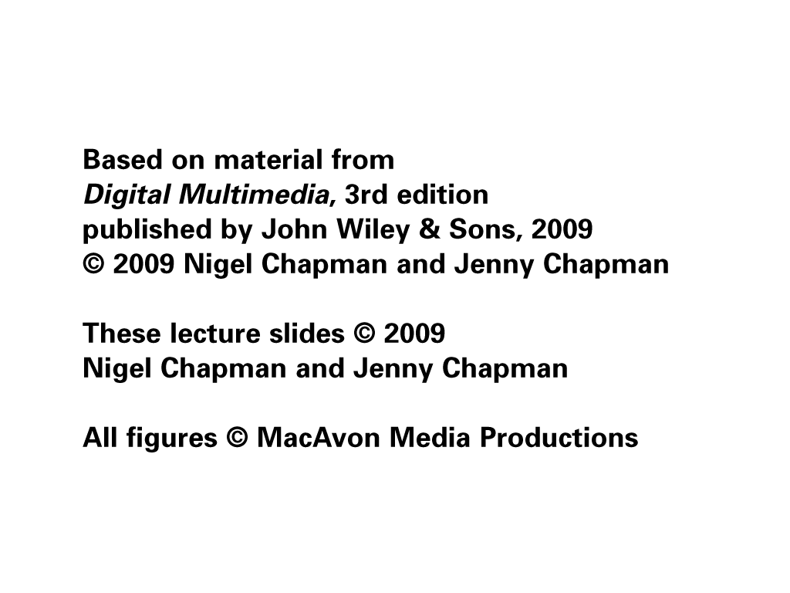

Slide 3
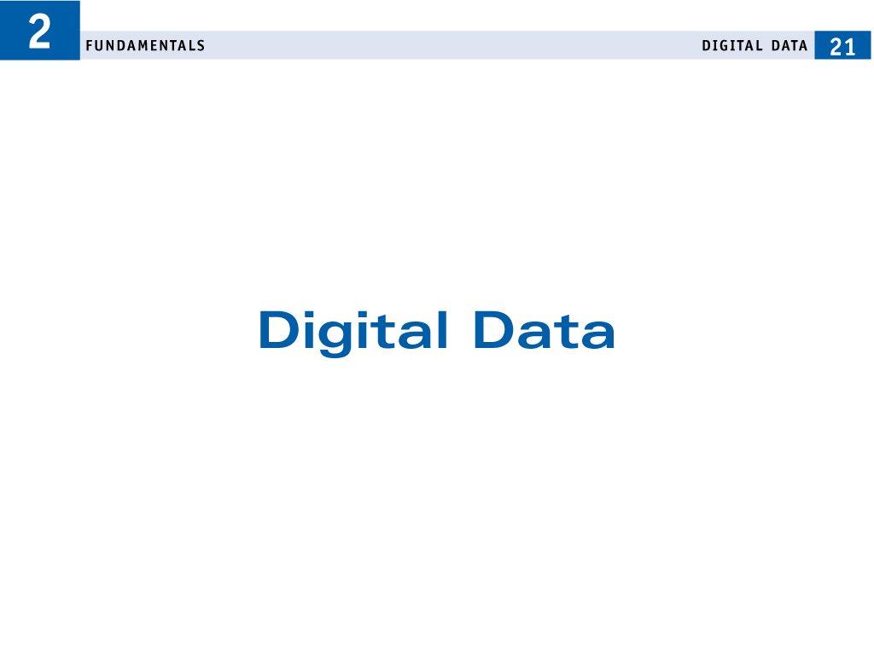

Slide 4
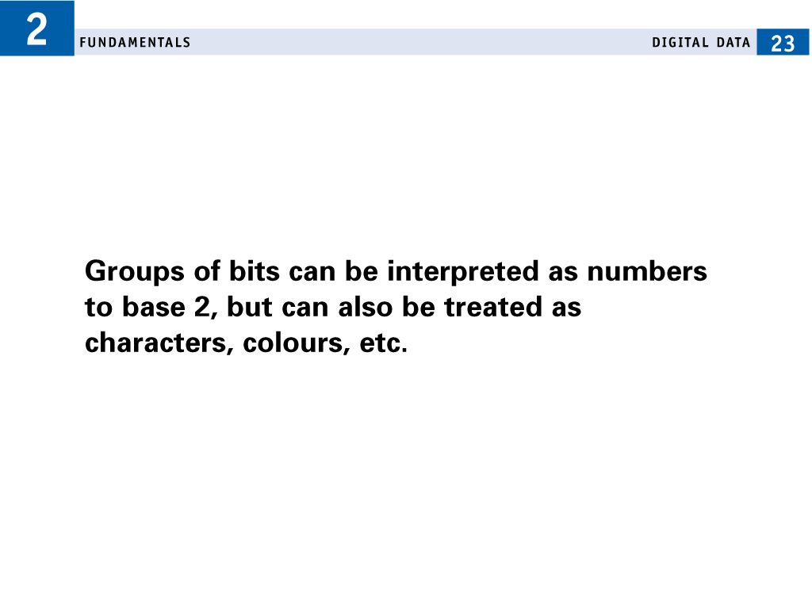

Slide 5
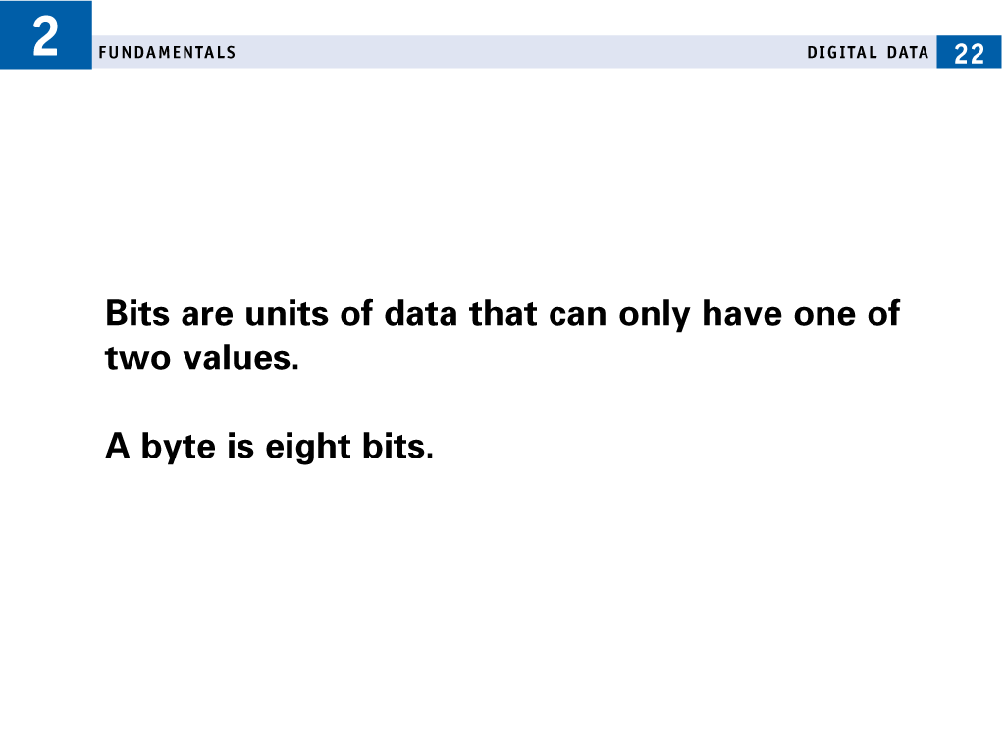

Slide 6
shade of grey occurring in an image: 01101010 = 106
ASCII character set is an association between characters and numbers
A = 65, B= 66, j = 106
Association between numbers and quantities:
the brightness of an image at a point, or the instantaneous amplitude of a sound wave.

Slide 7
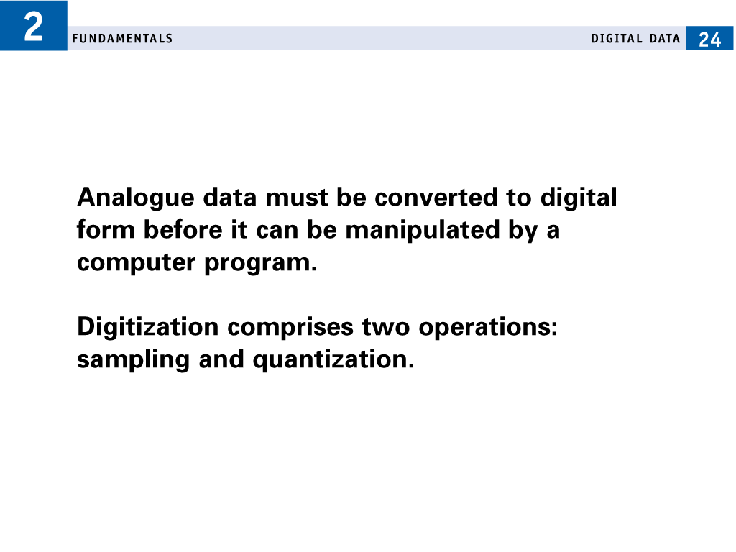

Slide 8
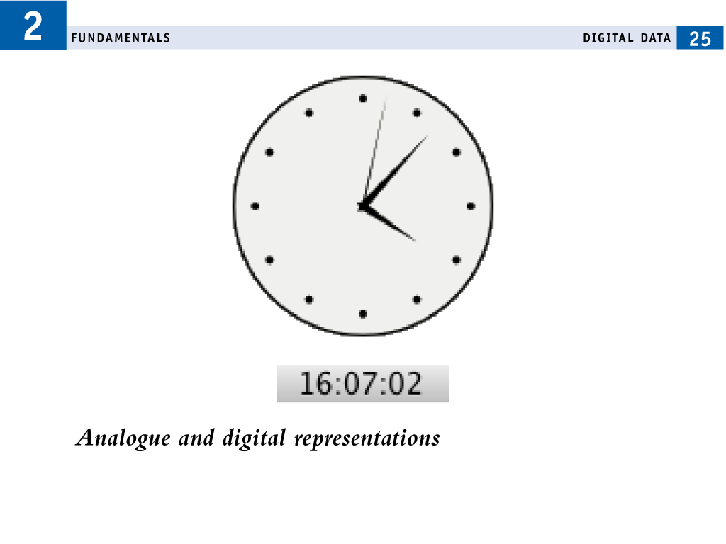

Slide 9
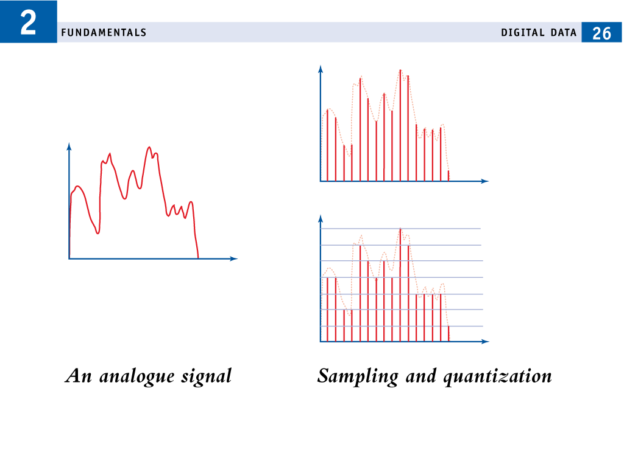

Slide 10
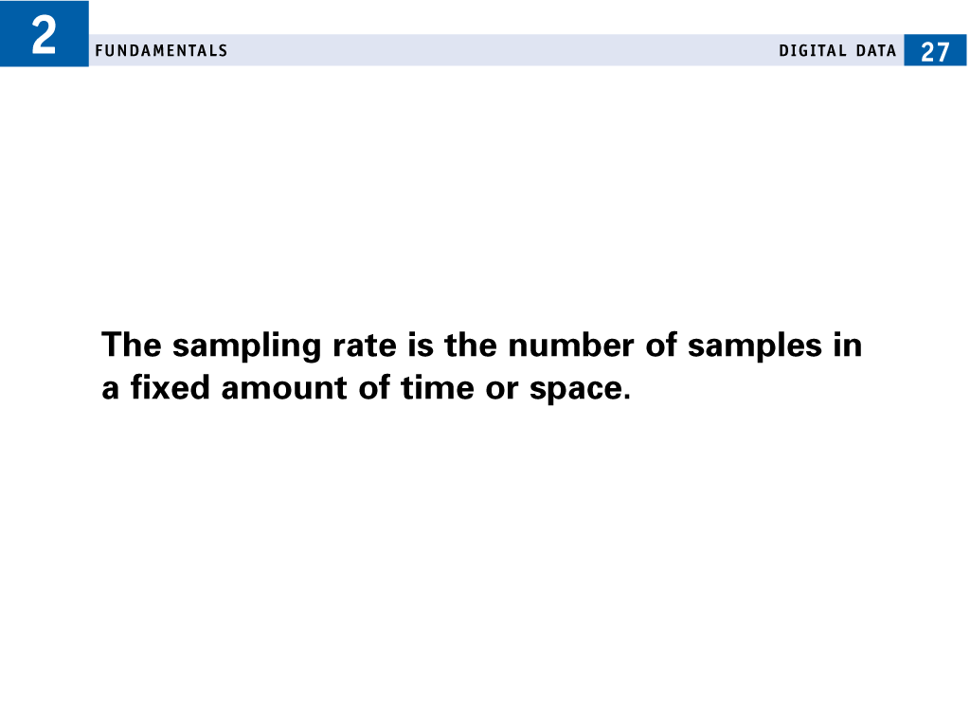

Slide 11
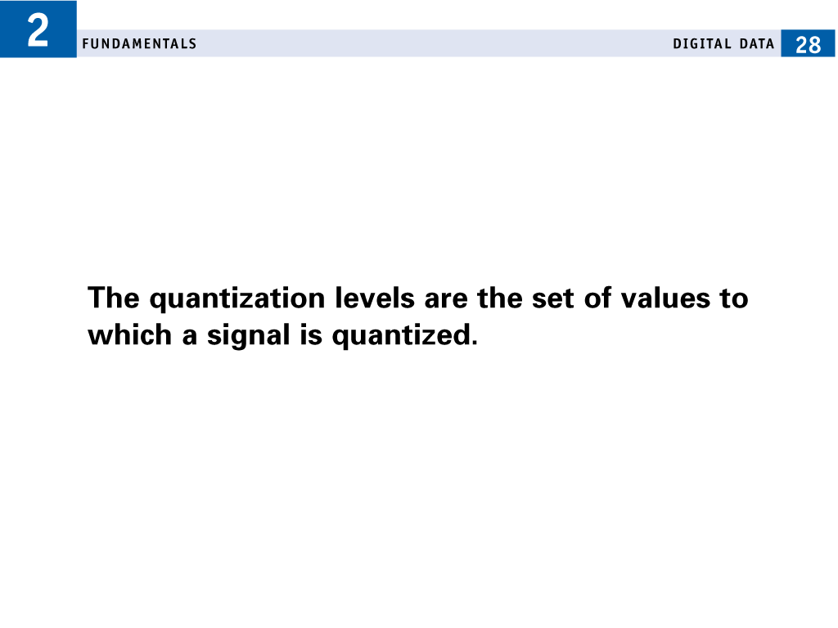

Slide 12
Digital signals are much more robust than analogue ones.
How can we claim that the digitized result is in any sense an accurate representation of the original analogue signal?
How closely the original can be reconstructed .
It is easy enough to see that if the sampling rate is too low some detail will be lost in the sampling
any rate at which we can be sure that the samples are close enough together to allow the signal to be accurately .

Slide 13
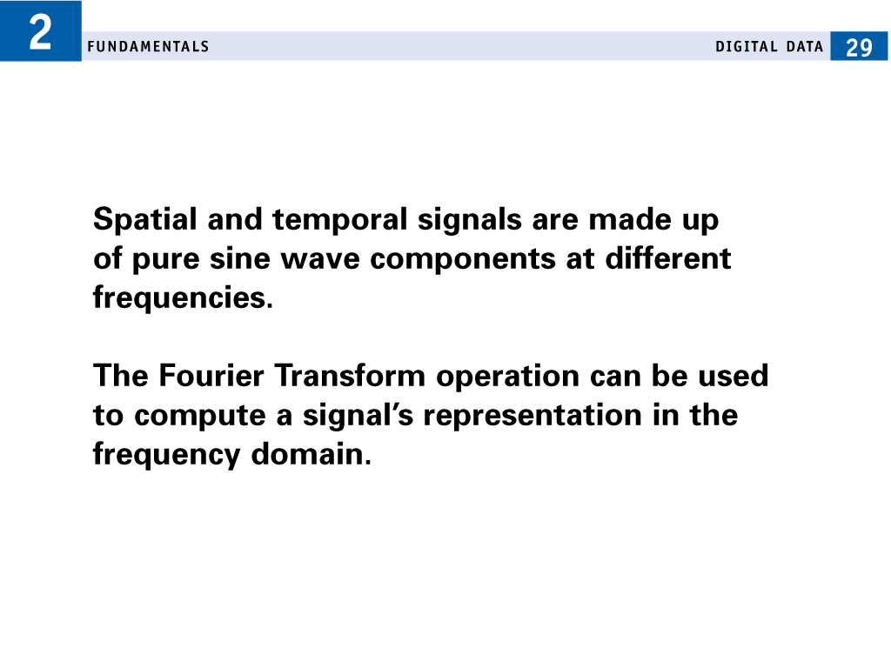

Slide 14
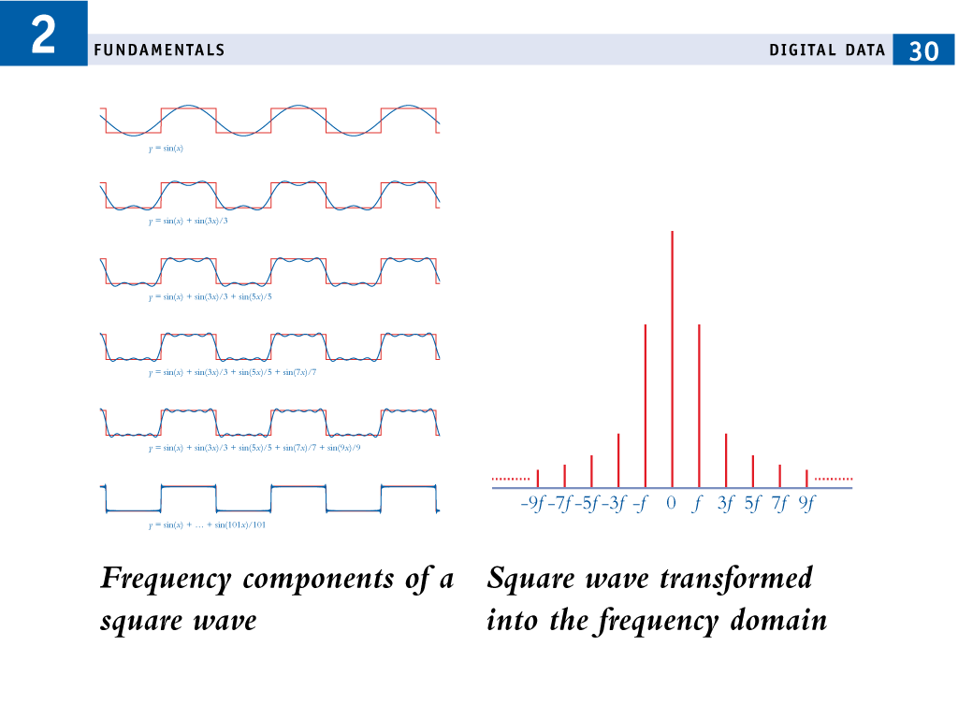

Slide 15
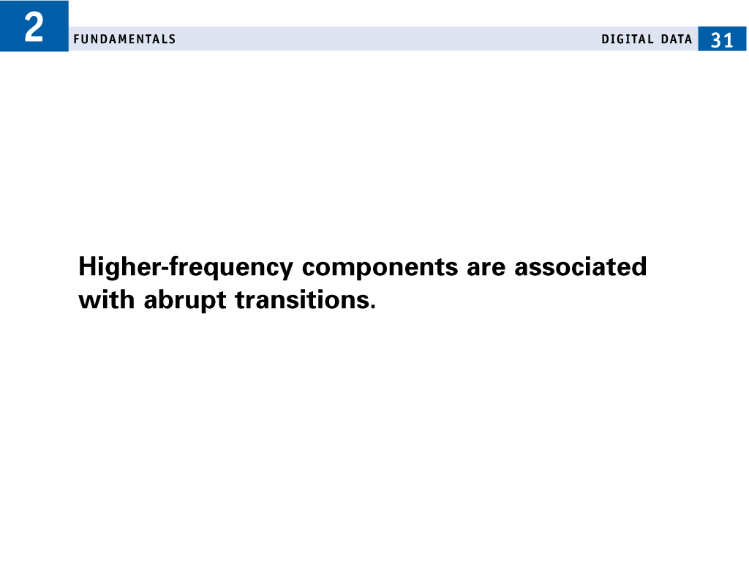

Slide 16
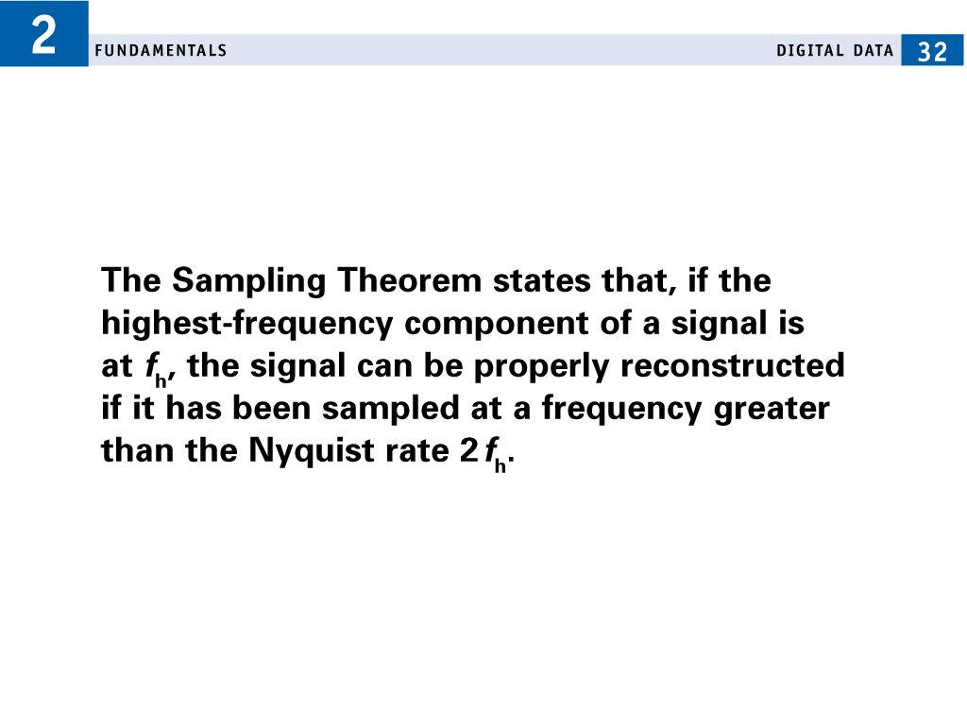

Slide 17
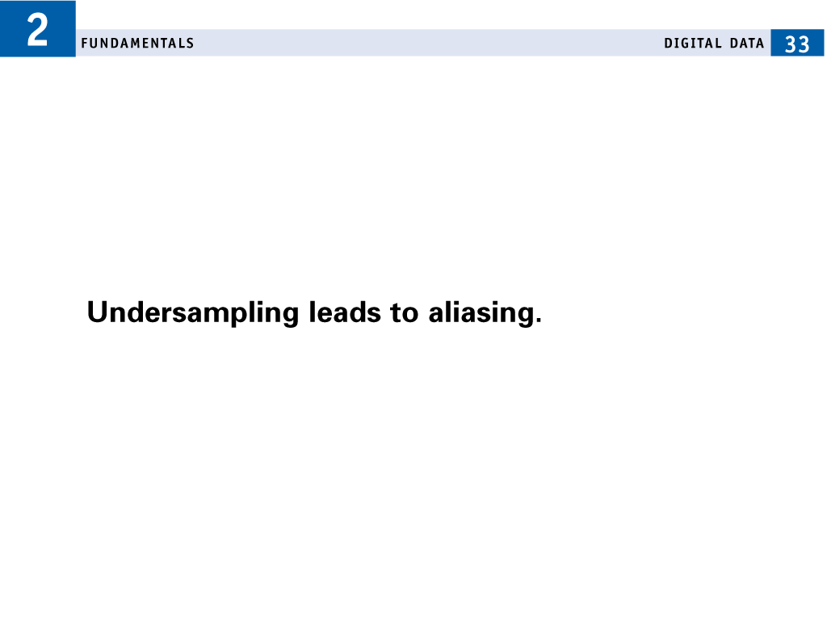

Slide 18
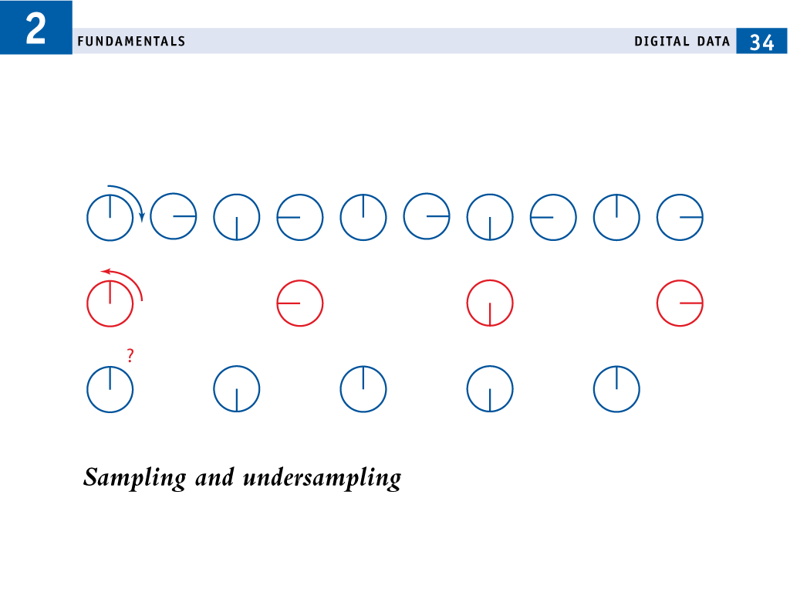

Slide 19
