Slide 1

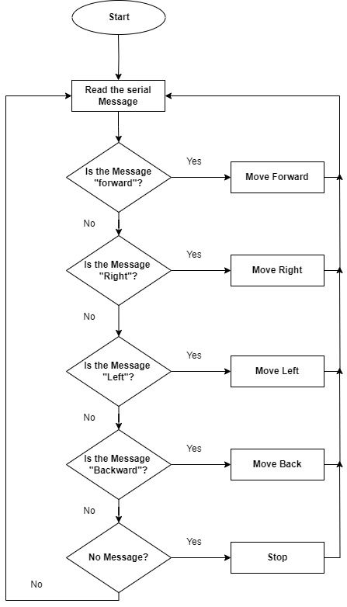
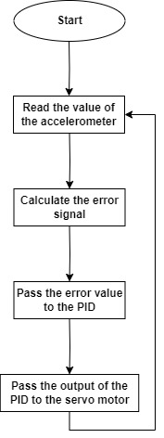
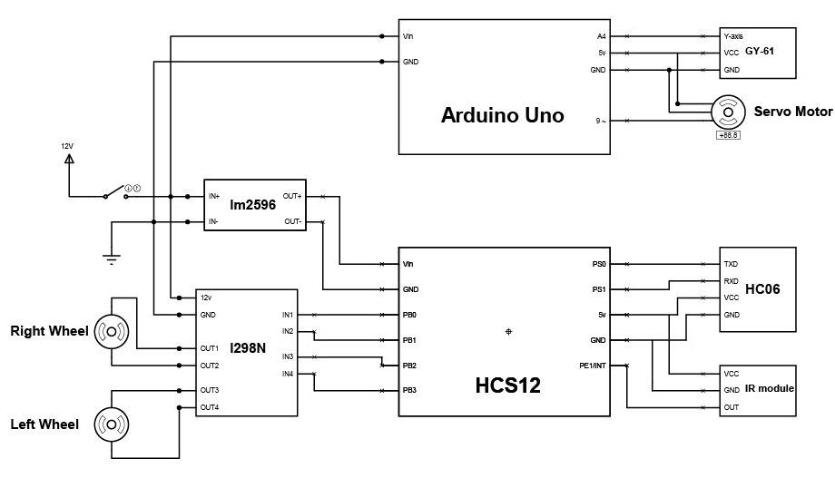
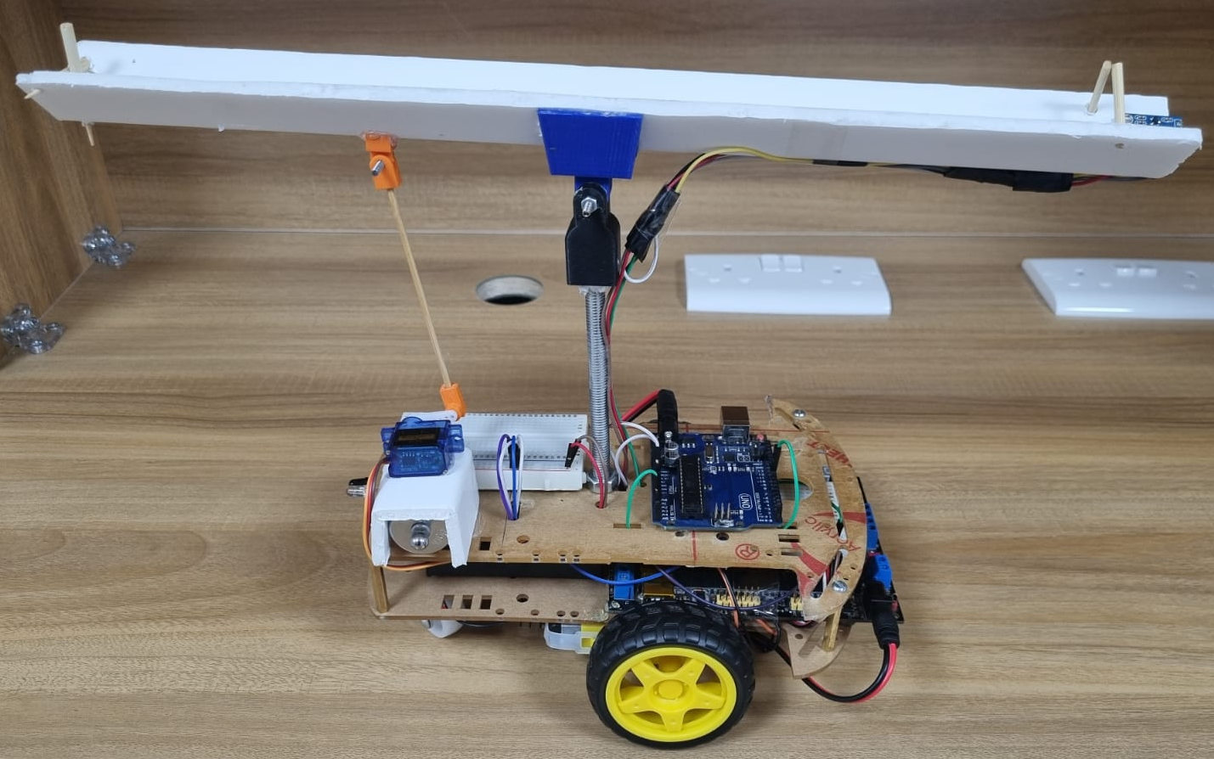
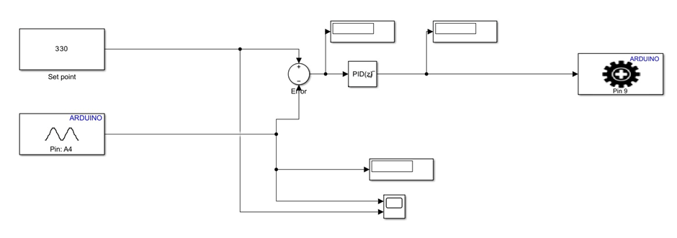
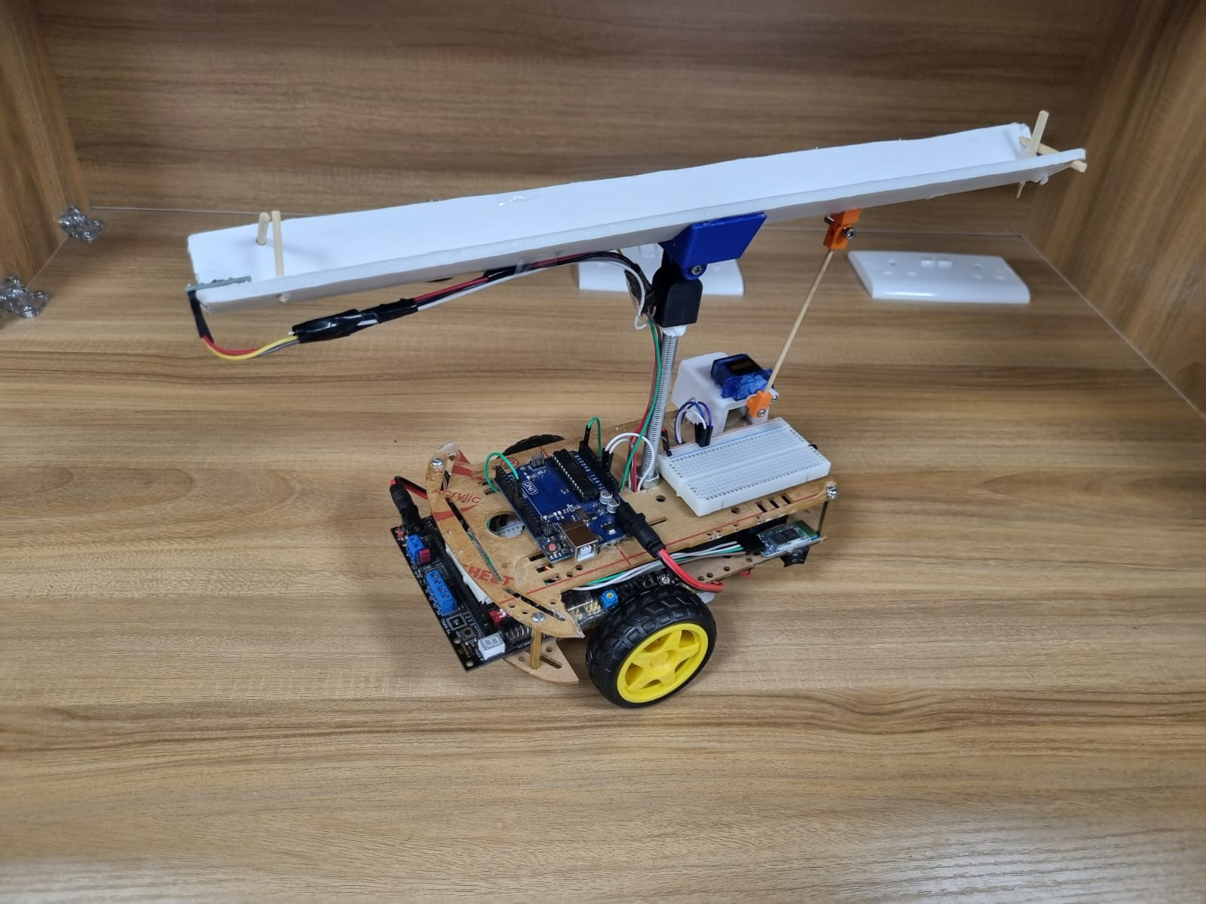
Load-Balancing Robot
Maissam Khalill , Omar Nemer, and Saad Al-Zoubi
Supervisor: Dr. Belal H. Sababha
Embedded Systems Final Design Project, Spring 2024
King Abdullah II School of Engineering
Princess Sumaya University for Technology
Introduction
In this work. we designed a load-balancing robot using the HCS12 microcontroller to control the car's movement. A Bluetooth module receives the movement direction from the user (mobile app), and then the car moves according to the user's instructions. Also, we use an IR sensor to detect obstacles as the car moves. On the other hand, the load will be hung above the robot on a flat surface, and the Arduino will balance the load and keep it stable on the surface under any circumstances using a PID controller. We use an accelerometer to determine the orientation of the surface, and servomotors will control this orientation.
Figure 3 Software Design.
Design
Our Load Balancing Robot excels in Bluetooth mode. Integrated components include HCS12, H-bridge, and Bluetooth HC-06. IR sensor connected to PORTE as an interrupt, the Bluetooth to PS0 and PS1. Motor control is managed via PORTB.
Additionally, an Arduino Uno is used to maintain the balance of the load above the car. It uses accelerometer reading as an input and adjusts the position of a servo motor to keep the load balanced.
Figure 1 Electrical Design.
Figure 2 MATLAB Block Diagram.
Results
The layout of our load-balancing robot is strategically designed to optimize functionality and ease of maintenance. The following figures illustrate the design layout.
Figure 4: Load-Balancing Robot Layout.
Figure 5: Load-Balancing Robot Layout.
Conclusion
This should not simply be a summary of what you did. Why should anyone care? What is the broader significance? Refer to the objective/purpose you stated in your first section somewhere in the conclusion.
Remember that a poster has two purposes. First, It should be meaningful standing alone without you explaining it or demoing your project. Someone walking by an going through it should get a clear and complete overview of your project without you having to explain or demo anything (i.e., include a description of what you produced and how well it worked it the poster). Secondly, a poster should serve as aid to you when presenting your work. You using figures, block diagrams, and/ flow graphs can make your oral presentation much more effective.

