Slide 1

Bangladesh Army University Of Science And Technology(BAUST), Saidpur
Project Proposal Report
Course Title : Software Development Project ||
Course Code : CSE 2200
Supervised By:
Name : Md.Toukir Ahmed
Designation : Lecturer
Submitted By :
Name : Tasmima Habib Tonny
Roll : 180201101
Batch : 8Th
Level : 2 Term : ||

Slide 2

Project Name: Tourist Reservation System
Introduction : Tourist reservation system is a web based application. The main purpose is to provide a convenient way for a customer to book hotel, flight, train and bus for tour purposes . We will make an easier task of searching places ,food, travel . There was two part admin and user . This is a simple reservation system developed using C++ .

Slide 3
Tourist Reservation System
Features
Tourist information
Payment
Travel bus
Food
Place

Slide 4
Tourist Reservation system
Module :
Administrator module:
Login
User profile
Update information
Manage trips
Manage places
User module :
Login
User profile
Update information

Slide 5
Tourist Reservation System
Overview : This tourist Reservation project is designed in C++ . This system is concept to store and generate all the records of the trips and their reservation. This program is a simple database of trips where the admin cam store trips and there reservation records easily as it is not time consuming . Moreover the user can make new reservations and als0 cancel reservation as per their wish . This project is easy to operate and understood by their users.

Slide 6
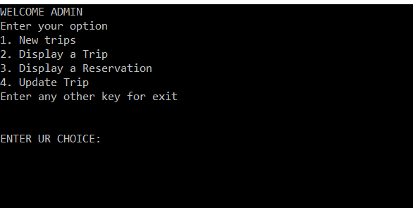
Tourist Reservation System
Admin output :

Slide 7
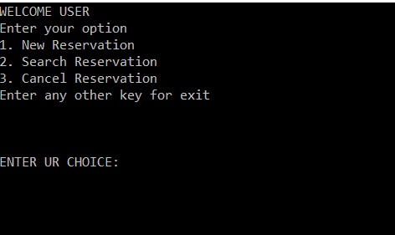
Tourist Reservation System
User output :

Slide 8
Tourist Reservation System
Goals : Tourist reservation system is based on the concept of recording trips and tourist reservation details . This whole system is in the C++ language . The system contains both admin and user side. Here the admin can perform all the tasks like adding , viewing, and updating trips records and there reservation . There was a login system for both side. This project will teach us how to add, modify ,delete and update.

Slide 9
Tourist Reservation system
Future Enhancement :
This project can easily implement under various situation . We can add new features as and when it requires . Reusability of this project is also possible. Tourism group can manage their place payment and days .

Slide 10
Tourist Reservation System
Github link :

Slide 11
Tourist Reservation System
THANK YOU

