Slide 1
TMS 320C6713 DSK

Slide 2
Digital Signal Processors
Digital Signal Processor (DSP) - specialized microprocessor designed specifically for digital signal processing, (mostly in real-time computing ).
Features
Specialized Design for real-time process
Specialized High Speed Arithmetic
Multiple Memory access

Slide 3
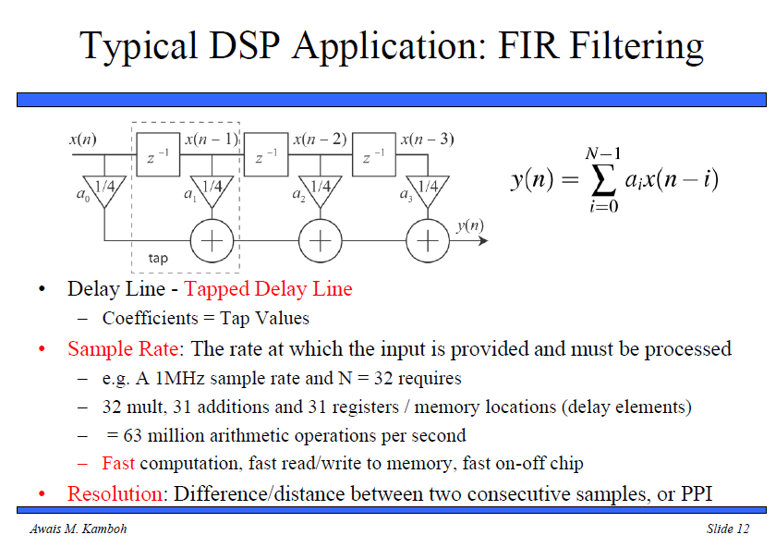

Slide 4
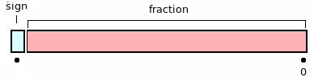
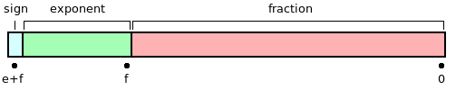
Fixed vs Floating Point
Fixed Point - Fixed number of digits before and after the radix point
Floating Point - Radix point can be placed anywhere relative to the digits.

Slide 5
Comparison of Fixed , Floating Point DSPs
Floating Point
Dynamic Range
High SNR
Costly
Easier Design
Slower
Audio Processing , Radar
Fixed Point
Limited Range
Low SNR
Lower Cost
Difficult Design (Over flow / Under flow)
Faster
Image , Video Processing

Slide 6
Introduction to DSK C6713
TMS 320C6713 Digital Signal Processor
Overview
Architecture
TMS 320C6713 Digital Signal Processing Kit
Overview
Components
Code Composer Studio
Overview
Features

Slide 7
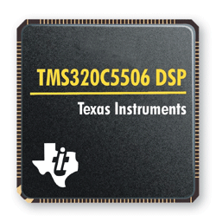
TMS320C6713 Digital Signal Processor
VLIW architecture Instruction
Word Length 256 bits = 8 x 32 bit instructions
Eight instructions can be fetched every cycle
264 kB of internal memory
4kB as L1Program Cache and 4kB as L1Data Cache
256kB as L2 memory shared between program and data
Eight functional or execution units
six arithmetic-logic units (ALUs) and two multiplier units
2 sets of L , S , D , M Units
Two sets of 16 32-bit general-purpose registers.
Internal buses include
32-bit program address bus, a 256-bit program data bus to accommodate eight 32-bit instructions
two 32-bit data address buses, two 64-bit data buses ,and two 64-bit store data buses.

Slide 8
TMS320C6713 Digital Signal Processor
On-chip PLL – generates processor clock rate .
2 Timers – generates periodic timer events as a function of the processor clock.
2 McBSPs – Multichannel buffered serial ports. Each McBSP can be used for high speed serial data transmission with external devices or reprogrammed as general purpose I/Os.
McBSP1 is used to transmit and receive audio data from the AIC23 stereo codec.
McBSP0 is used to control the codec through its serial control port.
2 McASPs – Multichannel audio serial ports. Used for multi-channel and professional audio applications.
2 x I2C Interfaces – Inter-Integrated Circuit Bus. An I2C bus is a serial bus format that can support several standard devices per bus.
EMIF – External Memory Interface. A 32-bit bus on which external memories and other devices can be connected.

Slide 9
Functional Units + Registers
The CPU consists of eight independent functional units.
Thus Units are
multiply operations (.M), floating/fixed-point multipliers
logical and arithmetic operations (.L), floating/fixed-point ALUs
branch, bit manipulation, and arithmeticoperations (.S), floating/fixed-point ALUs
loading/storing and arithmetic operations (.D). All data transfers make use of the .D units. fixed-point ALUs
The arithmetic operations, such as subtract or add (SUB or ADD), can be performed by all the units, except the .M units.

Slide 10
Registers
Each functional unit can read directly from or write directly to the register file within its own path.
Each path includes a set of sixteen 32-bit registers, A0 through A15 and B0 through B15.
There are 32 general purpose registers, but some of them are reserved for specific addressing or are used for conditional instructions.

Slide 11
C6713 DSK Overview
225 MHz TMS320C6713 floating point DSP
AIC23 stereo codec (ADC and DAC)
Ideal for audio applications
8-96 kHz sample rates
Memory
16 MB dynamic RAM
512 kB nonvolatile FLASH memory
General purpose I/O
4 LEDs
4 DIP switches
USB interface to PC

Slide 12
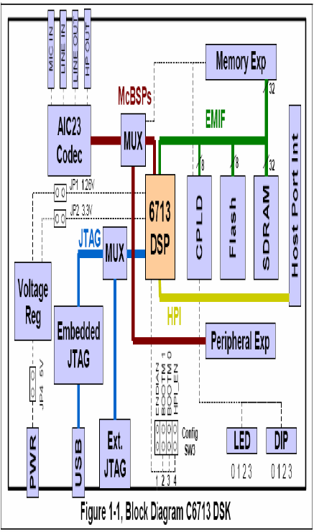
Functional Diagram

Slide 14
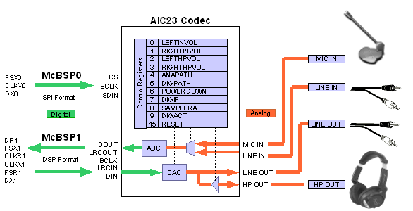
AIC 23 Codec
The codec samples analog signals on the microphone or line inputs and converts them into digital data that can be processed by the DSP.
When the DSP is finished with the data it uses the codec to convert the samples back into analog signals on the line and headphone outputs so the user can hear the output.

Slide 15
CPLD
The C6713 DSK uses an Altera EPM3128TC100-10 Complex Programmable Logic Device (CPLD) device to implement:
4 Memory-mapped control/status registers that allow software control of various board features.
Control of the daughter card interface and signals.
Assorted "glue" logic that ties the board components together.

Slide 16
Memory on DSK
The DSK uses a 64 megabit Synchronous DRAM (SDRAM) on the 32-bit EMIF. Total available memory is 16 megabytes.
The DSK uses a 512Kbyte external Flash as a boot option.

Slide 17
Onboard LEDs
The DSK has eight LEDs made up of four status indicators and four user defined LEDs.
The status indicators monitor the following functions.
The PWR LED is hardwired on the +5V supply and will illuminate whenever the power is connected.
The RESET LED illuminates when the a RESET event occurs.
The USB_IN_USE LED is on when USB emulation is used and goes off when an external emulator is applied.
The USB BUSY LED indicates that the a USB emulator transaction is in progress.

Slide 18
Onboard Switches
The four DIP switches allow simple feedback from the user.
The DIP switches can be read through the CPLD USER_REG register.
The 6713 DSK has 4 configuration switches that allows users to control the operational state of the DSP when it is released from reset.
Configuration switch 1 controls the endianness of the DSP
Switches 2 and 3 configure the boot mode that will be used when the DSP starts executing.
Switch 4 determines whether the HPI or McASP signals come out on shared pins.

Slide 19
CODE COMPOSER STUDIO
CCS provides an IDE to incorporate the software tools required to work with the DSK .
CCS includes tools for code generation, such as a C compiler, an assembler, and a linker.
The C compiler compiles a C source program with extension .c to produce an assembly source file with extension.asm.
The assembler assembles .asm source file to produce a machine language object file with extension .obj.
The linker combines object files and object libraries as input to produce an executable file with extension .out.
This executable file can be loaded and run directly on the C6713 processor.

Slide 20
References
Website -> DSP Tutorial -> http://www.bores.com/courses/intro/chips/index.htm
Rulph Chassaing –> “Digital Signal Processing and Applications with c6713”
Data sheets provided by TI

