Slide 1
MOTIVATION
Real time termperature monitoring with automatic control on LabVIEW
Design of control system immune to spur signals

Slide 2
APPROACH
We are measuring temperature of environment using first order sensors “3 LM-35s and 3 thermistors” in LABVIEW. It gives temperature of environment in real time. Furthermore, we also developed four threshold of temperature i.e. normal, alarm, threat and shutdown using fuzzy logic, which will help to automate systems (control based on temperature).

Slide 3
REDUNDANCY & DIVERSITY
Redundancy:
Inclusion of extra components which are not strictly necessary but prevent the failure of entire system if one component goes wrong.
Diversity:
Use of different technologies to avoid the possibility of error in case of some issues with one technology.

Slide 4
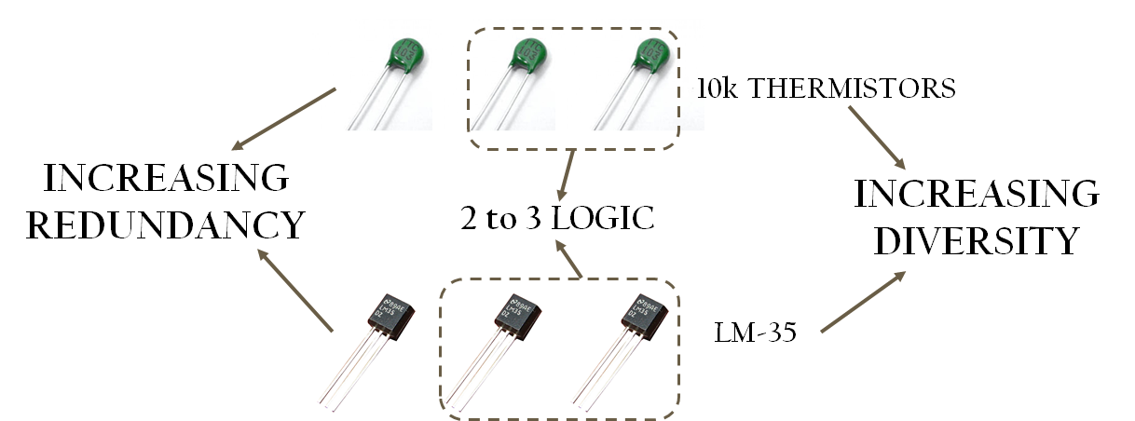
REDUNDANCY & DIVERSITY

Slide 5
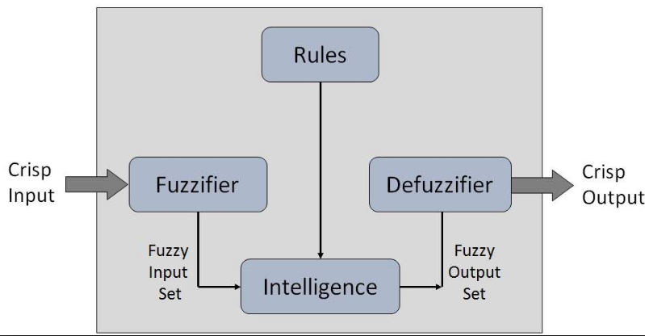
FUZZY LOGIC
The idea of fuzzy logic was first advanced by Dr. Lotfi Zadeh of the University of California at Berkeley in the 1960s
In classic term, Fuzzy logic can define as opposite concept of the Boolean logic
Fuzzy Control System

Slide 6
SYSTEM ARCHITECTURE DIAGRAM
Readings from different sensors
INDICATION
DAQ Card
LabVIEW IDE

Slide 7
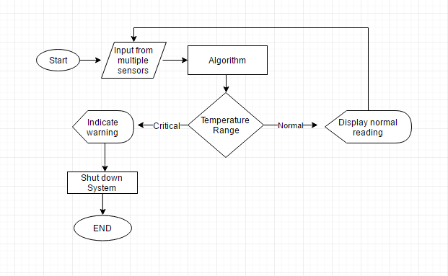
SYSTEM ARCHITECTURE DIAGRAM
Cont….

Slide 8
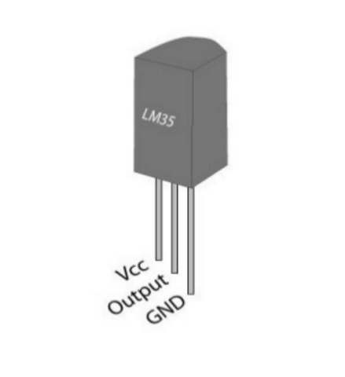
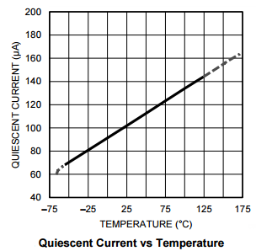
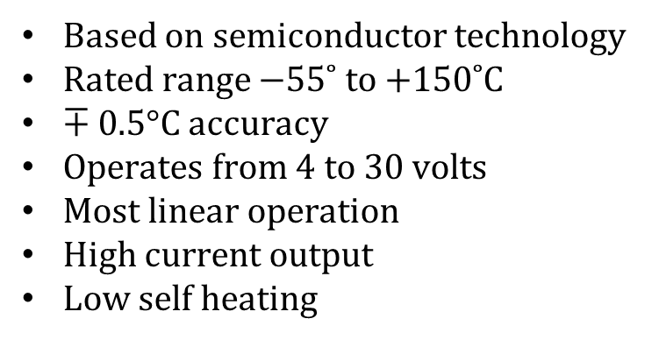
LM-35 TEMPERATURE SENSOR
Based on semiconductor technology
Rated range −55˚ to +150˚C
$∓$0.5°C accuracy
Operates from 4 to 30 volts
Most linear operation
High current output
Low self heating

Slide 9
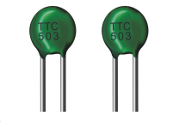
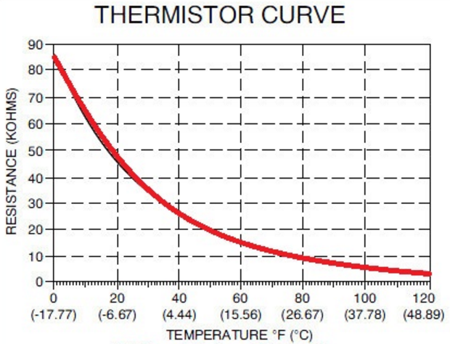
TTC-502 THERMISTOR
Negative temperature coefficient (NTC)
Non linear behavior
Rated range −30˚ to +125˚C
Fast response to temperature change
Self heating
Require a power source

Slide 10
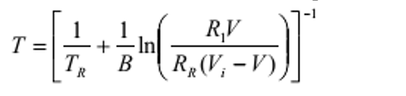
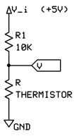
THERMISTOR EQUATION
Where,
T_{R} is the reference temperature.
R_{R} reference resistor at T_{R}
V_{i} is the input voltage
R₁ is the resistor in series

Slide 11
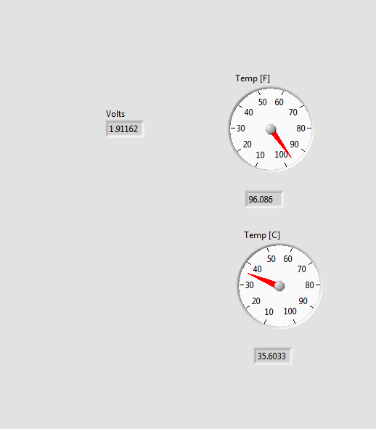
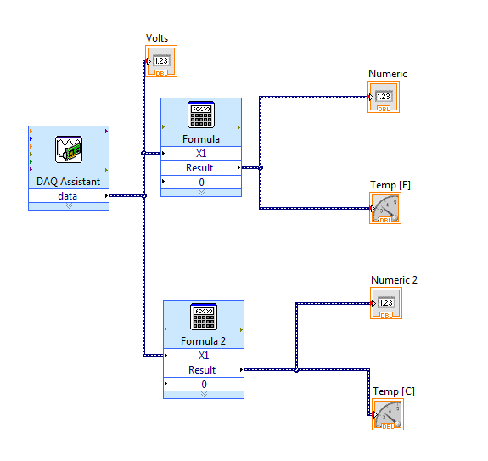
LabVIEW (SAMPLE)
Front Panel
Block Diagram

Slide 12
CONCLUSION
By implementing this logic we were able to obtain more accurate results compared to the standard technique
Real time monitoring of temperature with indication
Able to detect temperature overshoots above a threshold level
Same architecture can be employed on industrial scale using RTD’s and thermocouples

