Slide 1



RAS
LEISURE CLUB MANAGEMENT SYSTEM

Slide 2

CONTENT
01
USE CASE DIAGRAM
02
FUNCTIONAL & NON-FUNCTIONAL REQUIREMENTS
03
DOMAIN MODEL
04
CLASS DIAGRAM
05
SEQUENCE DIAGRAM
06
COMPONENT DIAGRAM
07
DEPLOYMENT DIAGRAM
08
DESIGN PATTERN
09
SAMPLE UI IMAGES

Slide 3

INTRODUCTION
Purpose: Streamline membership management, facility booking, and staff coordination in a leisure club environment.
Simplifies scheduling, resource allocation, and data management to improve operational efficiency and enhance user experience.

Slide 4
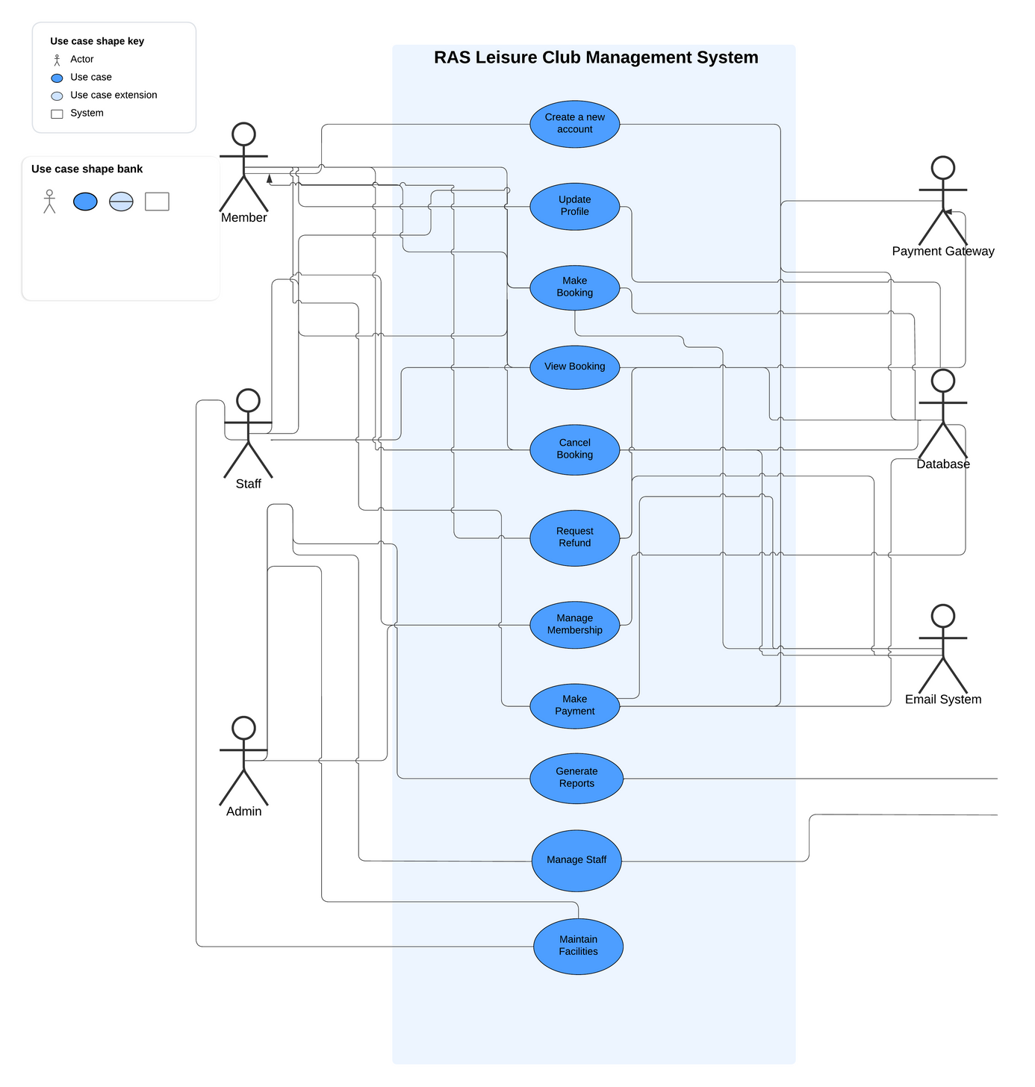
USE CASE
DIAGRAM

Slide 5





NON-FUNCTI0NAL REQUIREMENTS
Handle simultaneous logins and bookings without lag.
Respond to user actions within 2 seconds.
Only active members can book facilities.
Staff can override bookings in special cases.
Administrators have full access to system features.
Regular backups to prevent data loss.
Fail-safe mechanisms for database transactions.
PERFORMANCE
BUSINESS RULES
SAFETY

Slide 6
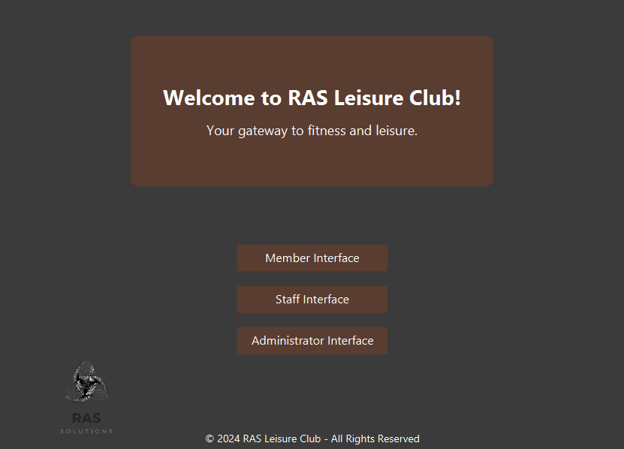
UI
IMAGES

Slide 7
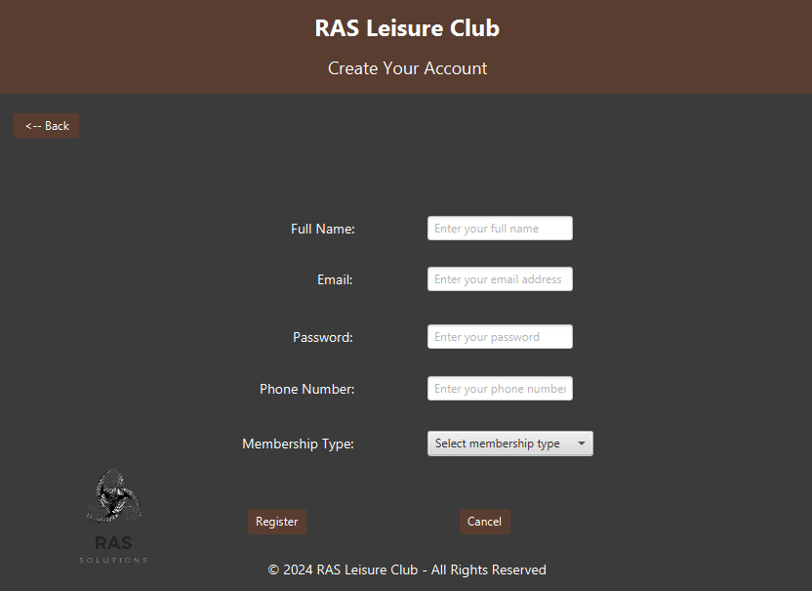
UI
IMAGES

Slide 8
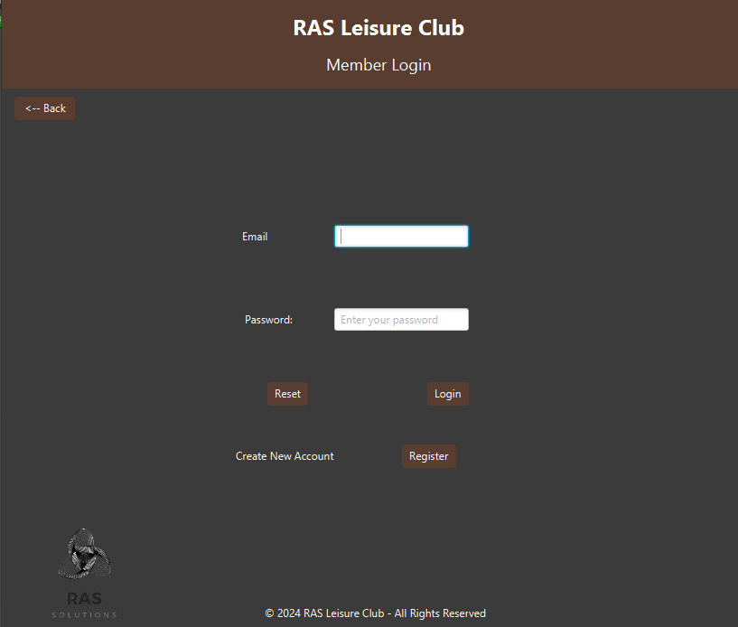
UI
IMAGES

Slide 9
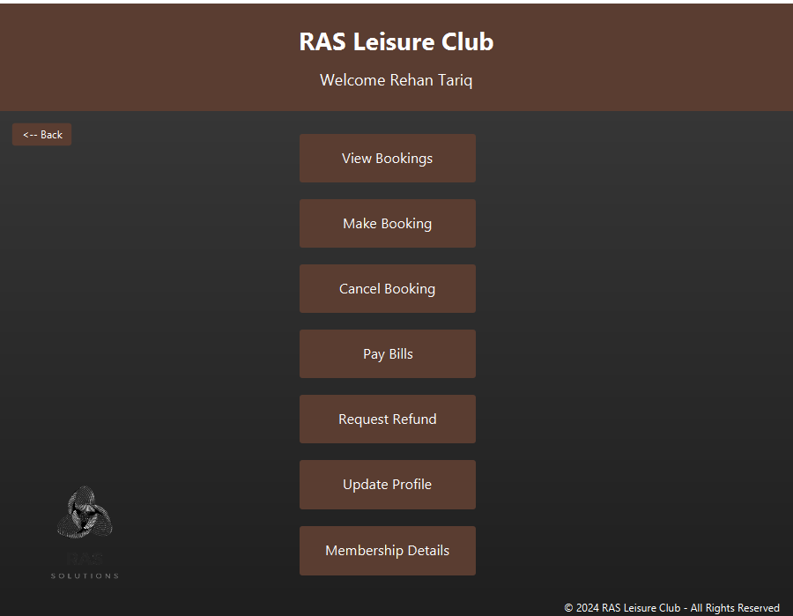
UI
IMAGES

Slide 10
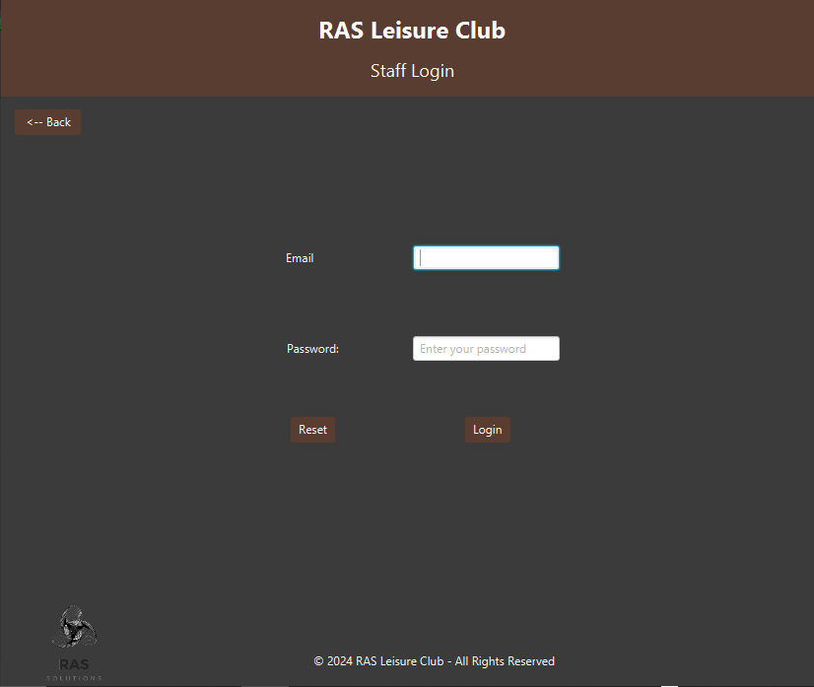
UI
IMAGES

Slide 11
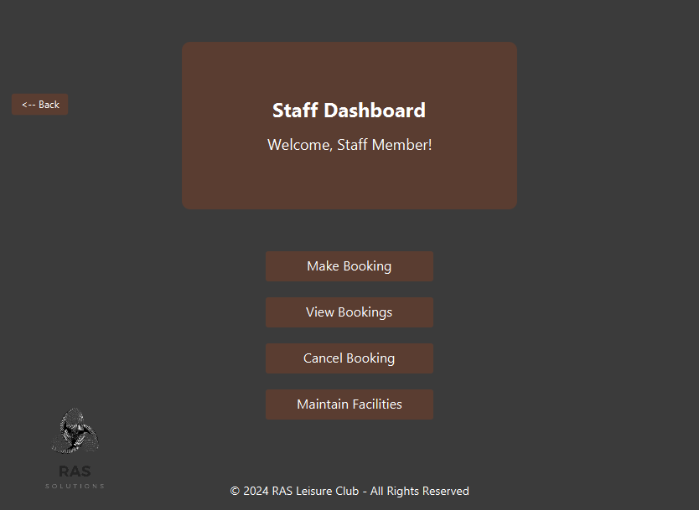
UI
IMAGES

Slide 12
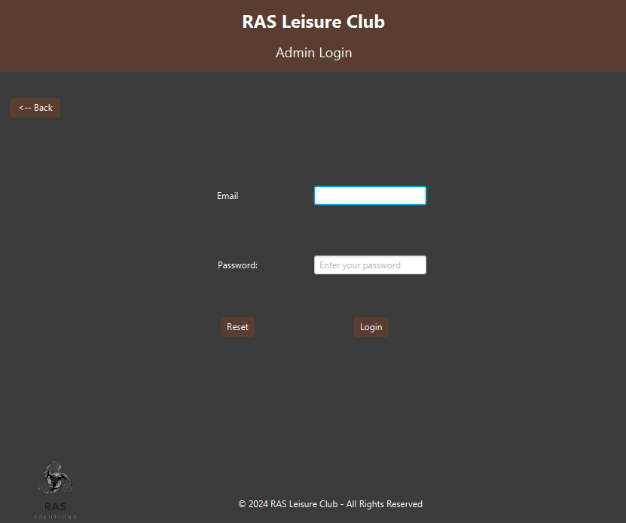
UI
IMAGES

Slide 13
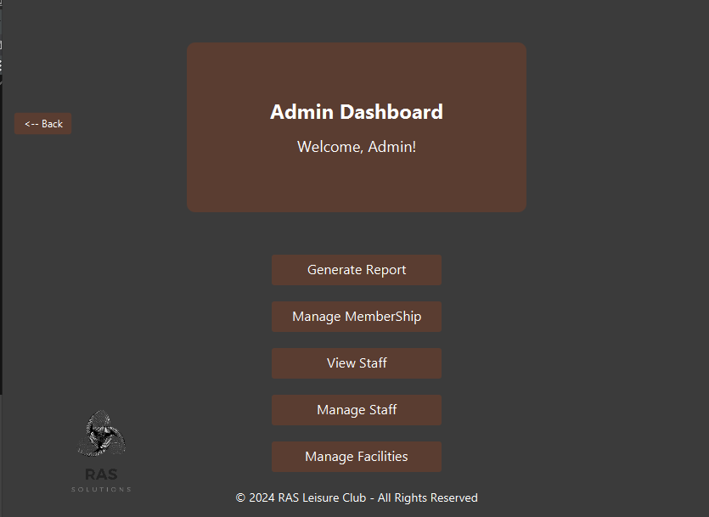
UI
IMAGES

Slide 14
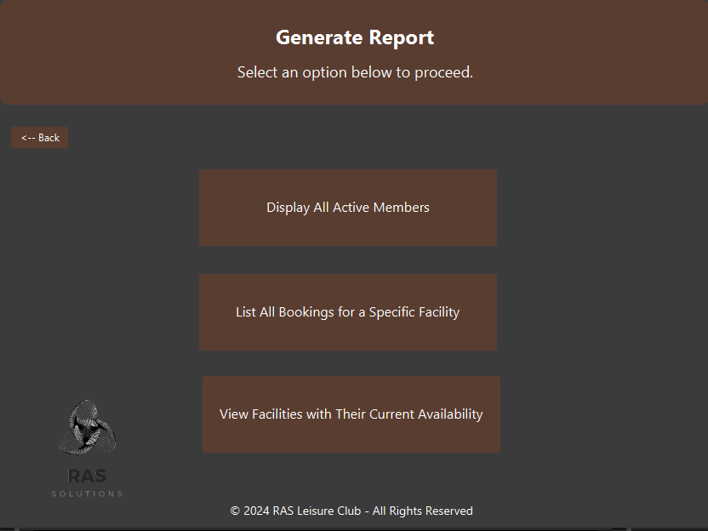
UI
IMAGES

Slide 15
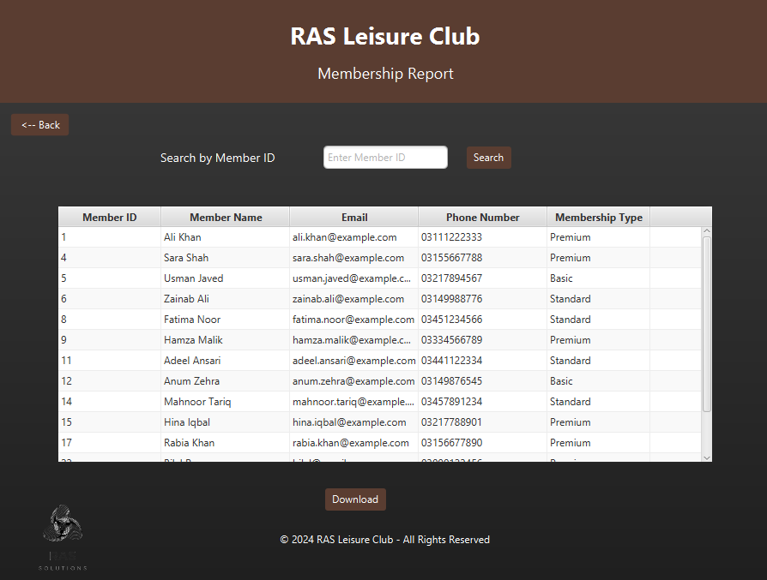
UI
IMAGES

Slide 16
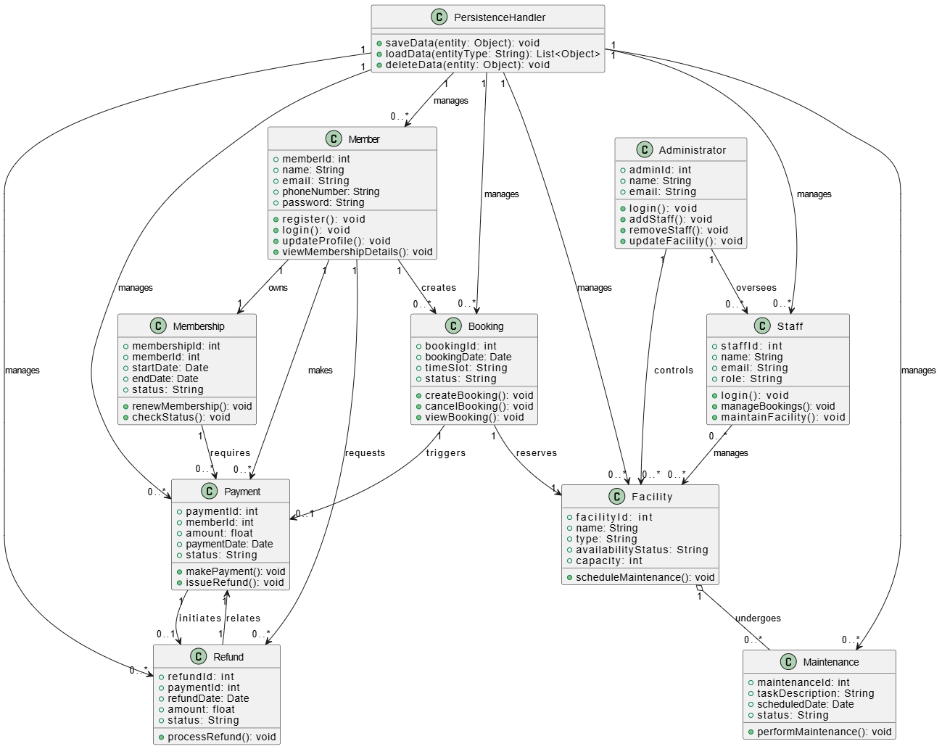
DOMAIN
MODEL

Slide 17
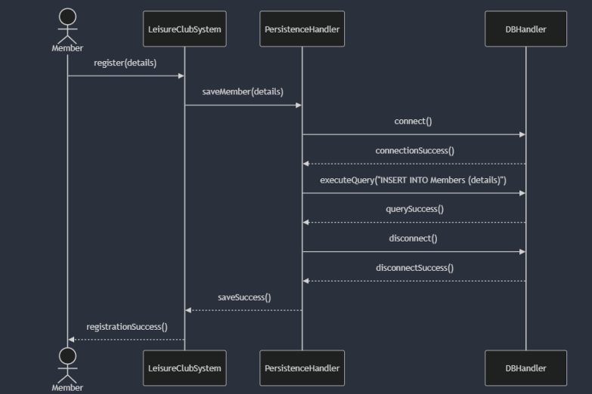
SEQUENCE DIAGRAM
REGISTER
ACCOUNT

Slide 18
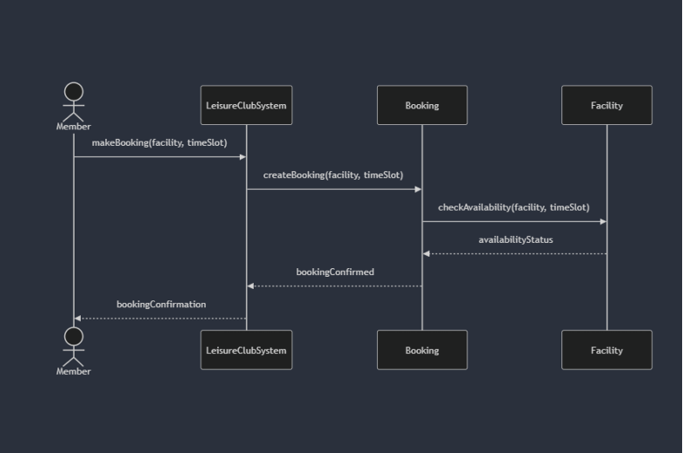
SEQUENCE DIAGRAM
MAKE
BOOKING

Slide 19
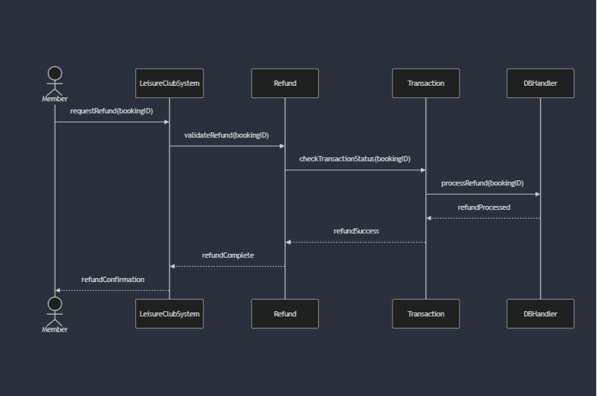
SEQUENCE DIAGRAM
REQUEST
REFUND

Slide 20
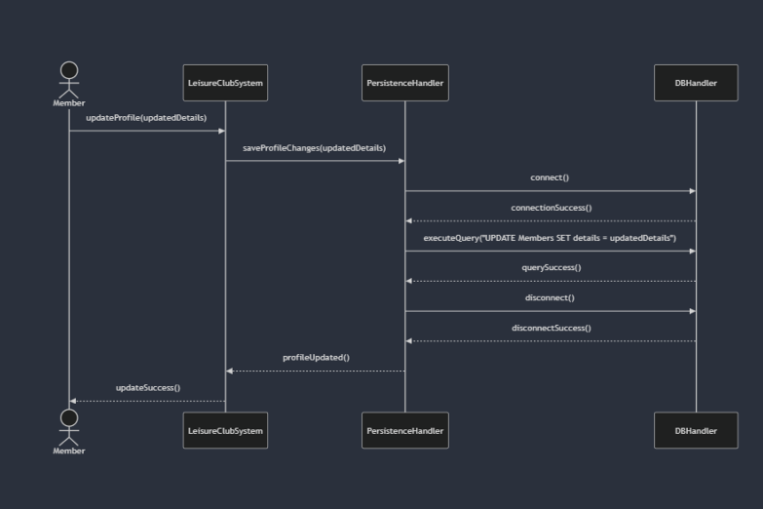
SEQUENCE DIAGRAM
UPDATE
PROFILE

Slide 21
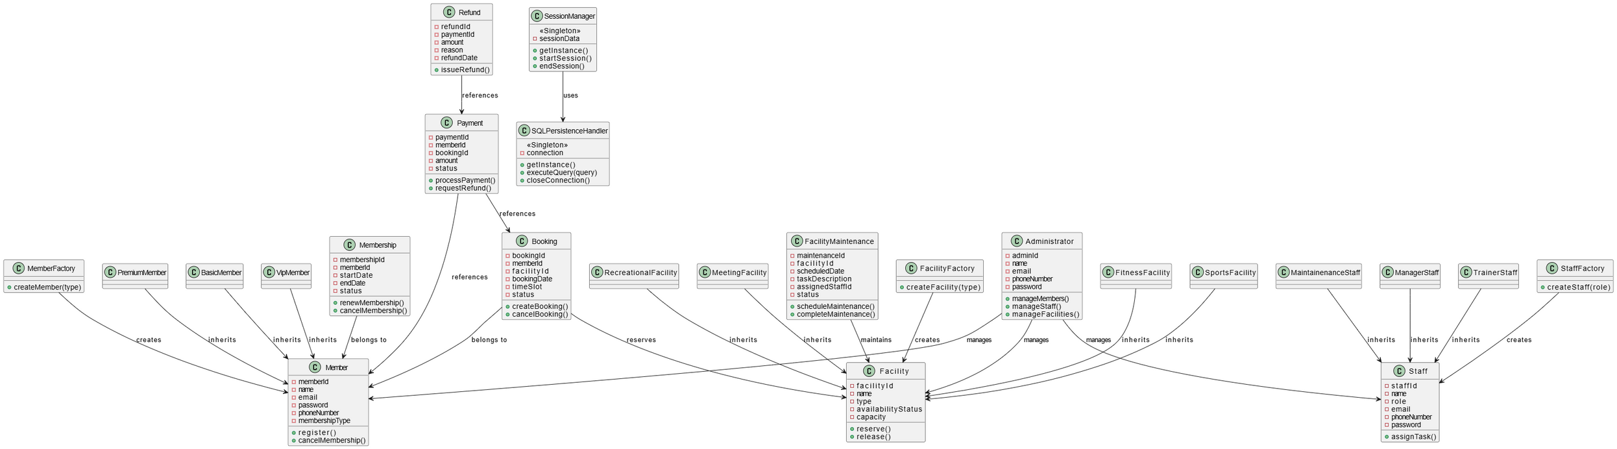
CLASS DIAGRAM

Slide 22
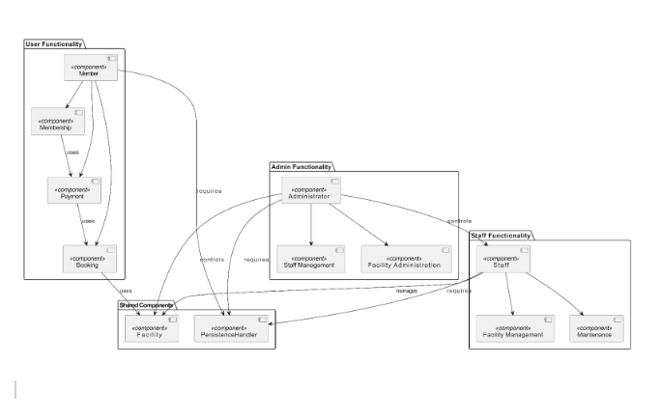
COMPONENT
DIAGRAM

Slide 23
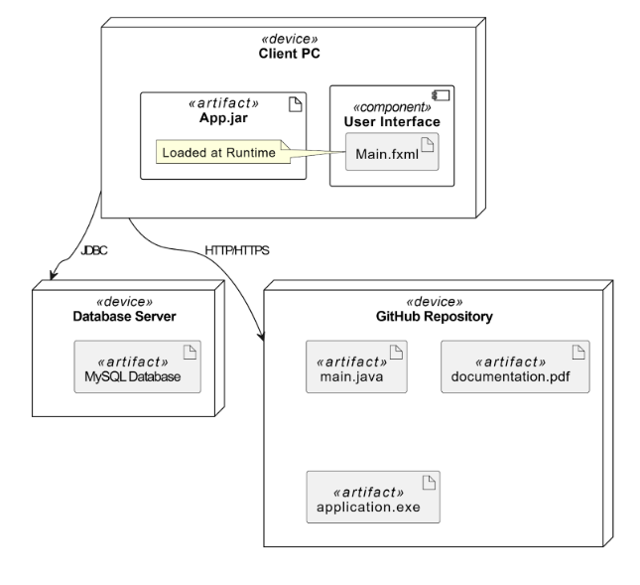
DEPLOYMENT
DIAGRAM

Slide 24
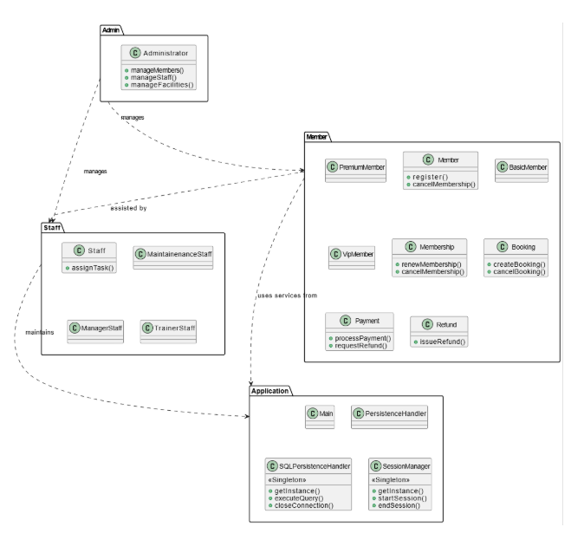
PACKAGE
DIAGRAM

Slide 25
DESIGN PATTERNS
GOF PATTERNS
SINGLETON(SQL HANDLER,SESSION MANAGER)
FACTORY(MEMBER, STAFF, FACILITY)

Slide 26
OUR TEAM
M Saad Mursaleen
Arshman khawar
Rehan Tariq
Team Member
Scrum Master
Team Member

Slide 27

THANKS FOR LISTENING

