Slide 1
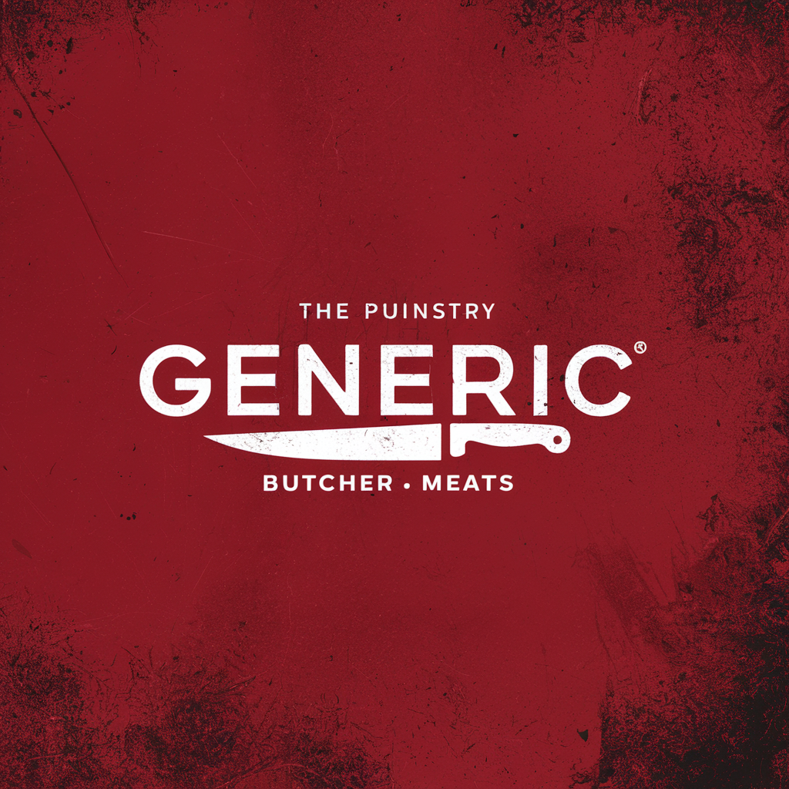

QUALITY : TOOLS FOR SUCCESS
July 2024

Slide 2
Quality : TooLs for success
Generic Butcher – An Introduction
Project Overview
Product Demo – the GBC Solution
Considerations and Future Features
Questions
Notes:
Who are we? GBC- quality control team
Who is our audience? GBC quality control manager, and the board.
What do we want? We want permission and capital to move foreward with managing new database and serving a dashboard website for the team.
Pitch method? STAR- situation, task, action, result
Powerpoint
Caite – Introduction to GBC and the problem
- Situation + problem
-Show what our raw data looks like in CSV, and how many hours might be spent reinventing this report in Excel every month ad-hoc.
Saad – Project Overview - discuss how the project is managed, and the workflow from ingestion through deployment.
- Converting CSV to database was the right solution- sell that AWS, to management!!
-fairly inexpensive for monthly reporting
- one of the industry standards
- data is not lost on a local machine
- importantly, data is not served to customer “raw”
- We kept security in mind- csvs are insecure. This app allows us to keep data password protected. API flask end points keep the database secure from bad actors.
- We ingested, cleaned, transformed, and served the data using various Python, Javascript, CSS, HTML, AWS tools.
Kevin – Introduction to our solution–
- As an ops guy, its important to see my action items first. I made sure that this was our number one focus.
- The data cleaning process kept that in mind.
- As we analyzed data this month, we discovered some products that had outliers skewing data:
- TEST BLOCKS were coming across as products, they aren’t so we dropped them.
-HEIGHT - no steak is < .05 inches that has to be water on the line, so we dropped these outliers.
-WEIGHT - no steak is 800# that has to be human error
-Other metrics- our customer only provided metrics for weight and height, so we are only going to review those metrics in depth. Other metrics are also not necessary for most of the products.
- Keeping customer specification in mind, we first and foremost made an “actions” landing page based on data that had been cleaned up of the errors we found.
- Allows for the QC manager to have and attack plan immediately, before this information gets passed to external stakeholders.
- Allows me to make an action list not only on the product, but on who might have been working during those runs and if there is maintenance on the machine needed, better process checks etc.
- Segue- Josh took that to heart and will discuss the “actions page”
Josh – Actions Page – discuss the features in Actions
- We designed our landing page so that if there are products out of spec, this page populates this way– highlighting the out of spec products in bright red.
- If nothing is out of spec, we show that. I know immediately which products I should review and address.
Segue- If I want to get an overall view- I can just tab over to the Overview page. Abigail can speak to the features in our overview page.
Abigail – Overview Page – discuss the features in Overview
- We have two major metrics to review. It’s annoying to scroll back and forth so we can toggle between reports.
- Following our goal to know exactly what our punch-products are, non-compliant products are found and listed at the top of each table.
- These tables show us everything we need to know. For example – 20 oz steaks are very non-compliant. We can see that this could be because there aren’t as many 20-oz steaks in the run so every single steak materially changes the data. They have a lower overall count, and it could be because the spec is unrealistic for such a big steak. Either way, we have all the information we need to start making an action list to address.
Segue- There are still some items that are hard to see in these tables. That is why we also created a products page. I’ll turn that over to Kevin.
Kevin – Products Page – Introduce Histograms
- Going to give a quick refresher on histograms –
- they show our “bell curve” that should be centered around the average, and that average should be close to the product spec
- We wanted the x-axis to step by a 10th of an inch and a quarter oz so that we could easily understand the data.
- each of these columns represents the count of the steaks in that month that fell within say 11 and 11.25 ounces. Hovering over the bar gives the exact count.
- a quality production line will have few outliers, and a narrow curve.
- give an example of a curve we might want to look at even though it’s in compliance
- Just another reminder that we need to hit that 95% compliance goal. So we drew out our goal posts to really easily see how far out of spec our outliers ended up.
- We also want to clearly understand our mean value.
- For example this product is 12 oz and our mean is X, are we under or overdelivering to the customer on average?
- We can’t re-educate stakeholders every month. Everything needs to be a simple read so we’re serving simple, gridded data by product.
- Just so we can present data quickly, we also created a feature on this page that calls out non-compliant products in the value tables to the right.
Segue – As we ask for the opportunity to move forward with this project, we were not without some challenges that Abigail can speak to.
Abigail- Challenges
- Testing across all browsers was necessary in order to ensure consistent view. For example, Kevin’s browser in dark-mode was serving a completely different plotly graph than ours.
- We found errors in data at the 11th hour- like 13 oz tail-on steak (show that view), but that is what this tool is designed to do– to open us us to questions and for those questions to give way to improving processes.
- Now that we have the overall structure working, we have a huge opportunity to add features and functionality.
- Team planning was another challenge. It was hard to work all on the git main. We had a moment of panic after hours of work “disappeared” from off-time pulls and pushes.
- Any other shout outs or challenges
Segue- Speaking of the team, as our youngest team member, its only fair that Josh is brought in to talk about the future---
Josh – Considerations and future features
- First and foremost, is this not the best logo on the planet?
- We set this up so that if there are future requests from stakeholders, we could customize the dashboard.
- This report is currently designed for INTERNAL stakeholders only – why , because we definitely don’t want to serve customers an actions page.
- could show a root cause analysis
or
- do much deeper dive into more historical data to see if we should create even more functions to “cleanup” human or machine errors.
- More complex errors (example 13oz tail-on) would be addressed for customer deployment
- We also want to be able to slice out data by date and time in order to drill even further down
- WARNING-- The more data is manipulated from raw to align with customer spec, the more management would need to be drawn in to address
- there is a fine ethical line here- we can easily delete “test blocks,” but the more we manipulate the less “real” the data becomes.
- Segue – we are excited to move forward with implementation. We welcome your thoughts.
-I’m going to turn this over to the class and TED. Does anyone have any questions?
QUESTIONS TIME

Slide 3

Generic Butcher – An Introduction
GBC cuts meat to the customer’s specifications.
The finished steaks are sent through a production line camera and scale to provide metric data to the quality control team.
The machine provides regular data in CSV format to the team who review it monthly.
The quality control team needs to be able to quickly see what products are at risk of non-compliance so they can quickly address them before they serve data to the customer.
The quality control team is challenged, because their current tools:
Only pull directly from raw data
Take a lot of time to determine the real want- “what is and is not compliant and why”
Don’t have robust or custom histogram items– list of “wants” like x-steps, and v-lines.
Can’t easily be served to stakeholders.
Errors are simply “deleted” instead logic allowing to store them and review, so there can’t be any campaigns to improve machine and human processes in data-capture.
Notes:
Caite
Who are we? GBC- quality control team
Who is our audience? GBC quality control manager, and the board.
What do we want? We want permission and capital to move foreward with managing new database and serving a dashboard website for the team.
Pitch method? STAR- situation, task, action, result
Powerpoint or Presentation Page (still working)
Caite – Introduction to GBC and the problem
- Situation + problem
-Show what our raw data looks like in CSV, and how many hours might be spent reinventing this report in Excel every month ad-hoc.

Slide 4


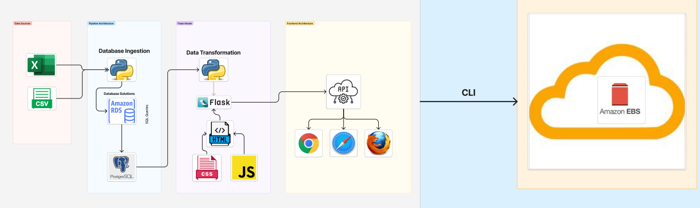
Project OVERVIEW
Notes:
Saad – Project Overview - discuss how the project is managed, and the workflow from ingestion through deployment.
- Converting CSV to database was the right solution- sell that AWS, to management!!
-fairly inexpensive for monthly reporting
- one of the industry standards
- data is not lost on a local machine
- importantly, data is not served to customer “raw”
- We kept security in mind- csvs are insecure. This app allows us to keep data password protected. API flask end points keep the database secure from bad actors.
- We ingested, cleaned, transformed, and served the data using various Python, Javascript, CSS, HTML, AWS tools.

Slide 5
Product Demo – the GBC Solution
Actions Page
Overview Page
Products Page
Challenges
Notes:
Kevin – Introduction to our solution–
- As an ops guy, its important to see my action items first. I made sure that this was our number one focus.
- The data cleaning process kept that in mind.
- As we analyzed data this month, we discovered some products that had outliers skewing data:
- TEST BLOCKS were coming across as products, they aren’t so we dropped them.
-HEIGHT - no steak is < .05 inches that has to be water on the line, so we dropped these outliers.
-WEIGHT - no steak is 800# that has to be human error
-Other metrics- our customer only provided metrics for weight and height, so we are only going to review those metrics in depth. Other metrics are also not necessary for most of the products.
- Keeping customer specification in mind, we first and foremost made an “actions” landing page based on data that had been cleaned up of the errors we found.
- Allows for the QC manager to have and attack plan immediately, before this information gets passed to external stakeholders.
- Allows me to make an action list not only on the product, but on who might have been working during those runs and if there is maintenance on the machine needed, better process checks etc.
- Segue- Josh took that to heart and will discuss the “actions page”
Josh – Actions Page – discuss the features in Actions
- We designed our landing page so that if there are products out of spec, this page populates this way– highlighting the out of spec products in bright red.
- If nothing is out of spec, we show that. I know immediately which products I should review and address.
Segue- If I want to get an overall view- I can just tab over to the Overview page. Abigail can speak to the features in our overview page.
Products Page – Introduce Histograms
Abigail – Overview Page – discuss the features in Overview
- We have two major metrics to review. It’s annoying to scroll back and forth so we can toggle between reports.
- Following our goal to know exactly what our punch-products are, non-compliant products are found and listed at the top of each table.
- These tables show us everything we need to know. For example – 20 oz steaks are very non-compliant. We can see that this could be because there aren’t as many 20-oz steaks in the run so every single steak materially changes the data. They have a lower overall count, and it could be because the spec is unrealistic for such a big steak. Either way, we have all the information we need to start making an action list to address.
Segue- There are still some items that are hard to see in these tables. That is why we also created a products page. I’ll turn that over to Kevin.
Kevin – - Going to give a quick refresher on histograms –
- they show our “bell curve” that should be centered around the average, and that average should be close to the product spec
- We wanted the x-axis to step by a 10th of an inch and a quarter oz so that we could easily understand the data.
- each of these columns represents the count of the steaks in that month that fell within say 11 and 11.25 ounces. Hovering over the bar gives the exact count.
- a quality production line will have few outliers, and a narrow curve.
- give an example of a curve we might want to look at even though it’s in compliance
- Just another reminder that we need to hit that 95% compliance goal. So we drew out our goal posts to really easily see how far out of spec our outliers ended up.
- We also want to clearly understand our mean value.
- For example this product is 12 oz and our mean is X, are we under or overdelivering to the customer on average?
- We can’t re-educate stakeholders every month. Everything needs to be a simple read so we’re serving simple, gridded data by product.
- Just so we can present data quickly, we also created a feature on this page that calls out non-compliant products in the value tables to the right.
Segue – As we ask for the opportunity to move forward with this project, we were not without some challenges that Abigail can speak to.

Slide 6
Considerations and Future Features
Functions wrapped and dynamic– allows for customization if there are other requests from stakeholders
Currently designed for INTERNAL stakeholders only
More complex errors (example 13oz tail-on) would be addressed for customer deployment
The more data is manipulated from raw to align with customer spec, the more management would need to be drawn in to address
Notes:
Abigail- Challenges
- Testing across all browsers was necessary in order to ensure consistent view. For example, Kevin’s browser in dark-mode was serving a completely different plotly graph than ours.
- We found errors in data at the 11th hour- like 13 oz tail-on steak (show that view), but that is what this tool is designed to do– to open us us to questions and for those questions to give way to improving processes.
- Now that we have the overall structure working, we have a huge opportunity to add features and functionality.
- Team planning was another challenge. It was hard to work all on the git main. We had a moment of panic after hours of work “disappeared” from off-time pulls and pushes.
- Any other shout outs or challenges
Segue- Speaking of the team, as our youngest team member, its only fair that Josh is brought in to talk about the future---
Josh – Considerations and future features
- First and foremost, is this not the best logo on the planet?
- We set this up so that if there are future requests from stakeholders, we could customize the dashboard.
- This report is currently designed for INTERNAL stakeholders only – why , because we definitely don’t want to serve customers an actions page.
- could show a root cause analysis
or
- do much deeper dive into more historical data to see if we should create even more functions to “cleanup” human or machine errors.
- More complex errors (example 13oz tail-on) would be addressed for customer deployment
- We also want to be able to slice out data by date and time in order to drill even further down
- WARNING-- The more data is manipulated from raw to align with customer spec, the more management would need to be drawn in to address
- there is a fine ethical line here- we can easily delete “test blocks,” but the more we manipulate the less “real” the data becomes.
- Segue – we are excited to move forward with implementation. We welcome your thoughts.
-I’m going to turn this over to the class and TED. Does anyone have any questions?

Slide 7
Questions
Notes:
QUESTION TIME

