Slide 1
Sales Report
Generated on January 09, 2026
Data Analytics Team | January 09, 2026

Slide 2
Data Summary
• Total Records: 12
• Columns Analyzed: 6
Revenue
• revenue Total: 811,000
• revenue Average: 67,583.33
• revenue Max: 95,000
Expenses
• expenses Total: 499,000
• expenses Average: 41,583.33
• expenses Max: 55,000
Profit
• profit Total: 312,000
• profit Average: 26,000.00
• profit Max: 40,000

Slide 3
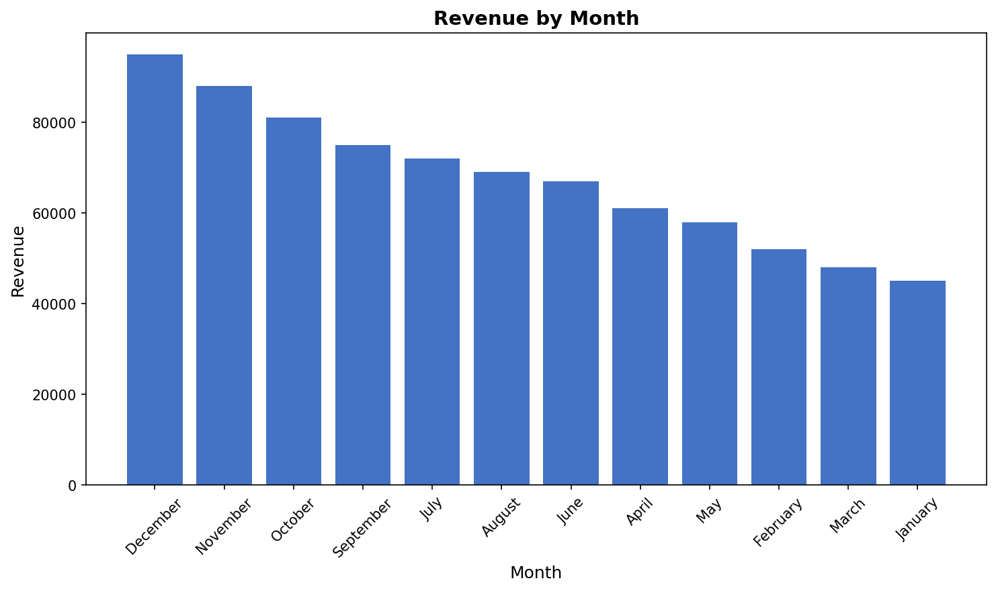
Revenue by Month
Top 12 month by revenue

Slide 4
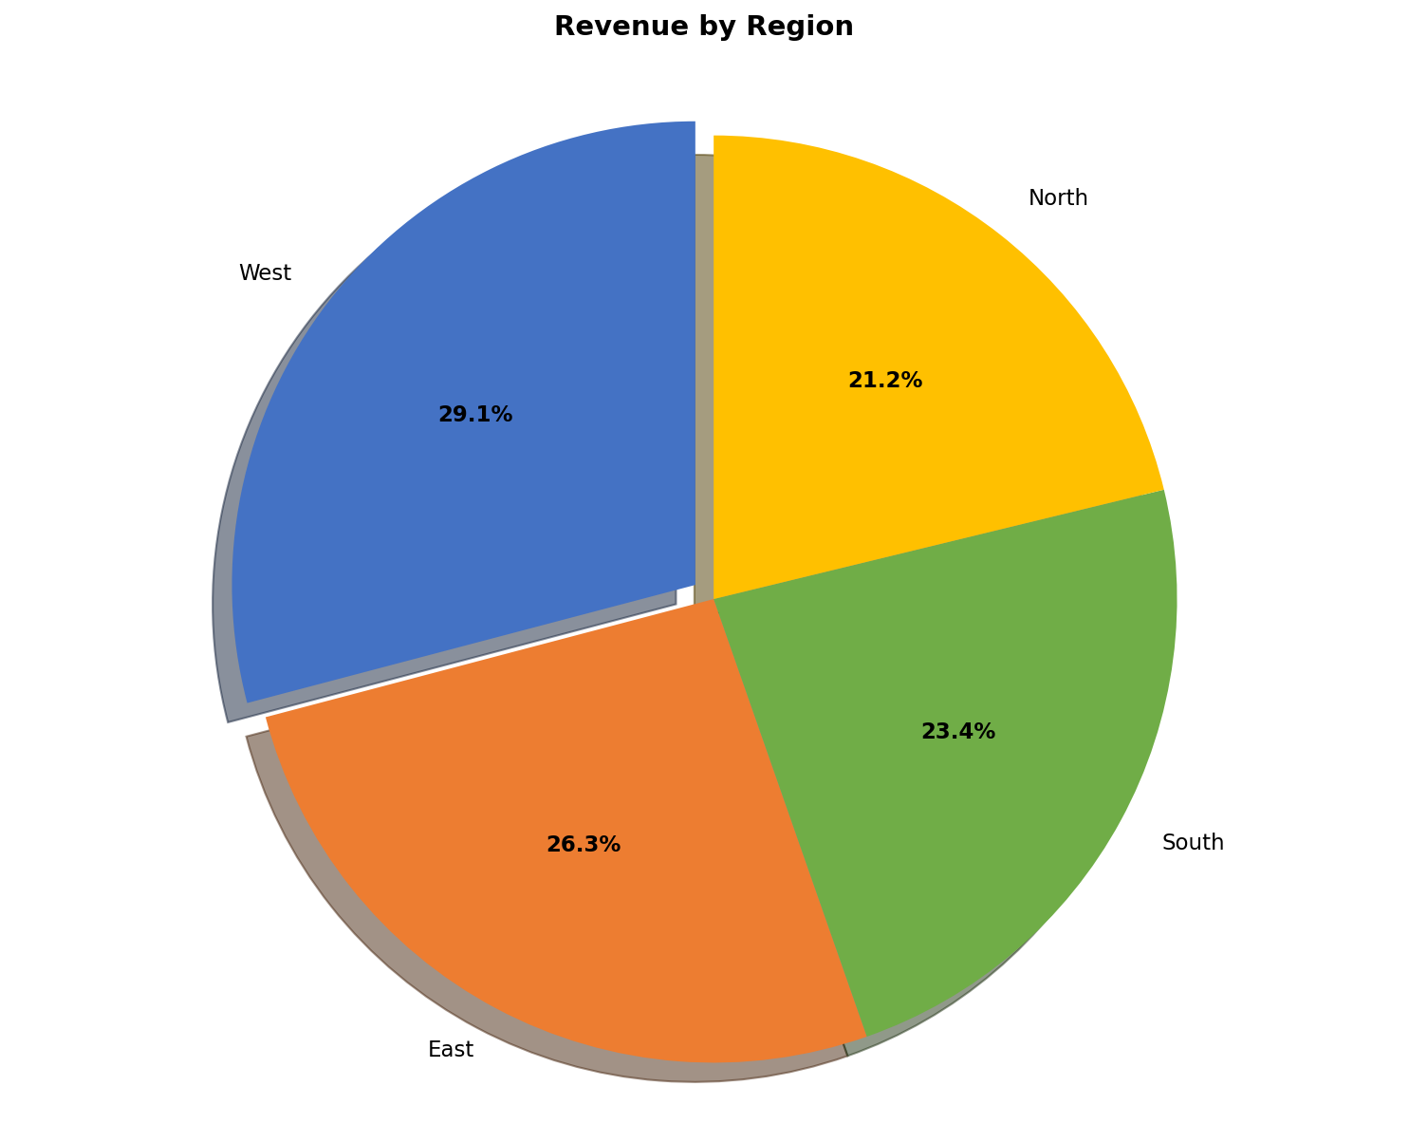
Revenue by Region
Distribution across region

Slide 5
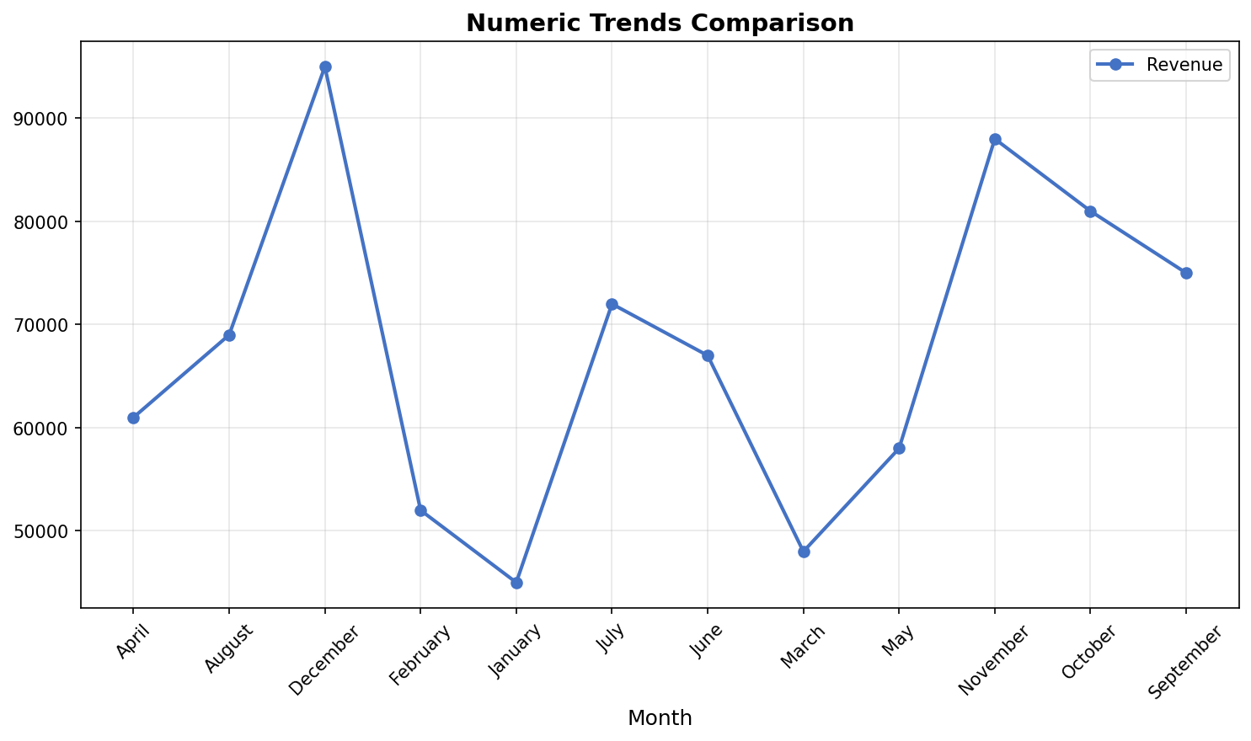
Numeric Trends Comparison
Trends across month

