Slide 1


Senior citizen help alert to nearest nurse
PHOENIX FLUX
Members :
Saad Khan
Ayan Shaikh
Sahil Pawade
Shreyash Tambe

Slide 2




Technical Approach
CareConnect’s frontend is built using React and Next.js for a dynamic, server-rendered UI. It integrates Leaflet.js and React-Leaflet to display interactive maps showing user and nurse locations, with real-time updates via WebSockets for smooth nurse availability and acceptance.
Geolocation API fetches and centers the map based on the user’s location, and predefined nurse locations appear once a nurse is accepted. Marker displays and a polyline visualize proximity between user and nurse, with distance calculated using the Haversine formula.
User inputs (name, number, city) are captured and sent via WebSocket to the backend for real-time processing. Dynamic imports ensure only necessary components are loaded, while Server-Side Rendering (SSR) in Next.js improves performance and SEO.
Error handling and form validation manage geolocation errors and ensure correct inputs. State is managed via React’s useState hook, which updates the map dynamically upon nurse acceptance.
The stack includes Next.js, React, Leaflet, TailwindCSS, and WebSocket for real-time communication, ensuring a seamless experience for users and nurses.

Slide 3
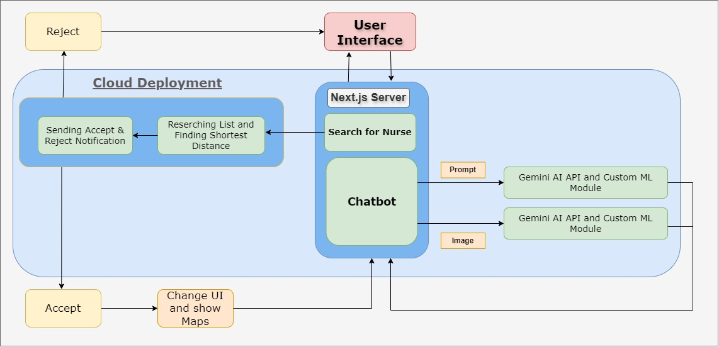
Flowchart

Slide 4
Feasibility of the Project:
Technical Feasibility: - Utilizes well-established technologies (React, Leaflet, OpenRouteService). - Integration is straight forward and can handle real-time tracking. - Scalable for additional regions and nurse assignments. - Can be developed within the 48-hour hackathon timeframe for a Minimum Viable Product (MVP).
Resource Feasibility: - Most tools are free and open-source. - Developers with JavaScript and React expertise can efficiently manage the project. - Compliance with data privacy laws (GDPR, HIPAA) is manageable with proper security measures.
Legal Feasibility: - Ensures patient data is secured and complies with health regulations.
Viability of the Project:
Market Need: - Addresses the growing demand for in-home nursing care, particularly for an aging population. - Enhances cost-effectiveness and patient care efficiency.
Competitive Advantage: - Provides real-time geo-location and routing for quicker nurse dispatching. - Continuous notifications minimize delays in emergency responses.
Financial Viability: - Potential revenue through partnerships with nursing agencies or a SaaS model. - Low development costs due to the use of free technologies.
Sustainability: - Easy expansion into new regions by onboarding more nurses and patients. - Opportunities for additional features like telemedicine can increase service value.

Slide 5
Thank You

