Slide 1
AgriGuardian: AI Crop Disease Detection & Treatment Advisor
Explanation of the Proposed Solution:
Problem Solving Approach :
AI-driven image analysis with scikit-learn and OpenCV enables early disease detection, reducing crop loss.
Environmental data integration allows proactive outbreak predictions, enhancing accuracy.
The system uses AI-based image analysis with CNNs (VGG- 16, Inception V-3, ResNet-50) to detect crop diseases from images captured by farmers.
Preprocessing (noise reduction, color normalization,
segmentation) with OpenCV and Computer Vision optimizes Real-time data drives customized treatment plans,
images for analysis.
Neural networks classify diseases and estimate severity, integrating environmental data from IoT devices and Open- Meteo Weather APIs.
Linear Regression models predict disease outbreaks by analyzing temperature, humidity, and other factors.
Upon detection, the system provides tailored treatment recommendations based on disease severity, crop type, and
with predictive alerts that distinguish it from traditional systems.
Unique Value Proposition :
Offers tailored treatments, preventive measures, and support through Professional Helpline and Community Support via Websockets and Stream API.
local conditions, and suggests nearby Agro-shops via Google  Cross-Platform Mobile and Web-Apps provide
Maps API.
The solution is accessible via mobile and web applications with multilingual support in 15 native languages, using generative text powered by OpenAI API, Ollama, Llama3.1, and Gemini.
easy access with a user-friendly interface, multilingual support, and offline functionality using Tensorflow lite model.

Slide 2
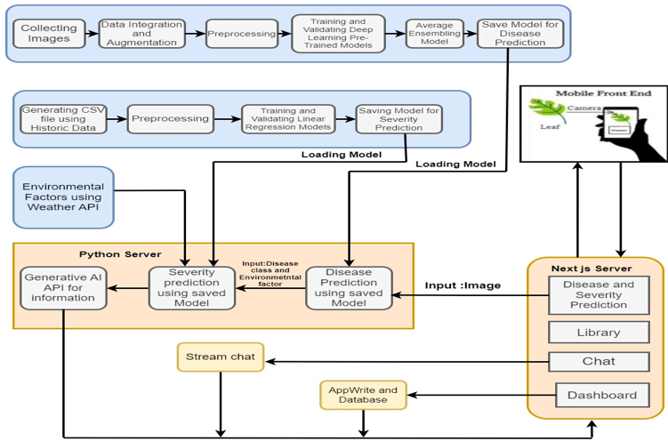






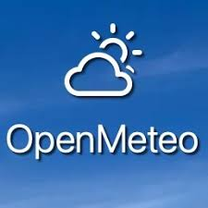

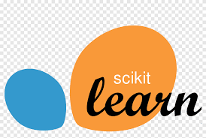



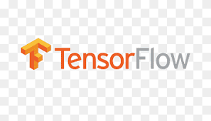


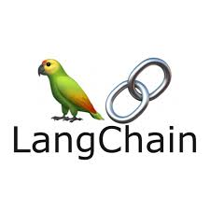
TECHNICAL APPROACH
Tech Stack:
Flowchart:
Frontend:
Backend:
ML Model Training:
Gen AI and Automation:

Slide 3
FEASIBILITY AND VIABILITY
Feasibility of Idea:
AI models like VGG-16, Inception V-3, and ResNet-50, along with OpenCV, enable accurate crop disease identification. Integration with IoT devices and weather APIs for environmental data is feasible with current infrastructure.
The cross-platform design ensures easy adoption by farmers, with multilingual support and offline functionality enhancing usability in diverse regions.
While investment is needed for AI training, app development, and IoT infrastructure, the system's potential to reduce crop loss and improve management efficiency makes it economically beneficial for farmers.
Challenges:
Poor or insufficient images
Lack of GPU and infrastructure
Training time
Inconsistency in environmental data
Countermeasures:
Partnership with agricultural organizations for
high-quality datasets
Use cloud-based infrastructure and microservices architecture
data augmentation to improve model accuracy
Provide training, helplines, and community support
Employ standardized APIs and protocols for seamless integration

Slide 4
IMPACT AND BENEFITS
Impact on Target Audience :
Impact on Farmers:
Higher crop yields through early disease
Benefits of the Solution:
Economic: Reduced crop loss and optimized resource use, leading to increased profitability. Precise recommendations help farmers use inputs like water, fertilizers, and pesticides more efficiently, reducing costs. Enhancing local businesses by recommendations.
Social: Improved food security and livelihood for farmers, especially in vulnerable regions. Access to advanced tools and data empowers farmers with knowledge, fostering greater self- sufficiency and community resilience. The system’s integration with helplines and community channels promotes collaboration and shared learning among farmers and retailers.
Environmental: Proactive disease management minimizes the need for harmful pesticides, promoting sustainable farming practices. The system’s predictive capabilities enable farmers to adapt to changing climate conditions, enhancing the resilience of crops to extreme weather events.
detection.
Reduced losses
and lower reliance on
chemical treatments.
Access to real-time and tailored
recommendations.
Technology that is easy to use, even in remote areas.
Strengthened agricultural practices and food security.
Impact on Retailers:
Recommending nearest shops and retailers.
Boosting Local Businesses

Slide 5
RESEARCH AND REFERENCES
Arsenovic, M., Karanovic, M., Sladojevic, S., Anderla, A., & Stefanovic, D. (2019). Solving Current Limitations of Deep Learning Based Approaches for Plant Disease Detection. Symmetry, 11(7), 939. doi: 10.3390/SYM11070939
Arnal Barbedo, J. G. (2019). Plant disease identification from individual lesions and spots using deep learning. Biosystems Engineering, 180, 96-107. doi: 10.1016/J.BIOSYSTEMSENG.2019.02.002
Artificial, A., Liu, D. L., Anwar, M., Rengel, Z., Ya, I., & Altan, A. (2022). Artificial Intelligence-Based Robust Hybrid Algorithm Design and Implementation for Real-Time Detection of Plant Diseases in Agricultural Environments. Biology, 11(12), 1732. doi:10.3390/BIOLOGY11121732
Basori, A. H., Mansur, A. B. F., & Riskiawan, H. Y. (2020). SMARF: Smart Farming Framework Based on Big Data, IoT and Deep Learning Model for Plant Disease Detection and Prevention. Communications in Computer and Information Science, 1174 CCIS, 44–56. doi:10.1007/978-3-030-38752-5_4/COVER

