Slide 1
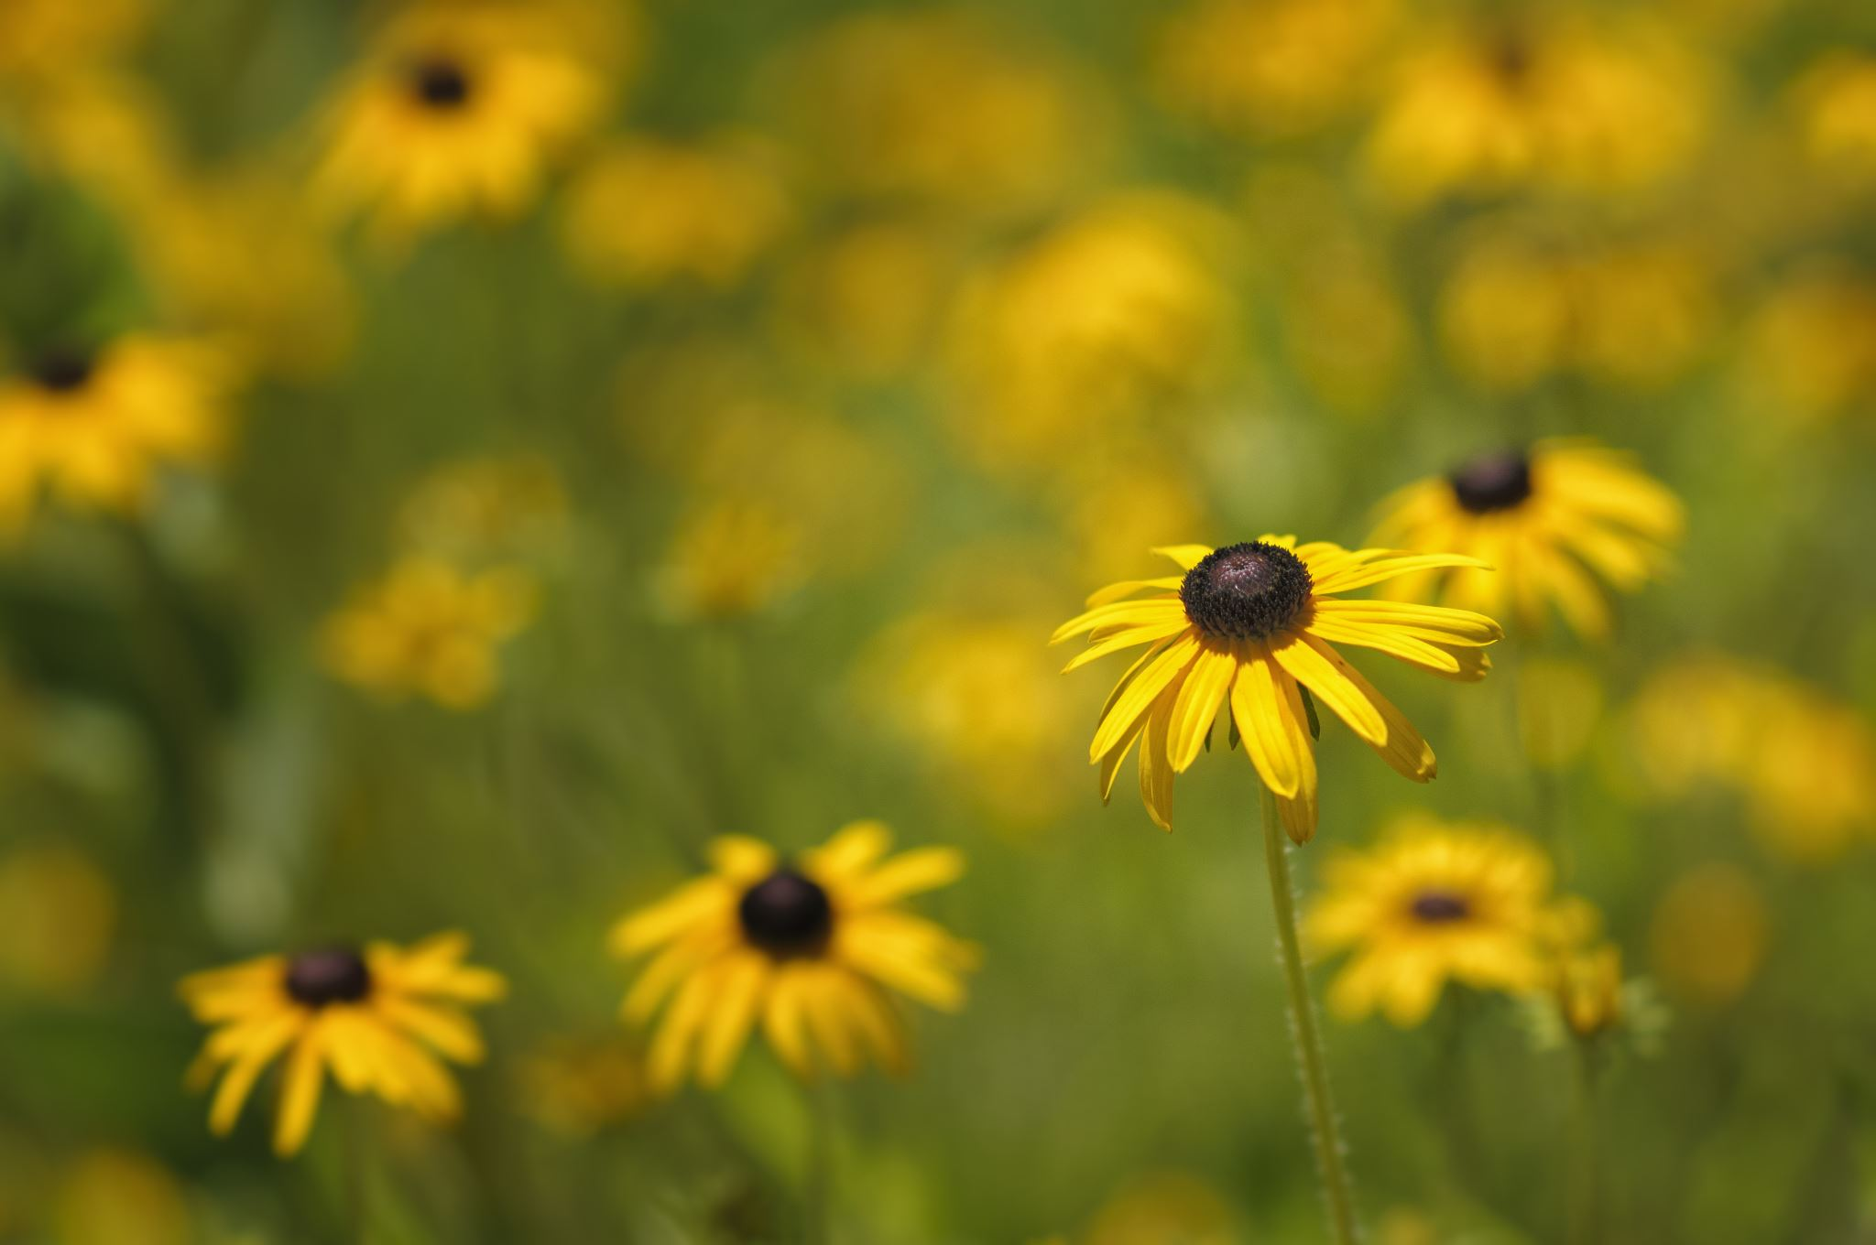
Title
Flowers

Slide 2
Chapter # 1 Flowers cycle

Slide 3
Outside Flowers
Chapter 1 of the flowering plant cycle focuses on the basic life cycle stages: germination, growth, flowering, seed formation, and seed dispersal. A flowering plant develops from a seed, grows into a mature plant, produces flowers, which then develop into fruits containing seeds, thus completing the cycle.

Slide 4
Indoor Flowers
Understanding the Flowering Cycle of Indoor Plants. The 3 stages: bud development, full bloom, and fading.Light Management for Extended Bloom Time. Ideal light intensity for flowering phase.Feeding Indoor Flowers for Longevity. Pruning, Deadheading, and Maintenance Tips

Slide 5
Best Flowers
The best flowers for a continuous blooming cycle are typically those that are heavy bloomers and well-suited for frequent harvesting. Zinnias, Cosmos, and Sweet Peas are known for their prolific blooming and ability to produce more flowers the more they are harvested.

