Slide 1
SMART INDIA HACKATHON 2026
National Innovation & Digital Governance Initiative • Idea Submission
• Problem Statement ID: SIH26-GOV-LAND-042
• Problem Statement Title: AI-Driven Digitization, Cadastral Extraction & Multi-Layer Validation of Historical Land Records
• Theme: Smart Governance / Digital Public Infrastructure (DPI)
• PS Category: Software / Enterprise Digital Governance
• Team ID: TEAM-ILRDVS-2026
• Team Name: GeoTrust Innovators (ILRDVS)
PROJECT ILRDVS
Intelligent Land Record Digitization & Validation System
🏛️ DILRMP 3.0 Standard • 14-Digit Bhu-Aadhaar (ULPIN)
✓ Multi-Pass Self-Correcting OCR (CLAHE + Rotation)
✓ Specialized Cadastral Named Entity Recognition (NER)
✓ Dual-Factor Physical Sticker PIN & 2D QR Verification
✓ Statutory Dual-Signature HITL Workstation (DSC-OFF)
✓ Unified 8-Layer Land Stack (GIS + RoR + Courts + Banks)
ILRDVS • AI-Powered Intelligent Land Record Digitization & Validation System • DILRMP 3.0
Slide 1 of 7 | SIH Idea Submission

Slide 2
PROBLEM STATEMENT & PROPOSED SOLUTION
INNOVATION & VALUE
⚠️ THE LAND-RECORD CRISIS
• Archival Degradation
Millions of 50+ year-old paper records (7/12 Satbara, Ferfar, Sale Deeds) suffer from faded Devanagari script, bleeding blue ink, and physical decay.
• Institutional Silos
Revenue offices, Sub-Registrars (SRO), Land Surveyors, Banks, and Courts operate independently—creating duplicate title claims and lending fraud.
• Physical-Digital Verification Gap
Digital portals cannot stop fraudsters from presenting forged paper photocopies to local tehsils and banks.
• Manual Backlogs & Bribery
Citizens face delays of 30-90 days for basic mutation (Ferfar) and ownership title clearances.
💡 OUR UNIFIED SOLUTION
▶ 1. Multi-Pass Adaptive OCR
OpenCV CLAHE contrast boosting + EasyOCR recovers faint stamps and folded paper.
▶ 2. Cadastral Entity NER
Custom multilingual NER extracts Owner Name, Survey/Gat #, Area (Ha/Acre), Village, and Khata.
▶ 3. Human-in-the-Loop Workstation
Dual-pane review with confidence gauges and Verifier/Officer digital signatures (DSC-OFF).
▶ 4. The 8-Layer Land Stack
Unifies GIS vector parcels, RoR ownership, bank mortgages (CERSAI), and court dispute stays under 14-digit ULPIN.
▶ 5. Dual-Factor QR Authentication
Physical adhesive sticker PIN (SEC-XXXX-YYYY) cryptographically linked to cloud scan SHA-256 hash.
⭐ KEY NOVELTY & EDGE
★ DILRMP 3.0 Operational Alignment
First system mapping 8 distinct governmental layers to the 14-digit Bhu-Aadhaar (ULPIN).
★ Active Self-Correcting Feedback
Continuous learning loop: corrections made in workstation dynamically train synonym dictionaries in real-time.
★ Tamper-Proof Physical Seal
Solves the 'offline fake paper' loophole via physical secret security PINs.
★ Real DLT SMS & HMAC Email OTP
Zero-plaintext cryptographic authentication with explicit legal distinction (Phone ≠ Title).
★ Vernacular & GIGW Accessible
Full Marathi/Hindi support + WCAG 2.1 screen-reader mode for rural inclusivity.
ILRDVS • AI-Powered Intelligent Land Record Digitization & Validation System • DILRMP 3.0
Slide 2 of 7 | SIH Idea Submission

Slide 3
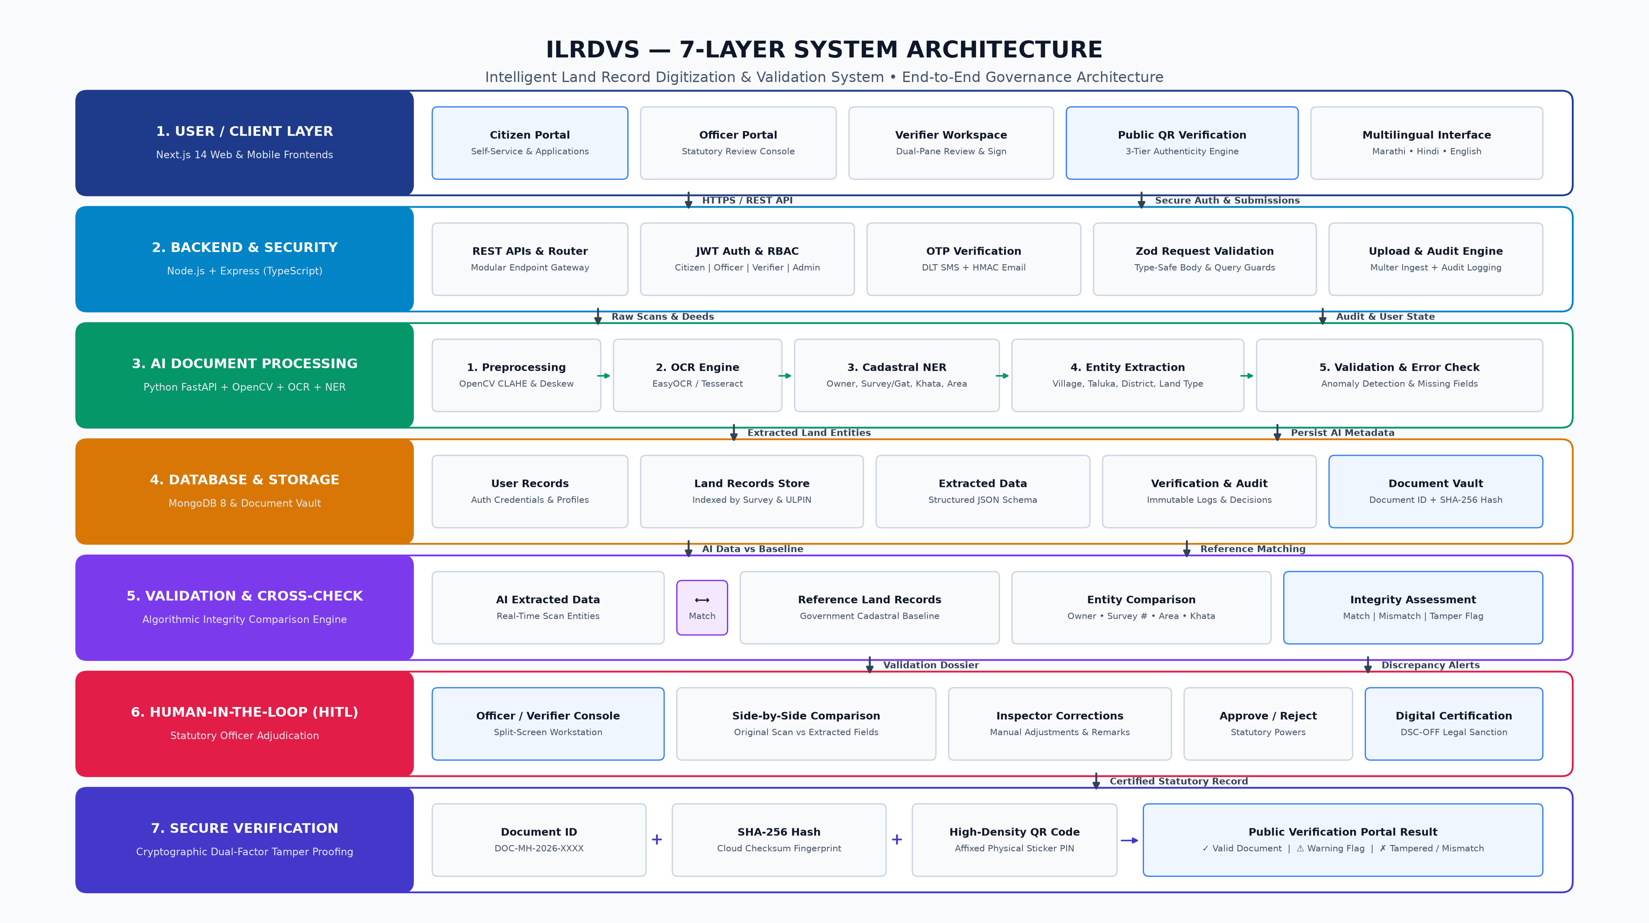
TECHNICAL APPROACH: 7-LAYER SYSTEM ARCHITECTURE
GOVERNANCE ARCHITECTURE
ILRDVS • AI-Powered Intelligent Land Record Digitization & Validation System • DILRMP 3.0
Slide 3 of 8 | SIH Idea Submission

Slide 4
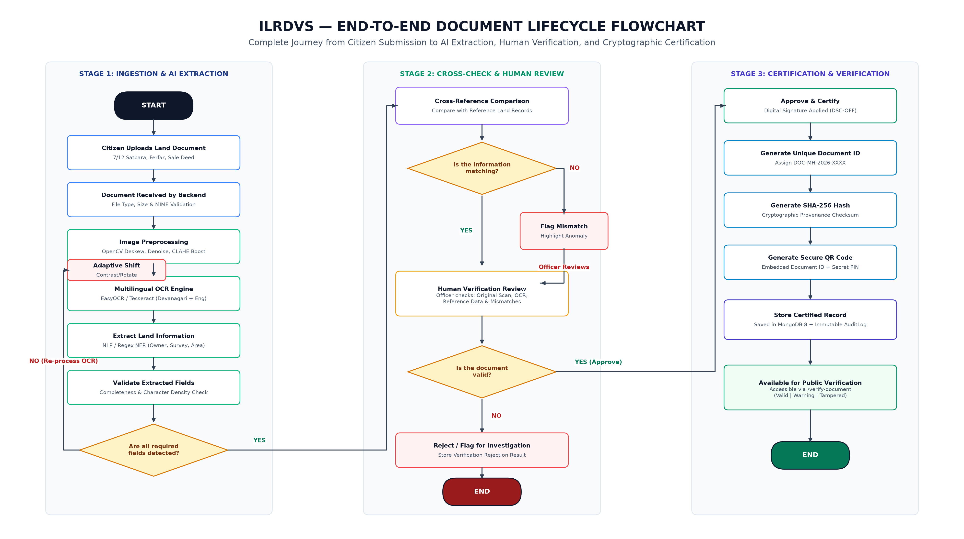
TECHNICAL APPROACH: END-TO-END PROCESS FLOWCHART
DECISION LIFECYCLE
ILRDVS • AI-Powered Intelligent Land Record Digitization & Validation System • DILRMP 3.0
Slide 4 of 8 | SIH Idea Submission

Slide 5
FEASIBILITY, VIABILITY & RISK MITIGATION
OPERATIONAL READINESS
⚙️ TECHNICAL & ECONOMIC FEASIBILITY
• Zero High-End GPU Barrier
Preprocessing and OCR pipeline is optimized for multi-core CPUs with OpenCV and lightweight quantized OCR, ensuring straightforward deployment on existing State Data Centre (SDC) servers without massive cloud expenses.
• Incremental Modular Adoption
Designed as an API-first microservice. Can integrate into existing state portals (e.g., Mahabhulekh, Bhulekh, Jamabandi) without replacing current infrastructure.
• Economic Cost Savings
Automates 70% of manual transcription effort, saving crores of rupees in third-party data entry contracts and reducing mutation cycle time from weeks to hours.
• Statutory Legal Viability
Fully compliant with the Indian Information Technology Act (2000) and Revenue Department regulations through dual digital signatures (DSC-VER & DSC-OFF).
🛡️ RISK ASSESSMENT & ENGINEERING MITIGATION MATRIX
⚠️ Risk: Severely Faded Inks & Historical Stamps
✅ Mitigation: Adaptive multi-pass pipeline automatically activates CLAHE 3.5 contrast boosting, unsharp masking, and morphological dilation upon detecting low character yield.
⚠️ Risk: AI Hallucinations on Legal Titles
✅ Mitigation: Human-in-the-Loop Workstation: AI provides confidence scores and highlight overlays; only authorized Revenue Officers can grant statutory approval via DSC-OFF digital signature.
⚠️ Risk: Paper Deed Forgery & Fake Photocopies
✅ Mitigation: Dual-Factor Physical-to-Digital Verification: Physical 80mm sticker QR + secret security PIN (SEC-XXXX-YYYY) cryptographically linked to cloud scan SHA-256 hash.
⚠️ Risk: Citizen Identity Spoofing / Account Takeover
✅ Mitigation: Salted HMAC-SHA256 OTP verification with zero plaintext database storage, automatic 5-min TTL pruning, and TRAI DLT-compliant SMS templates.
⚠️ Risk: Dialectal & Orthographic Variations
✅ Mitigation: Multilingual cadastral lexicon mapping regional terminology (Gat, Khasra, Khata, Bhogwatdar, Ferfar) with continuous feedback learning from verifier corrections.
ILRDVS • AI-Powered Intelligent Land Record Digitization & Validation System • DILRMP 3.0
Slide 5 of 8 | SIH Idea Submission

Slide 6
IMPACT AND MEASURABLE GOVERNANCE BENEFITS
NATIONAL RELEVANCE
“Transforming Millions of Vulnerable Paper Deeds into an Indisputable, Transparent Economic Asset”
🏛️ GOVERNANCE & LEGAL IMPACT
• Land Litigation Reduction: Addresses the root cause of land disputes which currently constitute ~66% of all civil cases in Indian courts.
• Instant Court Stay Enforcement: Layer 7 NJDG/RCCMS sync automatically flags disputed parcels, freezing illicit sales during pending litigation.
• Immutable Audit Trail: RTI-compliant audit logs track every document view, edit, zoom, remark, and approval.
💰 ECONOMIC & LENDING VELOCITY
• Eliminates Double-Financing: Layer 6 CERSAI/ULI integration locks parcels in real-time when mortgaged, preventing fraudulent multi-bank loans.
• Instant Kisan Credit Card (KCC): Farmers obtain verified land title certificates in minutes instead of paying middlemen for physical extracts.
• Automated Circle Rate Valuation: Layer 5 algorithmically prevents stamp duty evasion and manual undervaluation.
👥 CITIZEN EMPOWERMENT & EQUITY
• Transparent Citizen Self-Service: Dedicated /citizen portal allows tracking mutation applications and downloading certified extracts without red tape.
• Instant Fraud SMS Alerts: Masked Aadhaar (XXXX-XXXX-9124) linkage automatically dispatches alerts when transactions are initiated on personal land.
• Eradication of Broker Exploitation: Direct digital verification removes dependency on predatory local document writers.
♿ ACCESSIBILITY & VERNACULAR REACH
• GIGW & WCAG 2.1 Compliant: Dedicated /screen-reader mode with high-contrast UI and keyboard accessibility for visually impaired citizens.
• Native Vernacular Interface: Full localized support for Marathi (Devanagari) and Hindi ensuring rural common service centre (CSC) usability.
• Offline-Ready QR Verification: Inspectors and banks can verify paper authenticity in rural tehsils using any smartphone camera.
ILRDVS • AI-Powered Intelligent Land Record Digitization & Validation System • DILRMP 3.0
Slide 6 of 8 | SIH Idea Submission

Slide 7
WORKING PROTOTYPE & LIVE SYSTEM DEMONSTRATION
PRODUCTION READY
1. DUAL-PANE HITL WORKSTATION
• Side-by-side archival scan viewer + extracted metadata
• Field-level confidence scores & anomaly warning flags
• Verifier Digital Signature (DSC-VER) forwarding queue
• Revenue Officer statutory approval & rejection portal
• Audit log viewer tracking every click & edit
2. 3-TIER QR VERIFICATION ENGINE
• Public portal: /verify-document with live camera scan
• Tier 1 (Digital Only): Cloud archive validation
• Tier 2 (Dual-Factor Match): Validates physical sticker PIN
• Tier 3 (Counterfeit Alert): Detects altered paper deeds
• Instant PDF export of certified cadastral extracts
3. 8-LAYER LAND STACK VIEWER
• Interactive cadastral parcel visualizer with ULPIN
• Real-time RoR (7/12 & 8A) ownership registry lookup
• Bank mortgage status check (CERSAI & ULI sync)
• Automated Circle Rate Ready Reckoner tax calculator
• Revenue court active injunction / stay order monitor
🚀 LIVE DEPLOYMENT & JURY EVALUATION ACCESS
• Web Application: http://localhost:3000 (Next.js 14) | Backend API: http://localhost:5000 (Node.js/Express) | AI Service: http://localhost:8000
• Pre-Seeded One-Click Roles (Password: Password123!): Admin (admin@landrecord.gov.in) | Officer (officer1@landrecord.gov.in) | Verifier (verifier1@landrecord.gov.in)
ILRDVS • AI-Powered Intelligent Land Record Digitization & Validation System • DILRMP 3.0
Slide 7 of 8 | SIH Idea Submission

Slide 8
RESEARCH, REFERENCES & POLICY ALIGNMENT
AUTHORITATIVE BACKING
📚 GOVERNMENT POLICY & STANDARDS
• DILRMP 3.0 Operational Guidelines (2026–2031): Department of Land Resources (DoLR), Ministry of Rural Development, Government of India.
• Bhu-Aadhaar (ULPIN) Technical Standard: Survey of India standard for 14-digit deterministic cadastral parcel identification.
• TRAI DLT Commercial SMS Regulations: DLT Principal Entity registration & approved header framework for public notifications.
📚 ACADEMIC PAPERS & ALGORITHMS
• Adaptive Contrast for Low-Quality Manuscripts: Contrast Limited Adaptive Histogram Equalization (CLAHE) applied to historical document OCR.
• Named Entity Recognition in Vernacular Scripts: Hybrid regex and transformer models for multilingual cadastral extraction in Devanagari.
• Active Continuous Learning in Document Processing: Human-in-the-loop correction feedback loop for real-time synonym and entity adaptation.
📚 CADASTRAL DATASETS & TAXONOMY
• Maharashtra Mahabhulekh Schema: Standardized Form 7/12 (Satbara), Form 8A (Holding ledger), and Form 6 (Ferfar mutation register).
• National Land Records Modernization Corpus: Archival deeds spanning Pune, Nashik, Nagpur, Satara, and Thane revenue jurisdictions.
• CERSAI & NGDRS Open Standards: Conveyance registry protocols and central mortgage encumbrance data exchange formats.
📚 CRYPTOGRAPHIC & TECHNICAL DOCUMENTATION
• SHA-256 Document Provenance Standard: NIST FIPS 180-4 secure hashing for original archival document scan immutability.
• HMAC-SHA256 Zero-Plaintext Security: RFC 2104 cryptographic authentication for one-time verification tokens.
• GIGW 3.0 & WCAG 2.1 AA Accessibility: Ministry of Electronics and Information Technology (MeitY) guidelines for accessible portals.
ILRDVS • AI-Powered Intelligent Land Record Digitization & Validation System • DILRMP 3.0
Slide 8 of 8 | SIH Idea Submission

