Slide 1
SMART INDIA HACKATHON 2026
Technical Approach & System Architecture Specification
• Project Name: ILRDVS
• Full Title: Intelligent Land Record Digitization & Validation System
• Domain: Smart Governance • Digital Public Infrastructure (DPI)
• Focus Area: End-to-End AI Extraction, HITL Workstation & Dual-Factor QR
• National Alignment: DILRMP 3.0 Standard • 14-Digit Bhu-Aadhaar (ULPIN)
ENGINEERING PILLARS
⚡ Real-World Case: 1978 Faded 7/12 Satbara Extract
⚡ OpenCV CLAHE 3.5 Contrast Boost + Devanagari OCR
⚡ Cadastral NER Model with Missing-Field Self-Diagnosis
⚡ Statutory HITL Workstation with DSC-OFF Digital Sign
⚡ Dual-Factor Physical Sticker PIN & 2D QR Verification
ILRDVS • Technical Approach & Engineering Deep-Dive • Smart India Hackathon 2026
Slide 1 of 8 | SIH Technical Deck

Slide 2
REAL-WORLD CASE STUDY: FADED 1978 7/12 SATBARA
PRACTICAL VALIDATION
⚠️ THE REAL-WORLD PROBLEM (Ground Reality)
• Farmer / Landowner: Ramesh Narayan Patil, Village Hinjawadi, Taluka Mulshi, Dist. Pune.
• Document in Hand: A 48-year-old physical paper 7/12 Satbara extract issued in 1978.
• Physical Condition: Aged yellowed paper, faded blue handwritten Devanagari ink, smudged round revenue stamp, and paper fold creases.
• The Bottleneck: Ramesh applied for an agricultural bank loan. The bank rejected the photocopied extract due to unreadable survey boundaries and fears of paper forgery.
• Old Manual Process: Required visiting the local Tehsil office, paying middlemen, and waiting 45 to 60 days for manual ledger cross-verification.
✅ THE ILRDVS SOLUTION & OUTCOME
▶ Step 1 (Upload): Ramesh takes a phone camera scan and uploads it via the /citizen portal.
▶ Step 2 (AI Rescue): OpenCV CLAHE 3.5 enhances contrast; EasyOCR reads the faint ink: 'रमेश नारायण पाटील', Gat No. 104/4B, Area: 0.84 Hectares.
▶ Step 3 (Cross-Check): System algorithmically matches Gat 104 in Mahabhulekh & confirms zero active mortgage encumbrance in CERSAI.
▶ Step 4 (Officer Sign): Talathi & Tehsildar inspect side-by-side scan in workstation and apply digital certification (DSC-OFF).
▶ Step 5 (Dual-Factor Seal): Generates Document ID DOC-MH-2026-1042 + Secret PIN SEC-89A4-2C71 on an 80mm adhesive sticker affixed to the deed.
▶ Real-World Result: Bank officer scans the QR code at /verify-document. Tier 2 Authenticated Match confirmed in 10 seconds. Loan sanctioned in 24 hours!
ILRDVS • Technical Approach & Engineering Deep-Dive • Smart India Hackathon 2026
Slide 2 of 8 | SIH Technical Deck

Slide 3
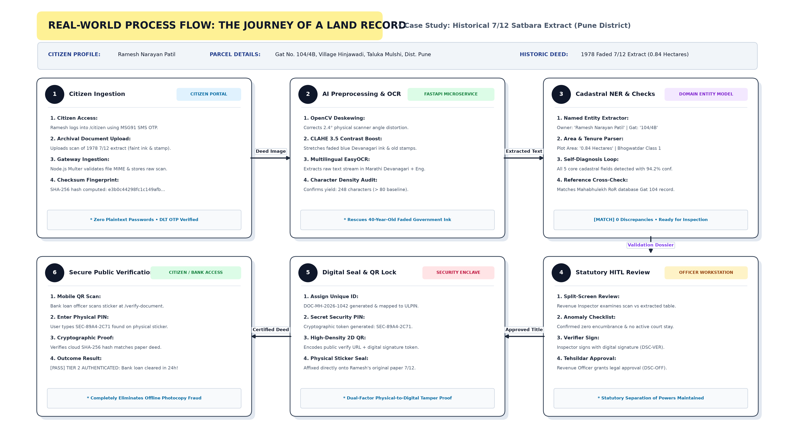
REAL-WORLD ILLUSTRATED PROCESS FLOWCHART
END-TO-END STORY
ILRDVS • Technical Approach & Engineering Deep-Dive • Smart India Hackathon 2026
Slide 3 of 8 | SIH Technical Deck

Slide 4
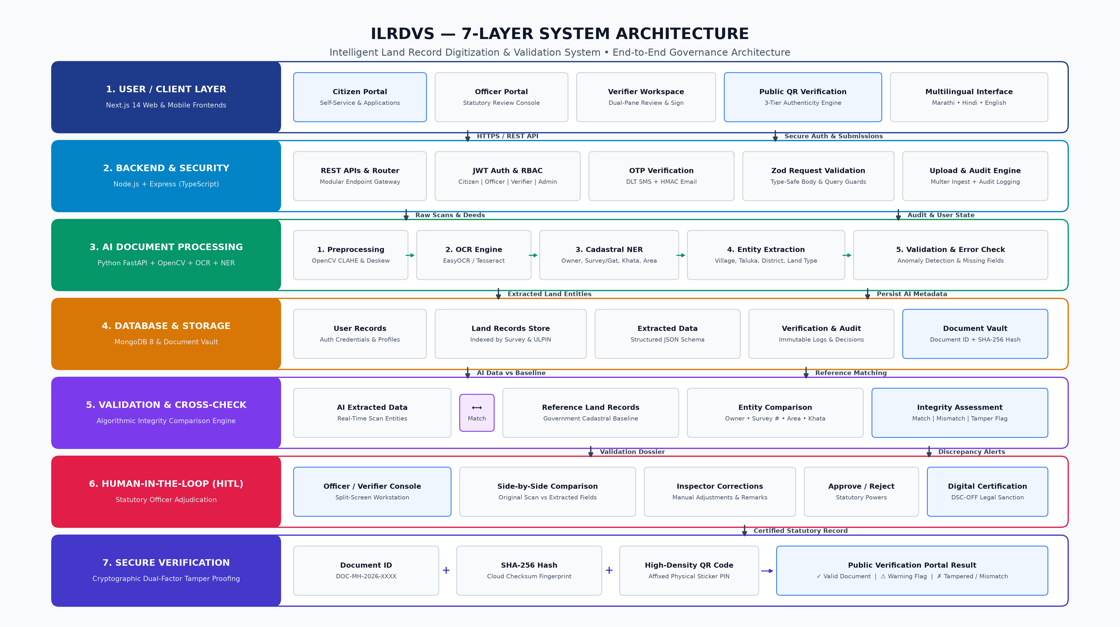
SYSTEM ARCHITECTURE: 7-LAYER ENTERPRISE STACK
GOVERNANCE ARCHITECTURE
ILRDVS • Technical Approach & Engineering Deep-Dive • Smart India Hackathon 2026
Slide 4 of 8 | SIH Technical Deck

Slide 5
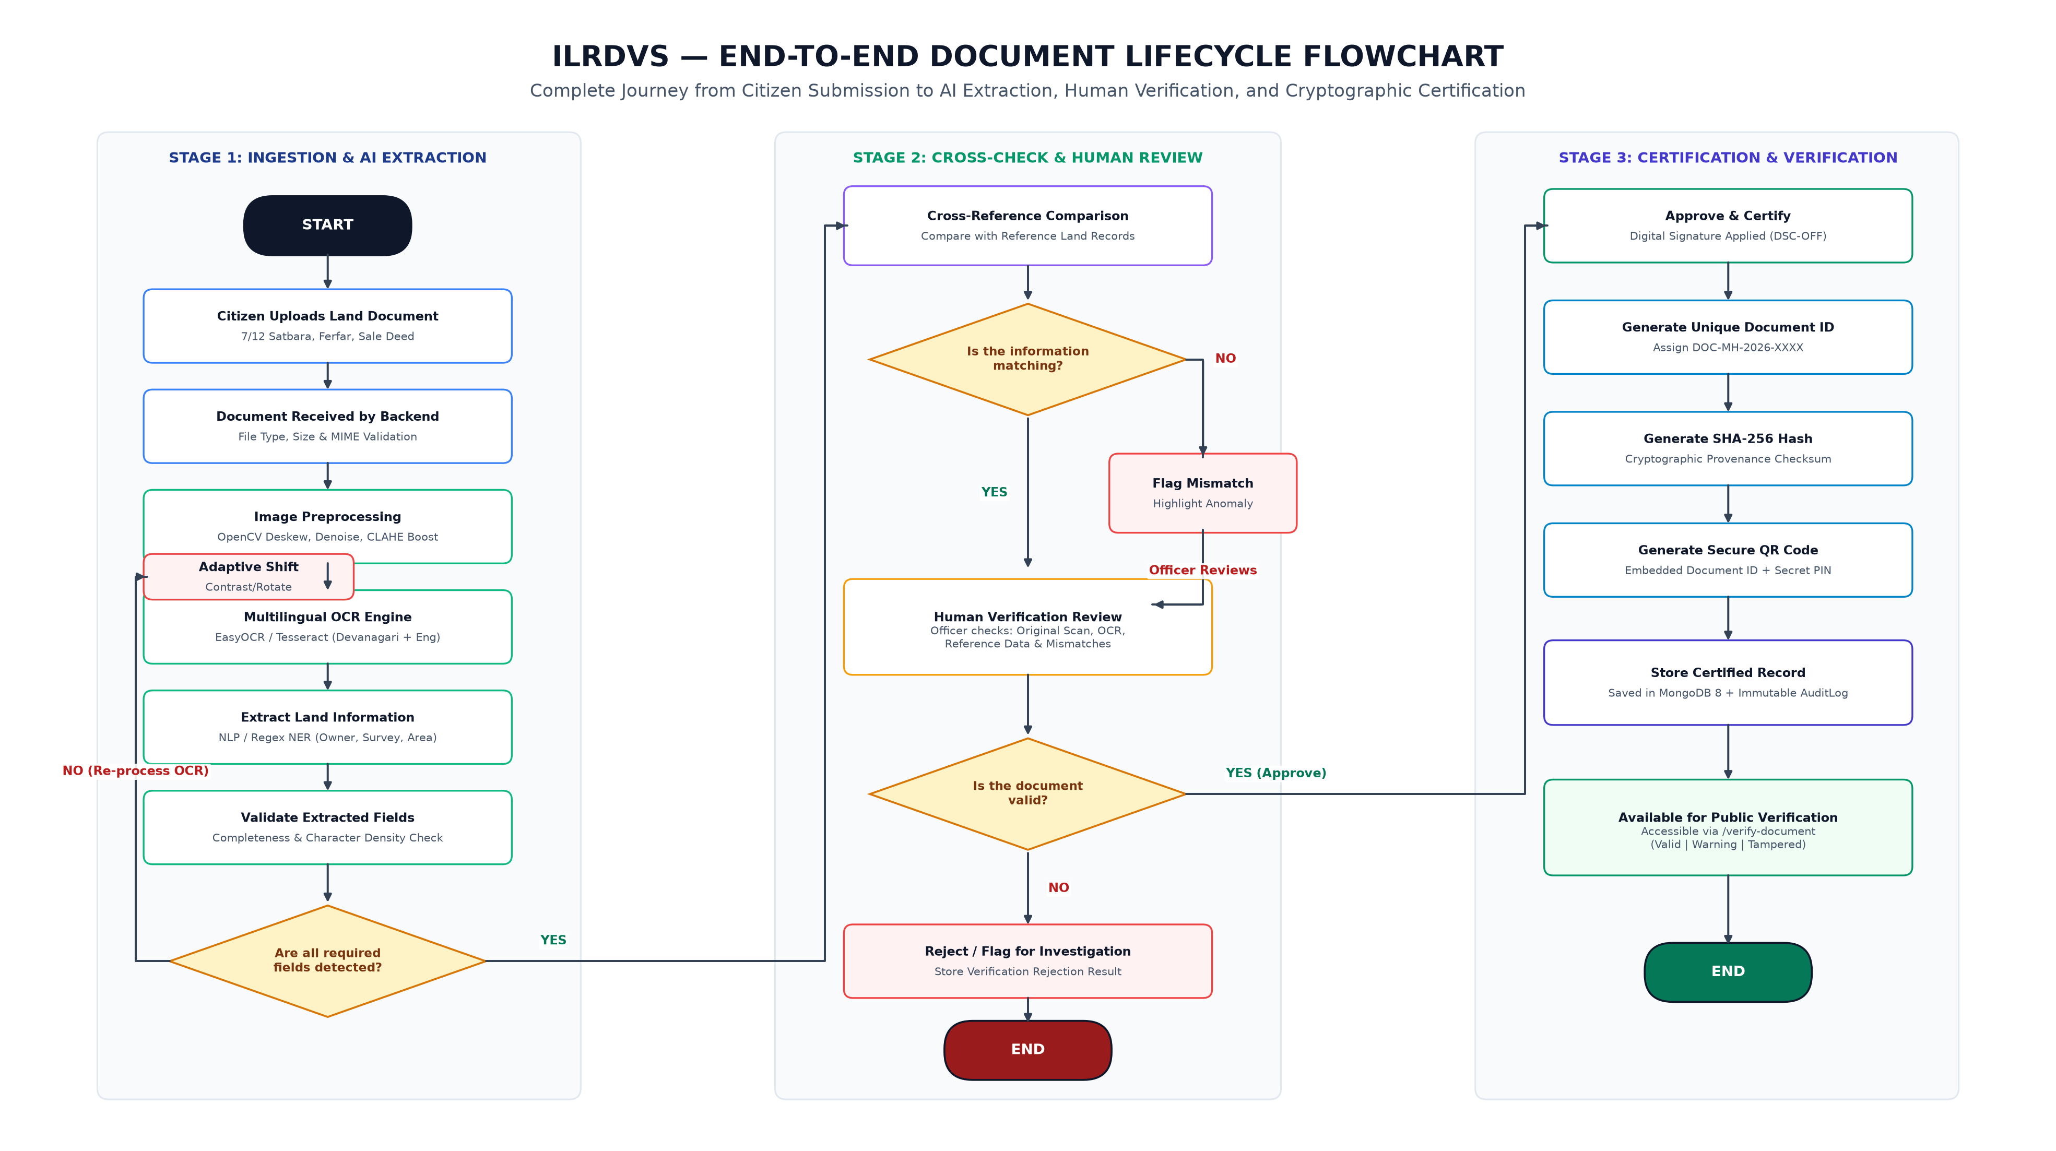
PROCESS FLOWCHART: DECISION & RE-OCR LOOP
DECISION LIFECYCLE
ILRDVS • Technical Approach & Engineering Deep-Dive • Smart India Hackathon 2026
Slide 5 of 8 | SIH Technical Deck

Slide 6
AI PIPELINE: ADAPTIVE PREPROCESSING & NER
COMPUTER VISION & NLP
1. OPENCV ADAPTIVE VISION
• CLAHE Contrast Stretching: Applies clipLimit 3.5 with an 8x8 tile grid. Rescues faint Devanagari handwriting and faded ink stamps.
• Automated Deskewing: Calculates Hough transform line angles and rotates scanned documents up to ±15° to achieve horizontal text alignment.
• Multi-Angle Orientation Recovery: Tests 90°, 180°, and 270° rotations if initial character yield is below 80 characters.
2. CADASTRAL NER ENGINE
• Multilingual EasyOCR: Trained on Marathi Devanagari + Latin alphabets to parse mixed revenue documents seamlessly.
• Cadastral Entity Extraction: Specialized regex & NLP patterns extract Owner Name, Survey/Gat #, Khata Account #, Area (Ha/Acre/R), Village, and Tehsil.
• Self-Diagnosis Check: Flags missing core entities and measures OCR confidence. Automatically branches into Strategy A (CLAHE) or Strategy C (Table cell parser).
3. ACTIVE CONTINUOUS LEARNING
• Feedback Loop Service: Captures corrections made by human inspectors inside the split-screen workstation in real time.
• Dynamic Synonym Registry: Automatically links spelling variations and colloquial Marathi revenue terms without full model retraining.
• Confidence Consensus Merger: Across multi-pass attempts, merges only the highest-confidence individual field values into a unified JSON record.
ILRDVS • Technical Approach & Engineering Deep-Dive • Smart India Hackathon 2026
Slide 6 of 8 | SIH Technical Deck

Slide 7
SECURITY PROTOCOL: DUAL-FACTOR QR VERIFICATION
FRAUD PREVENTION
“A cloud database alone cannot stop someone from showing a fake paper photocopy in rural tehsils.”
FACTOR 1: DIGITAL CLOUD ANCHOR
• Unique Document ID: Assigned per statutory record (e.g. DOC-MH-2026-1042).
• SHA-256 Hash Checksum: Cryptographic fingerprint of original scan stored in MongoDB.
• ULPIN Anchor: Anchored to 14-digit Bhu-Aadhaar cadastral vector parcel.
FACTOR 2: PHYSICAL STICKER SEAL
• Physical Adhesive Sticker: 80mm tamper-evident sticker printed by revenue authority.
• Secret Security PIN: 8-character cryptographic token (e.g. SEC-89A4-2C71).
• Proof of Physical Deed: Guarantees the paper document in hand matches the state registry.
THE 3-TIER VERIFICATION EVALUATION (/verify-document)
🟢 Tier 2: Authenticated Physical + Digital Match: Both cloud document ID and physical sticker PIN match perfectly. Indisputable ownership standing confirmed. Loan/transaction cleared immediately.
🟡 Tier 1: Digital Record Only (Warning Flag): Digital cloud archive is valid, but the user did not enter or verify the physical sticker PIN. System prompts for physical inspection before disbursal.
🔴 Tier 3: Tamper / Counterfeit Alert (Mismatch): Secret PIN or SHA-256 hash does not match cloud records. Flags altered or forged paper photocopies immediately and notifies authorities.
ILRDVS • Technical Approach & Engineering Deep-Dive • Smart India Hackathon 2026
Slide 7 of 8 | SIH Technical Deck

Slide 8
TECHNICAL SUMMARY & LIVE JURY EVALUATION
READY FOR EVALUATION
🎯 WHY THIS ARCHITECTURE WINS
✓ Solves the Offline Problem: Dual-factor QR bridges the gap between physical paper deeds and cloud registries.
✓ Statutory Legal Feasibility: Keeps the human revenue officer as the final authority via digital signatures (DSC-OFF).
✓ Active Continuous Learning: Learns from verifier corrections dynamically without expensive model retraining.
✓ 8-Layer Land Stack (DILRMP 3.0): Unifies GIS, RoR, NGDRS, Bank Mortgages, and Courts under a 14-digit Bhu-Aadhaar.
✓ Zero High-End GPU Requirement: Optimized CPU pipeline runs on state data centers at negligible infrastructure cost.
💻 LIVE DEMONSTRATION GUIDE FOR JUDGES
Step 1: Ingestion: Open /citizen -> Login using OTP -> Upload sample 7/12 scan.
Step 2: AI Extraction: FastAPI microservice executes CLAHE boost, EasyOCR, and Cadastral NER.
Step 3: Verifier Queue: Login as verifier1@landrecord.gov.in -> Review scan vs extracted fields -> Sign DSC-VER.
Step 4: Officer Sanction: Login as officer1@landrecord.gov.in -> Grant statutory approval DSC-OFF.
Step 5: Public QR Verify: Open /verify-document -> Scan QR code -> Enter Secret PIN -> View Tier 2 Authenticated Result!
ILRDVS • Technical Approach & Engineering Deep-Dive • Smart India Hackathon 2026
Slide 8 of 8 | SIH Technical Deck

