Slide 1

Java Parallel Programming
Technologies
Structure
Sequential
Solutions
Concurrent Image Processor
Saadeddine Dakdouki 6308
-
Presented to Dr Mohamad Aoude

Slide 2




Technologies
Structure
Sequential
Solutions
Page 01
Key Technologies Used
Gradle
IntelliJ IDEA IDE
Java 17
LTS with support for the following:
Vector API (from jdk.incubator)
Java Swing/AWT (Image Operations)
Concurrent APIs
Github
Docker

Slide 3
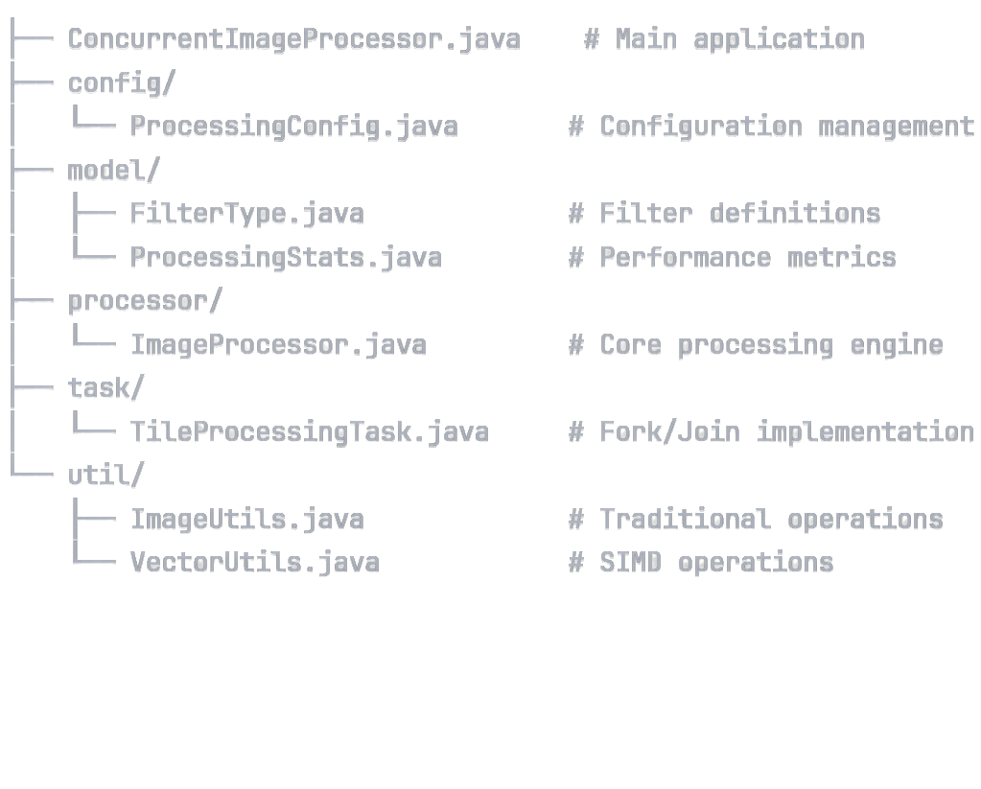
Page 02
Technologies
Structure
Sequential
Solutions
Project Structure

Slide 4
Page 03
Technologies
Structure
Sequential
Solutions
What is Image Processing?
Digital Image Manipulation
Algorithmic transformation of digital images
Pixel-Level Operations: Each pixel processed individually or in groups
Common Operations:
Color space conversion (RGB → Grayscale)
Filtering (Blur, Sharpen, Edge Detection)
Enhancement (Brightness, Contrast adjustment)
Geometric transformations (Resize, Rotate)
Computational Challenge:
Large images = millions of pixels to process
Perfect for Parallelization: Independent pixel operations

Slide 5

Page 05
Technologies
Structure
Sequential
Solutions
Techniques Implemented Part 1
Grayscale
Luminance-based weighted average
ConversionFormula:
Blur Filter
3×3 Gaussian kernel convolution
Averages neighboring pixels
Sharpen
FilterEdge enhancement using convolution
Kernel:
gray = 0.299×R + 0.587×G + 0.114×B
[0,-1,0; -1,5,-1; 0,-1,0]

Slide 6
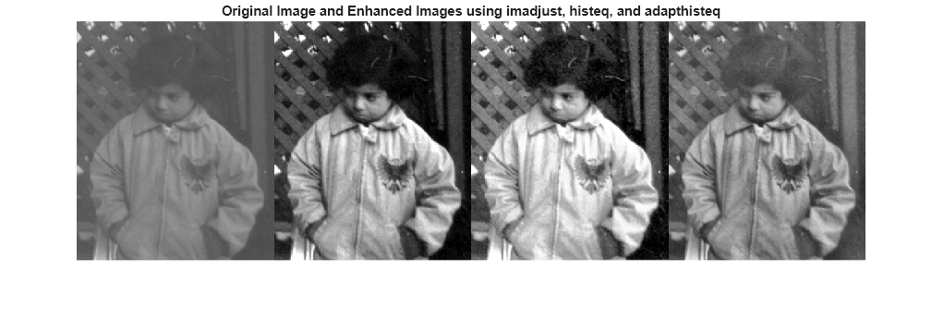
Page 06
Technologies
Structure
Sequential
Solutions
Techniques Implemented Part 2
Brightness Adjustment
Add constant value to each RGB channel
Clamp to valid range
Contrast Enhancement
Multiply by factor around midpoint (128)
Formula:
[0-255]
new = ((old - 128) × factor) + 128

Slide 7
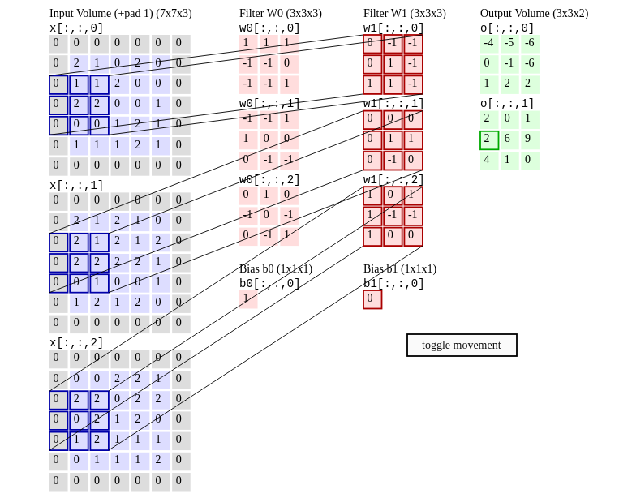
Page 07
Technologies
Structure
Sequential
Solutions
Mathematical Foundation of Filtering
Kernel/Filter Matrix:
Small matrix (3×3, 5×5, etc.)
Convolution Process:
Place kernel over each pixel
Multiply corresponding values
Sum all products
Replace center pixel with result
Example - Blur Kernel (1/9)
Computationally Intensive:
O(n²) for each pixel

Slide 8

Page 08
Technologies
Structure
Sequential
Solutions
Sequential Processing - The Baseline
How it Works:
Process images one by one
Apply filters sequentially
Single thread utilization
Advantages:
Simple to implement and debug
Predictable memory usage
No synchronization complexity
Disadvantages:
Underutilizes modern multi-core CPUs
Slow for large images or batches
Poor scalability
Performance: Baseline (1.0x) - our reference point

Slide 9
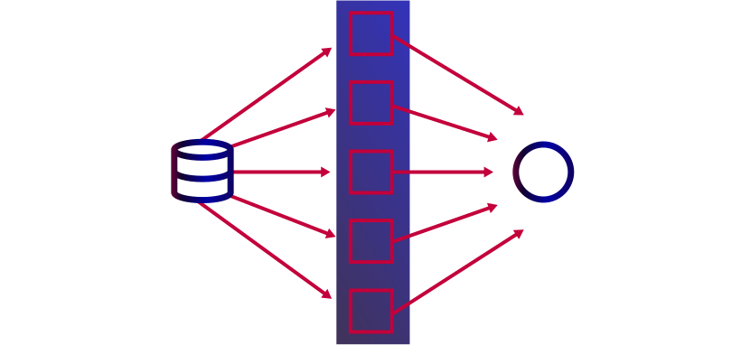
Page 09
Technologies
Structure
Sequential
Solutions
Why Parallel Processing Makes It Faster
Modern CPUs: 4-16+ cores available
Image Processing Characteristics:
Embarrassingly Parallel: Independent pixel operations
Data Parallelism: Same operation on different data
No Dependencies: Pixel processing doesn't depend on other pixels
Speedup Potential:
Theoretical: Linear with number of cores
Practical: 4-8x speedup on typical hardware
Memory Bandwidth:
Often the bottleneck, not CPU cores
Amdahl's Law:
Speedup limited by sequential portions

Slide 10
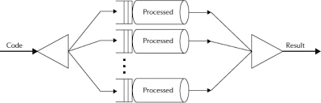
Page 10
Technologies
Structure
Sequential
Solutions
Parallel Technologies Implemented
Fixed Thread Pools (ExecutorService)
Controlled number of worker threads (8 threads)
Prevents memory exhaustion from unlimited thread creation
Batch processing for memory management
Fork/Join Framework
Divide-and-Conquer: Recursive tile splitting
Work Stealing: Idle threads steal work from busy threads
TileProcessingTask: 256×256 pixel tiles
Automatic Load Balancing: Framework handles thread distribution
CompletableFuture
Asynchronous processing with timeout handling
Composable pipeline operations
Better error handling than raw threads

Slide 11
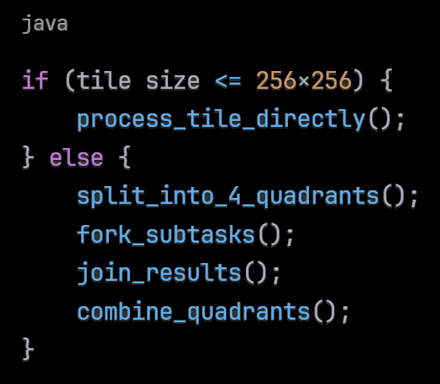
Page 11
Technologies
Structure
Sequential
Solutions
Fork/Join Deep Dive
Recursive Tile-Based Processing
Benefits:
Better cache locality (smaller working sets)
Automatic load balancing
Scales with available cores
Trade-offs:
Overhead from task creation
Memory for intermediate results
Complex result combination

Slide 12
Page 12
Technologies
Structure
Sequential
Solutions
Memory Management Strategy
Problem:
Parallel processing can consume excessive memory
Memory Monitoring:
Real-time tracking and warnings
Graceful Degradation:
Fallback strategies for low memory
Solutions Implemented:
Fixed Thread Pools: Limit concurrent operations
Batch Processing: Process images in controlled groups
Garbage Collection: Force GC between batches
Thread-Local Buffers: Reduce allocation overhead
Resource Cleanup: Proper shutdown procedures

Slide 13

Page 13
Technologies
Structure
Sequential
Solutions
Vector API - The Cutting Edge
What is Vector API?
Experimental Feature: Java 17+ incubator module
Hardware Acceleration:
Direct access to CPU SIMD instructions
How it Works:
Process 4-8 pixels simultaneously in single instruction
Vectorized arithmetic operations
Optimal for repetitive mathematical operations
Current Status:
Incubator Module:
--add-modules jdk.incubator.vector
Under Active Development: API may change
Performance Benefits: 2-4x speedup for pixel operations
SIMD: Single Instruction, Multiple Data

Slide 14

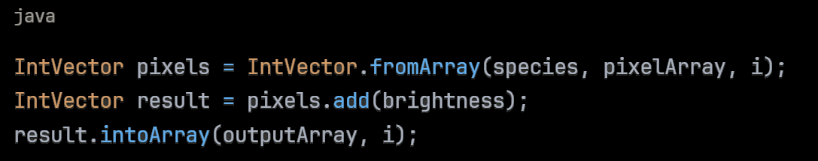
Page 14
Technologies
Structure
Sequential
Solutions
Vector API Implementation
Vector Species:
Platform-optimal vector length
Vectorized Operations:
Load multiple pixels into vector
Apply mathematical operations to all lanes simultaneously
Store results back to memory
Example - Brightness Adjustment:
Challenges:
Thread safety considerations
Fallback to scalar operations
Platform compatibility

Slide 15

Page 15
Technologies
Structure
Sequential
Solutions
Concept:
Combine thread-level AND instruction-level parallelism
Implementation:
Multiple threads (thread-level parallelism)
Each thread uses Vector API (instruction-level parallelism)
Thread-local buffers for safety
Theoretical Speedup:
Cores × SIMD_Factor
8-16x speedup on optimal hardware
Practical Considerations:
Memory bandwidth limitations
Synchronization overhead
Platform-dependent performance
Hybrid Approach
Vector API + Parallel Processing

Slide 16
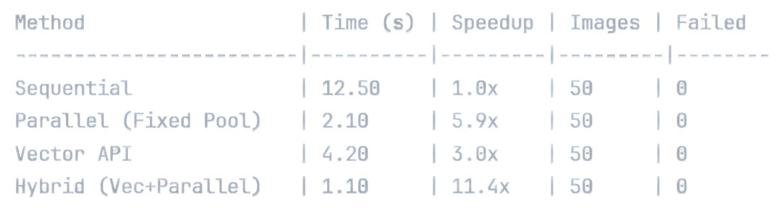
Page 16
Technologies
Structure
Sequential
Solutions
Performance Comparison - Processing Time
Key Insights:
Parallel processing provides significant speedup
Vector API shows moderate improvement
Hybrid approach delivers best performance
Fixed thread pools ensure stable operation

Slide 17
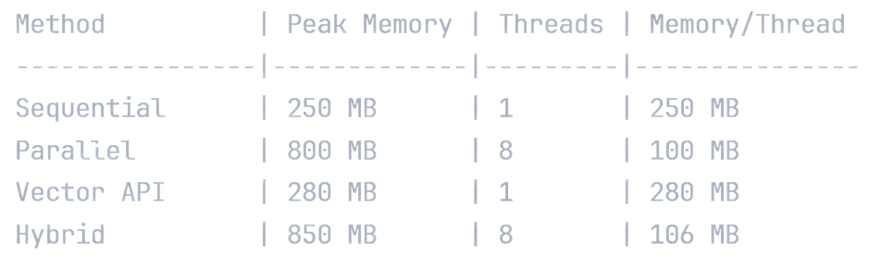
Page 17
Technologies
Structure
Sequential
Solutions
Performance Comparison - Memory Usage
Memory Management Success:
Fixed thread pools prevent memory explosion
Controlled memory growth even with parallelism
Efficient resource utilization
No memory exhaustion failures

Slide 18

Page 18
Technologies
Structure
Sequential
Solutions
Future Enhancements
Next Steps and Improvements
GPU Processing: CUDA or OpenCL integration
More Filters: Advanced computer vision algorithms
Adaptive Threading: Dynamic thread pool sizing
Vector API Maturity: Waiting for stable release
Cloud Integration: Distributed processing across multiple machines
Machine Learning: Neural network-based image enhancement
Performance Profiling: More detailed bottleneck analysis

Slide 19
Thank You
Saadeddine Dakdouki 6308
-
Presented to Dr Mohamad Aoude

