Slide 1
Design Dash Document
Mercan Esen
Saadet Yılmaz
Fuzzy Sets and Systems II
“Fuzzy Exercise Assistant”

Slide 2


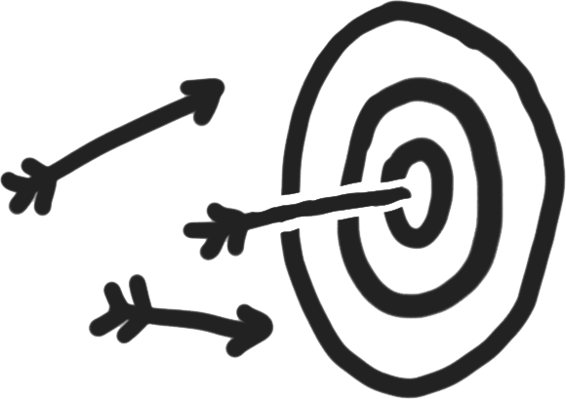





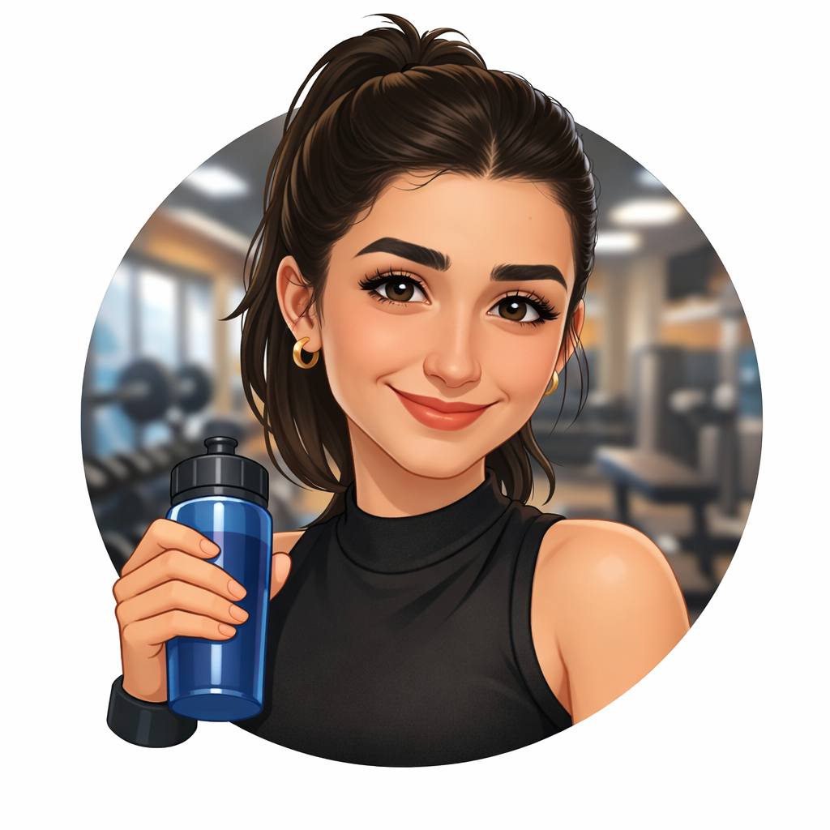
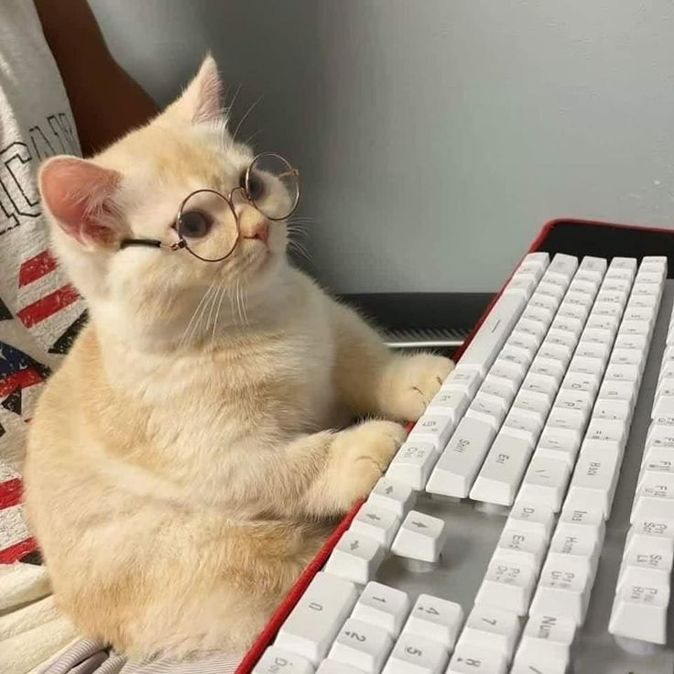
TEAM MEMBERS: 2
Mercan
Saadet

Slide 3
We are going to REDESIGN...
Breakfast
Lunch
Dinner
Exercising
Meeting new people
Keeping in touch with old friends
Moving to a new house/apartment
Celebrating your birthday
Sleeping
Listening to music
Waking up
Commuting
Gardening
Volunteering
Watching TV/movies
Planning a vacation
Being at the airport
Taking a road trip
Traveling in a country where you don’t know the language
Learning a new language
Grocery shopping
Doing the laundry
Reading the news
Recycling/composting
Cleaning your house
Giving gifts
Exploring your own city or town
Preserving memories
Personal style/beauty routine
Friday night

Slide 4
Getting to know our TEAM
3 ways we connect to this topic…
Mercan
# Exercise is an important part of my daily life and personal routine.
# I feel relaxed and mentally peaceful when I exercise
# Helping people make exercise part of their lifestyle
Saadet
# Love sports!
# Want to have a healthy lifestyle!
# I believe exercises are not “one fits all” - it must be flexible depending on one’s needs

Slide 5
OBSERVING a new perspective
We invited interviewees to gain different perspectives on our topic.
NOTES
“Sometimes I don't know how to exercise according to my body type, so having an assistant like this would increase the likelihood of me to exercise.”
ddd
“Exercise is equivalent to health. We must have healthy exercise habits/routines integrated to our lives. Exercises tire our body but increases our focus on other subjects ”
sefasddsf
“Biggest challenge is getting started. When unsure how much to do, she just keeps going decision is instinctive, not planned.”
“Exercises irregularly sessions vary from 30 to 90 min. Feels "done" only when every muscle group is worked, not based on time.”
“Measures fatigue through body signals and loss of desire to continue. Would trust a free app but never uses one all options are paid.”
“I do not exercise often but it would be nice to know what would improve my body health”
“We must find exercises that fits our body the most.”

Slide 6

DEFINING our challenge
WE TALKED TO
WE’D NICKNAME THEM
e to continue. Would trust a free app but never uses one app but never uses one — all options are paid.
Ms. Active
Ms.Yoga
HERE’S WHAT WE THINK IS
THE UNDERLYING PROBLEM
THEY SAY
They want to find a fitting exercise
Get started exercising without thinking too much on it
A free and simple tool to guide her workout to know when she's done enough and to help her get started.
A good plan that suits their needs.
Motivation to continue doing sports
. A free and simple tool to guide her workout to know when she's done enough and to help her get started.

Slide 7
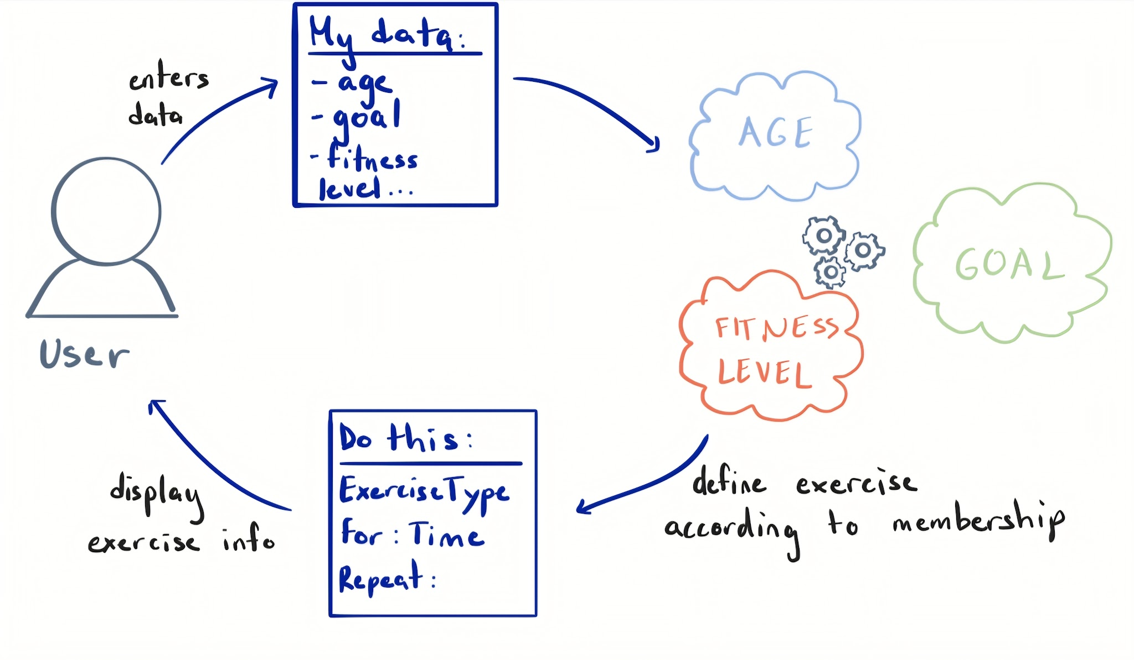
DRAWING an idea
Drawing an idea that solves the problem we found.
YOUR CHALLENGE
YOUR SOLUTION
A good plan that suits their needs.
Motivation to continue doing sports.

Slide 8




TESTING our prototype
Handing our prototype to our interviewees. What do they think?
Personalized recommendations fill relevant inputs like age, BMI and fitness level reflect real user needs
Improves motivation by giving relevant recommendations
No motivation feature biggest challenge was getting started, but system doesn't address this
Weekly activity level is hard to self-report accurately users may not know their exact level
WHAT WORKS (AND WHY)
WHAT DOESN’T (AND WHY)
QUESTIONS WE HAVE
NEW IDEAS
- How often should the user update their inputs?
-Can fuzzy rules capture the difference between "a little tired" and "very tired"?
-Would Ms. Yoga actually open the app when she doesn't feel like starting?
-Gentle nudge notification to help start
-Muscle group tracker for "full body" completion
- How practical is entering your information every time before doing exercise?
-Daily energy slider before workout (fuzzy motivation input)

