Slide 1

SMART INDIA HACKATHON 2026
TITLE PAGE
Problem Statement ID – 26180
Problem Statement Title- A field-deployable AI-powered Smart Farming Assistant that helps farmers detect crop diseases, pests, nutrient deficiencies, and irrigation needs at an early stage, while improving resilience against droughts, floods, heat waves, and other agricultural risks common in India. The solution should enable higher yields, lower input costs, more efficient water usage, and faster response to emerging threats through real-time on-device intelligence.
Theme- Agriculture, FoodTech & Rural Development
PS Category- Hardware
Team ID- SIH26-A0H-T294
Team Name - QBic innovators

Slide 2

IDEA TITLE
Proposed Solution: A portable AI-powered field device that combines camera-based crop analysis with soil and environmental sensors.Detects crop diseases, pests, nutrient deficiencies, and irrigation requirements at an early stage.Continuously monitors soil moisture, temperature, humidity, pH and other field parameters.AI analyzes sensor readings + crop images to provide real-time, crop-specific recommendations to farmers.
How it Addresses the Problem: Early detection → identifies crop stress before major damage occurs.Smart irrigation → recommends when and how much to irrigate based on actual soil conditions.Disease & pest detection → AI identifies visible symptoms from crop images.Nutrient monitoring → detects potential nutrient deficiencies using crop/soil data.Risk awareness → helps farmers respond to drought, heat, floods and other environmental stresses.
Innovation & Uniqueness: Multimodal AI: combines visual + sensor + environmental data instead of relying on a single input.Field-deployable: designed as a portable, low-cost device for use directly in farms.Real-time & localized: provides recommendations based on the specific crop and field conditions.Scalable: can be expanded with additional sensors, crops and regional-language support.

Slide 3


TECHNICAL APPROACH
SOFTWARE & MODEL
HARDWARE
Model:
YOLO for image detection/classification (disease, pest, deficiency), paired with a small language model that turns sensor + vision patterns into farmer-facing recommendations.
Handheld scanner (Android phone)
Field inspection tool — high-res camera, GPS, on-device NPU/GPU for offline data inference.
Runs both the YOLO image inference and data analyzer SLM.
Stationary field node
Training:
Supervised learning on labelled, multi-crop disease datasets (Mendeley, Kaggle) covering sugarcane, cashew, paddy and general crop disease for the image model training. We use pre existing models such as Qwen3 or Llama 3.2 with QLoRA to minimize the models footprint on the ram.
Grammar-Constrained Inference: SLM executed via llama.cpp using GBNF grammar rules to guarantee deterministic, structured JSON output for the mobile application.
Multilingual Voice Output: Integrated offline Text-to-Speech (TTS) pipeline delivers spoken agronomic advice in regional languages (e.g., Hindi, Tamil) for accessible, hands-free field use.
Raspberry Pi + Pi camera at fixed spots — time-lapse imagery for canopy monitoring, pest traps, blight spread.
Local Data Ledger & Gateway: Raspberry Pi runs an embedded SQLite database to log time-stamped environmental telemetry and hosts a local offline dashboard over Wi-Fi hotspot.
Low-power in-situ sensor hub
External data:
IMD weather/seasonal APIs + ISRO Bhuvan Geoportal through Bhoonidhi API, for flood detection and water-level monitoring.
ESP32 + capacitive soil moisture, SHT31 temp/humidity, optical/NPK sensors — telemetry via BLE to phone or Pi gateway.
Power Management & Longevity: ESP32 nodes utilize aggressive deep-sleep duty cycles powered by 18650 Li-ion cells paired with small 5V solar panels for continuous, maintenance-free field operation.
Hybrid Connectivity: Supports ESP-NOW / LoRa for long-range, line-of-sight sensor transmission back to the Pi gateway alongside direct BLE pairing for walk-by farmer scans.
Optimization:
Edge quantization compresses the model to fit on-device RAM (smartphone or Raspberry Pi) for offline inference.
Quantization Specifications: Vision model converted to INT8 TFLite (<30 MB) and SLM compressed to INT4 GGUF (<1 GB), ensuring sub-100ms inference without thermal throttling.
Unknown case handling:
If a disease or pest pattern isn't recognized, it's flagged as new/unknown and the farmer is prompted to consult an expert — never a silent failure.

Slide 4
FEASIBILITY AND VIABILITY
Strategies for Overcoming These Challenges
Use waterproof and heat‑resistant casing materials; test prototypes in multiple terrains.Include self‑calibration routines and periodic sensor checks.Add a small backup battery to handle low‑sunlight days.Conduct field demos and local‑language training sessions to build trust and familiarity.
Analysis of the Feasibility of the Idea
The proposed smart monitoring box is a highly feasible and scalable solution that utilizes low-cost components (like the ESP32 and solar panels) to operate entirely offline via local voice and SMS alerts. However, its success depends on overcoming potential challenges, including hardware durability in extreme weather, power management during prolonged cloudy periods, sensor calibration across diverse soil types, and the initial hesitation of farmers to adopt the new technology.
Potential Challenges and Risks
Sensor calibration errors due to varying soil types and climates.Hardware durability under extreme conditions (floods, heatwaves, heavy rainfall).Power management issues during long cloudy periods.Farmers’ initial hesitation to adopt new technology.

Slide 5
IMPACT AND BENEFITS
Impact on Farmers
Benefits
Early intervention
Detects diseases, pests and nutrient deficiencies before major crop damage. Reduced crop losses: Timely alerts help farmers respond quickly to emerging threats. Smarter irrigation: Provides crop- and field-specific irrigation recommendations, reducing unnecessary water usage.
Climate resilience
Helps farmers prepare for droughts, floods, heat waves and other weather risks.* Accessible decision support: Delivers simple, multilingual recommendations suitable for farmers with varying levels of technical knowledge.
Environmental Benefits
Efficient water utilization: Conserves increasingly limited water resources. Reduced chemical overuse :Minimizes unnecessary pesticide and fertilizer application. Better soil management : Supports sustainable nutrient management. Climate-smart farming : Encourages adaptation to changing weather conditions.
Social & National Impact
Supports small and marginal farmers Promotes data-driven and sustainable farming
Early Detection : Timely Action :Lower Inputs & Losses : Better Resource Efficiency : Higher Yield : Improved Farmer Income

Slide 6
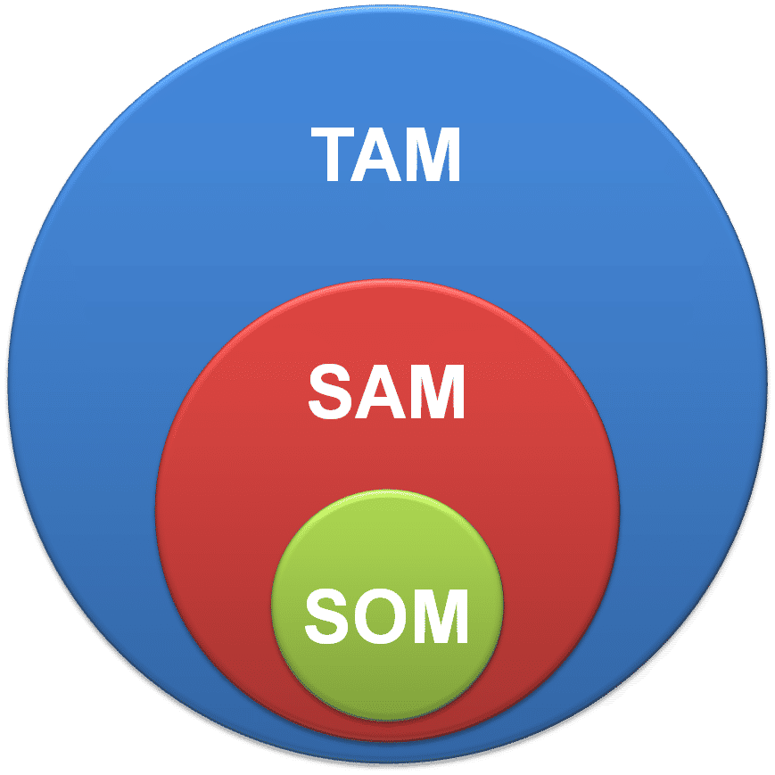
RESEARCH AND REFERENCES
Total Addressable Market: TAM talks about the total market that exists for smart agriculture in India. India’s total smart agricultural market is valued at around $850 Million in 2025
Reference and Links
[1] IEEE Xplore, Development of IoT Based Smart Crop and Pest Management System for Sustainable Smart Farming, 2025.
[2] IJRASET, Integration of IoT Boards (ESP32, Raspberry Pi) for Smart Agricultural Monitoring, 2023.
[3] Sistemasi Journal, Multi‑Modal Sensor System for Crop Monitoring using ESP32 and Raspberry Pi, 2024.
[4] Springer BioData Mining, Deep Vision in Agriculture: Assessing YOLO in Plant Leaf Disease Classification, 2024.
[5] Nature Scientific Reports, YOLO‑based Deep Learning Framework for Real‑Time Plant Health Monitoring, 2025.
https://www.fao.org/investment-centre/latest/news/detail/Transforming-food-systems-in-India-with-digital-agriculture/?utm
https://icar.gov.in/?utm_source=chatgpt.comhttps://www.icar.org.in/sites/default/files/2025-10/ICAR%20Eng%20Annual%20Report_2024-25.pdf?utm_
https://epubs.icar.org.in/index.php/IndFarm/article/view/130025?utm
https://www.pib.gov.in/PressReleasePage.aspx?PRID=2244628&utm
Serviceable Obtainable Market: SOM talks about what can be realistically achieved in that particular timeframe accounting for practical limitations. Total SOM in India is valued at around $200 Million
Serviceable Available Market:
SAM talks about the slice of TAM we can serve according to our specific solution. The total SAM in India is valued at around $300 Million

