Slide 1
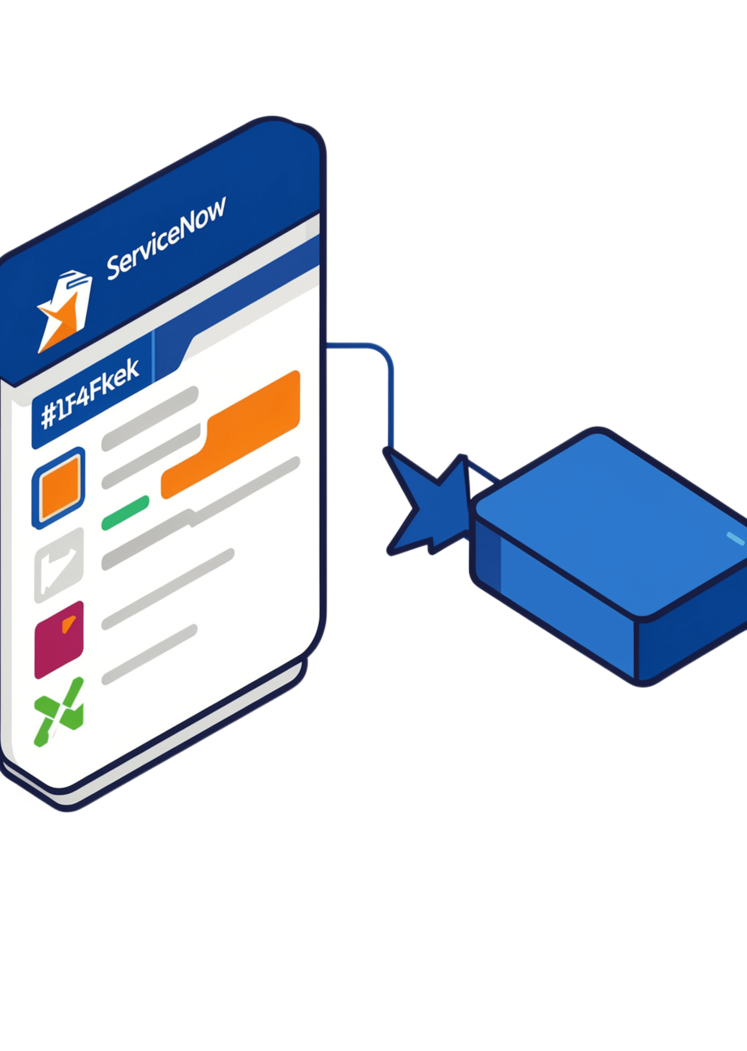
SERVICE NOW AUTOMATION
Auto Ticket
Classification
using Flow Designer
ServiceNow Automation Project · Team 18 · Velammal Institute of Technology
Saadhika K G · Nivetha M · Blessey Kiruba B · Harisha S · and Team
Notes:
Introduce the project: Team 18 built a ServiceNow Flow Designer workflow that classifies school IT tickets and notifies callers automatically.

Slide 2
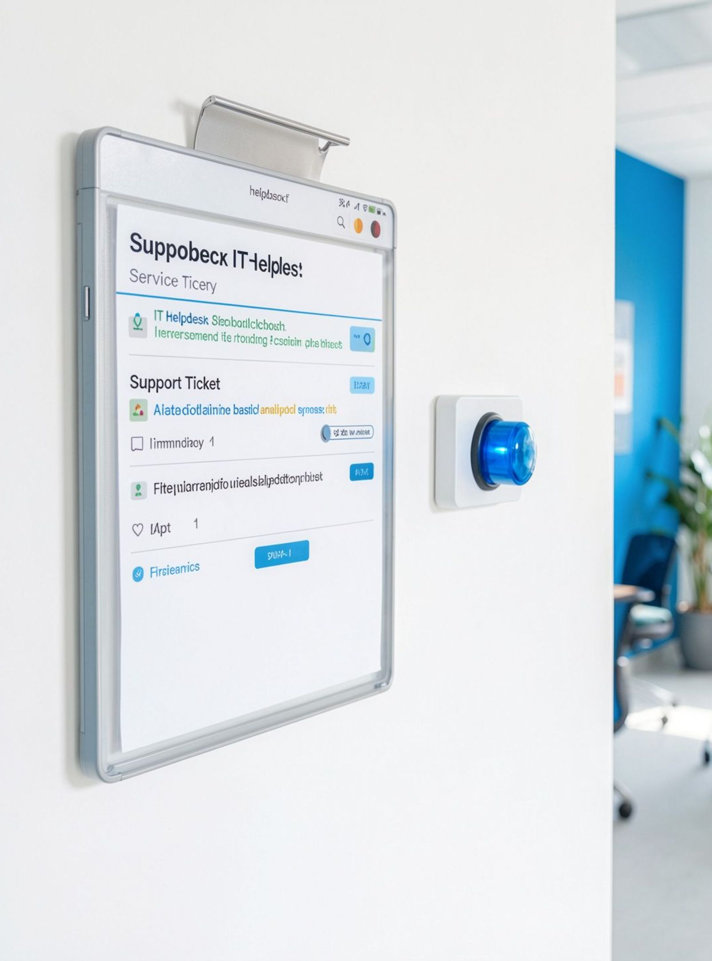
02 / OVERVIEW
School IT tickets can classify themselves
ServiceNow Flow Designer automates classification of school IT helpdesk tickets
Each new ticket receives a Category and dependent Subcategory
The result is structured ticket information with less manual handling
Notes:
Start with the outcome: a new school IT ticket can move from short description to structured Category and Subcategory with less manual handling.

Slide 3



03 / PROJECT SHAPE
The project turns a manual task into a repeatable flow
Objectives
Automation
Foundation
Classify tickets automatically; assign Category and Subcategory; implement dependent choice logic.
Send an email notification after classification.
Use a maintainable, scalable workflow and a structured custom table.
TECHNOLOGIES
ServiceNow · Flow Designer · Update Sets · Custom Table · Email Notification
Notes:
Frame the project in three parts: what it must achieve, what it automates after classification, and the maintainable foundation underneath.

Slide 4
04 / DATA MODEL
Incident WorkFlow stores every ticket in one structure
Field | Type
Number | Auto Number
Caller | Reference sys_user
Category / Subcategory / State | Choice fields
Short Description / Description | String fields
Assigned Group / Assigned to | Reference sys_user_group / sys_user
Planning covers the custom table, dependent choices, flow conditions, notification, testing, and deployment through an Update Set.
Notes:
Show that the workflow depends on one consistent structure: identity, classification, ticket text, and ownership fields all live in the Incident WorkFlow table.

Slide 5
05 / DEPENDENT CHOICES
Category drives the available subcategory
Subcategory is dependent on Category, so the selection stays consistent.
Category | Subcategory
Network | Wi-Fi
Hardware | Projector
Access | Forgot Password
Performance | Slow Computer
Notes:
The dependent choice logic keeps the second selection aligned with the first: each Category exposes its corresponding Subcategory.

Slide 6
06 / FLOW DESIGNER
The flow starts only when classification is needed
FLOW
TRIGGER
CONDITION
Auto Classify School IT Tickets
Record Created on the Incident WorkFlow table
Category is Empty
Record Created
Classify Ticket
Send Email
Check Short Description
Update Record
Notes:
The trigger is deliberately narrow: the flow runs when a record is created and Category is empty, then checks the short description, updates the record, and sends email.

Slide 7
07 / CLASSIFICATION LOGIC
Short descriptions route tickets to the right pair
Short description | Category → Subcategory
Wi-Fi / Network | Network → Wi-Fi
Projector | Hardware → Projector
Forgot password | Access → Forgot Password
Slow Computer | Performance → Slow Computer
AFTER UPDATE
Send Email
Confirms submission to the caller at Caller → Email.
Subject: “Your Request for the issue has been submitted.”
Notes:
These four examples show the routing pattern. Once the record is updated, the caller receives confirmation at Caller → Email.

Slide 8
08 / TESTING
Two tests validate the classification path
Each test follows the same path: ticket created → Category checked → Short Description evaluated → fields assigned → confirmation email sent.
Test | Input | Category | Subcategory
1 | WiFi not working in library | Network | Wi-Fi
2 | Projector not turning on | Hardware | Projector
INPUT
VALIDATION
Ticket created with a short description.
Fields assigned and confirmation email sent.
Notes:
Use the two supplied tests to demonstrate that different short descriptions follow the same classification path and produce the expected field pair.

Slide 9




09 / DEPLOYMENT
Deployment keeps the workflow shareable
01
02
03
Complete the Project Update Set
Save it and export it to XML
Retain the XML for project sharing and deployment
PROJECT VALUE
Automated classification
Reduced manual effort
Structured ticket information
Automatic email notification
Maintainable workflow
Notes:
Close the implementation story with the Update Set: complete it, save and export it to XML, then retain the XML for sharing and deployment.

Slide 10

Thank you
The project demonstrates a maintainable ServiceNow workflow for classifying school IT tickets and notifying callers automatically.
Team 18 · Velammal Institute of Technology
Questions?
Notes:
Thank the audience and invite questions. Reiterate that the project demonstrates a maintainable ServiceNow workflow for classification and automatic caller notification.

