Slide 1

Mode Collapse in GANs: Causes and Solutions
Muhammad Saad Bin Sagheer 23086746

Slide 2

Agenda
I
Introduction to GAN
GAN Objective Function
Mode Collapse
Causes of Mode Collapse
Mitigation Strategies
Advantages and disadvantages of mitigation strategies

Slide 3
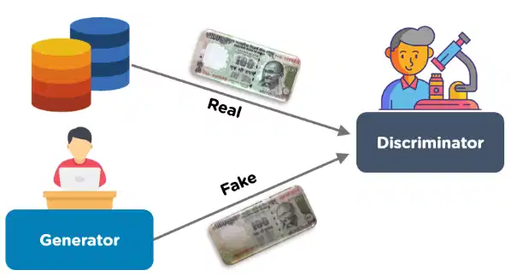
Introduction to GANs
GANs consist of a Generator and a Discriminator
They generate realistic synthetic data
Applications: Deepfakes, AI-generated art, and image synthesis

Slide 4
GAN Objective Function
The discriminator D tries to maximize this function:
It wants to correctly classify real data (x) as real (D(x))
It wants to classify fake data G(z) as fake (low D(G(z)))
The generator G tries to minimize this function:
It wants to fool the discriminator by making D(G(z)) as close to 1 as possible.
This creates a competitive game between G and D, driving G to produce realistic data.

Slide 5
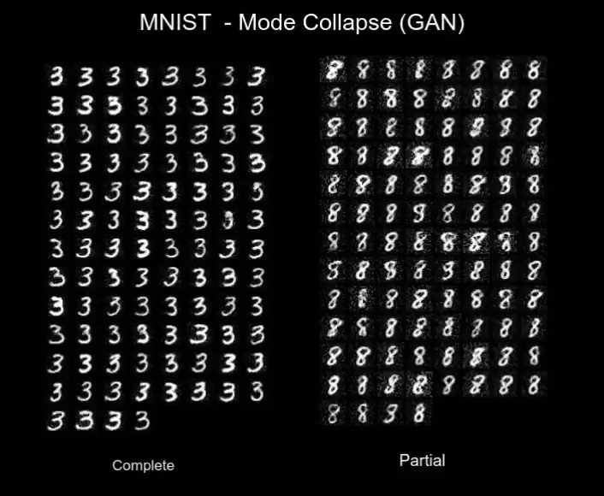
What is Mode Collapse?
The generator produces limited variations of outputs.
'Collapses' to generating a few patterns repeatedly.
Leads to low-quality and unrealistic data generation

Slide 6
Causes of Mode Collapse
Unstable Training – Adversarial training makes it hard to balance G and D
Overpowering Discriminator – A too strong discriminator prevents learning.
Poor Generator Updates – The generator may collapse to simple strategies.
High Learning Rate – Causes abrupt updates leading to unstable behavior.

Slide 7
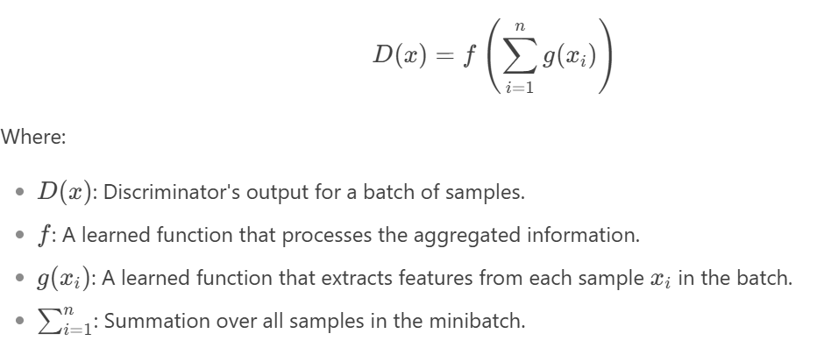
Solution 1 – Minibatch Discrimination
The discriminator evaluates groups of samples instead of individual ones.
Helps prevent the generator from producing similar outputs repeatedly.

Slide 8
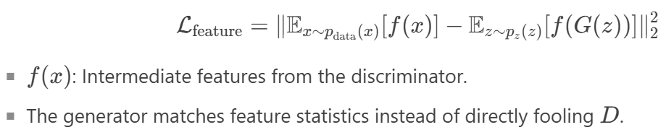
Solution 2 – Feature Matching
Instead of trying to fool the discriminator directly, the generator tries to match feature statistics
Encourages diverse outputs and prevents mode collapse

Slide 9
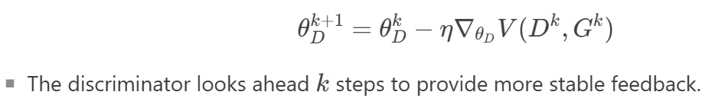
Solution 3 – Unrolled GANs
The discriminator looks ahead multiple training steps to provide more stable feedback
Add the unrolled optimization step
Reduces the chance of the generator converging to a single mode

Slide 10
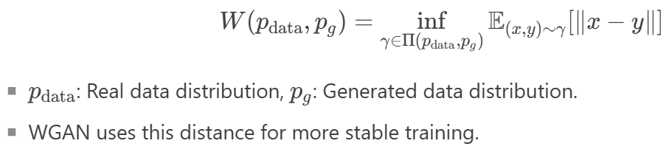
Solution 4 – Wasserstein GAN (WGAN)
Uses Wasserstein (Earth Mover’s ) Distance instead of traditional loss
Leads to more stable training and prevents mode collapse

Slide 11
Advantages of Addressing ModE Collapse
Improved quality and diversity of generated samples
Ability to learn complex data distributions
Increased stability and reliability of GAN training

Slide 12
Disadvantages of addressing ModE Collapse
Higher computational and training costs
Increased risk of overfitting
More difficult to train due to increased complexness
Prone to adversarial attacks

Slide 13
Conclusion
Mode collapse is a major issue in GAN training.
Several techniques help mitigate the problem:
Minibatch Discrimination
Feature Matching
Unrolled GANs
WGAN
Future work includes improved architectures for stable training.

Slide 14
References
https://www.geeksforgeeks.org/modal-collapse-in-gans/
https://medium.com/@miraytopal/what-is-mode-collapse-in-gans-d3428a7bd9b8
https://www.linkedin.com/pulse/addressing-mode-collapse-generative-adversarial-gans-andrew-jaramillo/

