Slide 1
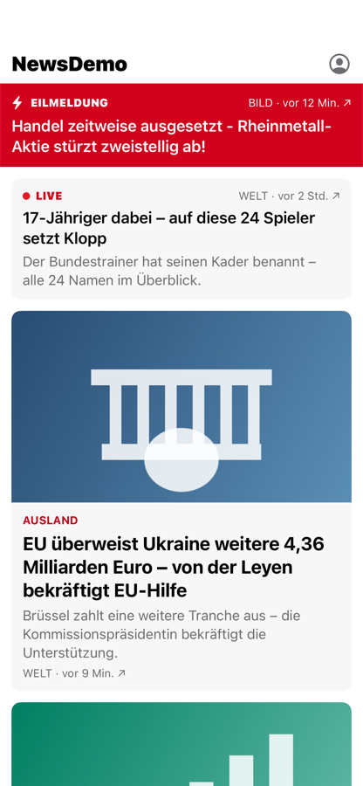
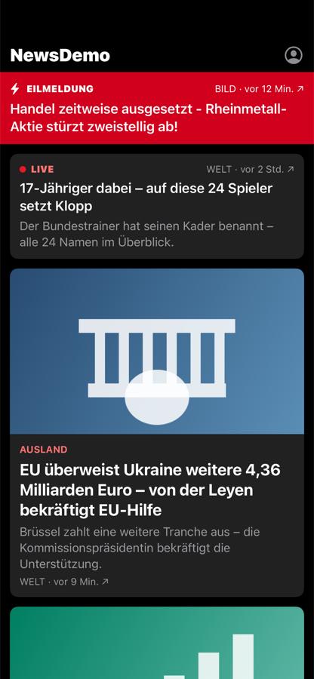
Catching visual bugs before readers do
Screenshot testing with mocked data for the BILD and WELT apps. Built for iOS, the same approach for Android.
Saad Iftikhar · QA Engineer
Light
Dark
Notes:
GOAL: Introduce yourself and set expectations: this is real and it runs.
TIME: about 1 min
SAY:
Hi, I'm Saad. Today I'll show how we can catch visual bugs in the BILD and WELT apps before a reader sees them, using screenshot tests with mocked data.
Everything I show is real and runs: a small news app in SwiftUI, its tests, and a CI pipeline on GitHub. I built it for iOS end to end; at the end I'll show how Android does exactly the same. A few times I'll switch to the terminal to show it live.
DO (on screen):
Stay on the slide.
NEXT (bridge sentence): "Let's start with why this is hard."

Slide 2
The problem: too many states to check by hand
4 apps
A news feed is many screens in one
BILD, Sport BILD, WELT News, WELT Edition
Breaking news, live tickers, PLUS paywalls, ads, video, offline and error states, dark mode, huge accessibility text, long German compound words. Each depends on backend data.
2 platforms
iOS and Android, built natively
The expensive bug is a small one
89 states
A refactor silently drops the PLUS badge: paid articles now look free. Nobody notices in a manual release check, because the screen still looks fine.
per platform in the demo alone
Notes:
GOAL: Make them feel the problem; plant the PLUS-badge example you'll use in the demo.
TIME: about 1.5 min
SAY:
Four apps share one design system, on two platforms. A single news feed has dozens of visual states, and all of them depend on data from the backend: breaking news, live tickers, PLUS articles, ads, offline, dark mode, accessibility text sizes, very long German words.
Checking these by hand before every release doesn't scale. And the bugs that cost money are small. My example for today: a refactor that silently drops the PLUS badge. The screen still looks fine, so nobody notices. But paid articles now look free.
DO (on screen):
Stay on the slide.
NEXT (bridge sentence): "So machines should compare the pixels, and people should decide. Here's how."

Slide 3
The approach in one picture
Same: pass
1
2
3
Shared JSON fixtures
Render the real screen
Compare to golden
Different: fail + diff
Frozen fake API data, used by both platforms
Production UI code, in a fast in-process test
An approved PNG stored in git
Inputs are frozen, so a difference always means the code changed how a screen looks
The fixtures are plain JSON: Android can use the very same files and test names
A human reviews every difference: machines compare, people decide
LIVE · Editor
Notes:
GOAL: They understand fixture → render → golden, and see that each is a real file.
TIME: about 2 min
SAY:
Three steps. One: JSON fixtures, frozen fake API data. Two: the test renders the real production screen with that data, in memory. Three: it compares the picture with a "golden", an approved screenshot stored in git. Same picture: pass. Different: fail, with a diff image.
Because every input is frozen, a difference can only mean the code changed how the screen looks. Let me show you the three pieces.
DO (on screen):
1. [Finder] Show the folder with the fake data.
$ open fixtures/feed
You'll see: The JSON files: feed_default, feed_edge_cases, feed_hostile_content…
2. [VS Code] Open the default fixture.
$ open -a "Visual Studio Code" fixtures/feed/feed_default.json
You'll see: Point at "premium": true on tsr-002: "this is the PLUS article we'll break later".
3. [VS Code] Open the screenshot test.
$ open -a "Visual Studio Code" ios/NewsKit/Tests/NewsUISnapshotTests/FeedScreenSnapshotTests.swift
You'll see: func test_feed_default: one line renders the real feed with the fixture and compares it.
4. [Finder] Show the goldens folder.
$ open ios/NewsKit/Tests/NewsUISnapshotTests/__Snapshots__/FeedScreenSnapshotTests
You'll see: One PNG per test and variant: test_feed_default.light.png, .dark.png, .light_xxxl.png…
5. [Preview] Open that golden.
$ open ios/NewsKit/Tests/NewsUISnapshotTests/__Snapshots__/FeedScreenSnapshotTests/test_feed_default.light.png
You'll see: "This is the approved picture every run is compared with."
6. Back to the slideshow.
IF IT FAILS: If an app doesn't open, describe the three folders; they're on the slide.
NEXT (bridge sentence): "Which tool draws these pictures?"

Slide 4
Tooling: native, in-process, fast
iOS (this demo): swift-snapshot-testing
Android: Roborazzi on Robolectric
Point-Free's library, pinned. Renders SwiftUI in-process on a pinned simulator. Fits a TCA codebase: mocking reuses withDependencies.
About 40 s for 89 screenshots and 35 logic tests.
The same approach for Compose: renders on the JVM, no emulator, works with Hilt, and the same run drives interaction and accessibility checks.
Built in an earlier version of this demo: 89 screenshots in ~20 s.
Rejected for the PR gate: Paparazzi (2.0 alpha, no Hilt), Compose Preview Screenshot Testing (alpha), Appium or Maestro with a paid visual service (minutes per screen, flakier). Device-level tools stay, as a nightly Layer 2 for what in-process rendering can't see: system chrome, real devices, hostile settings.
LIVE · Terminal
Notes:
GOAL: Justify the tool choice and show a real green run.
TIME: about 1.5 min
SAY:
On iOS I use swift-snapshot-testing from Point-Free: it renders SwiftUI inside the test on a pinned simulator, and since BILD and WELT probably use TCA, mocking reuses its dependency system. On Android the same role goes to Roborazzi on Robolectric: no emulator, works with Hilt.
Rejected for the pull-request gate: Paparazzi and Google's preview tool, both alpha, and device-based tools with a paid service, which take minutes per screen. Those stay for a nightly run on real devices. Let me run the whole iOS suite.
DO (on screen):
1. [Terminal] Run all screenshot and logic tests.
$ make ios-test
You'll see: ~40–60 s (start it, keep talking), ends with "no snapshot failures": 89 screenshots and 35 logic tests, green.
2. [Terminal] (Optional) list every command.
$ make help
You'll see: Each make target with a one-line description.
3. Back to the slideshow.
IF IT FAILS: If it's slow, keep talking about the tools; prepare.sh already ran it green.
NEXT (bridge sentence): "Now, the question everyone asks about a news app."

Slide 5

Mocked data: content changes, goldens don't
A golden belongs to a fixture, never to live news, so it can't go stale
Everything is pinned: clock, de_DE locale, Berlin time zone, seeded randomness, animations off, local images
Timestamps are relative to the pinned clock: "vor 9 Min." forever
Real data changes are tested without screenshots: decoder contract tests, a fuzz test, hostile-content fixtures
When the API changes, the fixture is refreshed in its own PR, which shows exactly which goldens change
Feed, light
Largest text
LIVE · Browser
Notes:
GOAL: Answer "won't the goldens be outdated tomorrow?" before they ask it.
TIME: about 1.5 min
SAY:
The content changes every minute, so won't the goldens be out of date tomorrow? No: a golden belongs to a fixture, not to live news. The fixture is frozen, and so is everything else: the clock, the German locale, the Berlin time zone, random numbers, animations, images. "vor 9 Min." stays "vor 9 Min." forever.
What really changes is the shape of the data, and that's tested without screenshots: contract tests, a fuzz test, hostile content. Here are all 89 approved states.
DO (on screen):
1. [VS Code] Show where the clock, locale and time zone are pinned.
$ open -a "Visual Studio Code" ios/NewsKit/Sources/NewsFixtures/FixtureStore.swift
You'll see: FixtureEnvironment: now = 2026-11-05 14:13:20Z, de_DE, Europe/Berlin.
2. [Browser] Open the gallery of every golden (built by prepare.sh).
$ open artifacts/gallery/index.html
You'll see: All 89 screenshots, grouped by test; light, dark and largest text side by side.
3. Back to the slideshow.
IF IT FAILS: If the gallery is missing: make gallery (1 s), then open it again.
NEXT (bridge sentence): "Now the part I care about most: does it catch a real bug?"

Slide 6
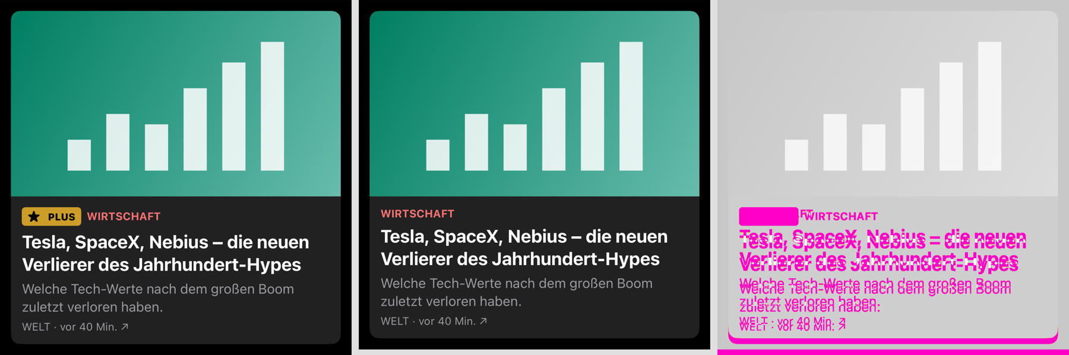
Demo: a refactor drops the PLUS badge
Golden (approved)
This PR
Changed pixels
29 of 89
60 green
10 + 19
screenshots fail
unaffected screens stay green
layout + visible, 0 subtle
LIVE · Terminal
Notes:
GOAL: The core moment: a harmless-looking change is caught.
TIME: about 3 min
SAY:
This branch contains a plausible refactor: "simplify the kicker row, tighten the banner". One file, a few lines. It drops the PLUS badge and takes 2 points of padding off the breaking banner.
[While the tests run, ~1 min:] This is supposed to fail. Every screen that shows a PLUS teaser or the banner should go red; everything else should stay green.
29 of 89 screenshots fail. Every unaffected screen stays green: games, account, the paywall itself. And the report already says what kind of change each one is: 10 layout changes, because the banner got shorter, and 19 visible ones.
DO (on screen):
1. [Terminal] Show how small the change is.
$ git diff main demo/regression --stat
You'll see: 1 file changed: "looks harmless".
2. [Terminal] Switch to the branch with the bug.
$ git checkout demo/regression
You'll see: Switched to branch 'demo/regression'.
3. [Terminal] Run the tests: they must fail.
$ make ios-test
You'll see: ~1 min, fails: "diff report: 29 failure(s)".
4. [Browser] Open the diff page.
$ open artifacts/ios/diffs/index.html
You'll see: Scroll to ComponentSnapshotTests/test_teaserCard_premium.dark: golden with PLUS | new without | magenta = the missing badge.
5. [Terminal] Show the triage table (what the PR bot posts).
$ cat artifacts/ios/diffs/summary.md
You'll see: 29 changed (layout: 10, visible: 19, subtle: 0).
6. [Terminal] ALWAYS switch back to the correct code.
$ git checkout main
You'll see: Switched to branch 'main'.
7. Back to the slideshow.
IF IT FAILS: If anything goes wrong live: git checkout main, then open docs/regression (the captured CI result). "Here's the captured run."
NEXT (bridge sentence): "So the gate failed. What happens next is a human decision."

Slide 7
Review: machines compare, people decide
1
PR fails
Not intended: fix the code
Bot comment: which screens, and what kind of change
Like the PLUS badge. The goldens stay; the PR stays blocked until the screen is right again.
2
Human looks
Diff gallery: golden, this PR, changed pixels
Intended: re-record on CI, then approve
Add the record-snapshots label. CI re-records on the pinned image, proves the new goldens (lint plus a full verify) and pushes them as a bot commit. A design or QA code owner approves the image diff.
Goldens never come from a laptop. Approval is never automatic.
LIVE · Browser
Notes:
GOAL: Show the decision path, and that it ran for real on GitHub.
TIME: about 1.5 min
SAY:
When a pull request fails, the bot posts one comment that lists the changed screens and what kind of change each is. A human opens the diff gallery and decides.
Not intended, like the badge: fix the code, the goldens stay. That's this pull request: blocked. Intended, like a redesign: add the record-snapshots label. CI re-records the goldens on its fixed machine, proves them, and pushes them as a bot commit; a design or QA code owner approves the image diff. That's this second pull request. Goldens never come from a laptop, and approval is never automatic.
DO (on screen):
1. [Browser] The regression pull request: blocked.
$ open https://github.com/SaadiIftikhar/newsdemo-screenshot-testing/pull/1
You'll see: Red check; the bot comment with the triage table (29 changed).
2. [Browser] The intended redesign: re-recorded by CI.
$ open https://github.com/SaadiIftikhar/newsdemo-screenshot-testing/pull/2/commits
You'll see: A "snapshot-bot" commit: "re-record iOS goldens"; then green checks.
3. [Terminal] Who must approve golden changes.
$ cat .github/CODEOWNERS
You'll see: Golden folders need design/QA review.
4. Back to the slideshow.
IF IT FAILS: Offline? open docs/regression/summary.md: "this is the comment the bot posts".
NEXT (bridge sentence): "A fair question: how much difference do we allow?"

Slide 8
How much difference is allowed?
Rendering noise: ignored
Any real change: fails
Triage, not approval
Perceptual precision 0.98 absorbs GPU anti-aliasing: differences no person can see. A 2pt shift still fails.
A 2pt shift and a missing badge are both "small". Both are bugs. A pixel count can't tell intent.
Each change is labelled layout, visible or subtle, so the reviewer knows what to look for. A person still decides.
No "small diff = auto-pass". Tolerance is never loosened globally; a per-test exception needs a comment and a review.
Notes:
GOAL: Show you thought about tolerance and human confirmation.
TIME: about 1.5 min
SAY:
Rendering noise is ignored: a perceptual precision of 0.98 absorbs GPU anti-aliasing. Anything beyond noise fails, however small. A 2-point shift and a missing badge are both small, and both are bugs: a pixel count can't tell intent.
So the labels are triage, not approval. Tolerance is never loosened globally; a per-test exception needs a comment and a review.
DO (on screen):
1. [VS Code] (Optional, if asked) the tolerance in code.
$ open -a "Visual Studio Code" ios/NewsKit/Tests/NewsUISnapshotTests/SnapshotSupport.swift
You'll see: perceptualPrecision: 0.98, and why, in the comment.
2. Back to the slideshow.
NEXT (bridge sentence): "Knowing it's a news app, I added the edge cases real content produces."

Slide 9
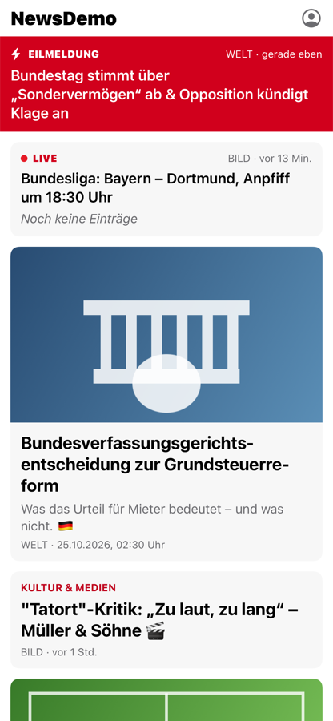
Edge cases of a news app
Messy CMS text
Long German words
&amp;, stray line breaks, emoji: cleaned identically on both platforms
Soft hyphens from the CMS let them break correctly
Ticker before kick-off
Long videos
"Noch keine Einträge" (it used to vanish)
1:02:03 (it showed 62:03)
Offline
Time
The last feed stays: "Stand 15:02 Uhr", pull to refresh
Daylight-saving night, New Year, clock skew
Hostile content
Plus a seeded fuzz test: one feed item corrupted 300 ways, and every other item must still show.
LIVE · Simulator
Notes:
GOAL: Show product thinking: real content is messy, and the app now handles it.
TIME: about 2 min
SAY:
Messy text from the content system, like ampersand entities and stray line breaks, is cleaned before it reaches the screen. Soft hyphens let long German words break properly. A live ticker before kick-off used to disappear; now it says "Noch keine Einträge". A one-hour video showed 62:03; now 1:02:03. Offline, the last feed stays with the time it was loaded. And dates: the daylight-saving night, New Year, clock skew.
Plus a fuzz test: one feed item corrupted 300 ways, and every other item must still show.
DO (on screen):
1. [VS Code] The messy fixture.
$ open -a "Visual Studio Code" fixtures/feed/feed_hostile_content.json
You'll see: &amp;, line breaks inside headlines, "durationSeconds": 3723.
2. [Simulator] The app with that fixture.
$ make ios-run FIXTURE=feed_hostile_content
You'll see: ~15 s: clean headlines, "Noch keine Einträge", the 1:02:03 video.
3. [Simulator] Offline after the first load.
$ make ios-run DROP_CONNECTION=1
You'll see: Drag the feed down: "Offline – gespeicherte Artikel · Stand 15:13 Uhr", articles stay.
4. Back to the slideshow.
IF IT FAILS: If the simulator is slow, use the screenshots on this slide.
NEXT (bridge sentence): "Screenshots only see pixels. So I added checks that see more."

Slide 10
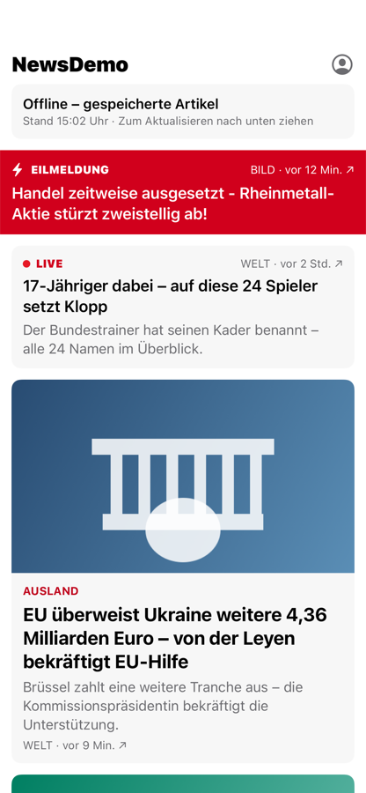
Beyond pixels: checks that can actually fail
1
Accessibility audits on every screen
Apple's audit runs on the real app. It found hidden tabs still reachable by VoiceOver: invisible in every screenshot.
2
Guards against green-but-empty tests
Golden lint (blank images), recording from an empty folder, fixture preconditions such as "the premium teaser is premium".
3
Every guard is shown to fail first
A check that can't fail protects nothing. On the Android version, an official accessibility hook silently checked nothing: a broken button passed.
Offline, cached feed
LIVE · Terminal
Notes:
GOAL: Show the quality of the safety net.
TIME: about 1.5 min
SAY:
Accessibility: Apple's audit runs on every screen. It found hidden tabs that VoiceOver could still reach: invisible in every screenshot.
Guards against tests that pass while protecting nothing: a lint rejects blank goldens, and fixture checks make sure "the premium teaser" really is premium. My rule: every guard must be shown to fail first. On the Android version, that caught an official accessibility hook that silently checked nothing.
DO (on screen):
1. [Terminal] Run the golden lint.
$ make lint-goldens
You'll see: "checked 89 image(s)" in ~2 s.
2. [VS Code] (Optional) the accessibility audit test.
$ open -a "Visual Studio Code" ios/UITests/AccessibilityAuditTests.swift
You'll see: Every accepted exception is documented with evidence. Don't run make ios-ui-test live (~5 min).
3. Back to the slideshow.
NEXT (bridge sentence): "Does this survive a real CI pipeline?"

Slide 11
CI/CD: proven on GitHub Actions
When it runs
Every PR, on its merge result
The merge queue
Main, after merge
Nightly in production (off in the demo)
What real CI taught us
• The pinned iOS 26.5 simulator wasn't on GitHub's Xcode 27 machines: re-pinned to 27.0 and re-recorded on CI, in one reviewed PR
• A tool (xcodegen) wasn't on the runner: now installed, pinned
• The first flaky UI test: fixed at the cause, with explicit waits; never retried
• A Mac verifies the CI-recorded goldens: local equals CI
• macOS minutes are expensive (10× on private repos): at scale, run iOS only when iOS files change
12–19 min
full iOS run, incl. UI tests and the accessibility audit
LIVE · Browser
Notes:
GOAL: Show it works beyond your laptop, and what real CI taught you.
TIME: about 1.5 min
SAY:
It runs on every pull request on its merge result, on the merge queue and on main. A full iOS run, snapshots plus UI tests and the accessibility audit, takes 12 to 19 minutes.
Real CI taught me things a laptop didn't. The simulator version I'd pinned didn't exist on GitHub's machines, so I re-pinned it and let CI re-record every golden, in one reviewed pull request. A tool was missing on the runner. And I got the first flaky test, racing an animation: I fixed the cause, no retries.
DO (on screen):
1. [Browser] The Actions tab.
$ open https://github.com/SaadiIftikhar/newsdemo-screenshot-testing/actions
You'll see: The run history: red for the regression, green for main; open a run to show its steps.
2. Back to the slideshow.
IF IT FAILS: Offline? Use the numbers on the slide.
NEXT (bridge sentence): "How would I roll this out at BILD and WELT?"

Slide 12
Rollout: about 4 sprints
Sprint | Step | Exit criterion
1 | One app, both platforms: support module, 5 design-system components, CI report-only | Green for 5 days, no flakes
2 | Shared fixtures, feed and paywall states, diff gallery and PR comment; pair with each squad | Every squad merged one snapshot test
3 | Gate required and in the Definition of Done; CI-only recording; nightly Layer 2 | Under 10 min, flake rate under 1%
4+ | The other three apps; accessibility snapshots; trial a hosted review tool | Visual bugs caught by the gate, not in release testing
Ownership: developers write and keep the tests; QA owns the strategy, the fixtures and the matrix rules; design approves goldens. AI may triage diffs, a human approves.
Notes:
GOAL: Show you can lead the change, not just build it.
TIME: about 1.5 min
SAY:
In about four sprints, without blocking feature work. Sprint 1: one app, both platforms, five design-system components, CI report-only. Sprint 2: shared fixtures, feed and paywall states, the diff gallery, and pairing with each squad. Sprint 3: the gate becomes required and part of the Definition of Done. Then the other three apps.
Developers write and maintain the tests, because they change the UI. QA owns the system around them: the strategy, the fixtures, the rules for what we test. Design approves goldens.
DO (on screen):
Stay on the slide.
NEXT (bridge sentence): "And Android? Exactly the same idea."

Slide 13
Android: the same approach
 | iOS (this demo) | Android (same design)
Fake data | fixtures/*.json | the same files
Screenshot tool | swift-snapshot-testing | Roborazzi on Robolectric (JVM, no emulator)
Seam for mocks | TCA withDependencies | Hilt @TestInstallIn, Coil fake engine
Test + golden names | test_feed_default.light.png | the same names → the same failures
CI | macOS runner (xcode-27) | Linux runner, in parallel
Built and then cut from this demo: the Android version ran the same 89 screenshots in ~20 s, failed on the same 29 in the regression, and found a decoder difference that made a PLUS article free.
Notes:
GOAL: Show the design transfers 1:1 to Android, and that you've done it.
TIME: about 1.5 min
SAY:
Everything I showed works on Android with the same pieces. Android reads the same fixture files with its own decoder and asserts the same contracts, and the tests use the same names, so one regression fails in the same places on both platforms.
The tool is Roborazzi on Robolectric: Compose rendered on the JVM, no emulator. I built that version first: the same 89 screenshots ran in about 20 seconds, and it found real bugs, like a decoder difference that made a PLUS article free on Android. I cut it from the demo to keep today focused.
DO (on screen):
Stay on the slide.
NEXT (bridge sentence): "To wrap up."

Slide 14
Takeaways
Frozen data makes every difference meaningful
Machines compare; a person decides what's intended
The same fixtures carry the approach to Android
Questions?
Largest text
Dark mode
Notes:
GOAL: Three sentences they'll remember, then questions.
TIME: about 0.5 min
SAY:
Frozen data makes every difference meaningful. Machines compare, but a person decides what's intended. And the same fixtures carry the approach to Android.
Everything is in the repo: the strategy, the evidence, the regression and the CI runs. Happy to take questions.
DO (on screen):
1. [Terminal] Make sure you're back on main.
$ git branch --show-current
You'll see: main
2. [Preview] Keep the strategy ready for questions.
$ open STRATEGY.pdf
You'll see: The 3-page strategy.
3. Back to the slideshow.

