Slide 1
Student Result Management System Mobile Application
Group 2
E/18/398 Wijerathne RMNS
E/18/147 Jameel S
E/18/379 Wanduragala TDB

Slide 2
What is this application for?
Manage and analyse Course marks and keep track of student’s performance

Slide 3

Users of this application
Undergraduate students

Slide 4




Technology Stack
UI - Android Studio
Storage - MYSQL database
Back end development- Spring API
Testing of the application- Postman
Found in the app!

Slide 5

Solution Architecture

Slide 6
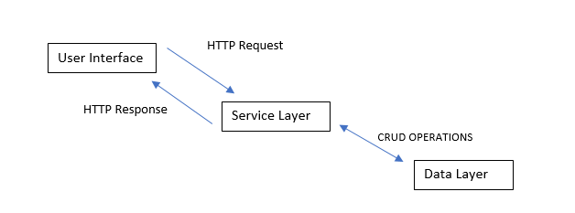
High-Level System Organization

Slide 7
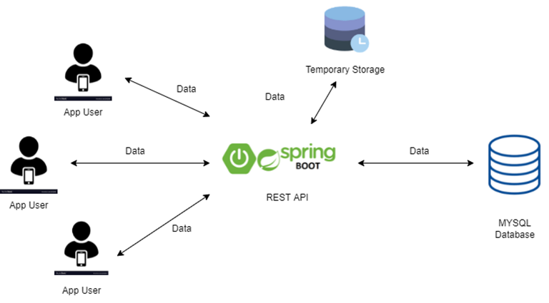
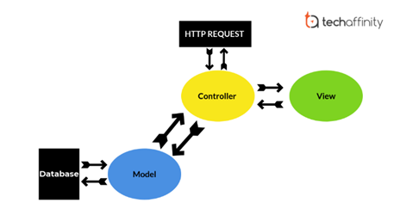
Data Flow

Slide 8
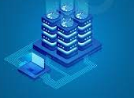
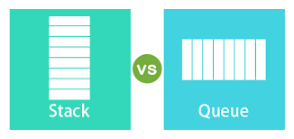
Storage of Data
The data required for calculations will be mainly stored in a MySql database.
The expected grades, GPA and such data entered by a user upon logging into the app, will be stored temporarily. This data will be deleted when necessary (a long time of inactivity, etc)
To store data temporarily we will be using stacks or queues.

Slide 9
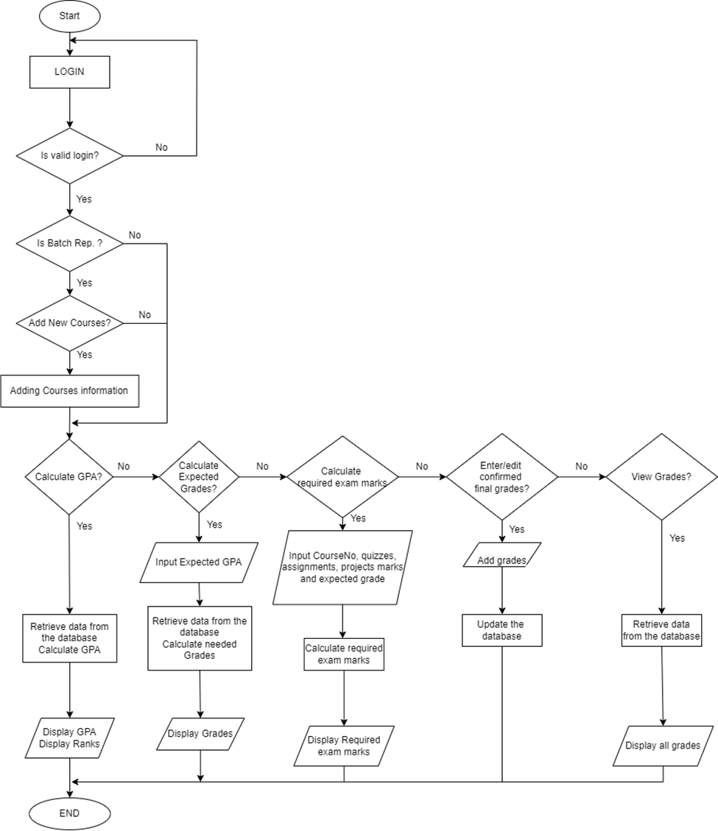
Control Flow

Slide 10
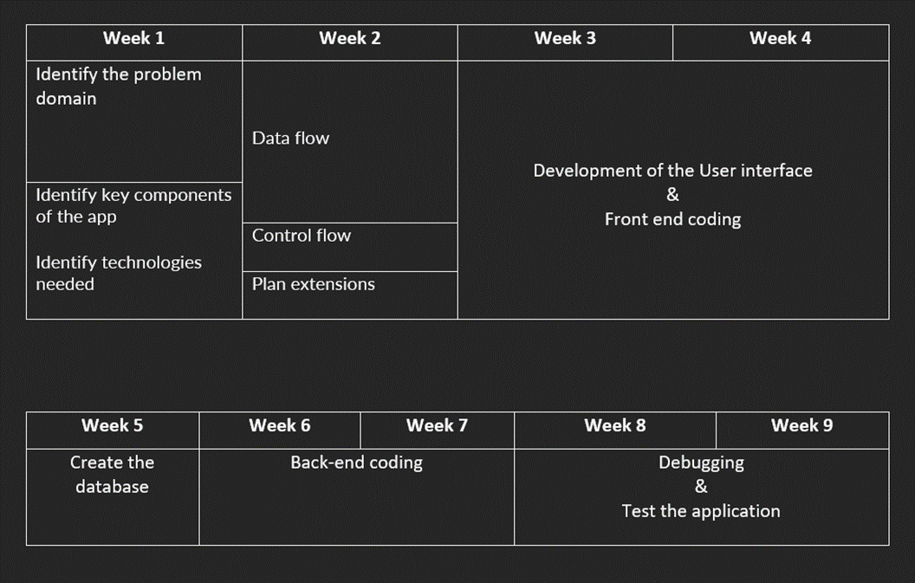
Project Plan

Slide 11
Extensions
Ability for the Batch Representative to add the marks allocated for continuous assessments separately for each course.
Ability to get a graphical analysis of his performance in various courses and semesters. This representation can be done against his/ her own performance or against the field.
Add a cache to be part of the temporary memory that will be used to enhance the performance of the application

Slide 12
GitHub Repository
https://github.com/SaadiaJameel/E18-CO225-group2
Github wiki
https://github.com/SaadiaJameel/E18-CO225-group2/wiki

Slide 13
ThankYou!

