Slide 1























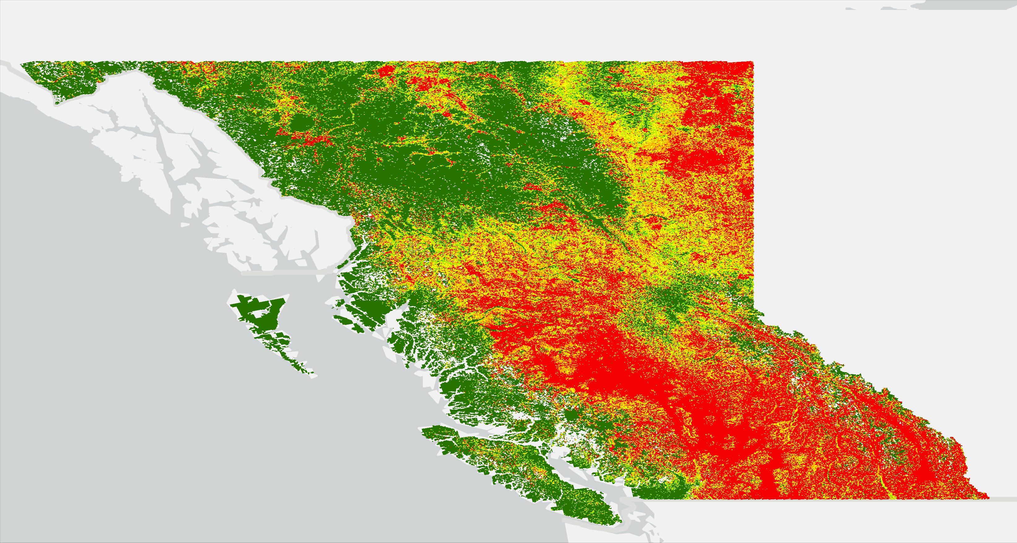




1
Data acquisition
2
Predictor variables
3
Spatiotemporal analyses
4
Data preparation & sampling
5
Modeling pipeline
6
Validation & interpretability
7
Outputs & exposure
1. Data Acquisition
Raster layers
Landsat-8
SRTM
ESRI-LULC
TerraClimate
ERA5-Land
Vector layers
Canadian Wildland Fire Information System (CWFIS) 2000-2024
Natural Resources Canada
2. Predictor Variables
3. Spatiotemporal Analyses (2000-2024)
Fire inventory
Burned area
Climate
National fire database fire point data
National burned-area composite data
Climatic data (2000-2024)
Topographic
Environmental
Vegetation
Aspect
Slope
Elevation
TWI
Profile curvature
Plan curvature
Land use / land cover
Distance from rivers
Distance from households
Distance from roads
NDVI (Normalized Difference Vegetation Index)
Annual & monthly fire trends
Fire density maps
(annual · monthly · seasonal)
Climate variability & trends
District-wise analysis
District-wise analysis
Temperature · Wind speed · Relative humidity · Precipitation · Evapotranspiration · Drought severity index · Soil moisture
All predictors resampled to 1.5 km and harmonized
to a common grid (BC Albers, EPSG:3005)
4. Data Preparation & Sampling
5. Modeling Pipeline
Inventory maps preparation
Wildfire points
2000-2024
1,992 fire, 1,992 non-fire points
Raster to point (1.5 km grid)
Dataset split
(70% training/30% testing)
Preprocessing & feature selection (RF-RFE)
10-fold spatial
cross-validation
DL models (LSTM & BiLSTM)
Hyperparameter optimization (PSO)
Implemented in ArcGIS Pro 3.6
7. Outputs & Exposure Assessment
6. Validation & Interpretability
Wildfire susceptibility mapping
Exposure assessment
Model evaluation
Very Low
Very High susceptibility zones
Accuracy · Sensitivity · Specificity · Precision · F1-score · ROC-AUC · PR-AUC
Low
Top ten districts
Cross-border consistency
Moderate
Comparison with U.S. FSim estimates
Consistent high-susceptibility patterns across the border
Interpretability SHAP analysis
High
Very High
Influential-variable assessment global & local feature attributions
BiLSTM-PSO · AUC = 0.92 · 1.5 km resolution
Trees
Road network
Households

