Slide 1
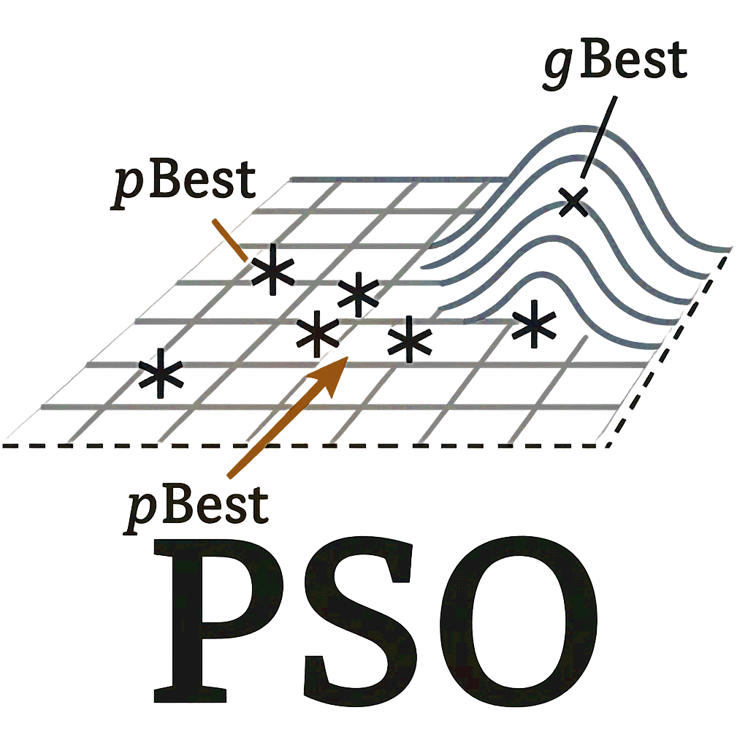
PSO
(c)
Start
Initialize population randomly
Evaluate fitness of each particle and identify global best
Yes
Are termination conditions met?
No
Update velocity and position of particles
Recalculate fitness of each particle
Update personal best for each particle
Update global best position
End
Legend
Start / End
initialization & fitness
particle-update step
decision
main flow
branch / iteration loop

