Slide 1
Coal lab final project
By: Saad Nadeem (21F-9104)
To: Sir Rana Mubeen Tariq
1

Slide 2
ARITHMETIC CALCULATOR USING ASSEMBLY LANGUAGE (X8086)

Slide 3
AGENDA
Introduction
Objective
Project Description
Project Features
Tools Used
Outcome
Project Working
Some Sample Results

Slide 4
INTRODUCTION
Implementation of Calculator Program, using Assembly Language 8086.
4

Slide 5
Objective
To implement my approach in the best way possible, and to have most of the knowledge towards my implementation.
5

Slide 6
Project description
Implementation of Calculator Program, using Assembly Language 8086.
Project is a Simple and User-Friendly “Calculator Program”.
It can perform Simple Arithmetic Operations depending upon the user input.
For Instance, It will take two numbers as input and will output the desired result. Just like addition of two numbers.
6

Slide 7
Project features
A Calculator Program fully Capable of doing Arithmetic Operations.
Simple Approach towards program execution.
Fully Capable to perform Simple Arithmetic Operations.
For Instance:- > Addition > Subtraction > Multiplication > Division
User-Friendly, Easy to use with simple instructions.
7

Slide 8
Tools used
DOS Box (Open-Source Emulator to run MS-DOS)
Microsoft Macro Assembler (MASM x8086)
Linker to Link Object Modules into a single object file (.exe)
8

Slide 9
instructions used
JUMPS
ADD
SUB
MUL
DIV
PROCEDURES
MACRO
CONDITIONAL JUMPS
CMP
LABELS
9

Slide 10
Outcome
A successful operational, user-friendly calculator.
Furthermore, It helped me to revise most of my Assembly Language (x8086) concepts and to implement them in my project.
10

Slide 11
project working
11

Slide 12
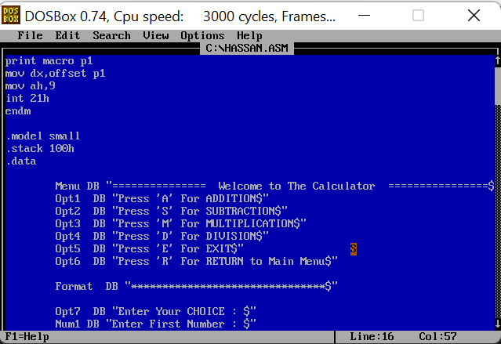
Use of macro
12

Slide 13
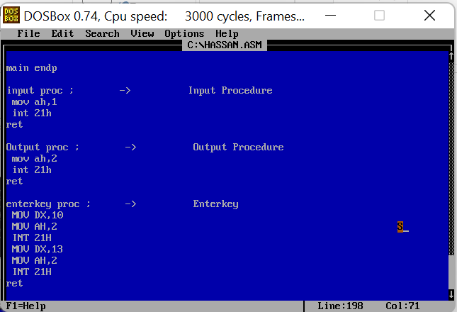
Use of procedures
113

Slide 14
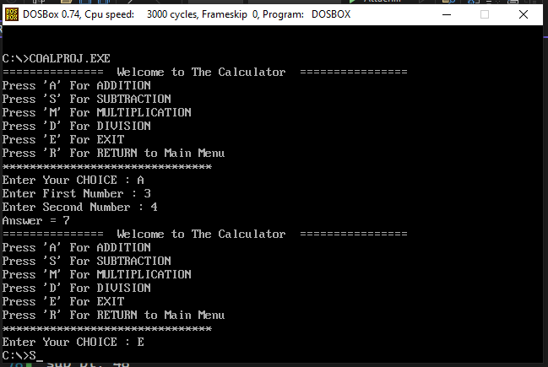
ADDITION
14

Slide 15
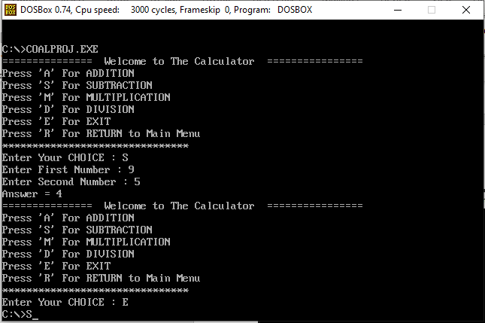
Subtraction
15

Slide 16
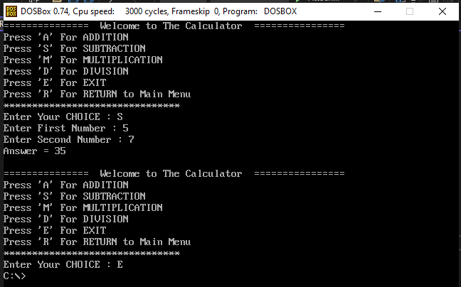
Multiplication
16

Slide 17
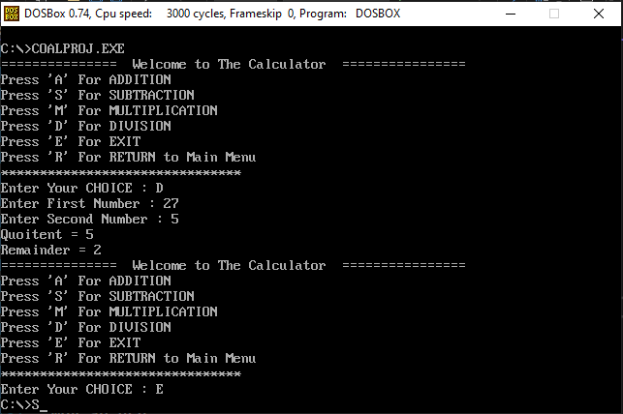
Division
17

Slide 18
Some sample results
​Sr. | INPUT 1 | INPUT 2 | OPERATION | OUTPUT
1 | 3 | 4 | Addition | 7
2 | 9 | 5 | Subtraction | 4
3 | 5 | 7 | Multiplication | 35
4 | 27 | 5 | Division | 5, 2
18

Slide 19
ANY QUESTIONS ??
19

Slide 20
THANK YOU !! ☺
20

Slide 21
THE END
21

