Slide 1

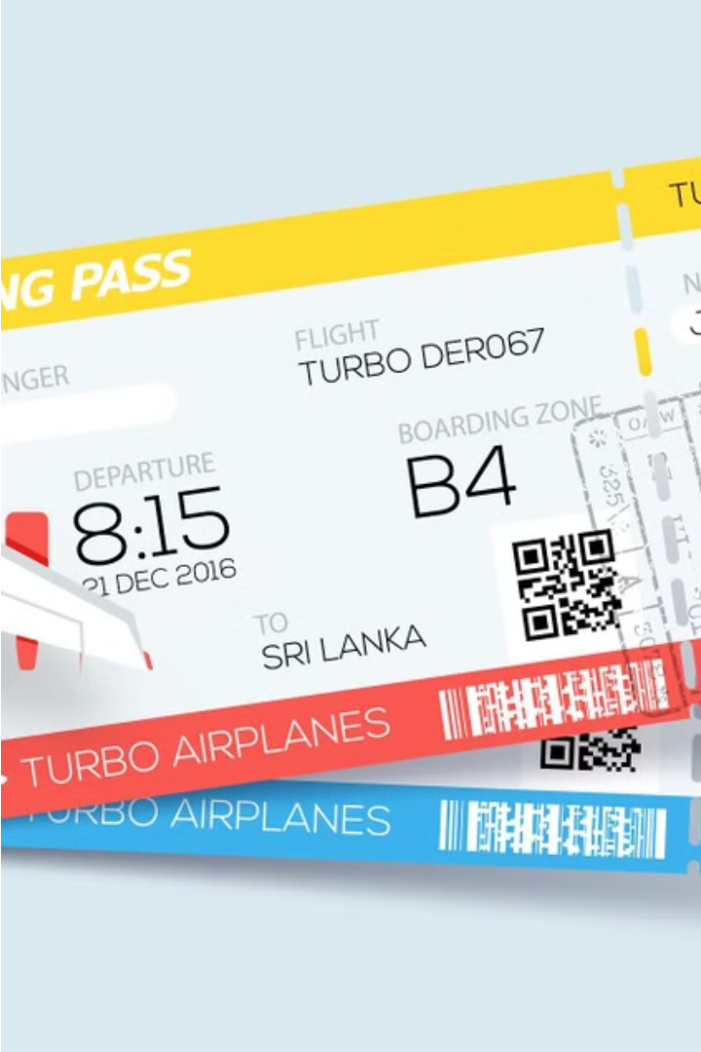
Flight Ticket Trek
Presented By:
Muhammad Saad Khan
Muhammad Waqas Siddique
Abdul Basit

Slide 2




Libraries Used:
Conio.h ; have input output commands built in functions like getch().
Fstream ; for file handling
Cctype;for dealing with characters
Strings;for dealing with strings

Slide 3
Booking Ticket
Select Your Destination
1
Choose your departure and arrival locations from our extensive database of domestic and international destinations. Find the route that best fits your travel needs.
2
Pick Your Dates
Easily select your travel dates.
Complete Your Booking
3
Securely enter your personal information for ticket purchase.

Slide 4
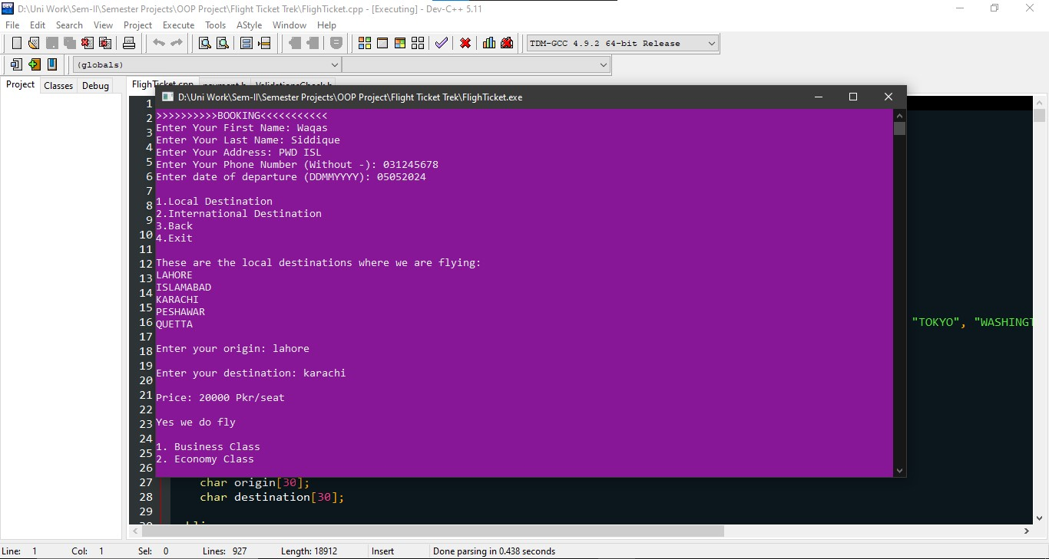
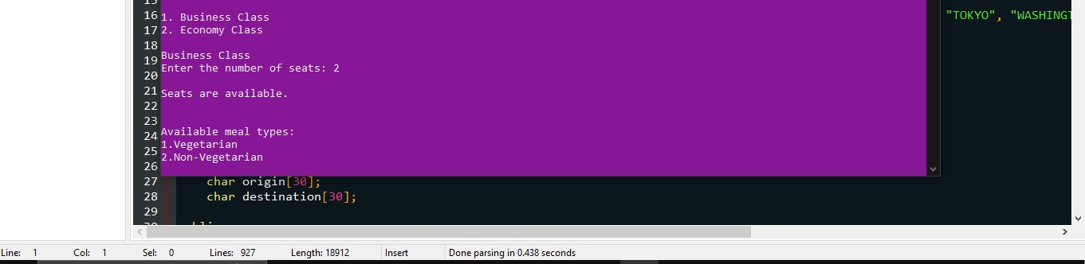
Booking Ticket:

Slide 5

Display Booked Tickets
1
View Ticket Details
Easily access and review all your booked flight tickets, including departure and arrival times, flight numbers, and passenger information.

Slide 6
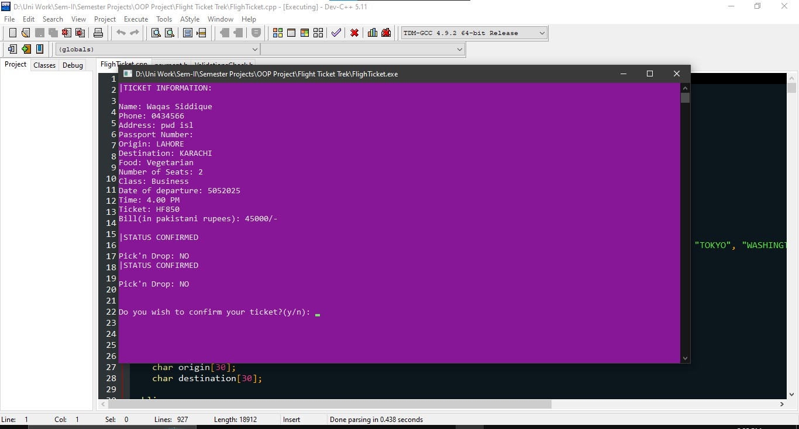
Display Ticket:

Slide 7
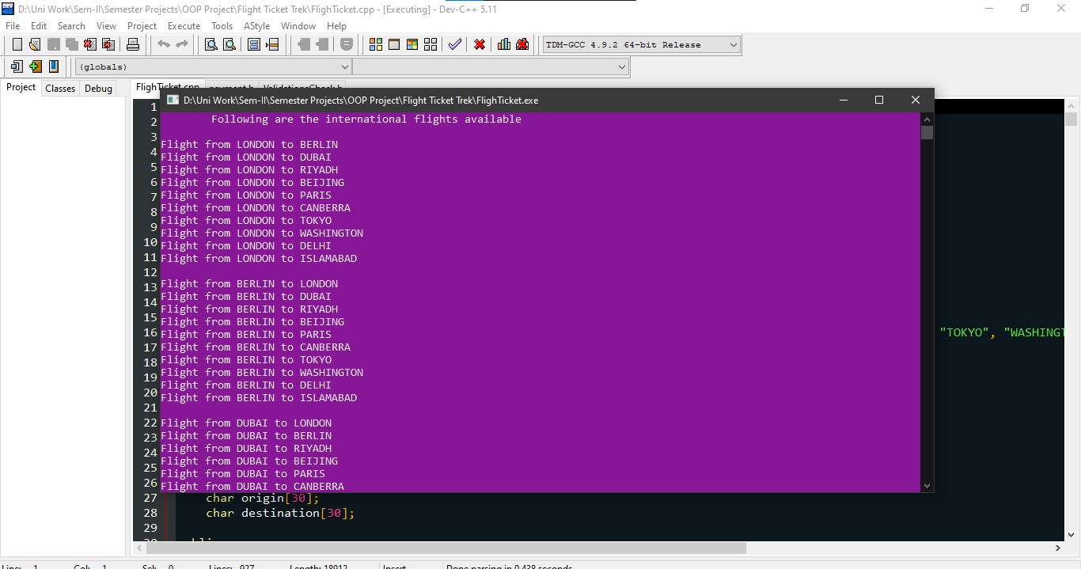
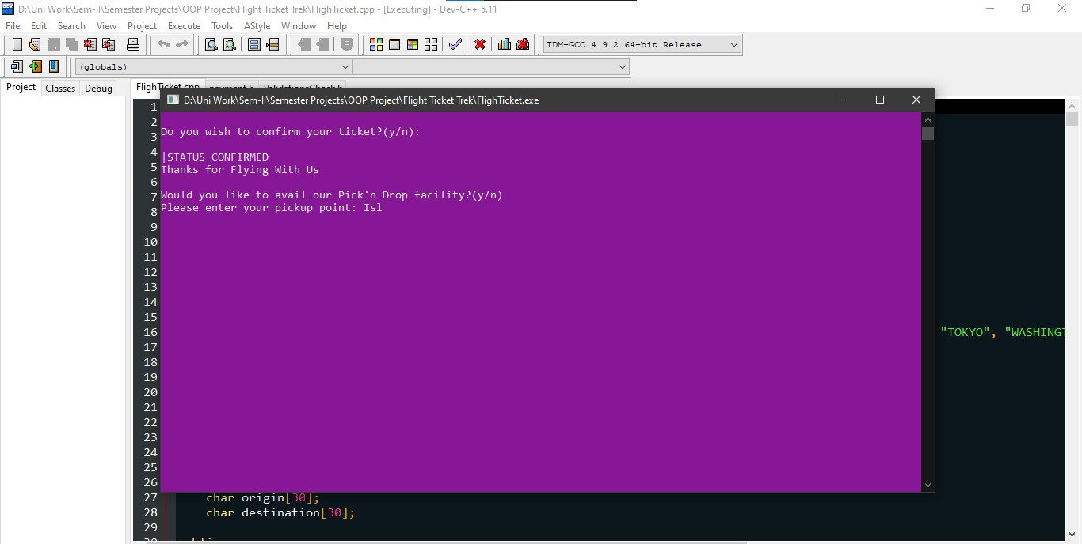
Route Options
Domestic Flights
International Destinations
.
Browse our extensive selection of domestic flight routes within the country, connecting major cities and popular destinations.
Explore our wide range of international flight options, opening up a world of travel possibilities to destinations across the globe.

Slide 8
Manage Ticket
Date Change
1
Reschedule your flight
Cancel Booking
2
Request a refund or reservation change
View Itinerary
3
Review your booked flight details
The Manage Ticket section allows you to easily make adjustments to your flight booking. You can change the date of your flight, and cancel your reservation,

Slide 9



Date Change
Modify Booking
1
Update your flight details
Reschedule Trip
2
Change your travel dates
Flexible Policies
3
Take advantage of our flexible policies
At Flight Ticket Trek, we understand that travel plans can change. That's why we offer flexible date change options to accommodate your needs. Simply modify your booking, and reschedule your trip for a more convenient time.

Slide 10
Cancel Booking
Select Booking
First, locate the booking you wish to cancel by entering the ticket number
Review Details
Confirm the flight details and passenger information for the booking you want to cancel.
Initiate Cancellation
Follow the prompts to initiate the cancellation process.
Receive Confirmation
Once the cancellation is complete, you will receive a confirmation message ''Booking Cancelled'.

Slide 11
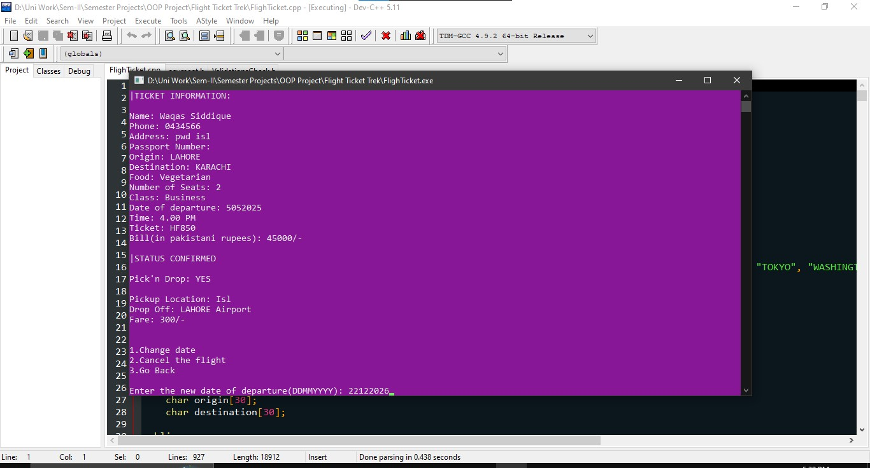
Manage Ticket:

Slide 12


Complaint System
Submit Complaint
File Handling
If you have any issues or concerns, please don't hesitate to submit a complaint. We take all feedback seriously and will work to address your concerns promptly.
All the complaints will be saved in a file and can we viewd from the file

Slide 13
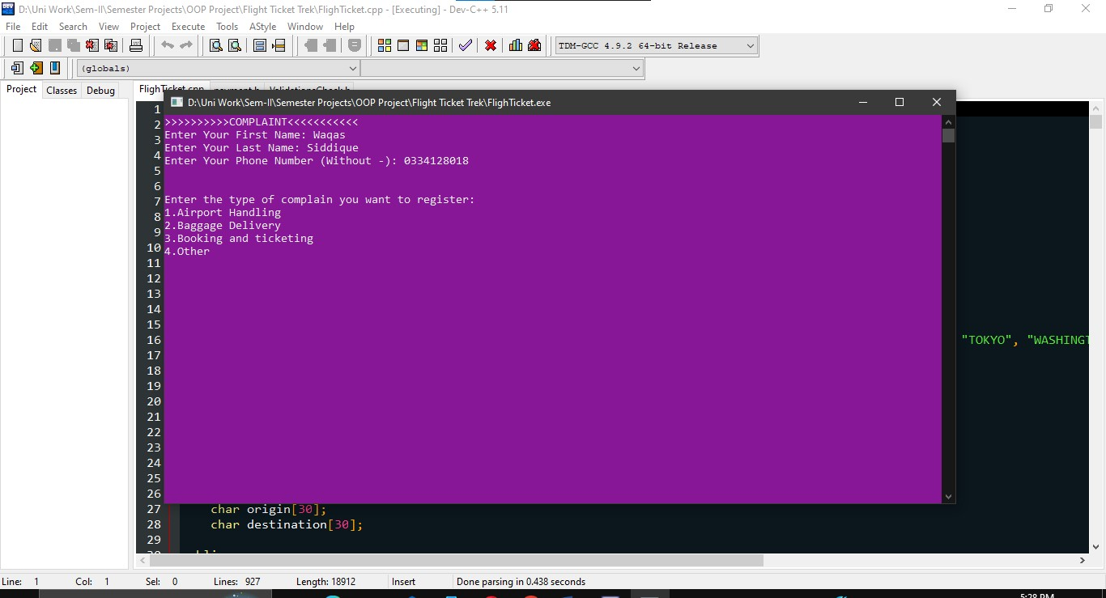
Complaint System:

Slide 14
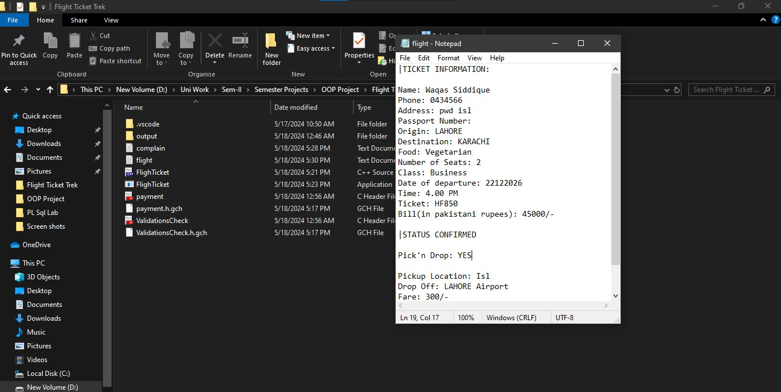
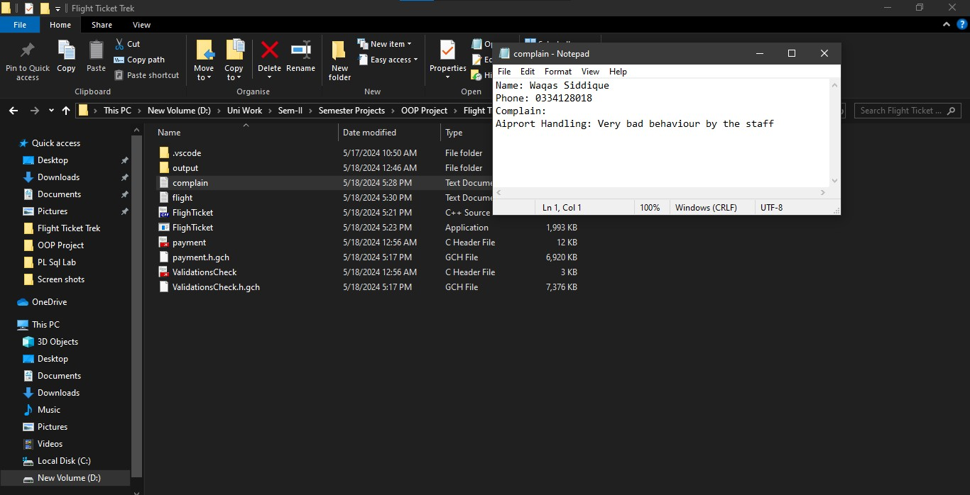
File Handling:

Slide 15
Validations:
The program handles about 90% validation issues .
• Validation on Name .
• Validation on Phone No and Passport No.
• Validation on file opening.
• Validation on date.
• Validation on switches and choices.

Slide 16

Exit
Thank you for using our Flight Ticket Trek booking system. We hope you found the experience convenient and satisfactory. If you have any further questions or concerns, please don't hesitate to reach out. Have a wonderful day and safe travels!

