Slide 1
Tree
Tree is a non-linear data structure which organizes data in hierarchical structure.
In tree data structure, every individual element is called as Node. Node in a tree data structure stores the actual data of that particular element and link to next elements in hierarchical structure.

Slide 2
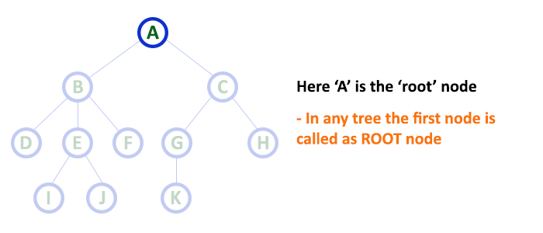
Terminology
Root- In a tree data structure, the first node is called as Root Node.

Slide 3
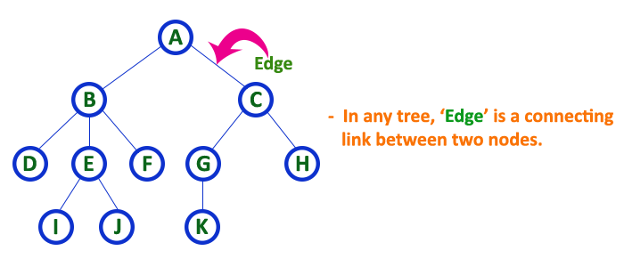
Terminology
Edge- In a tree data structure, the connecting link between any two nodes is called as Edge

Slide 4
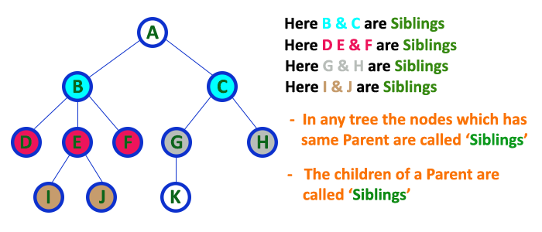
Terminology
Siblings- In a tree data structure, nodes which belong to same Parent are called as Siblings

Slide 5
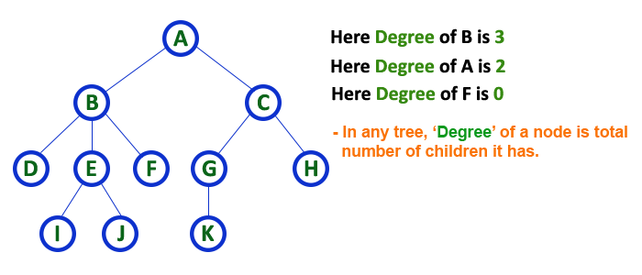
Terminology
Degree of Node - The total number of children of a node is called as Degree of that Node

Slide 6
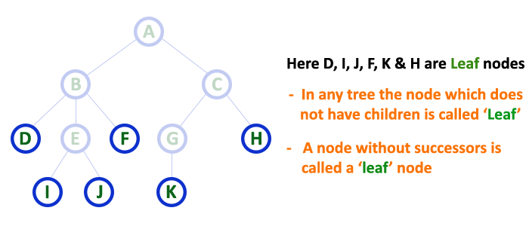
Terminology
Terminal Node/ Leaf Node - In a tree data structure, the node which does not have a child is called as Terminal/Leaf Node

Slide 7
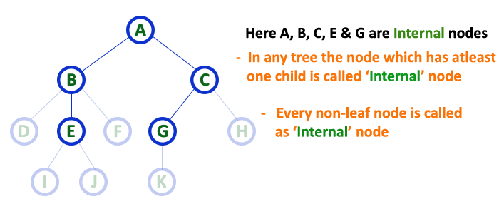
Terminology
Nonterminal Node/Internal Node - In a tree data structure, the node which has at least one child is called as Nonterminal/Internal Node

Slide 8
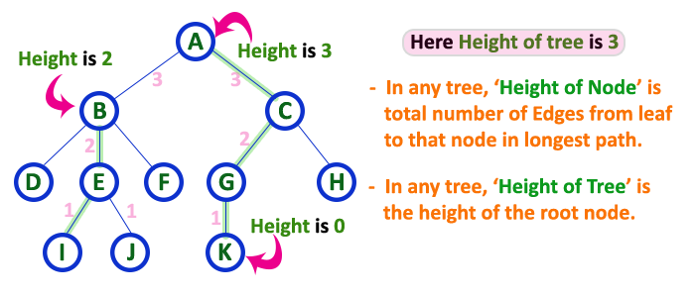
Terminology
Height - In a tree data structure, the total number of edges from leaf node to a particular node in the longest path is called as Height of that Node

Slide 9
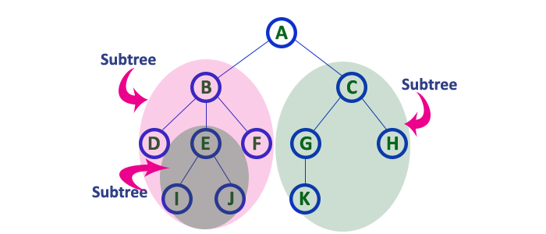
Terminology
Subtree - In a tree data structure, each child from a node forms a subtree recursively. Every child node will form a subtree on its parent node.

Slide 10
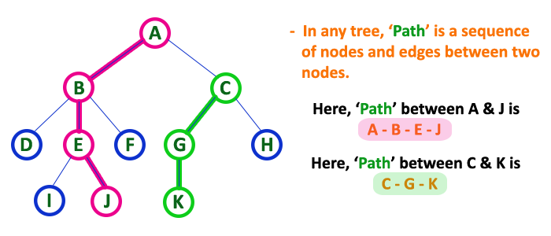
Terminology
Path- In a tree data structure, the sequence of Nodes and Edges from one node to another node is called as Path between those two Nodes

Slide 11
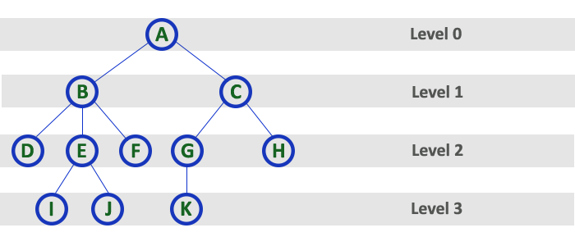
Terminology
Level- In a tree data structure, the root node is said to be at Level 0 and the children of root node are at Level 1 and the children of the nodes which are at Level 1 will be at Level 2 and so on

Slide 12
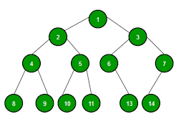
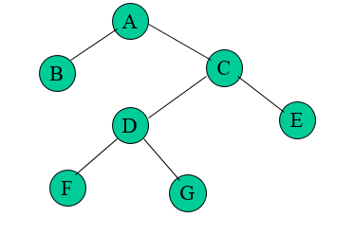
Types of Tree
Binary Tree- A binary tree is either an empty tree or a binary tree consists of a root node, a left subtree and a right subtree, both of which will act as a binary tree once again.
Strictly Binary Tree- Strictly binary tree is defined as a binary tree where all the nodes will have either zero or two children. It does not include one child in any node.

Slide 13
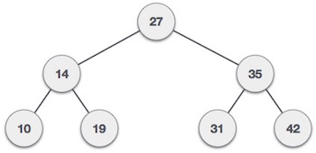
Types of Tree
Complete Binary Tree- A complete binary tree is a strictly binary tree in which all leaf nodes are at same level.

Slide 14
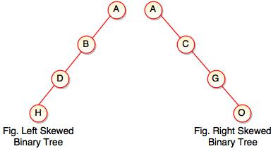
Types of Tree
Left skewed binary tree- A left skew tree has node associated with only the left child. It is a binary tree contains only left subtrees.
Right skewed binary tree- A right skew tree has node associated with only the right child. It is a binary tree contains only right subtrees.

Slide 15
Types of Tree
A Binary Search Tree (BST)- It is a tree in which all the nodes follow the below-mentioned properties −
The left sub-tree of a node has a value less than its parent node's value.
The right sub-tree of a node has a value greater than or equal to its parent node's value.
All sub trees follow above two rules

Slide 16
Construct BST with following elements: 27, 14, 19, 35, 31, 10, 42, 15, 55, 92, 50, -3

Slide 17

BST Traversals
Preorder Traversal
Root- Left Subtree - Right Subtree
27,14,10,19,35,31,42

Slide 18
BST Traversals
Inorder Traversal
Left Subtree- Root- Right Subtree
10,14,19,27,31,35,42

Slide 19
BST Traversals
Postorder Traversal
Left Subtree - Right Subtree - Root
10,19,14,31,42,35,27

Slide 20
Construct BST with following elements and write traversals. 75, 34, 45, 62, 22, 96, 82,105, 98, 25

Slide 21
Construct BST with following elements and write traversals. 50, 15, 62, 5, 20, 58, 91, 3, 8, 37, 60, 24

Slide 22
Construct BST with following traversals Inorder – 3, 5, 8, 15, 20, 24, 37, 50, 58, 60, 62, 91 Postorder – 3, 8, 5, 24, 37, 20, 15, 60, 58, 91, 62, 50

Slide 23
Construct BST with following traversals Inorder: 3, 5, 8, 15, 20, 24, 37, 50, 58, 60, 62, 91 Preorder: 50, 15, 5, 3, 8, 20, 37, 24, 62, 58, 60, 91

Slide 24
Construct BST for following data
jan, feb, mar, apr, may, june, july, august, sept, oct, nov, dec

Slide 25
Construct BST with following traversals
1. Preorder Traversal- 20, 16, 5, 18, 17, 19, 60, 85, 70
2. Postorder Traversal- -3, 12, 15, 10 , 30 , 20 , 150 , 300 , 200 , 100

Slide 26
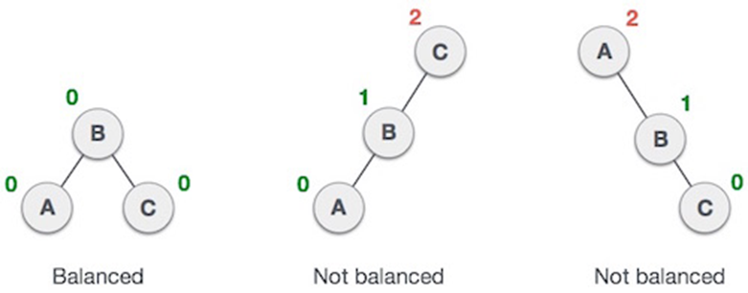
AVL Tree (Height Balanced Tree)

Slide 27
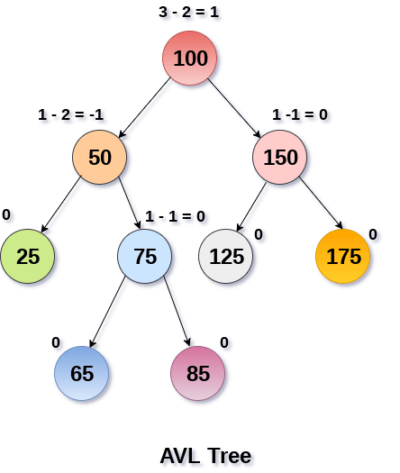
AVL Trees- Balance Factor
BalanceFactor = height(left-sutree) − height(right-sutree)

Slide 28
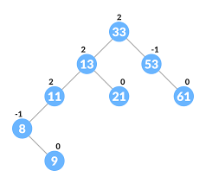
AVL Trees- Balance Factor

Slide 29
AVL Tree- Rotations
To balance itself, an AVL tree may perform the following four kinds of rotations −
Left to left rotation (L-L)
Right to right rotation (R-R)
Left to right rotation (L-R)
Right to left rotation (R-L)

Slide 30
Left to Left Rotation
30,20,10

Slide 31
Right to Right Rotation
10,20,30

Slide 32
Left to Right Rotation
30,10,20

Slide 33
Right to Left Rotation
10,30,20

Slide 34
Examples
1. Construct AVL Tree- 14, 17, 11, 7, 53, 4, 13, 12, 8, 60, 19, 16, 20
2. Construct AVL Tree- 10, 8, 15, 12, 13, 7, 9, 17, 20, 18, 4, 5, -3
3. Construct AVL Tree- char, break, switch, if, int, struct, malloc, void, return, goto
4. Construct AVL Tree- Mumbai, Pune, Nagpur, Amaravati, Kolhapur, Nanded, Solapur, Nagar, Nasik, Dhule, Aurangabad, Jalgaon

