Slide 1

Model-based Clustering of Educational Engagement Measures ST606 Project Presentations – June 12th 2024
Saad Siddiqui - 23250068
Supervisor: Dr. Keefe Murphy

Slide 2
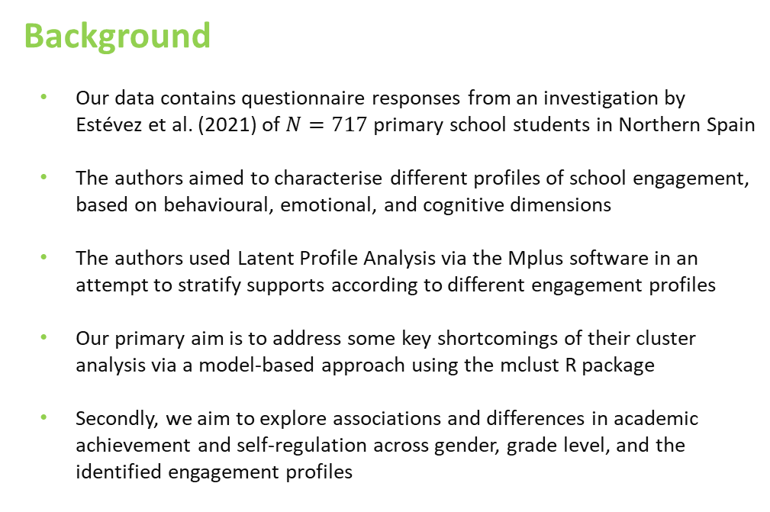
Background
Our data contains questionnaire responses from an investigation by Estévez et al. (2021) of $N=717$ primary school students in Northern Spain
The authors aimed to characterise different profiles of school engagement, based on behavioural, emotional, and cognitive dimensions
The authors used Latent Profile Analysis via the Mplus software in an attempt to stratify supports according to different engagement profiles
Our primary aim is to address some key shortcomings of their cluster analysis via a model-based approach using the mclust R package
Secondly, we aim to explore associations and differences in academic achievement and self-regulation across gender, grade level, and the identified engagement profiles

Slide 3
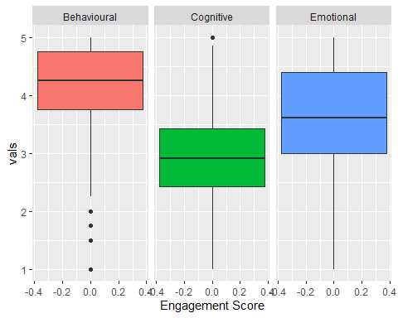
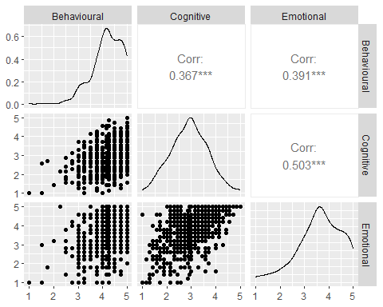
Exploratory Data Analysis
Behavioral engagement is highest on average
Emotional engagement shows the highest variability
There are a small number of outlying students in the behavioral engagement dimension
There is significant moderately strong positive correlation among all three variables
There are a large number of duplicated engagement scores
Variable | Unique | Mean | Std Dev | Min | Median | Max
Behavioral | 17 | 4.171 | 0.626 | 1 | 4.250 | 5
Cognitive | 30 | 2.916 | 0.771 | 1 | 2.916 | 5
Emotional | 22 | 3.609 | 0.911 | 1 | 3.609 | 5

Slide 4
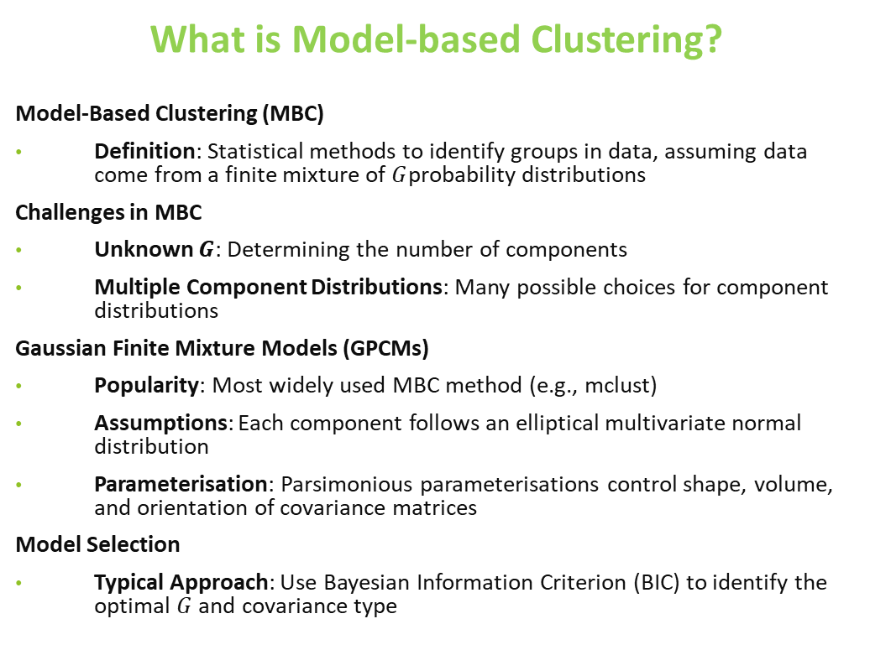
What is Model-based Clustering?
Model-Based Clustering (MBC)
Definition: Statistical methods to identify groups in data, assuming data come from a finite mixture of $G$probability distributions
Challenges in MBC
Unknown $G$: Determining the number of components
Multiple Component Distributions: Many possible choices for component distributions
Gaussian Finite Mixture Models (GPCMs)
Popularity: Most widely used MBC method (e.g., mclust)
Assumptions: Each component follows an elliptical multivariate normal distribution
Parameterisation: Parsimonious parameterisations control shape, volume, and orientation of covariance matrices
Model Selection
Typical Approach: Use Bayesian Information Criterion (BIC) to identify the optimal $G$ and covariance type

Slide 5
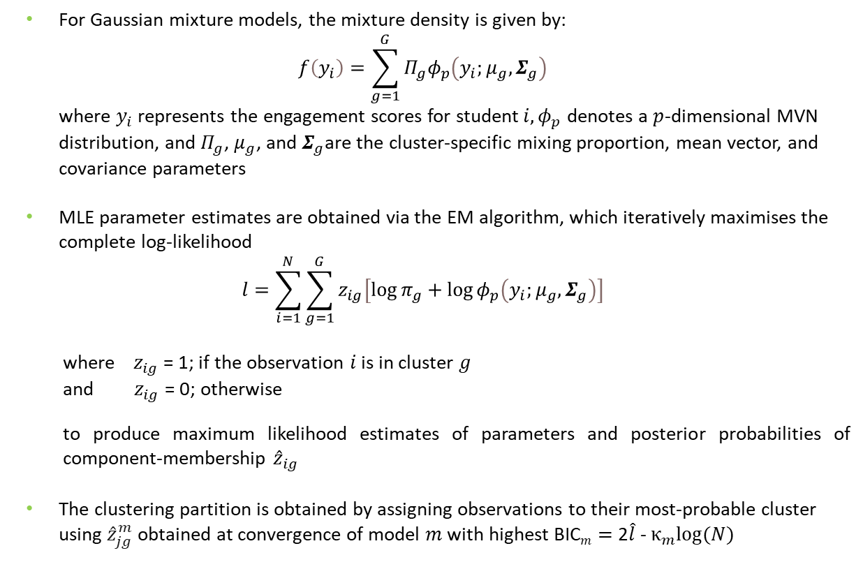
For Gaussian mixture models, the mixture density is given by: $f\left(y_{i}\right)=\sum_{g=1}^{G}{Π_{g}φ_{p}\left(y_{i};μ_{g},Σ_{g}\right)}$ where $y_{i}$ represents the engagement scores for student$i, φ_{p}$ denotes a $p$-dimensional MVN distribution, and $Π_{g}$, $μ_{g}$, and $Σ_{g}$are the cluster-specific mixing proportion, mean vector, and covariance parameters
MLE parameter estimates are obtained via the EM algorithm, which iteratively maximises the complete log-likelihood
$$l=\sum_{i=1}^{N}{\sum_{g=1}^{G}{z_{ig}\left[\log{π_{g}}+\log{φ_{p}\left(y_{i};μ_{g},Σ_{g}\right)}\right]}}$$
where ${ z}_{ig}$ = 1; if the observation $i$ is in cluster $g$ and${ z}_{ig}$ = 0; otherwise
to produce maximum likelihood estimates of parameters and posterior probabilities of component-membership ${\hat{z}}_{ig}$
The clustering partition is obtained by assigning observations to their most-probable cluster using ${\hat{z}}_{jg}^{m}$ obtained at convergence of model $m$ with highest BIC$m=$ 2$\hat{l}$ - $κ_{m}log⁡(N)$

Slide 6
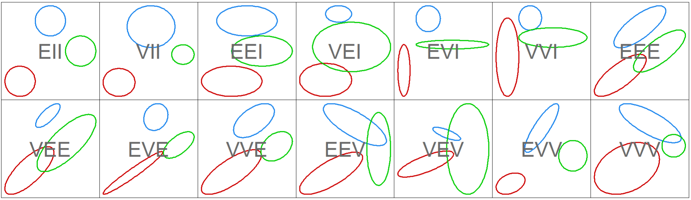
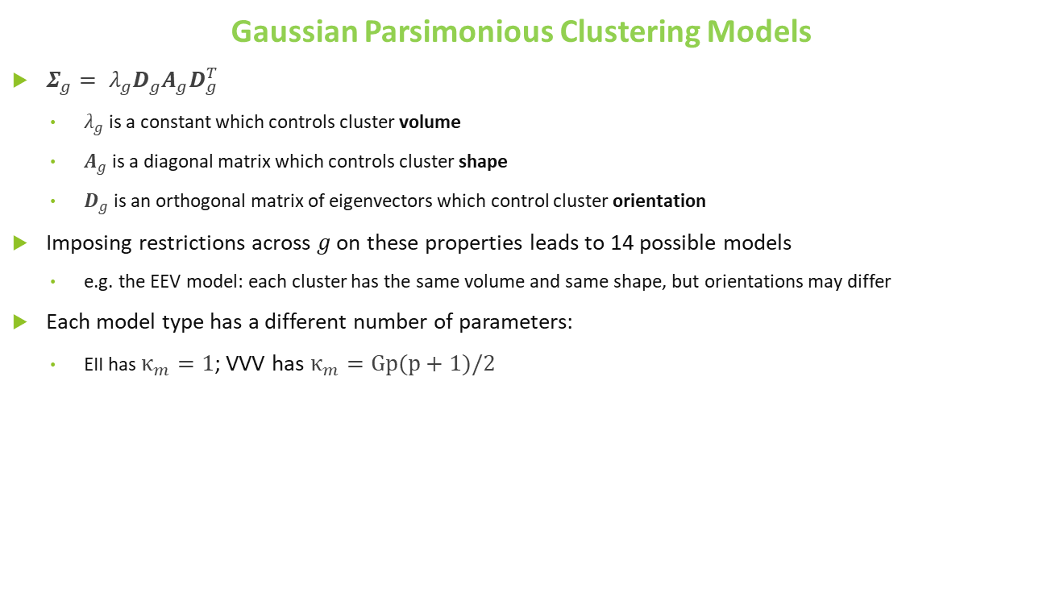
Gaussian Parsimonious Clustering Models
$Σ_{g}= λ_{g}D_{g}A_{g}D_{g}^{T}$
$λ_{g}$is a constant which controls cluster volume
$A_{g}$ is a diagonal matrix which controls cluster shape
$D_{g}$ is an orthogonal matrix of eigenvectors which control cluster orientation
Imposing restrictions across $g$ on these properties leads to 14 possible models
e.g. the EEV model: each cluster has the same volume and same shape, but orientations may differ
Each model type has a different number of parameters:
EII has $κ_{m}=1$; VVV has $κ_{m}=Gp(p+1)/2$

Slide 7
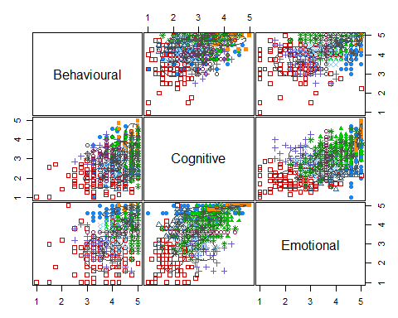
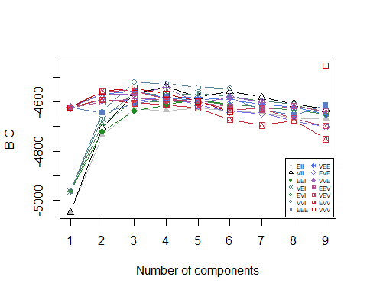
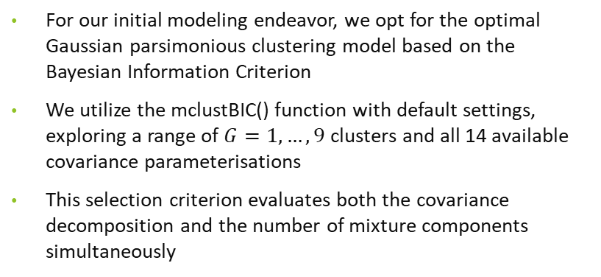
Preliminary Clustering Results
For our initial modeling endeavor, we opt for the optimal Gaussian parsimonious clustering model based on the Bayesian Information Criterion
We utilize the mclustBIC() function with default settings, exploring a range of $G=1, …, 9$ clusters and all 14 available covariance parameterisations
This selection criterion evaluates both the covariance decomposition and the number of mixture components simultaneously
Best BIC values:
 | VVV,9 | VVI,3 | VVI,4
BIC | -4453.309 | -4520.169 | -4525.757
BIC DIFF | 0.000 | -66.859 | -72.448
Mclust VVV (ellipsoidal, varying volume, shape, and orientation) model with 9 components

Slide 8
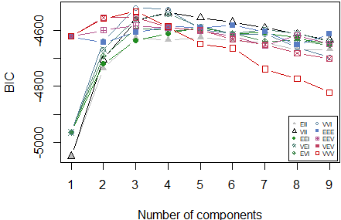
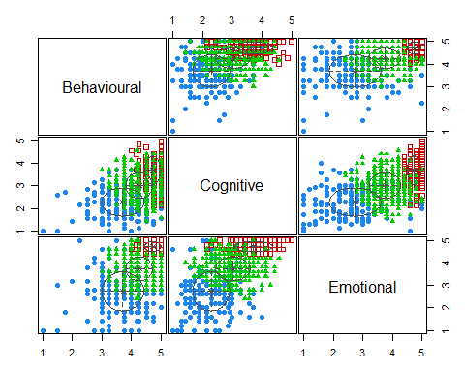
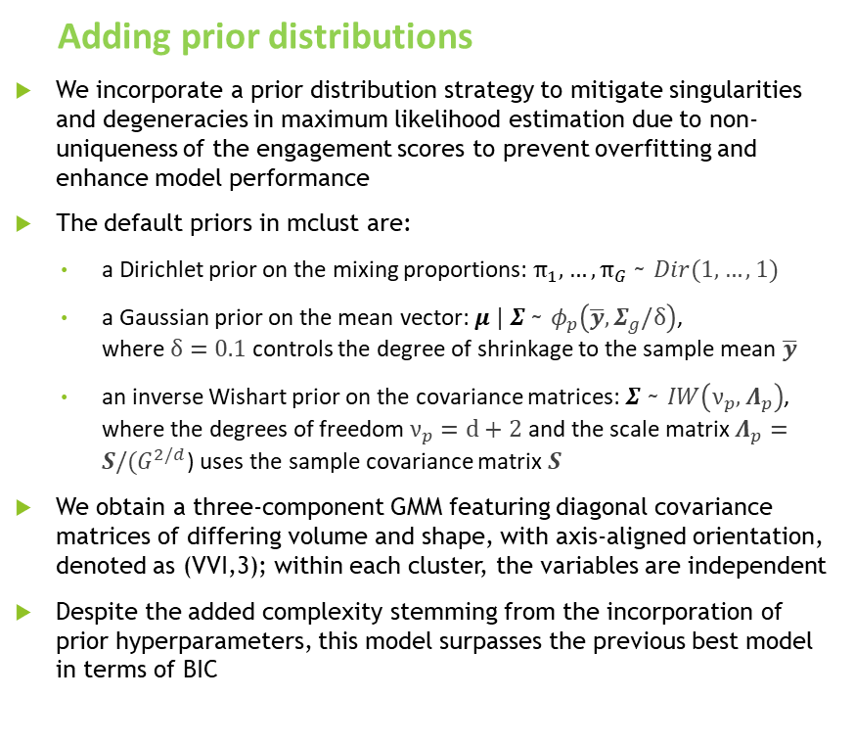
Adding prior distributions
We incorporate a prior distribution strategy to mitigate singularities and degeneracies in maximum likelihood estimation due to non-uniqueness of the engagement scores to prevent overfitting and enhance model performance
The default priors in mclust are:
a Dirichlet prior on the mixing proportions: $π_{1},…,π_{G}$ ~ $Dir(1,…,1)$
a Gaussian prior on the mean vector: $μ | Σ$ ~ $φ_{p}\left(\overline{y},Σ_{g}/δ\right)$, where $δ=0.1$ controls the degree of shrinkage to the sample mean $\overline{y}$
an inverse Wishart prior on the covariance matrices: $Σ$ ~ $IW\left(ν_{p}, Λ_{p}\right)$, where the degrees of freedom $ν_{p}=d+2$ and the scale matrix $Λ_{p}=S/(G^{2/d}$) uses the sample covariance matrix $S$
We obtain a three-component GMM featuring diagonal covariance matrices of differing volume and shape, with axis-aligned orientation, denoted as (VVI,3); within each cluster, the variables are independent
Despite the added complexity stemming from the incorporation of prior hyperparameters, this model surpasses the previous best model in terms of BIC
Notes:
Incorporating a prior distribution over the mixture parameters proves to be a valuable strategy to mitigate singularities and degeneracies in maximum likelihood estimation. Additionally, this approach aids in preventing overfitting and enhancing model performance. In scenarios like the present one, where the variables of interest are discrete or have a limited number of unique values compared to the overall sample size, integrating a prior distribution helps regularize the model estimation process.
Despite the inclusion of priors, the EM algorithm remains suitable for model fitting, albeit with a shift from maximum likelihood estimates (MLEs) to maximum a posteriori (MAP) estimates. A slightly modified version of the Bayesian Information Criterion (BIC) is employed for model selection, with the maximized log-likelihood substituted by the log-likelihood evaluated at the MAP or posterior mode.
This approach can be seamlessly implemented within mclust; however, it's worth noting that only 10 out of the 14 available model types can be used in conjunction with priors. For now, we opt for default conjugate priors with corresponding default hyperparameters.

Slide 9
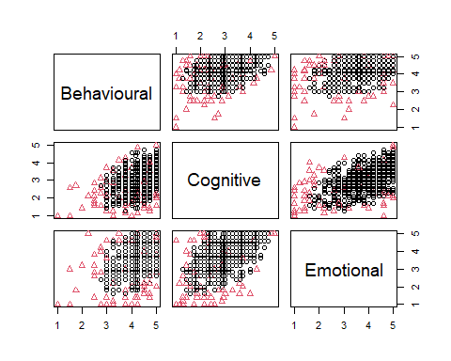
Advanced cluster modelling
To ensure the optimal model is identified, we explore combinations of the following alternative approaches:
Modifying Hyperparameters:
Adjust some hyperparameters of the priors:
assume diagonal scale parameter for prior on the covariance,
remove shrinkage prior on the mean but assume default covariance prior
remove shrinkage prior on the mean and assuming diagonal scale parameter for prior on the covariance
Adding a Uniform Noise Component:
Introduce a uniform noise component to account for outlying observations, reducing their impact on the defined Gaussian clusters
This requires an initial guess of which observations are outliers, which we obtain through calculating the Mahalanobis distance with the sample mean and sample covariance matrix
Notes:
Added details on the modified hyperparameters.

Slide 10
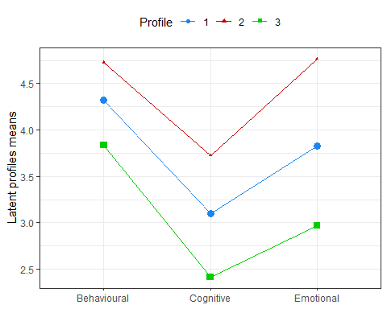
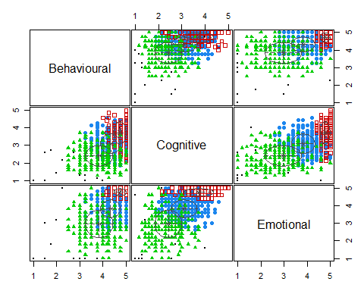
Results
The optimal model maintains a (VVI,3) structure, removes the prior on the means, retains the default priors on the variances and mixing proportions, and incorporates a uniform noise component. 49.7%, 15.1%, and 33.1% observations are in Clusters 1, 2, and 3, while 2.2% of observations are designated as noise.
Cluster 2 has higher mean average for all of the engagement variables and cluster 3 has the lowest.
Notes:
* Cluster 1 has moderate engagements on average and the best grade distribution * Cluster 2 has the highest engagements on average but fewer 5 grades and more low grades than cluster 1 * Cluster 3 has the lowest engagements on average and the lowest proportion of 5 grades / highest proportions of low grades. * Overall, Cluster 1 captures most average-to-good students, Cluster 3 captures that disengaged poor students, and Cluster 2 captures the small number of students who have to work really hard to do well.

Slide 11
Conclusions & Future Work
Conclusions:
Advanced features of mclust led to a superior model, accounting for duplicated and outlying observations through prior distributions and a noise component
The modelling strategies used here uncovered three interpretable clusters of low, medium, and high engagement
On average, students with low, medium, or high engagement in one dimension correspondingly have low, medium, or high engagement in the other two dimensions
In one cluster, low engagement maps to low grades, mostly for males; the other two clusters separate most students who do well despite being averagely engaged from a small group who slightly less well despite being most highly engaged on average
Future Work:
Investigate the bootstrap functionalities of mclust to quantify uncertainty in the uncovered engagement profiles
Quantify the performance of the best model using the entropy and average posterior probability measures commonly used in Latent Profile Analysis
Conduct a more thorough exploration of the profiles uncovered by the model built on engagement scores in relation to the grades, self-regulation, and demographic covariates
Thoroughly investigate the backgrounds of the 16 struggling students in the outlying noise component

Slide 12
Thank You!!!

Slide 13
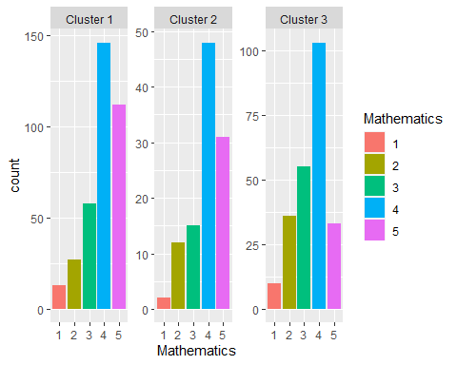
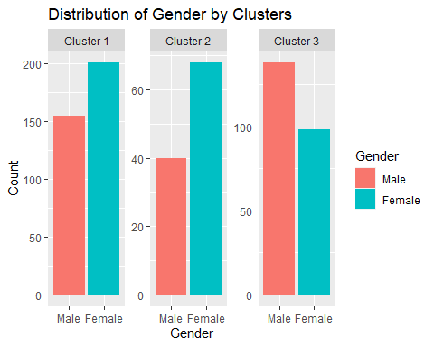
Females are more numerous in clusters 1 and 2, while males are the majority in cluster 3
In the mathematics module, clusters 1 and 2 have a better grade distribution compared to cluster 3, which has higher proportions of lower grades

