Slide 1



Agentic AI for Accounts Payable
PURCHASE ORDER
what we ordered
Invoice three-way match with a team of cooperating agents
GOODS RECEIPT
what arrived
INVOICE
Swastik Gavhane & Saafalya Sengupta
what we are billed
PRN 24070126224 · 24070126158
Symbiosis Institute of Technology
All three must agree before payment
Notes:
Introduce yourself. One line on the project: agents that check vendor invoices against purchase orders and goods receipts before payment.

Slide 2
Why invoices go wrong
Before paying a vendor, finance teams must check the invoice against the purchase order and the goods receipt. Done by hand, it is slow, and every miss becomes an overpayment.
=
=
Purchase order
Goods receipt
Invoice
What we agreed to buy
What actually arrived
What the vendor bills
What slips through
Price above the PO
Billed more than received
Same invoice paid twice
Domain: Banking & Finance, Business Operations
Notes:
Explain three-way match in plain words: ordered, received, billed. Errors like these cause overpayments and duplicate payments.

Slide 3


From manual checks to agents
Today: manual review
With agents
Staff compare three documents by hand
Planner orders the batch by urgency
Slow and repetitive for every invoice
Agents extract, validate and match
Errors often found after payment
Problems caught before payment
No consistent written reason
Every decision comes with a reason
Notes:
Contrast the manual process with the agent workflow. Stress that humans still review flagged invoices.

Slide 4





Seven agents, one job
Planner
Sequences the batch by due date and amount; flags urgent invoices
Extraction
Turns invoice text into a typed schema with an LLM or parser; retries if rejected
Critic
Rejects bad arithmetic or invented values; gets a model second opinion; checks every variance
Matching
Compares invoice, PO and goods receipt on price, quantity, tax, vendor and duplicates
Fraud
Flags lookalike vendors, bank changes and spikes; scores and explains risk
Decision
Applies rules to approve, hold or escalate; writes the reason and a case summary
Human Review
Pauses escalations for a person, then updates vendor memory
Notes:
Walk down the list. Each agent has one job; the Critic appears twice. New in this version: the Critic also checks that key fields really appear in the invoice and can ask the local model for a second opinion, the Fraud Agent explains its score in plain words, and the Decision Agent writes a case summary for every escalated invoice.

Slide 5
How the agents hand off
Rejected: retry with robust parser
Planner
order batch
Extraction
read invoice
Critic
validate
Matching
3-way match
Fraud
risk score
Critic
cross-check
Decision
act
Approved
Hold
Escalated
No issues. Safe to pay.
Low-value mismatch. Vendor corrects it.
Fraud signal, duplicate, unknown vendor or INR 10,000+ at risk. Paused for a human.
Notes:
The retry loop is still the key agentic behaviour: the Critic rejects bad extractions and the Extraction Agent tries again. New: the Fraud Agent sits after matching, and escalations now pause for a human instead of just ending.

Slide 6
Fraud Agent: what matching misses
+70
+60
+40
+15
pay-to bank account differs from the one on file
vendor name one letter off an approved vendor
total above 3x the vendor's largest past invoice
suspiciously round total
Risk score 0-100: these points, plus up to 20 for a vendor whose invoices were often escalated. 40 or more escalates.
Every point comes with its reason, so the reviewer sees exactly why an invoice was stopped.
The spike rule was tuned on 200,000 simulated invoices: about 0.02% false alarms.
Notes:
A three-way match only checks that the documents agree. Fraud often passes that: a fake vendor copying a real PO, or a real vendor's invoice asking to be paid into a new account. The Fraud Agent adds up risk points and shows the reason for each one.

Slide 7
Human in the loop, with memory
1
Pause
2
Review
3
Resume
4
Learn
LangGraph interrupt checkpoints the graph on escalation
Read the case summary, then approve, hold or reject
The graph continues from its checkpoint
The decision is saved to vendor memory
Real trace: a vendor's bank-account change, approved by a reviewer
Fraud Agent: BANK_CHANGE; risk score 70/100
Decision Agent: ESCALATED (fraud / control risk: BANK_CHANGE)
... graph paused at interrupt; invoice waits in the Review queue ...
Human Review: Saafalya reviewed: APPROVE -> APPROVED - "new account confirmed by phone"
new bank account saved to vendor memory: next invoice is not flagged
Notes:
This is LangGraph's interrupt with a checkpointer: the graph really stops and resumes later from saved state. Show the bank-change example: once a reviewer approves it, the memory updates and the same vendor is not flagged again. That is the system learning from people.

Slide 8
The local model, with guardrails
1
Extract
2
2nd opinion
3
Risk note
4
Case brief
Reads the invoice; every key field must appear in it
Doubts trigger a retry, never an escalation
Explains the rules' score in plain words
Briefs the reviewer on each escalated invoice
Real case summary for a bank-change invoice. Any number the model adds is rejected.
Problem: pay-to account 50100990490278 differs from account on file 50100341316475.
Stake: INR 12,358.99 at risk, risk score 70/100.
Vendor history: 14 past approved invoices, largest INR 213,993.83.
Check: call the vendor on the number in the vendor master to confirm the new account.
Notes:
The rules decide; the model explains. The local model (Ollama) helps in four places, and each has a hard check behind it. Its extraction must pass the Critic's arithmetic and grounding checks. Its second opinion can cause one more retry but never escalates an invoice on its own. Its risk note and case summary are rejected if they contain any number that is not in the facts, and the rule-based text is shown instead. Without Ollama, the same rule-based texts are used, so the demo always works.

Slide 9
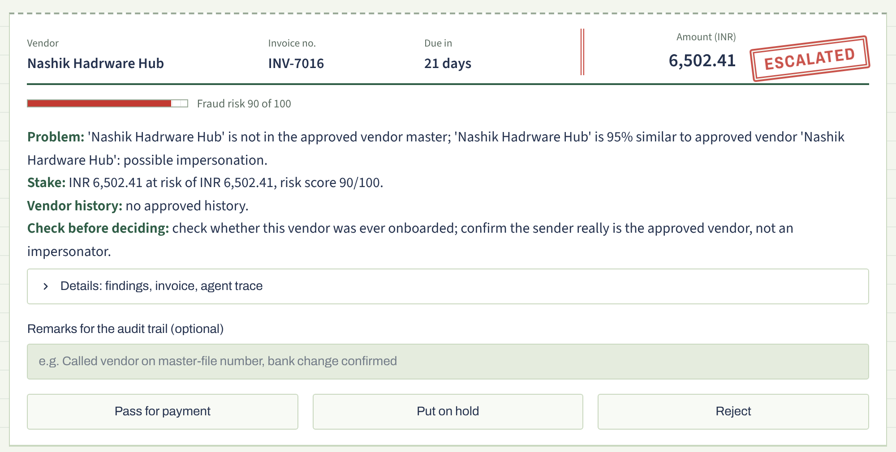
The reviewer's view
Ledger-style app with rubber-stamp decisions and a seven-step pipeline strip
Case summary up front; findings and trace one click away
Approve, hold and reject carry equal weight
Every decision goes to the audit trail and vendor memory
Review queue case card (real screenshot)
Notes:
This is the new interface. It is designed like an accounts ledger: decisions appear as rubber stamps, and a pipeline strip ticks off each agent as it runs. For an escalated invoice the reviewer reads the case summary first, opens the details only if needed, and then decides. The three buttons look the same on purpose, so nobody is nudged into paying a risky invoice. Only the presentation changed; the agent logic is the same.

Slide 10
System architecture
Streamlit UI
ledger-style app: live trace, pipeline strip, review queue, PDF upload, results
Data flow
Batch or PDF enters
Graph shares state
Agents use tools and memory
Escalations pause for a human
Decision goes to the UI
LangGraph state graph
shared state, retry edge, interrupt + checkpointer for human review
Agents
Planner
Extraction
Critic
Matching
Fraud
Decision
Human
Tools and data
PO DB, GRN DB, vendor master, duplicate registry, vendor memory, rules
LLM
Ollama local model (guarded) or rule-based mock
Notes:
Top to bottom: UI, orchestration, agents, then tools, data and memory. Decisions are rule-based in tools.decide. The LLM only reads and explains: it extracts, gives the Critic a second opinion, and writes the risk note and the case summary. Escalations pause in the graph until a reviewer answers.

Slide 11
Demo walkthrough
1
Generate batch
2
Run agents
3
Review queue
4
Upload PDF
24 synthetic invoices, 8 seeded errors, 3 of them fraud
Watch the pipeline strip and live trace
Read the case summary, then decide
Run the agents on a PDF invoice
Live trace for one invoice (real output)
Extraction Agent: attempt 1 via fast parser: INV-7009 | total 1.00
Critic Agent: extraction REJECTED (qty x unit != amount) -> retry
Extraction Agent: attempt 2 via robust parser: INV-7009 | total 1,734,135.13
Fraud Agent: AMOUNT_SPIKE (8.1x vendor's largest invoice); risk score 40/100
Decision Agent: ESCALATED (fraud risk score 40 >= 40) -> Review queue
Notes:
Run the live app. Show the Critic retry in the trace, then open the Review queue, read a case summary and approve or reject the invoice. Finish by downloading a sample PDF and uploading it: the agents catch it as a duplicate. If Ollama is installed, switch the engine to show the model-written notes.

Slide 12
What the validation shows
8/8
3/3
0/16
99.98%
seeded errors caught
fraud cases escalated
clean invoices wrongly flagged
decided correctly across 37,200 generated invoices
Default batch: 24 invoices, 8 seeded errors (3 fraud) and 16 clean; INR 0.99L at risk flagged, equal to the seeded total.
The Critic loop fixed misread amounts before matching. 24 automated tests pass.
High scores reflect rule-based matching on known data, not real-world accuracy.
Notes:
Be upfront: the answer key is known because the data is synthetic, and the rules are deterministic, so these numbers show the pipeline works, not how it would score on messy real invoices. The 37,200-invoice run shows the fraud rules rarely misfire.

Slide 13

Limits and next steps
Limitations
Future scope
Synthetic data and one fixed invoice layout
OCR for scanned PDFs and photos
Rule-based matching scores optimistically
ERP connectors such as SAP and Tally
No OCR for scanned PDFs, no ERP link or login
Benchmark LLM extraction against the parser
Time savings are estimates, not measurements
Learn fraud weights from reviewer decisions
Ollama runs are slower; small models can misread fields
Role-based approvals and MCP tools
Notes:
Be honest about limitations; it shows judgement. With Ollama, runs are slower and a small model can misread fields, which is why the Critic checks are always on. The biggest next step is real invoices via OCR plus an LLM extractor, then learning the fraud weights from reviewer decisions.

Slide 14
Thank you
Questions?
Swastik Gavhane & Saafalya Sengupta
PRN 24070126224 · 24070126158
Symbiosis Institute of Technology

