Slide 1
Scholarship Screening Desk
ELIGIBLE
Six AI agents that screen scholarship applications, check every rule and explain each decision
Saafalya Sengupta
PRN 24070126158 · AIML C1 · CA-3 Agentic AI PoC
Domain: Education
Notes:
Hi, I'm Saafalya. My project is the Scholarship Screening Desk, an agentic AI proof of concept in the education domain. It uses six agents to screen scholarship applications the way a college office does, but with every rule checked and every decision explained.

Slide 2




Screening today is slow, uneven and unexplained
How it works today
Students submit a form plus an income certificate, a marksheet and, for reserved categories, a category certificate. Office staff check each application against six rules by hand, then build a shortlist in a spreadsheet.
Typing errors
Income and CGPA are re-typed into a sheet by hand
Uneven rules
Two reviewers can read the same cutoff differently
Mismatches slip through
Inflated CGPA on the form is rarely cross-checked
Problem statement
Manual screening is slow, inconsistent between reviewers, misses form-versus-marksheet mismatches, and rarely tells a rejected student why.
No reasons
Rejected students rarely learn which rule they failed
Notes:
Today a scholarship office reads each form, opens each attachment, and checks six rules by hand: income, CGPA cutoff by category, attendance, documents, whether the form CGPA matches the marksheet, and whether the student already has a full award. That causes typing errors, uneven decisions, missed mismatches, and no written reason for rejections.

Slide 3






Six agents split the job the way an office would
Planner
Ollama
Extractor
Ollama
Critic
Python
Decides which checks apply, such as relaxed cutoffs for reserved categories
Pulls income, CGPA, attendance and other fields from free text
Re-reads the source, sends wrong extractions back, checks the final verdict
Validator
Python
Decision
Python
Reporter
Ollama
Executor: runs six rule checks as Python tool calls
Eligible, not eligible or needs documents, plus a merit-cum-means score
Writes a plain-English reason for the reviewer
Notes:
I split the work across six agents. The Planner decides which checks apply. The Extractor uses a local Ollama model to read the free-text form and marksheet. The Critic, in amber, independently re-reads the source and sends the case back if a field is wrong. The Validator is the executor: it calls six Python rule tools. The Decision agent gives one of three verdicts and a score. The Reporter writes the reason in plain English.

Slide 4
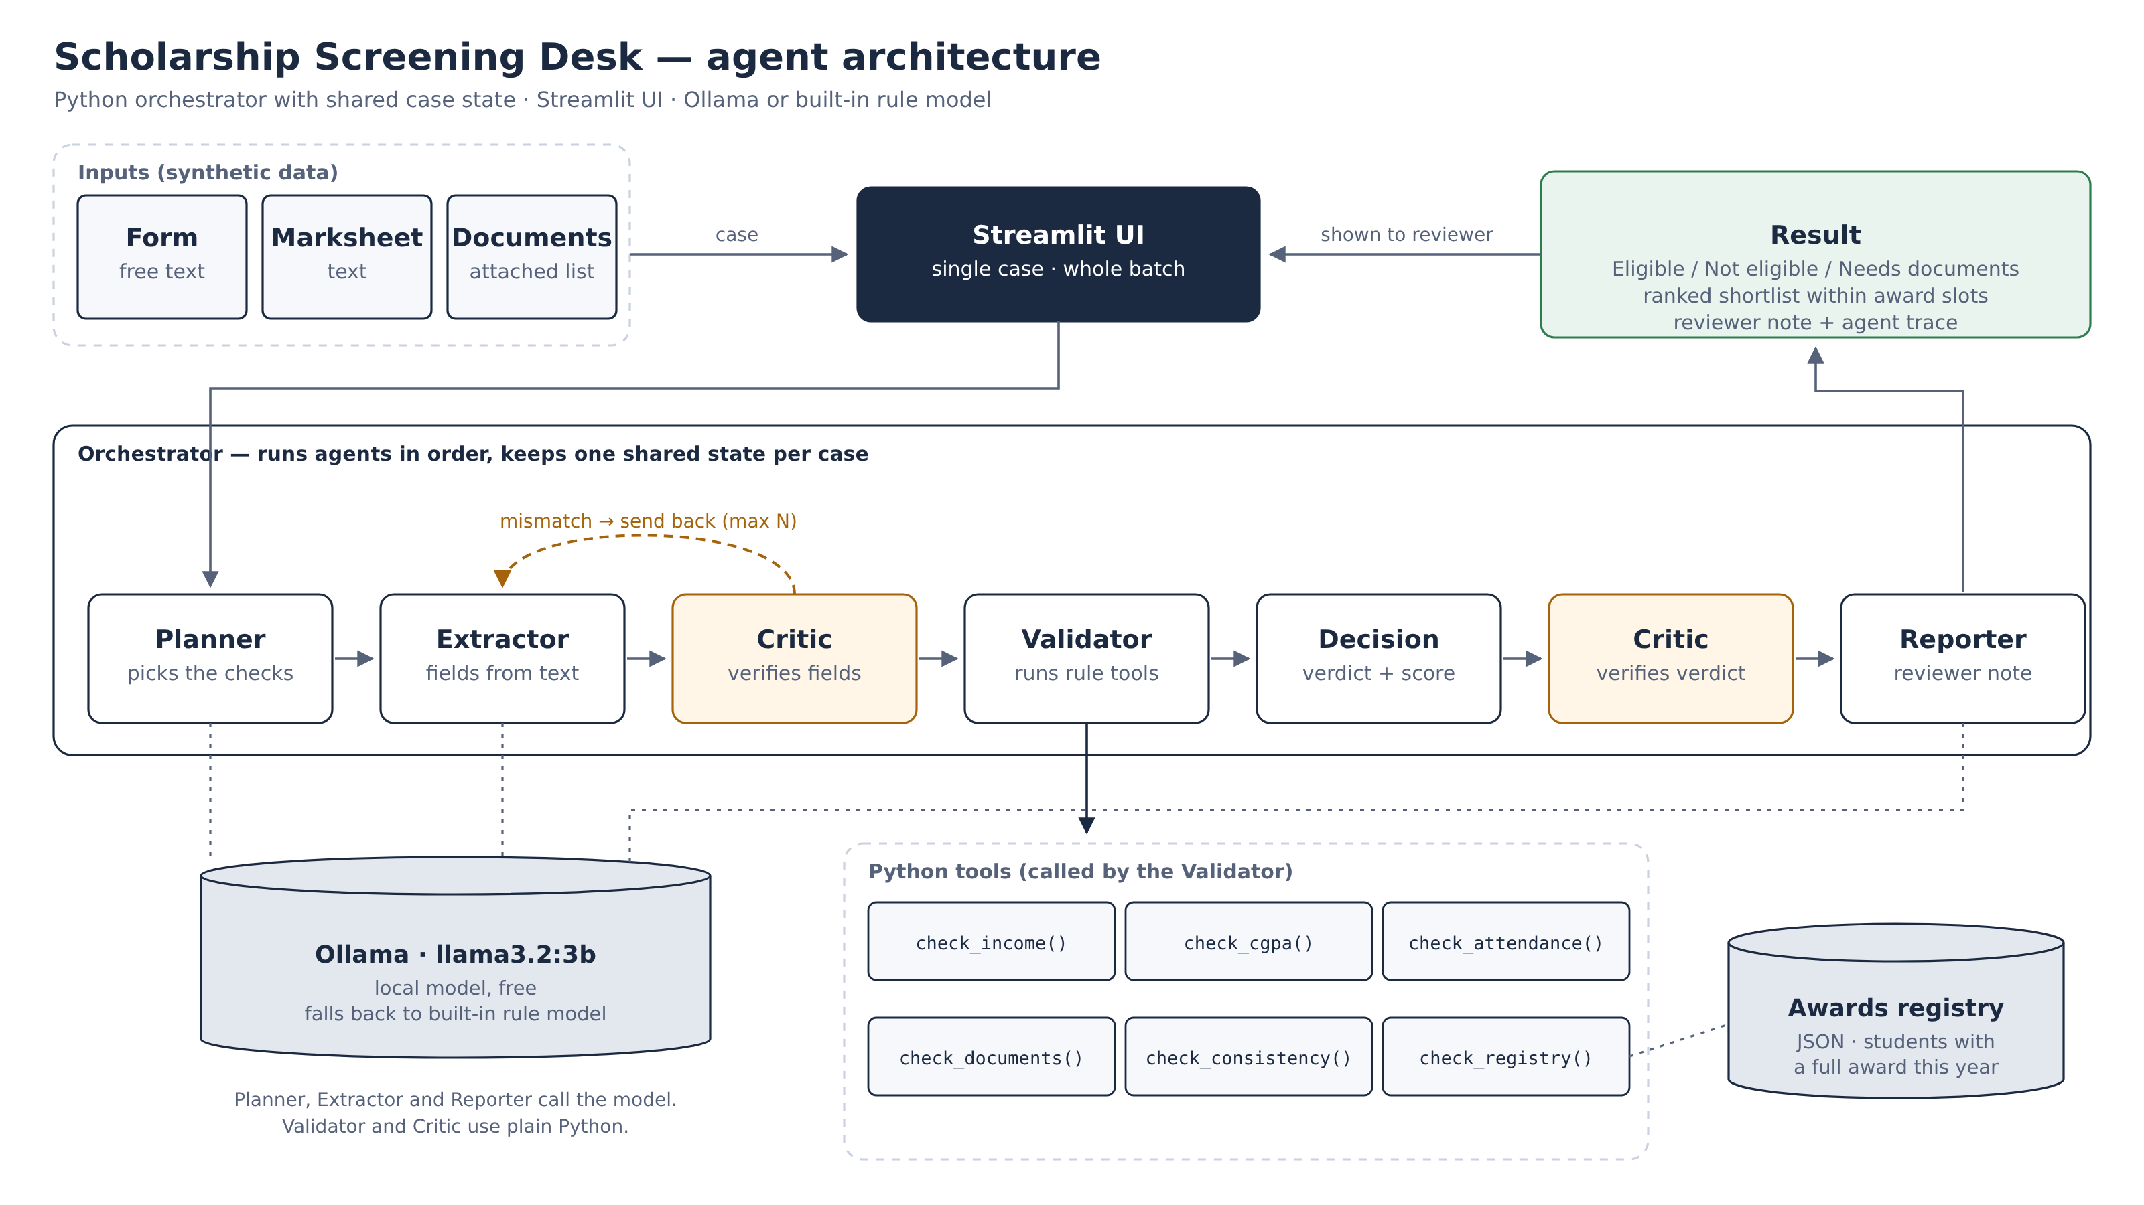
Architecture: one orchestrator, one shared state
Notes:
Here is the architecture. The Streamlit UI passes a case to a Python orchestrator, which runs the agents in order and keeps one shared state per case. The dashed amber loop is the Critic sending the case back to the Extractor. Planner, Extractor and Reporter call Ollama; the Validator calls plain Python tools, one of which checks a JSON awards registry. If Ollama isn't running, a built-in rule model takes over with the same interface.

Slide 5
Where the agents make decisions
send back if wrong
Planner
Extractor
Critic
Validator
Decision
Critic
Reporter
1
2
3
Planner chooses the checks
Per case. Reserved categories get a relaxed CGPA cutoff and need a category certificate. A guardrail adds back any mandatory check the model skips.
Critic accepts, sends back or overrides
It compares every field with the source text. Wrong fields go back to the Extractor with notes. If retries run out, it overrides them.
Decision picks one of three outcomes
Any failed rule means not eligible; anything missing means needs documents. In batch mode, eligible students are ranked and fill the award slots.
Notes:
This is what makes it agentic rather than a fixed script. Three points of judgment. The Planner picks checks per case. The Critic decides whether to accept the extraction, send it back with notes, or override it. The Decision agent picks one of three outcomes, and in batch mode the orchestrator decides who is awarded and who is waitlisted based on how many awards are available.

Slide 6
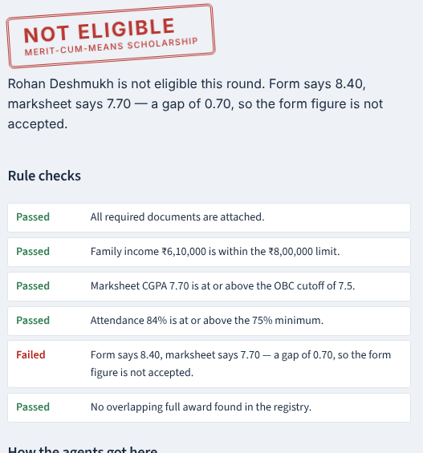
Demo: the Critic catches a slip
1
Pick an application
MCM-2026-002, Rohan Deshmukh, OBC. The demo switch makes the Extractor slip once.
2
Critic sends it back
Trace steps 3–6: the Critic spots a wrong field, the Extractor re-reads, the Critic accepts.
3
Validator runs six tools
Five pass. check_consistency fails: form says 8.40, marksheet says 7.70.
4
Stamp and reason
Not eligible, with the exact rule named for the reviewer.
Live: scholardesk-wpdp.onrender.com
Notes:
Switch to the app now. Pick MCM-2026-002, turn on 'Make the Extractor slip once', and press Screen. Point at the trace: the Critic finds a mismatch, the orchestrator sends it back, the Extractor re-reads and the Critic accepts. Then the Validator runs six tools. Five pass, but the form says CGPA 8.40 while the marksheet says 7.70, so it's not eligible. Then switch to the batch tab, set four awards, and screen all twelve.

Slide 7
Validated against hand-checked answers
12/12
verdicts match the hand-checked labels
12/12
injected extraction slips caught by the Critic
0
verdicts contradicted by the rule results
Top rank went to an ST student with CGPA 7.80 and income ₹3.6 lakh, ahead of a General student with CGPA 9.12 and ₹5.4 lakh. The score weighs need alongside merit, as the scheme intends.
Notes:
Validation. The twelve synthetic applications each test one rule. All twelve verdicts match my hand-checked labels. With mistakes injected, the Critic caught all twelve and the final verdicts didn't change. And the Critic's second check found zero verdicts that contradict the rule results. I also simulated a wrong Ollama answer in the tests and the send-back loop fixed it. In the batch run, four students are awarded and one is waitlisted.

Slide 8


Limitations and what comes next
Limitations
Future scope
Synthetic, clean text; real forms are scanned PDFs
Small local model can misread numbers or break JSON
Render free tier has too little RAM for Ollama, so the hosted demo uses the rule model
Checks that documents exist, not that they are genuine
OCR so the Extractor reads scanned certificates
Rules editable in the app for several schemes
LangGraph orchestration and MCP-exposed rule tools
Draft each student's result email automatically
Notes:
Limitations: the data is synthetic and clean, the local model is small, and Render's free tier can't run Ollama, so the hosted link uses the rule model. Next steps would be OCR for scanned documents, rules the office can edit, moving to LangGraph and MCP, and drafting result emails to students.

Slide 9
Thank you
REVIEWED
Questions welcome
Live app scholardesk-wpdp.onrender.com
Code github.com/Saafalya/scholardesk-
Notes:
Thank you. The app is live on Render and the code is on GitHub. Happy to take questions.

