Slide 1






Slide 2
Team: GaurNitai
Team members:
Bhavya Garg (220296)
Saagar K V (220927)

Slide 3
Problem Statement: The Crisis in Digital Identity Verification
Deepfake Threat Explosion
704% increase in deepfake attacks against financial services (2023)
$43 billion lost globally to identity fraud
62% accuracy - humans cannot reliably detect deepfakes
Free tools make sophisticated attacks accessible to anyone
Banking-Specific Challenges
Video KYC (VKYC) systems vulnerable to AI-generated synthetic media
Face swap attacks using virtual cameras and digital injection
Voice cloning technology defeating audio verification
Human-led verification fails 38% of the time
The Challenge: Create an unbreakable identity verification system that works across hybrid environments while defeating the most sophisticated AI-generated attacks.

Slide 4
TrustNet 360°: The Complete Identity Ecosystem
Revolutionary Dynamic Biometric Interrogation (DBI) (The Un-Spoofable VKYC)
Multi-Modal Challenge Engine:
Visual + Audio Synthesis: "Count backwards from 47 while looking top-left”
Cognitive + Motor Integration: "Type 'Bank of Baroda' then touch your nose"
Advanced Anti-Spoofing Science:
Eye Movement Tracking: Saccades and microsaccades analysis
Environmental Coherence: Light reflection + ambient audio validation
Digital DNA Creation:
Voiceprint Vectors, Facial Geometry Maps, Behavioral Signatures, Environment Hash
Real-Time Continuous Trust Score (CTS): 0-100
Passive Biometric Monitoring:
Behavioural Biometrics: Keystroke dynamics, mouse patterns
Device Intelligence: Hardware fingerprinting, sensor analysis
Contextual Awareness: Geolocation, time patterns, network behaviour
Adaptive Security Response:
CTS 90+: Seamless access
CTS 70-90: Smart friction (OTP)
CTS 40-70: Micro-VKYC challenge
CTS <40: Account protection

Slide 5
Commercialization potential
Market Size & Growth
$15 billion global identity verification market
22% CAGR projected through 2028
Regulatory compliance driving adoption (EU AI Act, eIDAS 2.0)
Go-to-Market Strategy
Pilot with Bank of Baroda (proof of concept)
Indian banking consortium (market validation)
Global financial services (scale deployment)
Multi-industry expansion (platform monetization)

Slide 6
Business models
1. Direct Implementation (Year 1):
Bank of Baroda deployment: $2M implementation contract
Enterprise licensing: $500K-$2M per institution
Compliance consulting: $100K-$500K per project
2. B2B SaaS Platform (Years 2-3):
API-based pricing: $0.50-$2.00 per verification
Monthly subscriptions: $10K-$100K based on volume
White-label solutions: $1M-$5M annual contracts
3. Ecosystem Expansion (Years 4-5):
Cross-industry deployment: Healthcare, government, education
International markets: Europe, APAC, Americas
Partnership revenue: 20-30% revenue share with system integrators

Slide 7
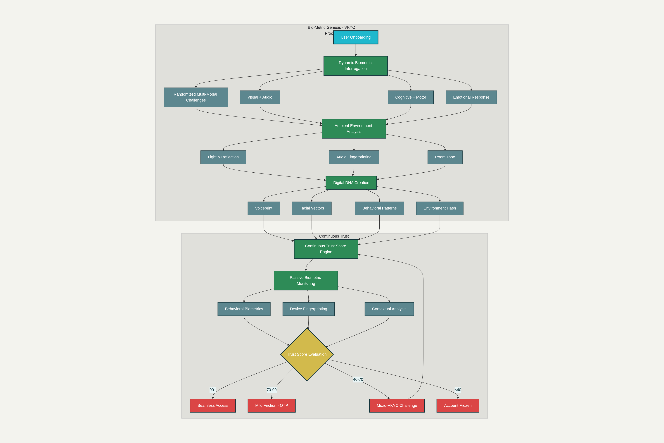
Architecture of the implementation

Slide 8
Architecture of the implementation

Slide 9
Technical Details:
Core Services (Microservices):
DBI Engine: Real-time challenge generation
Biometric Processor: AI/ML analysis pipeline
Trust Score Calculator: Behavioural analytics
Risk Assessment: Fraud detection algorithms
User Experience:
30-second onboarding
95% invisible security
Tech Stack:
Computer Vision: OpenCV, MediaPipe, MTCNN
Deep Learning: TensorFlow, PyTorch, Keras
Audio Processing: Librosa, PyAudio
Behavioral Analytics: scikit-learn, XGBoost
Real-time Processing: Apache Kafka, Redis

Slide 10
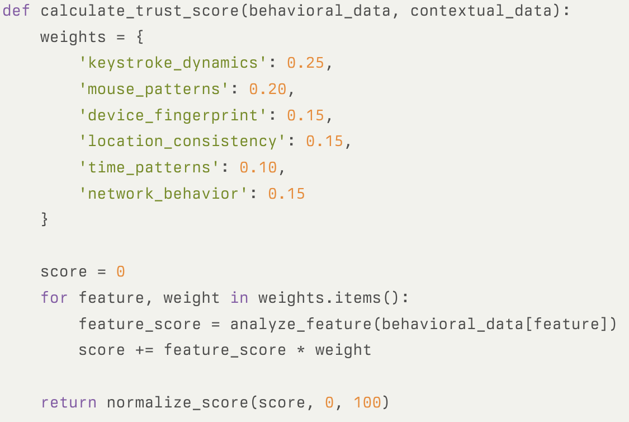
CTS Calculation

Slide 11
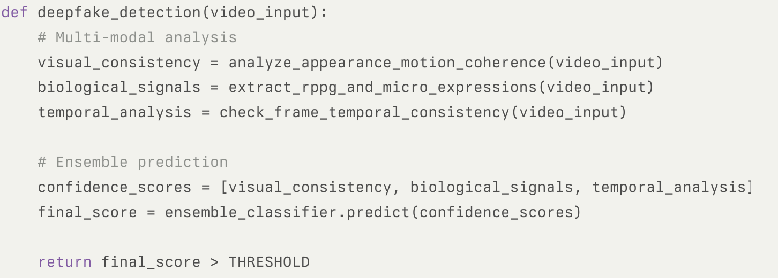
Deepfake Detection Pipeline

Slide 12
Summary
TrustNet 360° is a two-part revolutionary system combining Bio-Metric Genesis (un-spoofable VKYC) with Continuous Trust Assurance (real-time monitoring) to create an unbreakable chain of digital identity trust.
Key innovations:
Dynamic Biometric Interrogation (DBI): Real-time, unpredictable challenges that synthetic media cannot replicate
Multi-Modal Authentication: Heartbeat analysis, micro-expressions, eye tracking, environmental validation
Continuous Trust Score (CTS): 0-100 real-time risk assessment with adaptive security responses
Digital DNA: Unique, encrypted identity signature combining biological and behavioural patterns
Business Impact:
Market: $15B identity verification industry with 22% CAGR
ROI for BoB: 99.5% reduction in deepfake attacks, $50M annual fraud savings
Scalability: B2B SaaS platform serving global financial institutions

