Slide 1
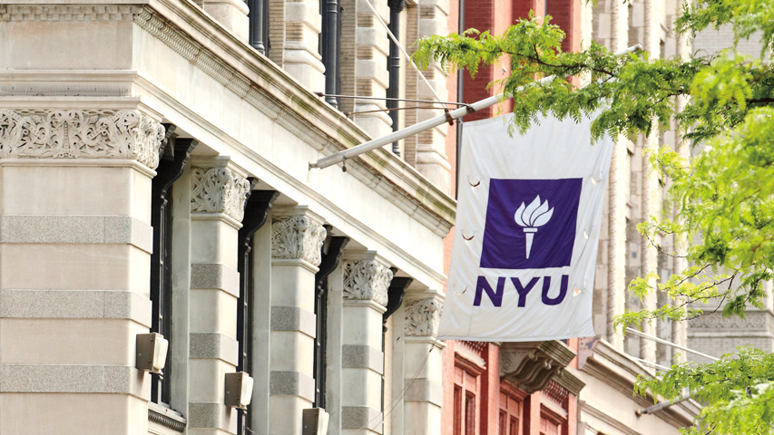

Traffic Sign Detection
Sahil Kumar
12/11/2019

Slide 2
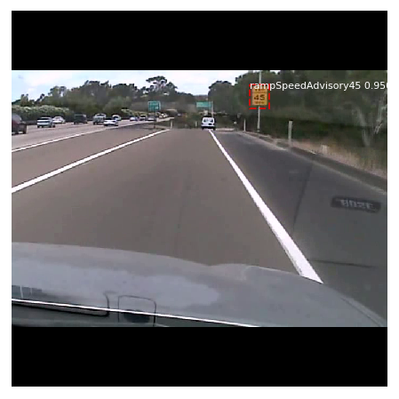
Semantic segmentation using Mask-RCNN for Traffic Sign Detection
  To implement pre-existing neural network used for Mask RCNN.
  Identify Data set to be used.
  Train and test neural network on dataset.
  Test different parameters for neural network to improve accuracy.
  Understand and identify problem areas/ limitations.
12/11/2019

Slide 3
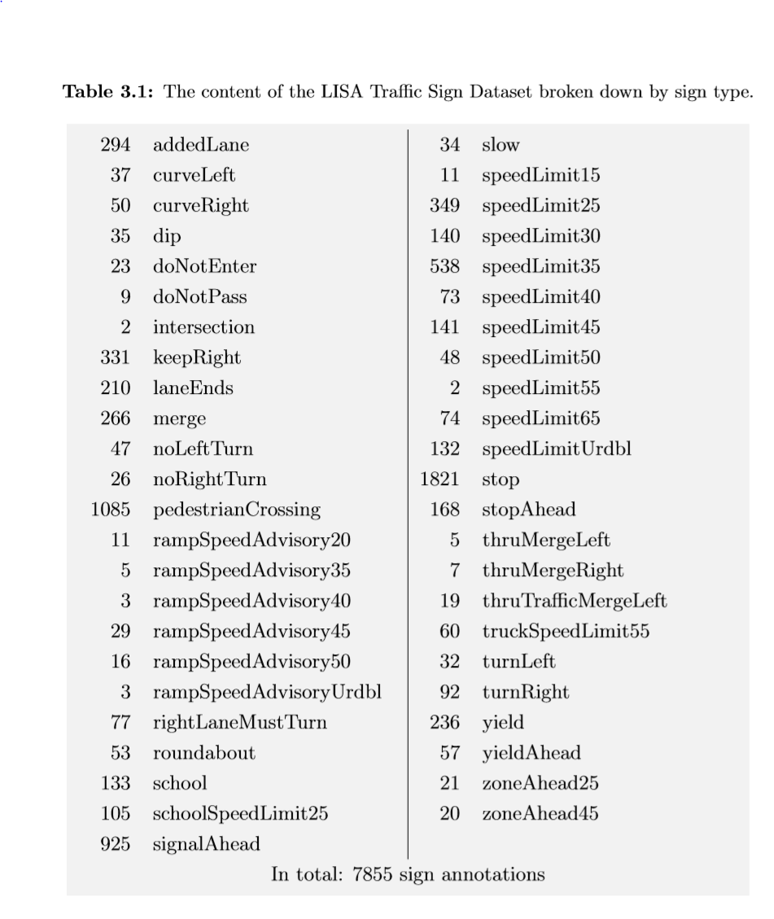
Dataset
The Dataset used in this project is the LISA¹ dataset.
  It is named after Laboratory for Intelligent and Safe Automobiles at UCSD.
  This dataset takes learning from other open source traffic datasets such as :
        German Traffic Sign Recognition benchmark(GTSRB)
        KUL
        STS
  This dataset includes still images as well as frames from video tracks that can allow us to access temporal information.
  The database is approx. 9 GB of images(6618 images,7856 annotations).
12/11/2019

Slide 4
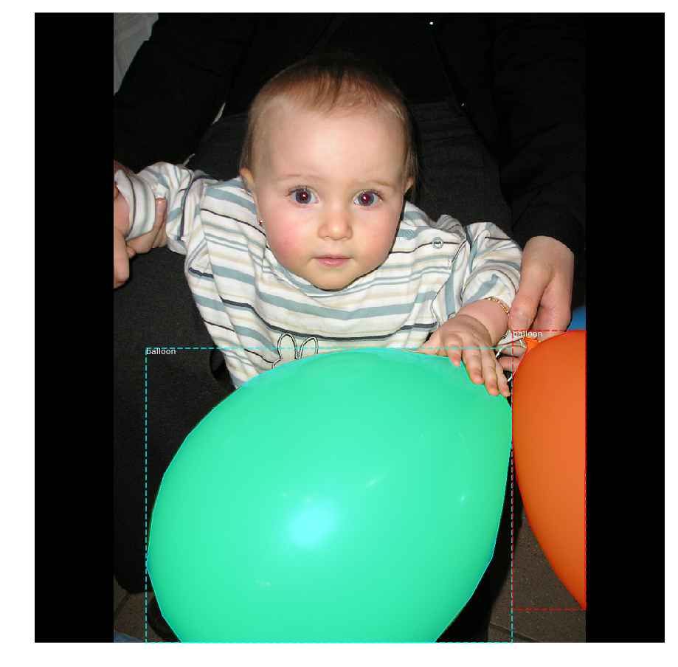
Perception Technique
³
Semantic Segmentation
  Semantic Segmentation is the process of assigning a label to every pixel in the image
  This technique allows us to accurately identify object boundaries
We used Mask RCNN deep learning technique to implement Semantic Segmentation on our dataset
Mask RCNN is a combination of Faster Recurrent neural networks and fully convolution network.
12/11/2019

Slide 5
Hardware Used
The code was run on the following configurations:
  Laptop:
      Processor : Intel I7-6500 U @2.59GHz
      Ram: 8GB
      OS: Windows 10 64 bit edition
  Desktop:
      Processor : Intel i9-9900K @3.60 GHz
      Ram : 32 GB
      Graphics Card: Nvidia RTX 2080 8GB
      OS : Windows 10 64 bit edition
Config | Processing Unit | Average Time taken for one epoch (seconds)
Laptop | CPU(2 cores) | 27040
Desktop | CPU(8 cores) | 4020
Desktop | GPU (2944 CUDA cores) | 67
12/11/2019

Slide 6
Implementation
Used Matterport Mask R-CNN github² as foundational code.
Matterport was setup to use MS COCO dataset.
The neural network used consists of 236 layers and uses Resnet101 as its backbone network
The following modifications were made to the code:
    Modified code to import LISA dataset and bounding box annotations.
    Used subset of LISA dataset comprising of 273 images.
    Created code to pre process dataset images.
    Modified code to run on both CPU and GPU.
    Modified code to use only bounding box coordinates as input for detection i.e use 0s mask. Code still remains compatible with masked images.
    Fine tuned parameters and training length to optimize accuracy.
    Added code to save trained model and weights for future training.
    Trained our head layers for 4 epochs and then finetuned all layers for 4 epochs.
12/11/2019

Slide 7
Results
Used subset of LISA dataset successfully to train and validate on 17 different traffic sign classes.
Used entire LISA dataset successfully to train and validate on 47 different traffic sign classes.
Accuracy for bounding box was measures in Area IoU(Intersections over Union)
Achieved an average accuracy of 77.41% over 500 images in validation dataset.
12/11/2019

Slide 8
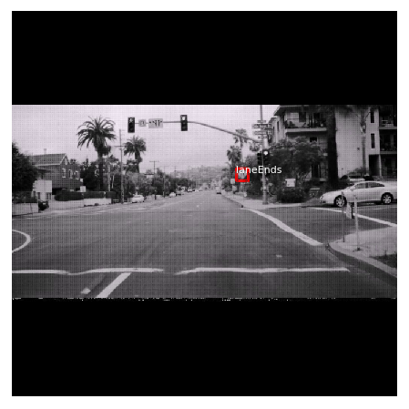
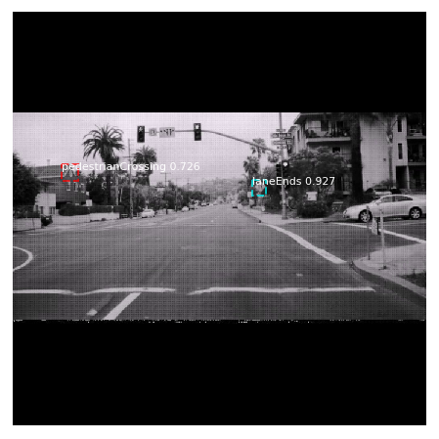
Results
Ground Truth
Detected output
12/11/2019

Slide 9
Learnings
Neural network theory
Semantic Segmentation theory
Writing your own neural network without libraries
Use of convolutional neural network to implement Semantic Segmentation
Image pre processing and preparing dataset.
Using Keras, Tensorflow and OpenCV in python.
12/11/2019

Slide 10
Future Improvements
Create Mask annotations for LISA Dataset.
Use new dataset to train current model to predict masks.
Try different combinations of parameters to optimize accuracy and reduce training time(e.g: larger batch sizes for resized smaller images).
Change measure of accuracy to account for incorrect and multiple sign detection.
Optimize code even further to run on GPUs faster.
12/11/2019
Notes:
Can be optimized converting np arrays to tensor. Understand tensor to np array translation overhead which might end up being more computationally expensive

Slide 11
Bibliography
http://cvrr.ucsd.edu/LISA/lisa-traffic-sign-dataset.html
https://github.com/matterport/Mask_RCNN
https://github.com/matterport/Mask_RCNN/releases/download/v2.1/balloon_dataset.zip
12/11/2019

