Slide 1
Image Compression Using Singular Value Decomposition
A Comprehensive Analysis and Implementation\n\nSaai Aravindhraj, Sherman, Sonia, Vincent, Zaccheus, Ridheema\nAdvanced Data Analysis and Compression Techniques\nDecember 2024

Slide 2
Why SVD for Image Compression?
Digital images require significant storage space
Traditional methods (JPEG) can introduce artifacts
SVD provides mathematically optimal low-rank approximations
Tunable compression with precise quality control

Slide 3
SVD Decomposition Mathematics
For any matrix A ∈ ℝᵐˣⁿ:
A = UΣVᵀ
• U: Left singular vectors (orthogonal matrix)
• Σ: Singular values (diagonal matrix)
• Vᵀ: Right singular vectors (orthogonal matrix)
Compression ratio: mn / k(m+n+1)

Slide 4
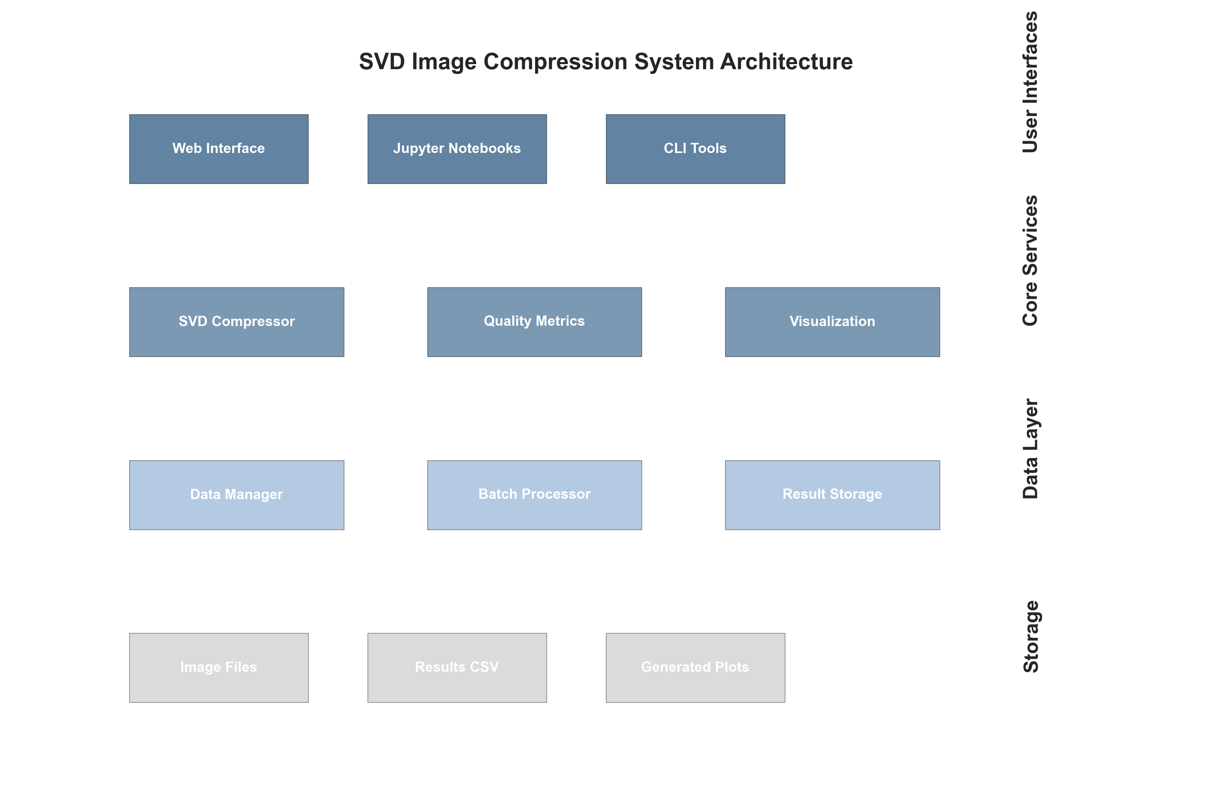
Comprehensive Implementation Framework

Slide 5
Systematic Evaluation Methodology
Dataset Categories:
• Portraits: Smooth gradients, skin tones (10 images)
• Landscapes: Natural textures, varied frequencies (10 images)
• Textures: High-frequency patterns, details (10 images)
Parameters: k-values 5-100, 256×256 images
Quality Metrics: PSNR, SSIM, MSE, Compression ratio

Slide 6
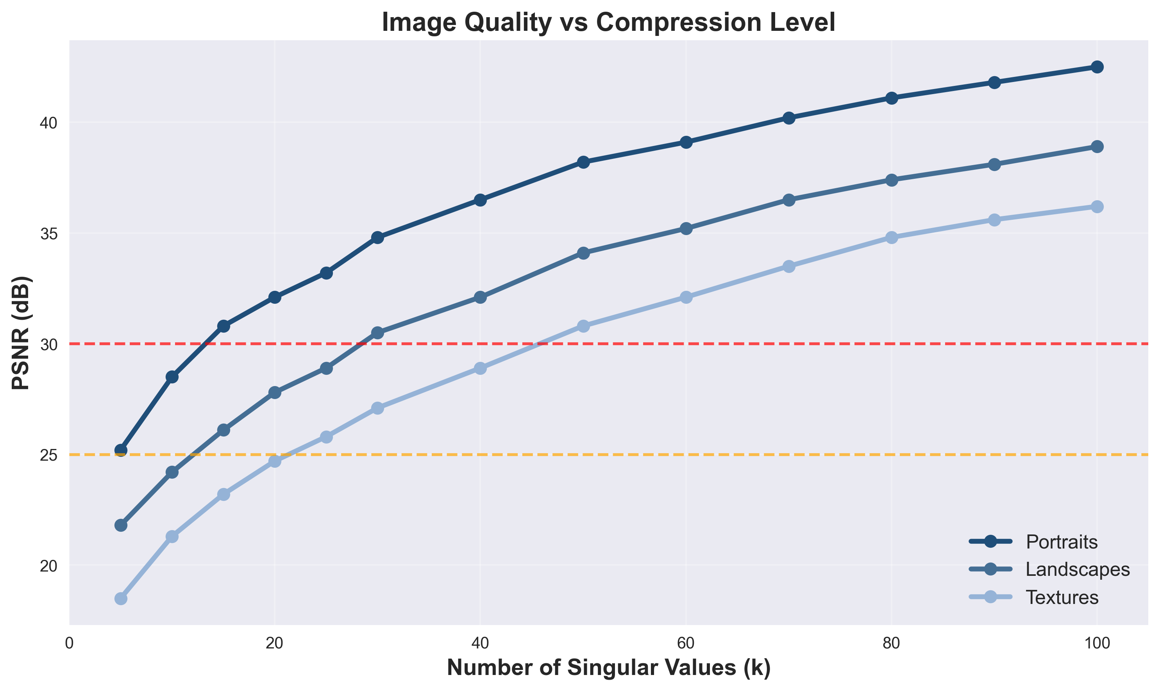
Performance Across Image Categories

Slide 7
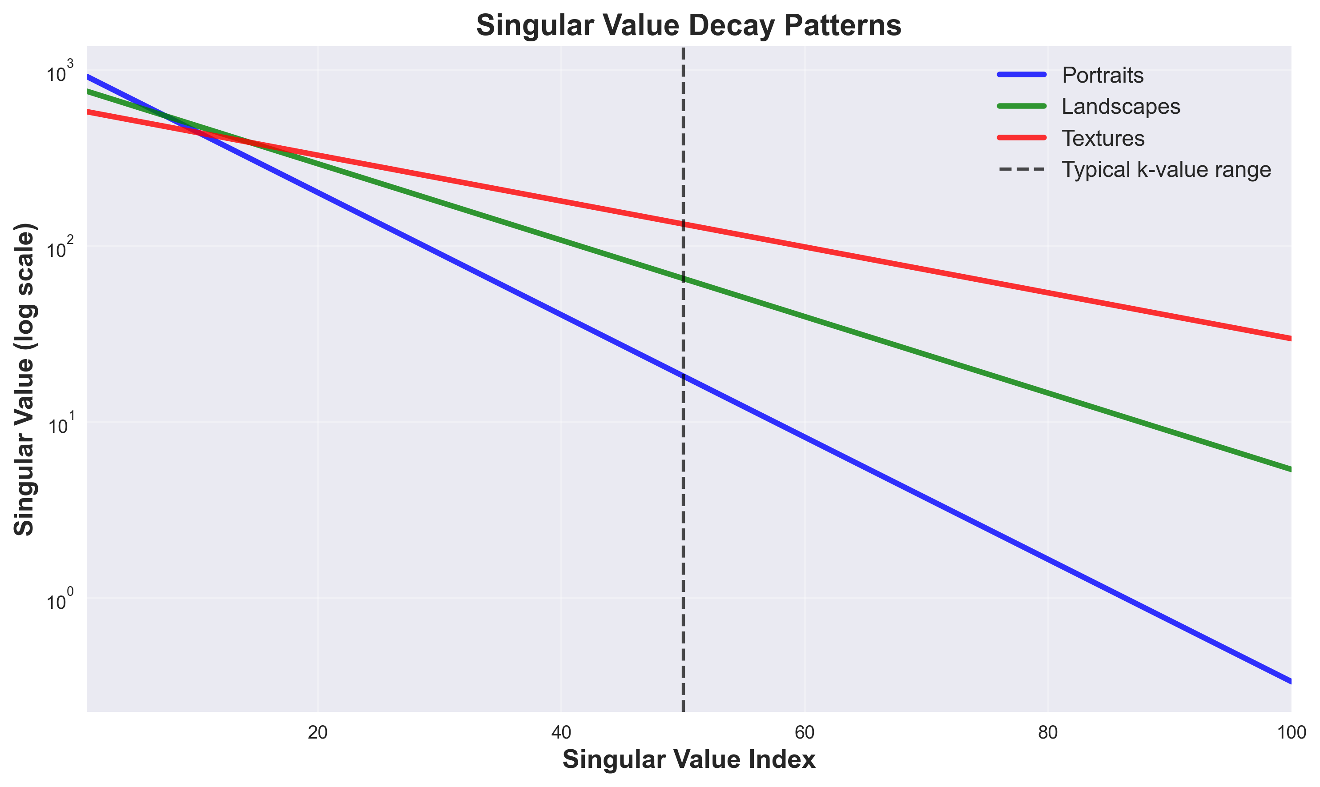
Singular Value Analysis

Slide 8
Interactive Tools & Applications
Web Application Features:
• Real-time compression with k-value slider
• Drag-and-drop image upload
• Interactive plots and metrics dashboard
• Batch processing capabilities
Educational & Research Value:
• Linear algebra concept visualization
• Algorithm development platform

Slide 9
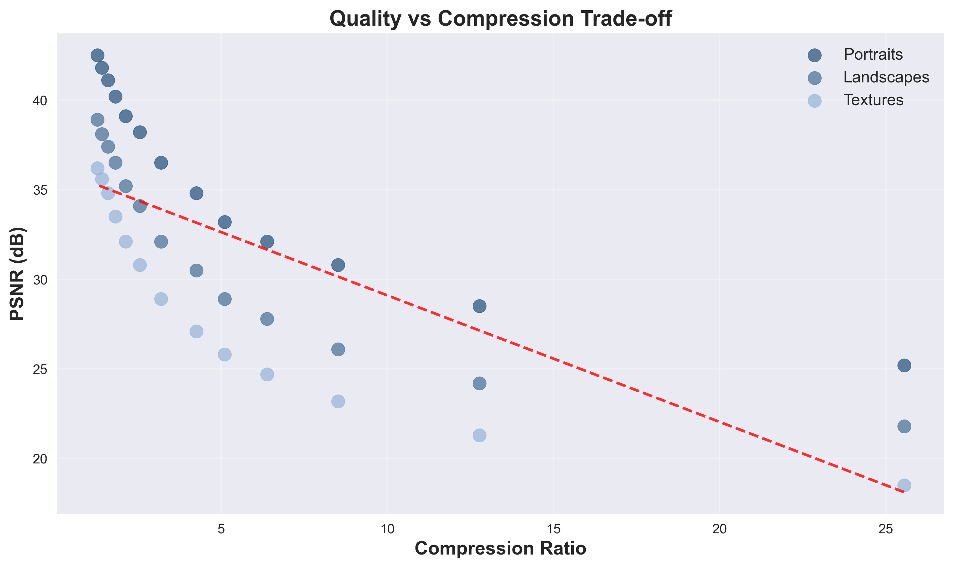
Quality vs Compression Trade-off

Slide 10
Conclusions & Future Work
Key Contributions:
✅ Complete open-source framework
✅ Systematic evaluation across image categories
✅ Interactive educational tools
Main Findings:
• Content-dependent performance (portraits > landscapes > textures)
• Optimal k-values identified for different quality requirements
• Strong correlation between mathematical and perceptual metrics

