Slide 1
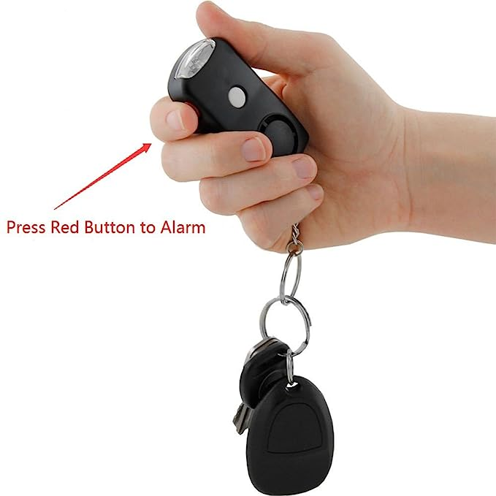
Design Presentation SOS Emergency Device with Emergency Call Facility
Team# 3
Prince Dr K Vasudevan College of Engineering and Technology , Chennai
19-Oct-2023

Slide 2
Outline
About Team
Problem Statement
Selected Concept Design
Block Diagram
Projection views of the proposed design
Bill of Material and Cost estimates
Gantt Chart – Project Plan
Open Issues
References

Slide 3
Team
Team Number:
SN | Student Name | Roll # | Year of Study | Department
1 | Saai Krahaanth |  | 3rd | CSE
2 | Dinesh raj |  | 2nd | AIDS
3 | Aastin |  | 3rd | AIDS
4 | Bhavani |  | 3rd | AIDS
5 | Divya |  | 3rd | CSE
SN | Faculty Name | Department
Notes:
Few guidelines:
Preferably, pics/diagrams, tables etc. to be freshly prepared instead of taking from net. Few pics/diagrams in sample docs/slides to be hand-drawn and few could be drawn with machine/computer tools
Avoid copying text from net.
Components details/datasheet not required. Instead a reference link can be added, if required

Slide 4
Problem Statement
Limited Access to Smartphones: There are situations where individuals may not have access to smartphones. This could be due to various reasons, such as not owning a smartphone, a dead battery, or a lost device.
Kidnapping Scenarios: In cases of kidnapping or abduction, the perpetrators may separate the victim from their smartphone, making it impossible for them to call for help. This is a significant concern, especially in emergency situations.
Elderly Individuals: Older people may face health emergencies and need immediate medical assistance. However, they may not have smartphones or may not be proficient in using them to call for an ambulance.
Children Going to School: School children, especially in some areas or age groups, may not be allowed to carry smartphones to school. In such cases, they lack a direct means of communication in case of emergencies, and this can be a safety concern for both parents and school staff.
Notes:
Provide brief about problem/project being worked upon

Slide 5
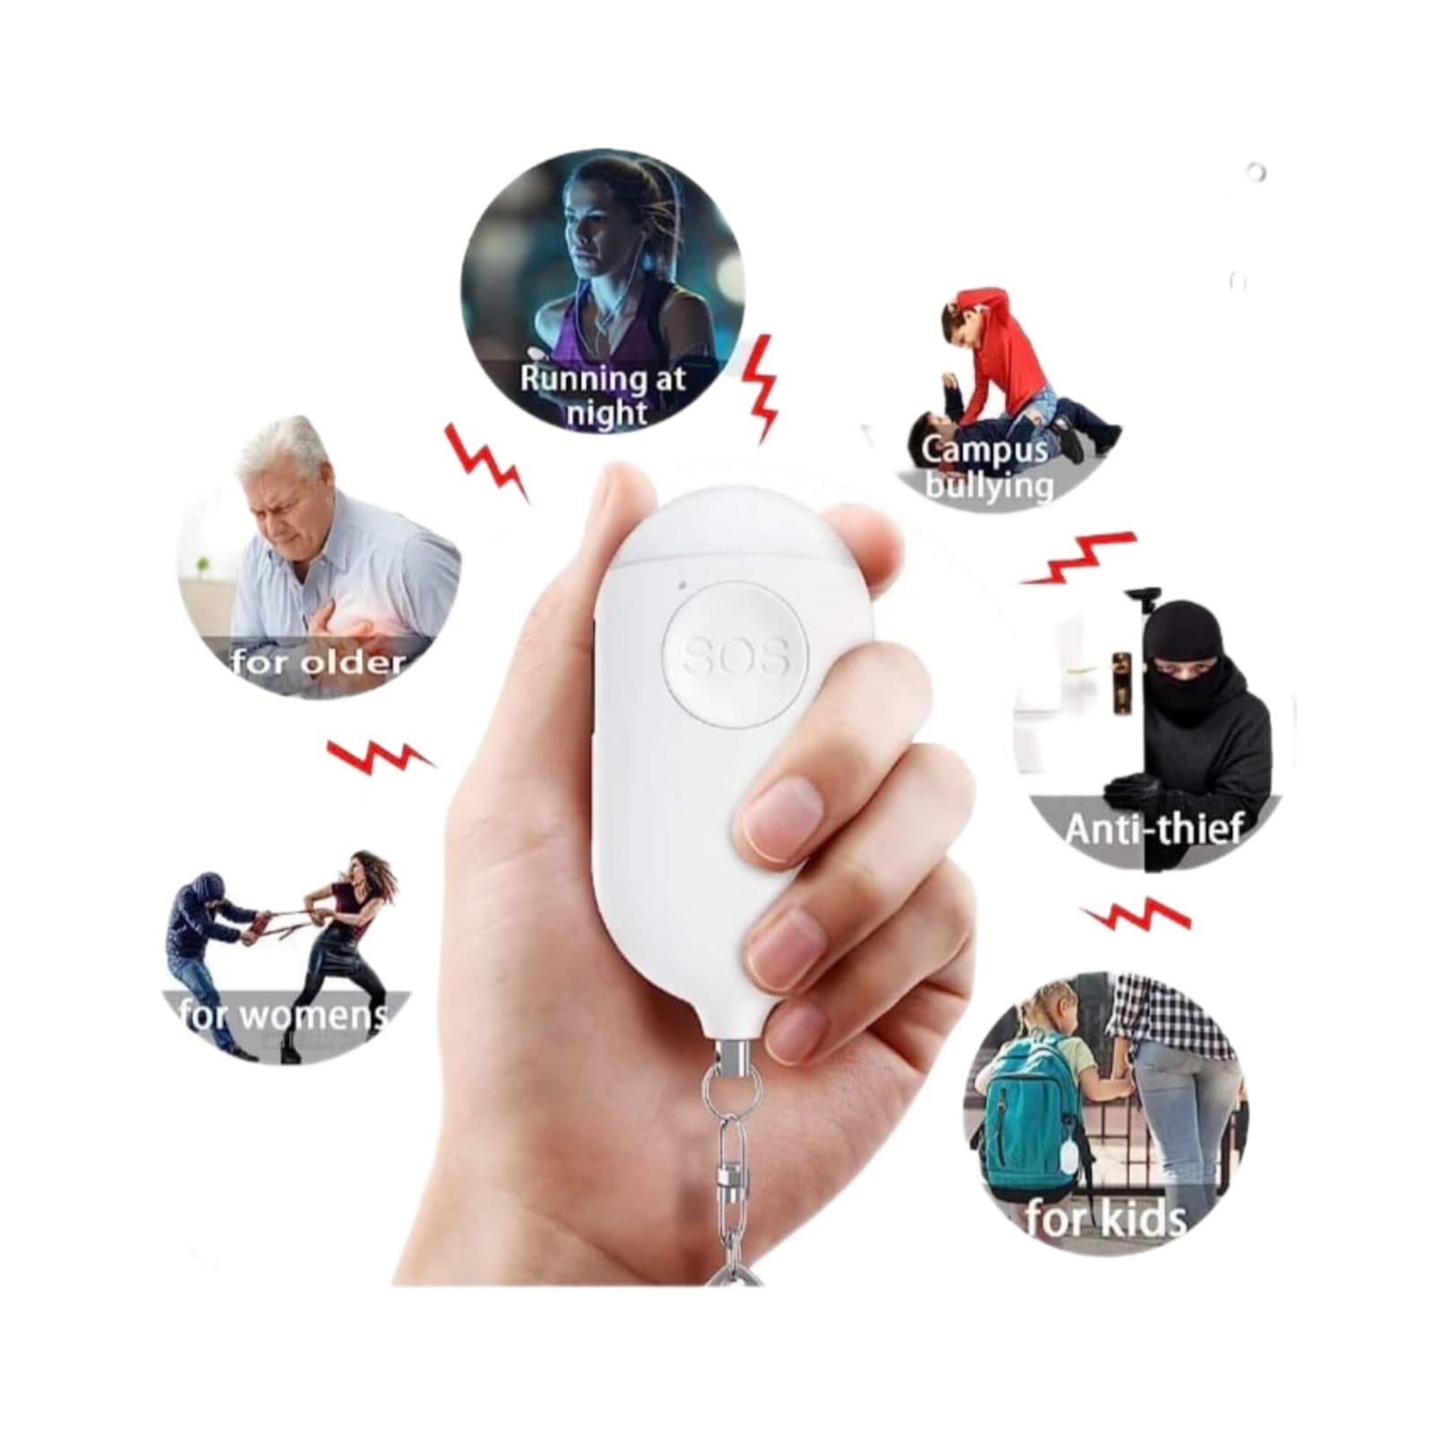
Selected Concept Design
Limited to Smartphones: The SOS keychain concept appears to be restricted to smartphone usage. This limitation can pose challenges in situations where individuals do not have access to smartphones.
Potential Kidnapping Scenario: In case of a kidnapping, perpetrators might separate the affected individual from their smartphone, preventing them from using the SOS feature. It's essential to consider alternative methods for alerting authorities or seeking help.
Health Emergencies for the Elderly: Older individuals may experience health emergencies where they need immediate medical assistance. Relying solely on smartphones may not be practical for this demographic.
School Children's Usage: Schoolchildren often do not have access to smartphones during school hours. However, emergencies can still occur when they are away from home or school. The keychain should provide a solution for these situations.
Notes:
Provide brief about selected concept in terms of visual diagram and textual points
Avoid copying pictures/text from net as it is. Visual diagram can be hand-drawn.

Slide 6
Selected Concept Design ..contd
Key aspects of the design:
1. Compact and portable design for easy carrying.
2. User-friendly interface for quick and intuitive operation.
3. Clear and prominent SOS button for immediate emergency activation.
4. Robust and durable construction to withstand harsh conditions.
5. GPS location sending functionality for precise location identification.
6. Long-lasting battery life to ensure reliable usage during emergencies.
7. Integration with voice transmitting device to establish the current situation.
Notes:
Provide key aspects of the design being considered wrt selected concept design

Slide 7
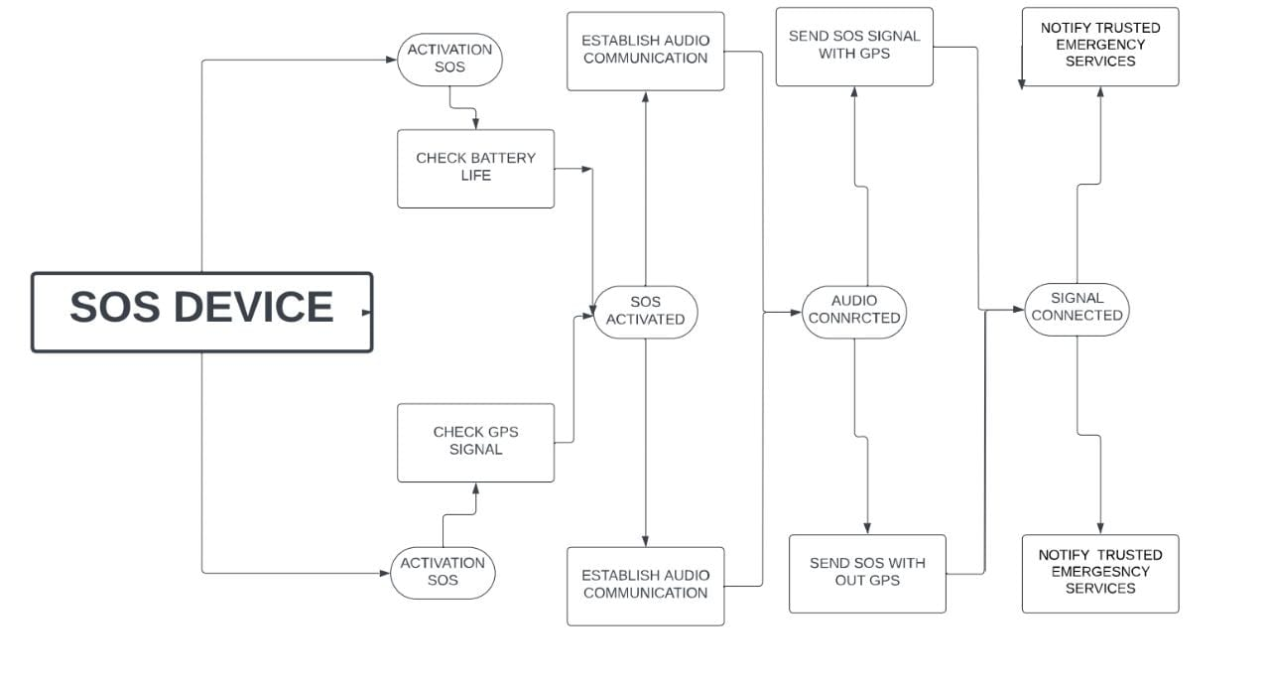
Block Diagram
Source for functional blocks for toaster: https://home.howstuffworks.com/toaster.htm
Notes:
Provide block diagram covering functional blocks for selected concept design

Slide 8
Block Diagram ..contd
5. Speak clearly into the device's microphone to explain your situation and provide necessary details.
6. The device will send the voice through outgoing call to authorized person
7. Our devices send messages to certain people and the message contains location of user with a small emergency details
1 .Carry the SOS Key chain device all the time.,.
2. In case of an emergency, locate the prominent SOS button on the device.
3. Press and hold the SOS button for a few seconds to activate the emergency call function.
4. The device will establish a connection with emergency services or designated contacts.
Notes:
Notes about block diagram

Slide 9
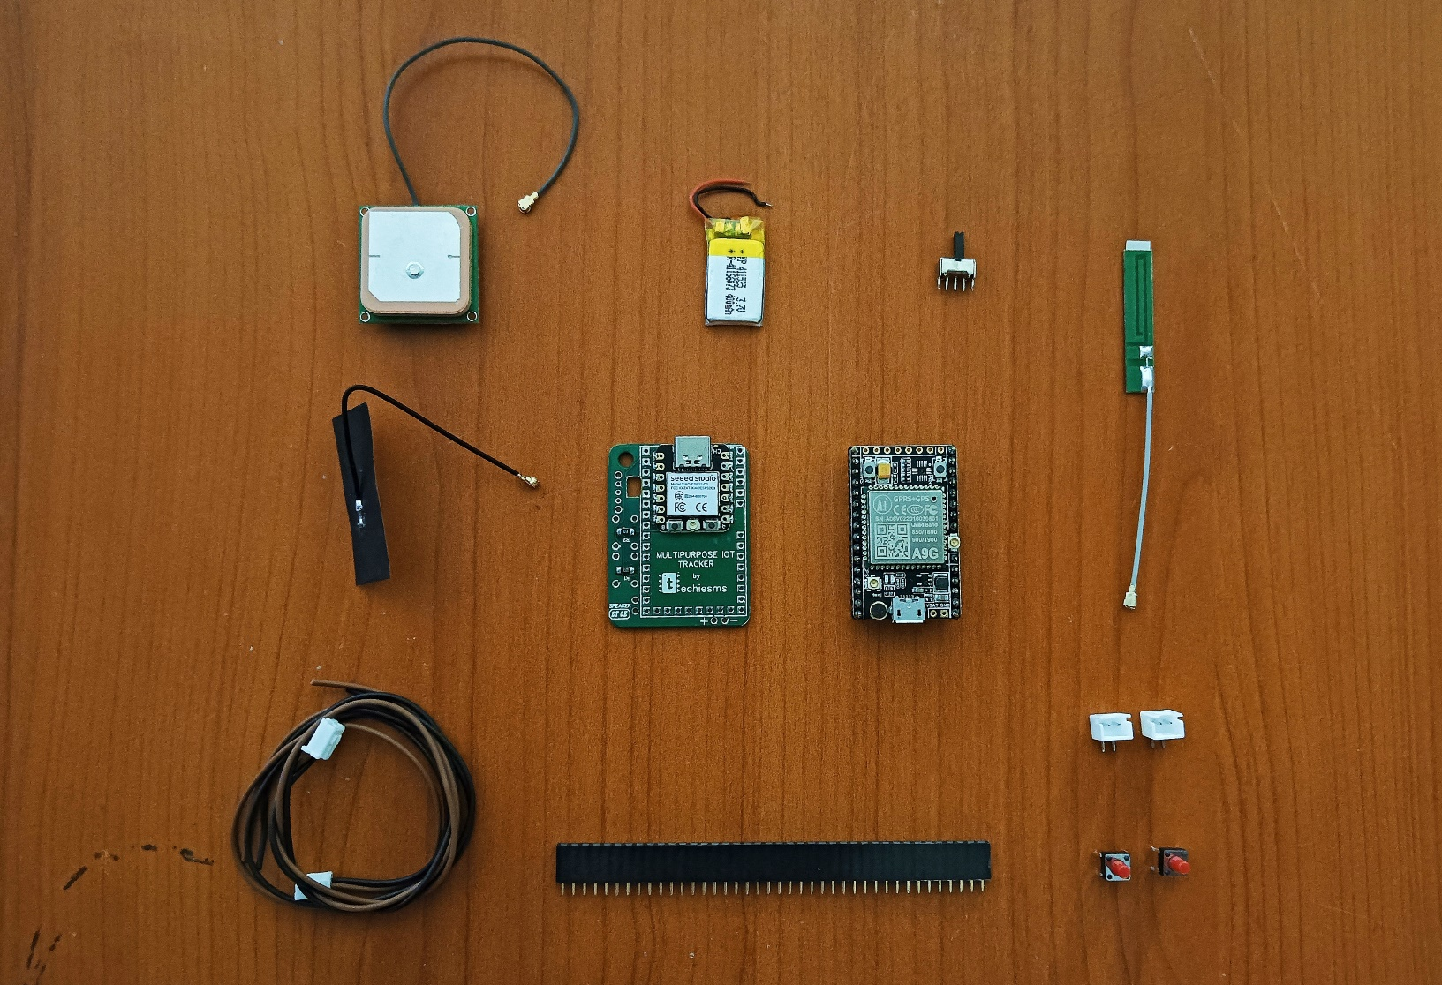
Projection views of the proposed design
Components Link
1. A9G GSM/GPRS+GPS/BDS Development Board (AI-thinker):-
A9G GSM/GPRS+GPS/BDS Development Board (AI-thinker) - leetechbd
2. London Retro KP 402025 Battery :-
London Retro KP 402025 Battery - London Retro : Flipkart.com
3. Seeed Studio XIAO ESP32C3 :-
Buy Seeed Studio XIAO ESP32C3 Online at Robu.in
4. IPEX WiFi Antenna:-
IPEX WiFi Antenna, Wide Range RG1.13 Wire FPC Internal Antenna 868-915MHZ for Wireless Monitoring : Amazon.in: Electronics
Wires
SOS Emergency Device
Notes:
Drawings, Schematics, Algorithm/Flow Charts. Separate diagrams for each of mechanical, electrical, electronic and software aspects.
Avoid copying pictures/text from net as it is. Visual diagram can be hand-drawn or using machine tools, e.g. CAD, Powerpoint, ..

Slide 10
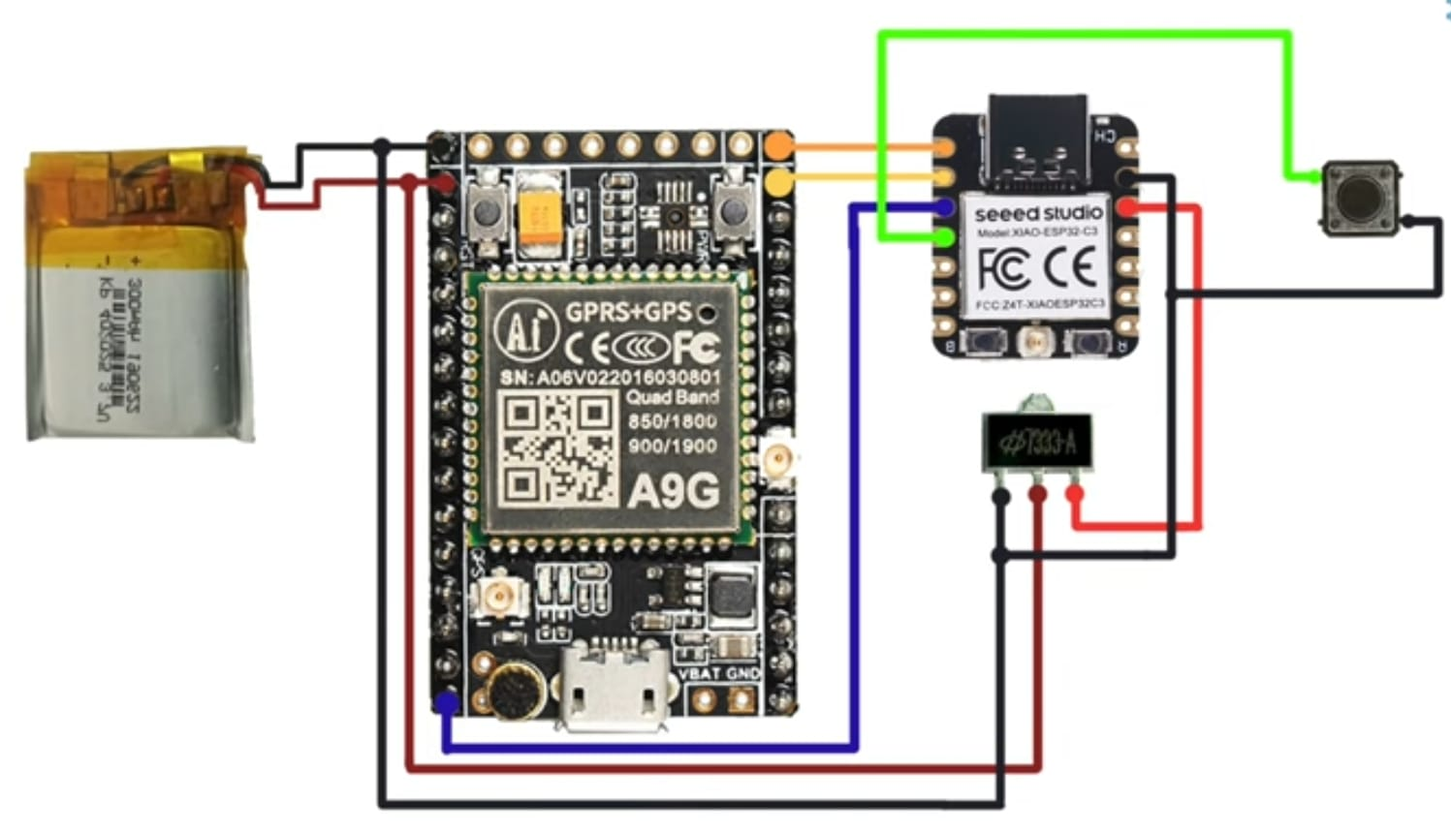
Projection views of the proposed design ..contd
Electrical circuit diagram
Notes:
For software, insert flowcharts, pseudo-code, data structures as appropriate
Add more slides as needed

Slide 11
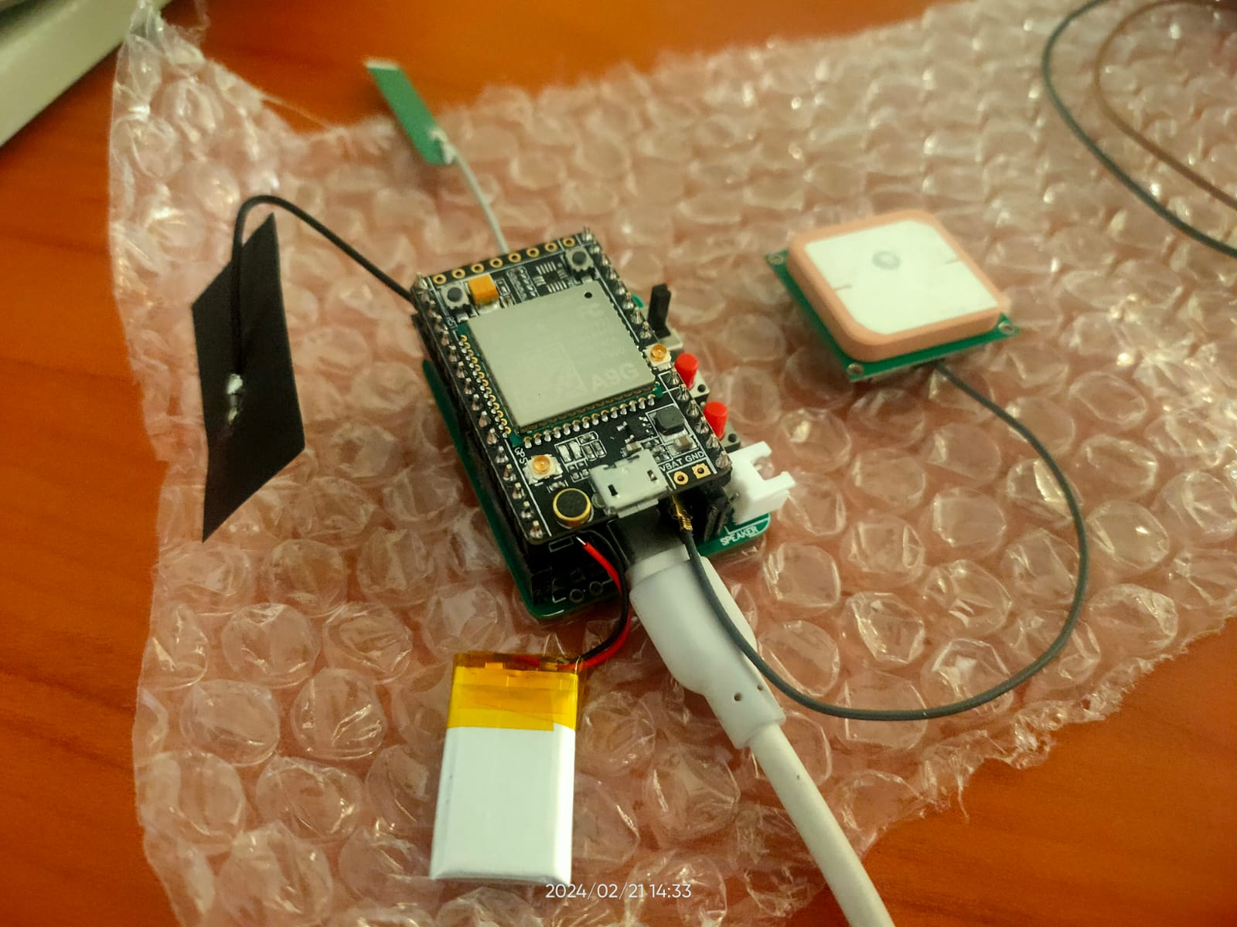
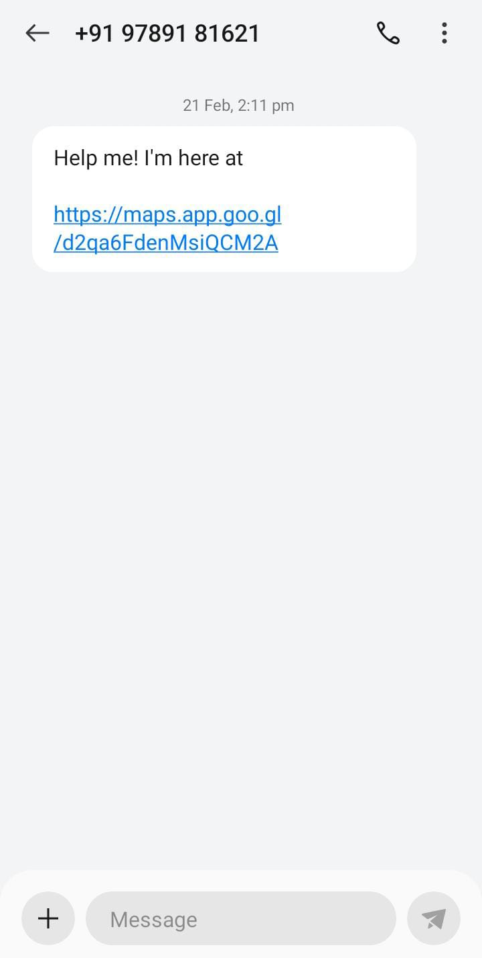

Slide 12
Bill of Material (BOM) and Cost Estimate
SNO | COMPONENTS | QUANTITY | PRIZE
01 | Ai Thinker A9G GSM/GPRS+GPS/BDS Development Board | 1 | ₹1,008.47
02 | Seeed Studio XIAO ESP32C3 | 1 | ₹588.14
03 | London Retro KP 402025 Battery | 1 | ₹399.00
04 | IPEX WiFi Antenna | 1 | ₹179.00
05 | ON-OFF Switch | 1 | ₹13
06 | Restart switch | 1 | ₹13
07 | Sos switch | 1 | ₹12
08 | Required Wired | 7 | ₹18
 |  | Total:- | ₹2230.61
Source: Section 4.1 of https://courses.engr.illinois.edu/ece445/getfile.asp?id=9487, Dollar values converted to INR
Notes:
Provide bill of material including cost estimate, based on parts required to build the project as per selected design
We can also add reference links for purchasing material

Slide 13
Gantt Chart -- Project Plan
Task/Activity | Wk3 | Wk4 | Wk5 | Wk6 | Wk7 | Wk8 | Wk9 | Wk10 | Wk11
Wk start date | 22-Feb | 01-Mar | 08-Mar | 15-Mar | 22-Mar | 29-Mar | 5-Apr | 12-Apr | 19-Apr
Wk end date | 28-Feb | 7-Mar | 14-Mar | 21-Mar | 28-Mar | 4-Apr | 11-Apr | 18-Apr | 25-Apr
List 3 design alternatives
Freeze on one design
Design Presentation/ Review
Detailed design, BOM, place orders
Implementation and Testing
Notes:
Provide a high level Project plan for developing the prototype for your selected design. Keep in mind the weekly schedule of LP201 and ensure that the completion dates are sufficiently before the LEAP deadlines!

Slide 14
Gantt Chart -- Project Plan ..contd
Task/Activity | Wk3 | Wk4 | Wk5 | Wk6 | Wk7 | Wk8 | Wk9 | Wk10 | Wk11
Wk start date | 22-Feb | 01-Mar | 08-Mar | 15-Mar | 22-Mar | 29-Mar | 5-Apr | 12-Apr | 19-Apr
Wk end date | 28-Feb | 7-Mar | 14-Mar | 21-Mar | 28-Mar | 4-Apr | 11-Apr | 18-Apr | 25-Apr
Demo, Open house preparation
Open house
Closure Project Report Feedback Settling bills Returning tools/ equipment ..
Notes:
Provide a high level Project plan for developing the prototype for your selected design. Keep in mind the weekly schedule of LP201 and ensure that the completion dates are sufficiently before the LEAP deadlines!

Slide 15
Open Issues
Notes:
Highlight open issues, if any, for which you do not have answers/solutions at present.
Also, suggest by when these open issues are to be resolved if they are critical for project execution.

Slide 16
References
https://home.howstuffworks.com/toaster.htm
https://courses.engr.illinois.edu/ece445/getfile.asp?id=9487
Notes:
Please provide the list of references that you used for design of your project

