Slide 1
Tilt Sensor With Raspberry Pi and Webex Teams
Saakshi gusain
CISCO

Slide 2
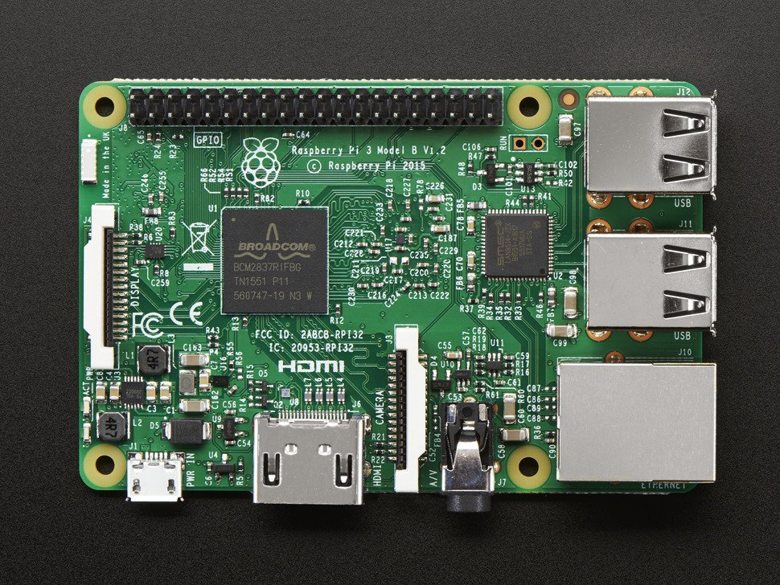
About Raspberry Pi
The Raspberry Pi is a low cost, credit-card sized computer that plugs into a computer monitor or TV, and uses a standard keyboard and mouse. It is a capable little device that enables people of all ages to explore computing, and to learn how to program.
Here are the various components on the Raspberry Pi board:
ARM CPU/GPU
GPIO RCA
Audio out.
LEDs USB HDMI
Power
SD cardslot
Ethernet

Slide 3
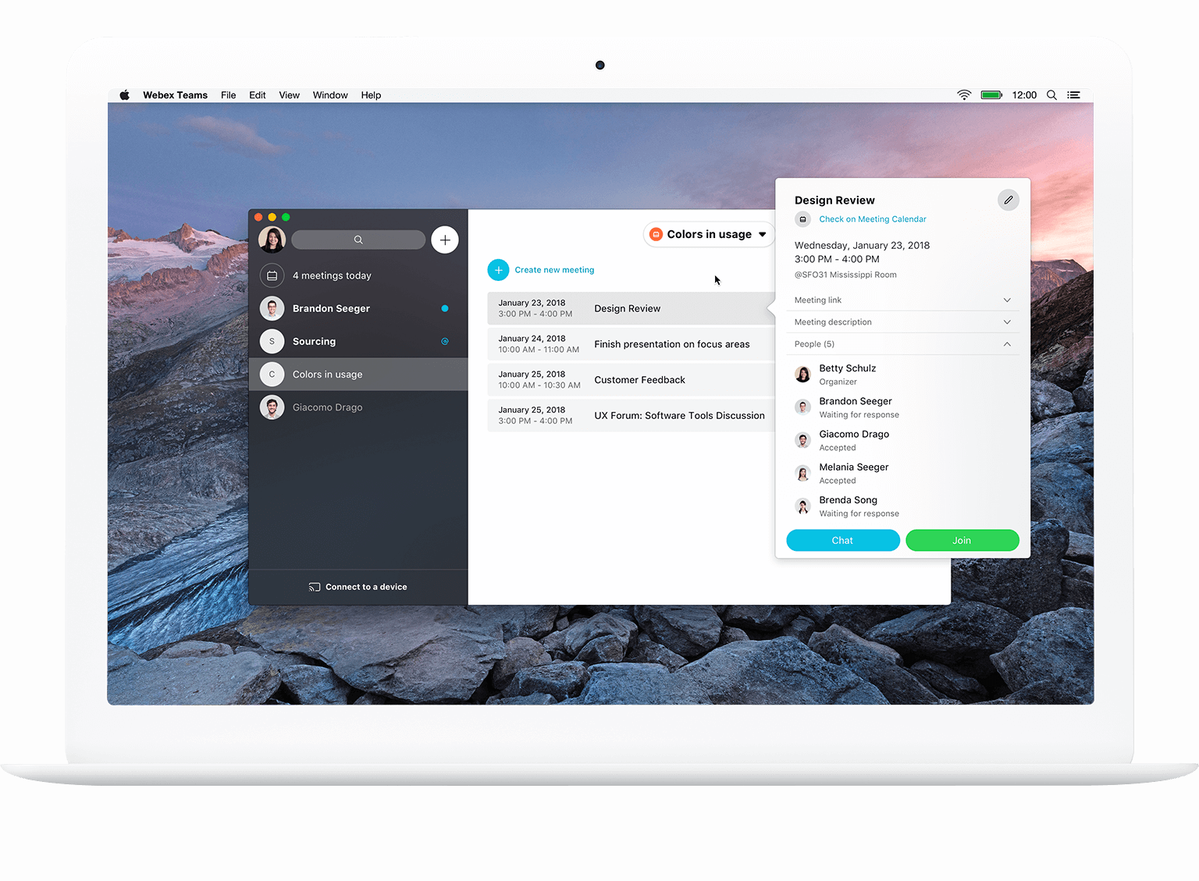
Webex Teams
Webex Teams is an all-in-one solution for messaging, file sharing, white boarding, video meetings, calling, and more. It keeps teams connected anytime, anywhere, and moves work forward faster.

Slide 4
About this Project
Upon motion detection by the tilt sensor, a display message will be displayed on the LCD screen, LED light will blink and a message will displayed on the WebEx teams alerting the user about the motion.
Use Case
In scenarios where motion detection can alert the user about a possible intrusion or violation etc..
Next Steps
WebEx calling feature: to immediately place a call after the motion is detected
Webhooks : type a message on Webex teams and make the LED/LCD work

Slide 5
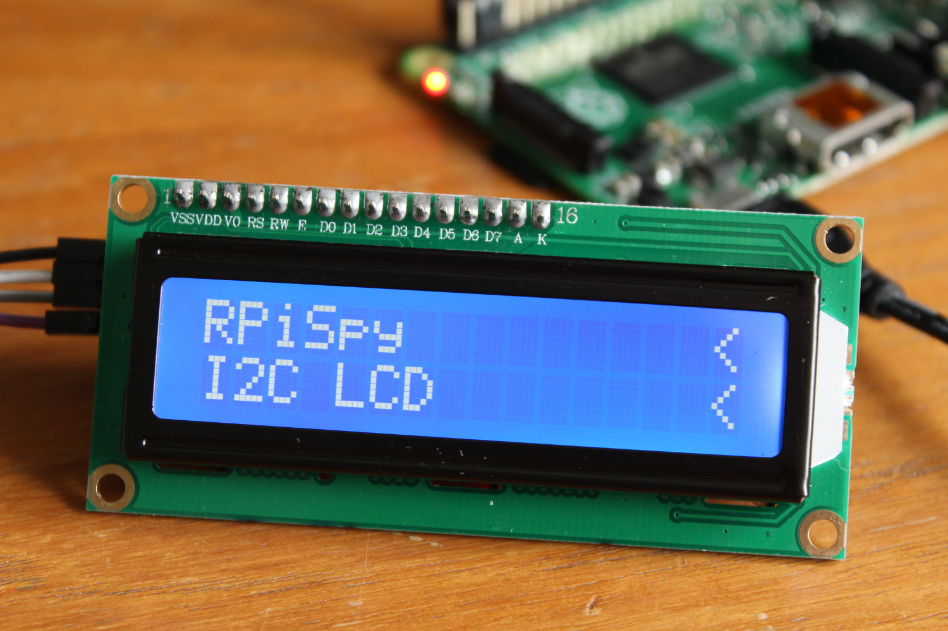
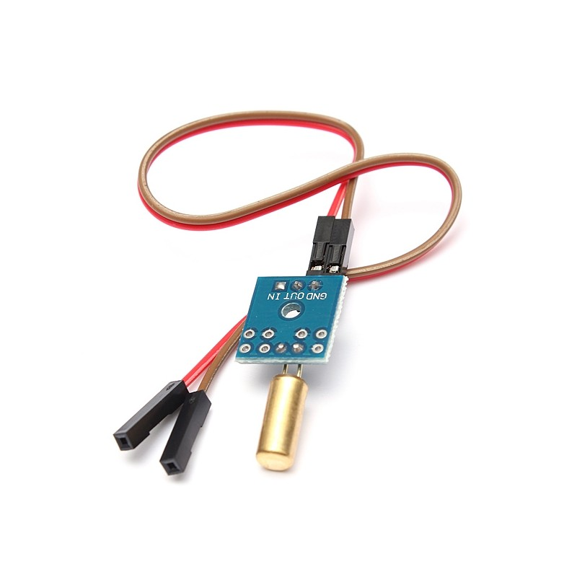
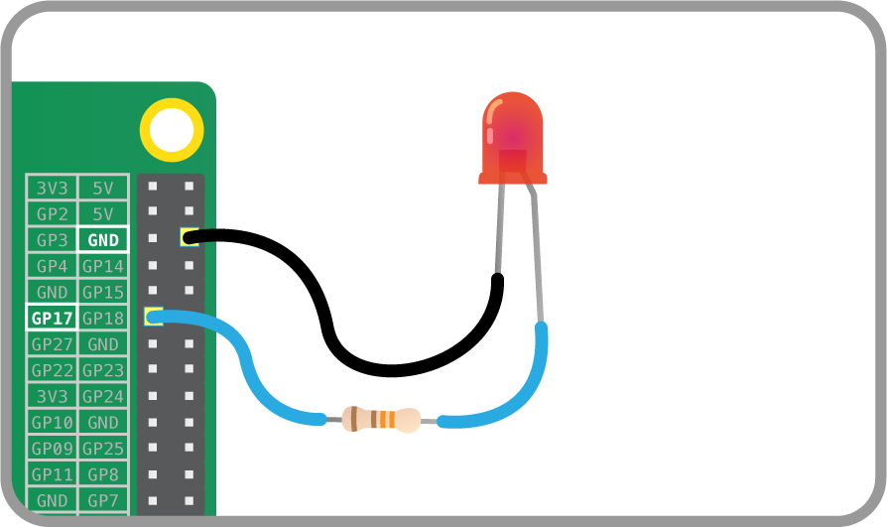
Hardware Used
LCD-1x I2C 1602 LCD module
1x SW-520D Tilt Switch Sensor Module
1x LED

Slide 6
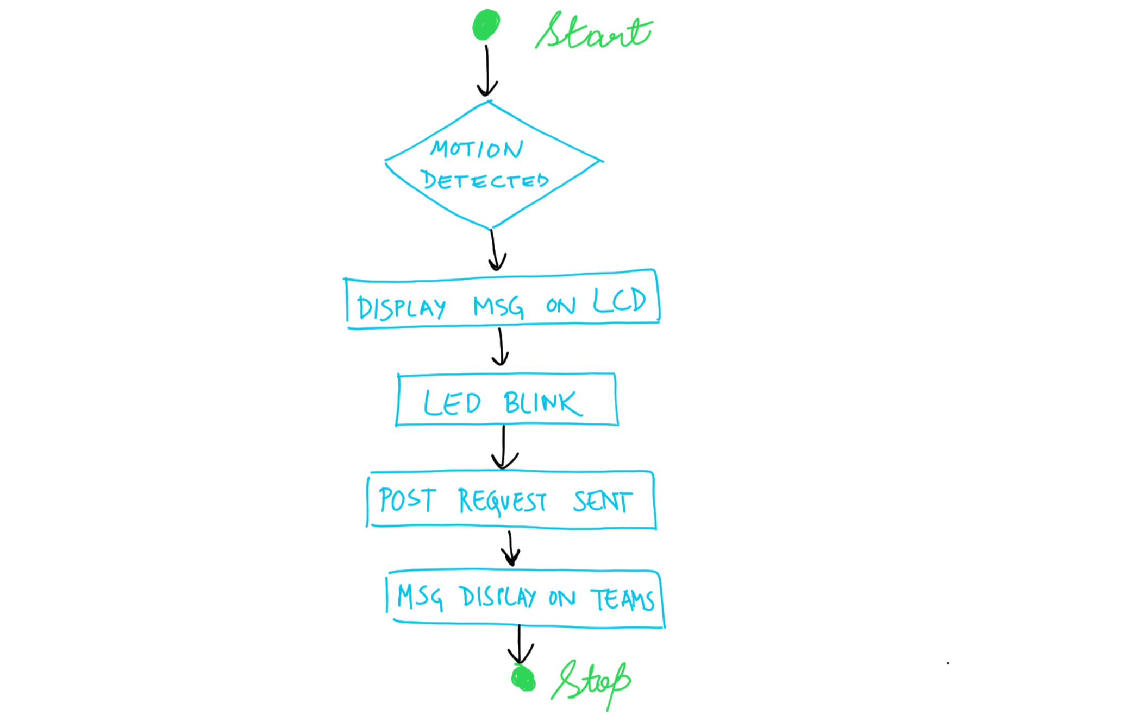
FlowChart

Slide 7
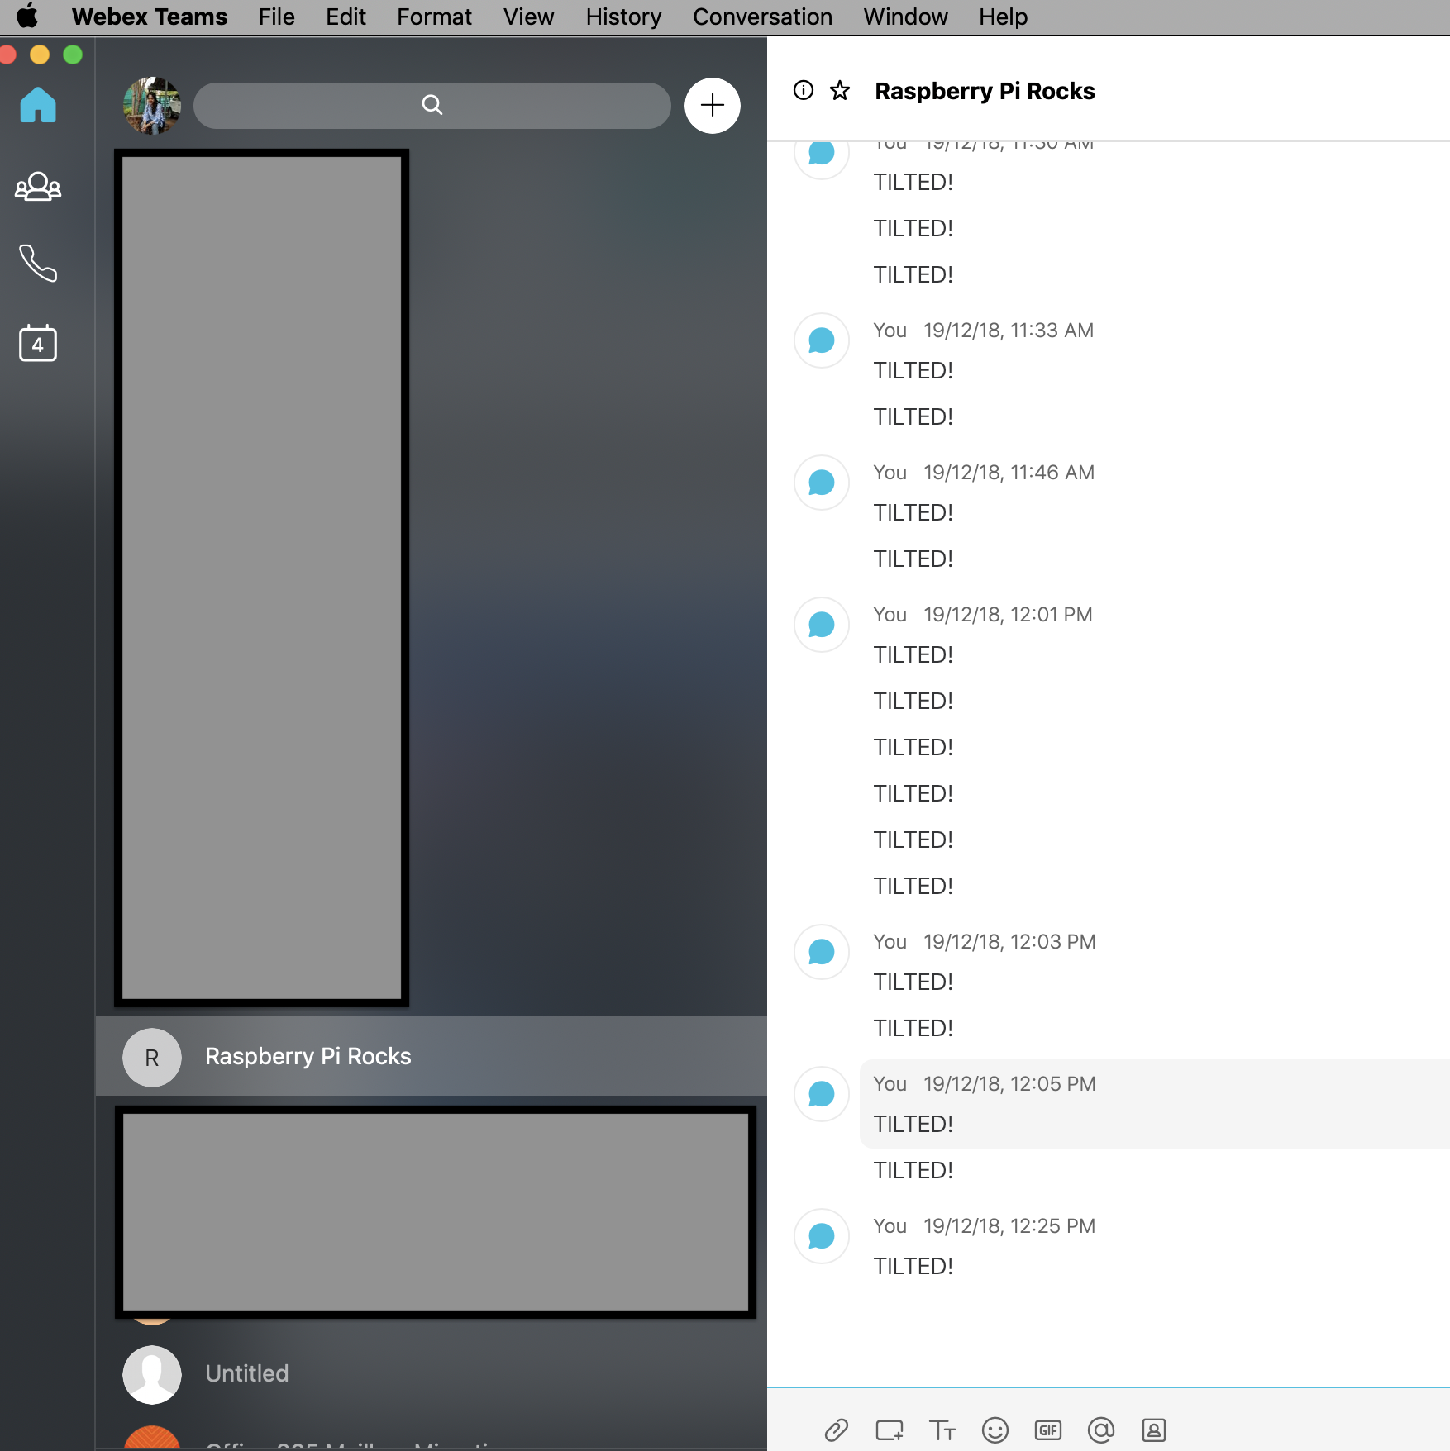
RESULTS

Slide 8
Thank You

