Slide 1

Modeling and implementing a correct backend
Tentative de plan
Saalik Hatia
Notes:
Change date

Slide 2

A Transactionally and Causally-Consistent Database
Geo-distributed data centers (DC)
Full replication
Causal consistency between DCs
In a DC:
Total order per DC [Akkoorath et al. ‘16]
Sharding [DeCandia et al ‘07]
Multiversion Concurrency Control (MVCC) with partial order
Journal of operations
Safe journal truncation
States stored in a Checkpoint Store

Slide 3
These are complex features
Support for transaction and session
Journal based backend
State based backend
Journal truncation
Recovery
Sharding and geo-replication

Slide 4
These are complex features to do correctly
Support for transaction and session
Journal based backend
State based backend
Journal truncation
Recovery
Sharding and geo-replication

Slide 5
What we want from the system
Keep our data safe
If one update happens before another they will be observed in the same order
Updates in the same transaction are observed all-or-nothing
While having having a mechanism for pruning the journal safely, by storing recent checkpoints.

Slide 6
Writing a specification
Specification of the structures of interest, i.e., journal, materialization cache, and checkpoint store.
Specification of transaction
Specification of the invariants that link the different parts together
Let’s do an implementation to verify the specification

Slide 7

Overview and requirements
Geo-distributed data centers (DC)
Full replication
Causal consistency between DCs
In a DC:
Total order per DC [Akkoorath et al. ‘16]
Sharding [DeCandia et al ‘07]
Multiversion Concurrency Control (MVCC) with partial order
Journal of operations
Safe journal truncation
States stored in a Checkpoint Store

Slide 8
Let’s implement these features
Support for transaction and session
Journal based backend
State based backend
Journal truncation
Recovery
Sharding and geo-replication
Implementation of the specification API
Actor based programming

Slide 9
Architecture
Database
InterDC
Session Manager
Start
Coordinator
Session Coordinator
Session Coordinator
Session Coordinator
InterShard
Cache
Lookup Service
Fill
Service
Backend Actor
Journal
Checkpoint Store
Truncation Service
Recovery
Service
Fill
Service
Checkpoint
Service

Slide 10

Interactions
Database
Transaction Begin | Put | Get | Abort | Commit
InterDC
Begin Session
Session Manager
Start
Coordinator
Session Coordinator
Session Coordinator
Session Coordinator
InterShard
Put | Get
Client
Transaction Begin | Put | Get | Abort | Commit
Get
Cache
Lookup Service
Fill
Service
Begin | Put |
Prepare | Commit
Get
Backend Actor
Journal
Checkpoint Store
Truncation Service
Recovery
Service
Fill
Service
Checkpoint
Service

Slide 11
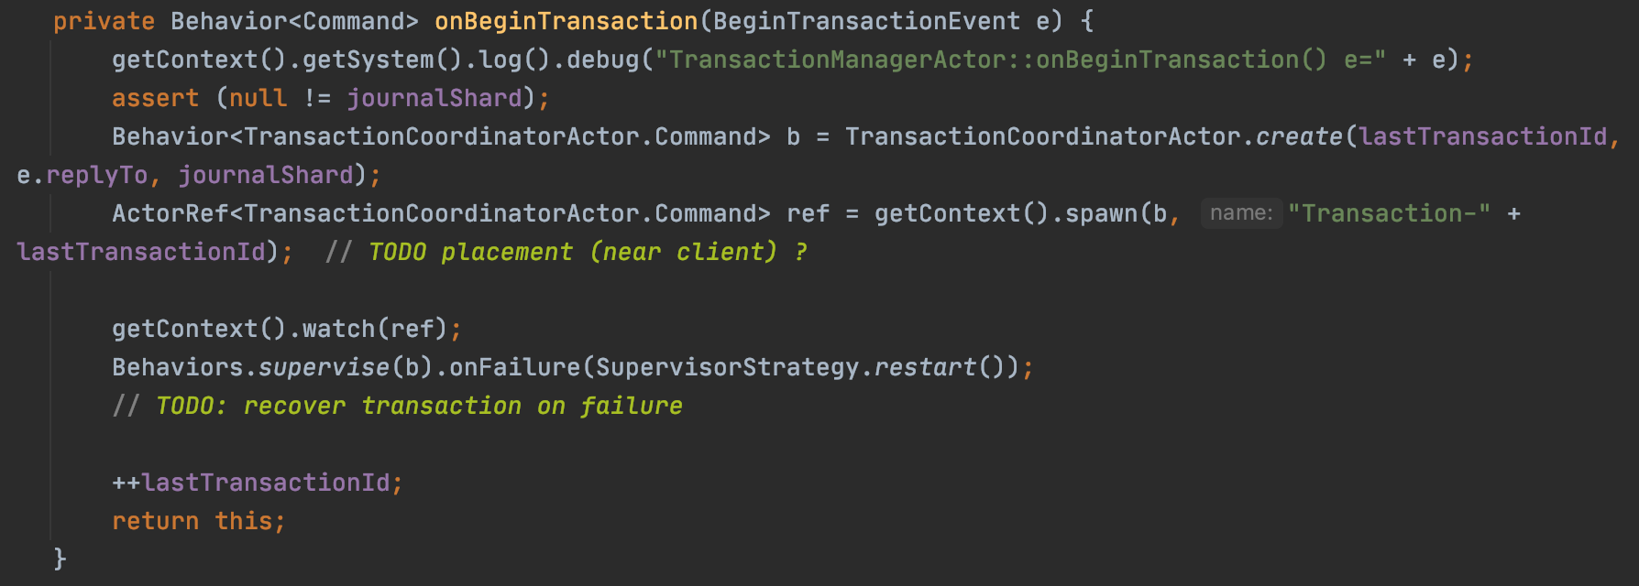
Transaction handling : Implementation

Slide 12
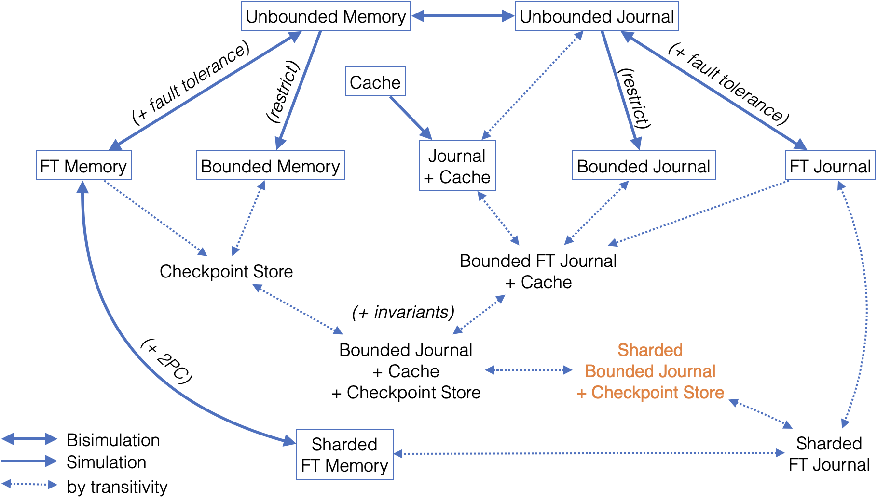
Decomposing features

Slide 13
Notes:
inte

Slide 17
Implementing step by step
Starting with the basic versions
Reference implementation as a baseline
Unbounded Journal
Unbounded Memory
Unify the API
Unify the tests
Add features

Slide 18
Transaction handling : Specification
read(Transaction, key)
Preconditions
The transaction is active.
The caller is in the transaction.
Returns
The value of the key in the buffer if it exist, otherwise returns the value in the snapshot.

Slide 19
Links
https://github.com/Saalik/MultiKVS
https://github.com/Saalik/MultiKVS
https://hal.sorbonne-universite.fr/hal-02902474v2
https://hal.sorbonne-universite.fr/hal-02902474v2

Slide 20
Next steps
Use the implementation to complete and adjust the specification
Compare different implementation
Unify the APIs of all the versions
Test
Correct APIs in the specification and code if needed
Test
Benchmark

Slide 21
Transaction Begin
Database
InterDC
activeTransaction: true
activeTransaction: false
Begin Session
Session Manager
Start
Coordinator
Session Coordinator
InterShard
Client
trID: 23 , [SnapVTS]
begin()
begin(23, SnapVTS)
Cache
Lookup Service
Fill
Service
Backend Actor
Journal
Checkpoint Store
Truncation Service
Recovery
Service
Fill
Service
Checkpoint
Service

Slide 22
Transaction Begin
Database
InterDC
activeTransaction: true
Session Manager
Session Coordinator
InterShard
Client
trID: 23 , [SnapVTS]
put(Hello, “World”)
put(23, Hello, “World”)
Cache
Lookup Service
Fill
Service
Backend Actor
Journal
Checkpoint Store
Truncation Service
Recovery
Service
Fill
Service
Checkpoint
Service

Slide 23

Transactions
Database
InterDC
activeTransaction: false
Session Manager
Session Coordinator
InterShard
Client
get(Hello)
Cache
Lookup Service
Fill
Service
Backend Actor
Journal
Checkpoint Store
Truncation Service
Recovery
Service
Fill
Service
Checkpoint
Service

Slide 24
Transaction handling : Specification
beginTransaction()
When a client starts a transaction at the database, BeginTransaction creates a transaction object which has the transaction snapshot as an attribute. Transaction object attributes are a unique identifier, dependency snapshot, CommitTimestamp, initialized at +∞, buffer of pending updates.
Preconditions
The snapshot is valid in regard to the consistency model.
Returns
The transaction object.

Slide 25
Transaction handling : Specification
put(Transaction, Key, Operation)
The update create a version of the object Key and is added to the buffer of the transaction object.
An operation record is written in the journal with the following information: CommitTimestamp, TransactionID, Type, Key, Operation, SnapshotTime.
Preconditions
The transaction is active.
The caller is in the transaction.
Returns
Nothing

Slide 26
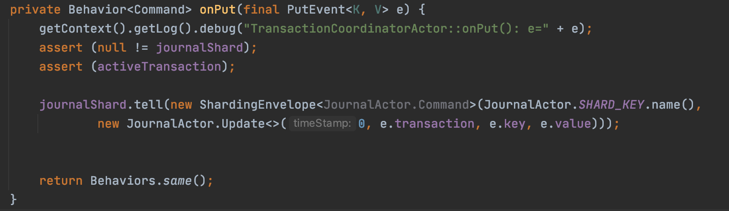
Transaction handling : Specification

Slide 27
State of the Thesis
Work in progress
Prototype based on the specification (Collaboration with Benoit Martin)
Verify our design (Collaboration with Carla Ferreira, Annette Beniusa and Gustavo Petri)
Benchmark
Future Work
Submit Paper to SIGMOD/ASPLOS/PODS (October – December)
Write Thesis ( December – April 2022)
PhD Defense (June 2022)
Notes:
Add information about the demo.
Add information about what happened since the last CSD.
Move work to the beginning of the slide to talk about.

Slide 28
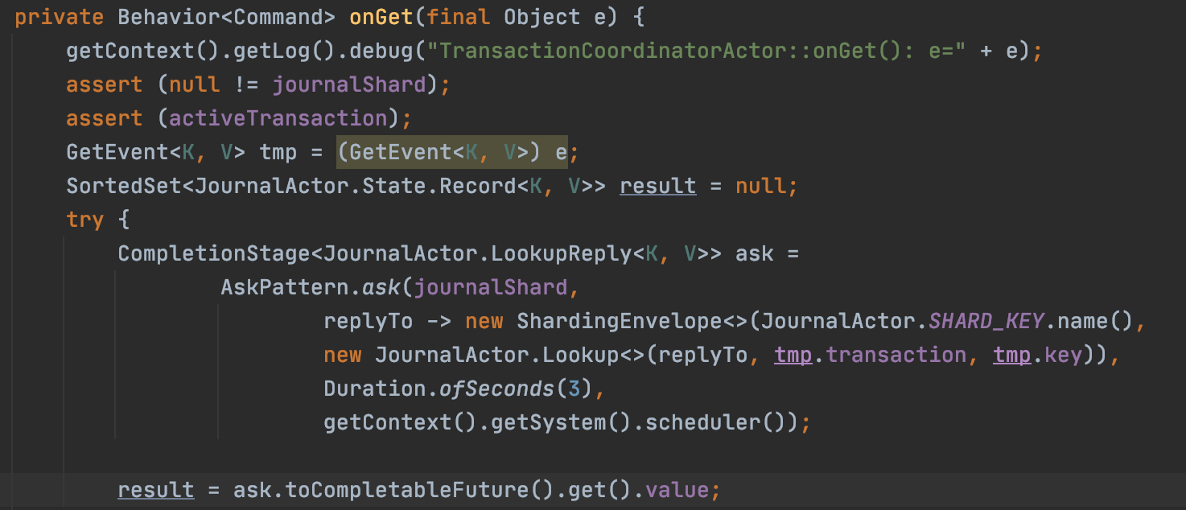
Transaction handling : Specification

Slide 29
Transaction handling
When a client connects, it connects to a Session Manager:
A Session Coordinator is assigned to the client
Session guarantees for a client
One transaction at a time
Causality between transactions in a Session
On session end (abort or commit) all transactions are committed or aborted
Transaction Guarantees
Reads from a snapshot (Dependency Snapshot)
Effects are visible at commit time
Aborting a transaction deletes the effects of the transaction
Notes:
A transaction reads from a snapshot. A snapshot is a set of versions. For any key, it maps the start/dependency timestamp of the transaction to the version of that key that is visible at that timestamp. The visibility relation is specific to an isolation level
Presenting the guarantees, this is how we do it.
Here's is the goal:
take one specific piece from the piece
Read something from write. Here's the implement.
Transactions how we do a transaction:
Change life cycle of the transactions

Slide 30
Transaction handling
Sessions are a sequence of transaction from a client:
One transaction at a time
A transaction in a session reads from a Snapshot with the commit time of the last transaction.
On session end (abort or commit) all transactions are committed or aborted
Notes:
A transaction reads from a snapshot. A snapshot is a set of versions. For any key, it maps the start/dependency timestamp of the transaction to the version of that key that is visible at that timestamp. The visibility relation is specific to an isolation level
Presenting the guarantees, this is how we do it.
Here's is the goal:
take one specific piece from the piece
Read something from write. Here's the implement.
Transactions how we do a transaction:
Change life cycle of the transactions

Slide 31
Architecture
Presentation specification -> implementation
Gestion des transactions

Slide 32
Three main parts
Specification rappel (2) – (Mention de la verification formelle et de la collaboration)
Prototype(6)
Ending(1)

Slide 33


Architecture
Database
Shard
Session Manager
Session Coordinator
Truncate/Fill Actor
Overview
Session Manager
Session Coordinator
Backend Actor
Cache
Truncate/Fill Actor
Client
Cache
Backend Actor

Slide 34
Architecture
Presentation implementation -> specification
Session Coordinator

Slide 35
Architecture
Presentation specification -> implementation
Session Coordinator

Slide 36
What can we do to make it easy
What can we do to make it easy

Slide 37
End of thesis plan
Continue working on the implementation of the specification.
Collaborate on the formal verification side to compare to the prototype results.
Submit paper in SIGMOD (Deadline (tbc))
Write Thesis
Estimated date of defense May 2022

Slide 38
Architecture
Database
Shard
Session Manager
Session Coordinator
Truncate/Fill Actor
Session Coordinator
Session Coordinator
Overview
Session Manager
Session Coordinator
Backend Actor
Cache
Truncate/Fill Actor
Cache
Backend Actor

Slide 39
Formal verification: Semantic approach to database design
Semantic domains
Generic Conditions and Predicates

Slide 40
Current architecture
Database
Shard
Session Manager
Session Coordinator
InterShard
Session Coordinator
Session Coordinator
Overview
Session Manager
Session Coordinator
Cache
Backend Actor
Journal
Checkpoint Store
Client
Cache
Backend Actor
Notes:
Remove this slide and extend the next slide

